Slide 1

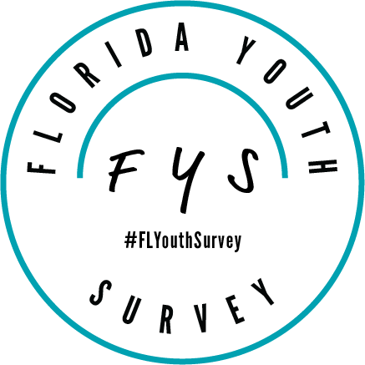


2025 Florida Youth Substance Abuse Survey (FYSAS)
Florida Department of Children and Families (DCF)
Bert Rothenbach, PhD
Rothenbach Research and Consulting, LLC
10/10/2025

Slide 2
Background and Methods
The Florida Youth Survey (FYS) is a multi-survey data collection project: Three questionnaires in odd years, two in even years:
Florida Youth Substance Abuse Survey (FYSAS)
Florida Youth Tobacco Survey (FYTS)
Florida Specific Youth Survey (FSYS)
2025 is a “state-level” sample, so not every county is selected to participate: 43 counties selected, 36 participated.
Final sample size is 13,412 across grades 6-8 (M.S.) and 9-12 (H.S.).
99.2% administered online and 0.8% with booklets.
The margin of error is less than 2.0 percentage points for state-level M.S. and H.S. prevalence rates.
2

Slide 3
FYSAS
Florida Youth
Substance Abuse Survey
DCF
M.S. and H.S.
Even years
Odd years
FYS
Florida
Youth Survey
FYTS
Florida Youth
Tobacco Survey
DOH
M.S. and H.S.
Even years
Odd years
FSYS
Florida Specific
Youth Survey
DOE
H.S. only
Odd years
3

Slide 4
2025 FYSAS Key Finding:
Substance use rates among Florida students continue their long-term decline.
4

Slide 5

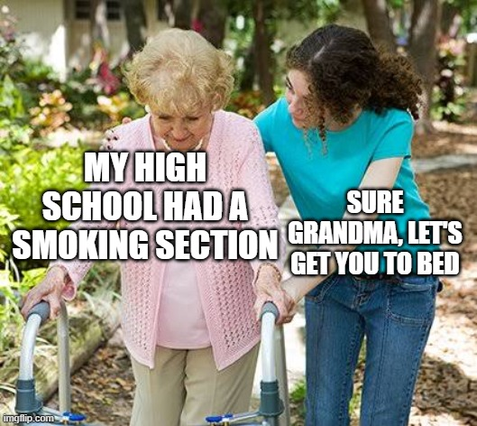
Remember where we started?
5

Slide 6
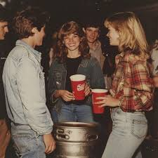
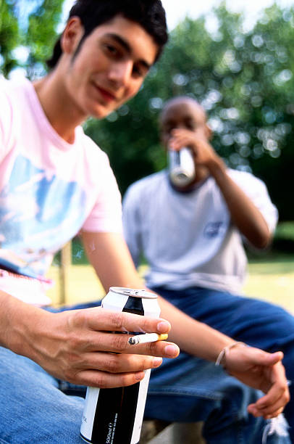
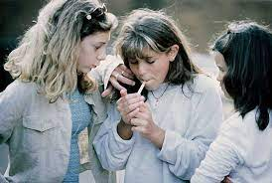
In the 1990s, substance use was a core part of youth culture. Families and communities struggled to find a response.
IN THE PARK CITIES, WHEN IT COMES TO UNDERAGE DRINKING, THE ONLY REAL CRIME IS GETTING CAUGHT.
May 1, 1999
Nantucket beach party results in 125 arrests on alcohol charges
Aug 5, 1991
WHILE PARENTS ARE PARALYZED BY AMBIVALENCE TOWARD ALCOHOL , TEENAGERS ARE DRINKING SOONER AND MORE HEAVILY
June 7, 1998
6

Slide 7
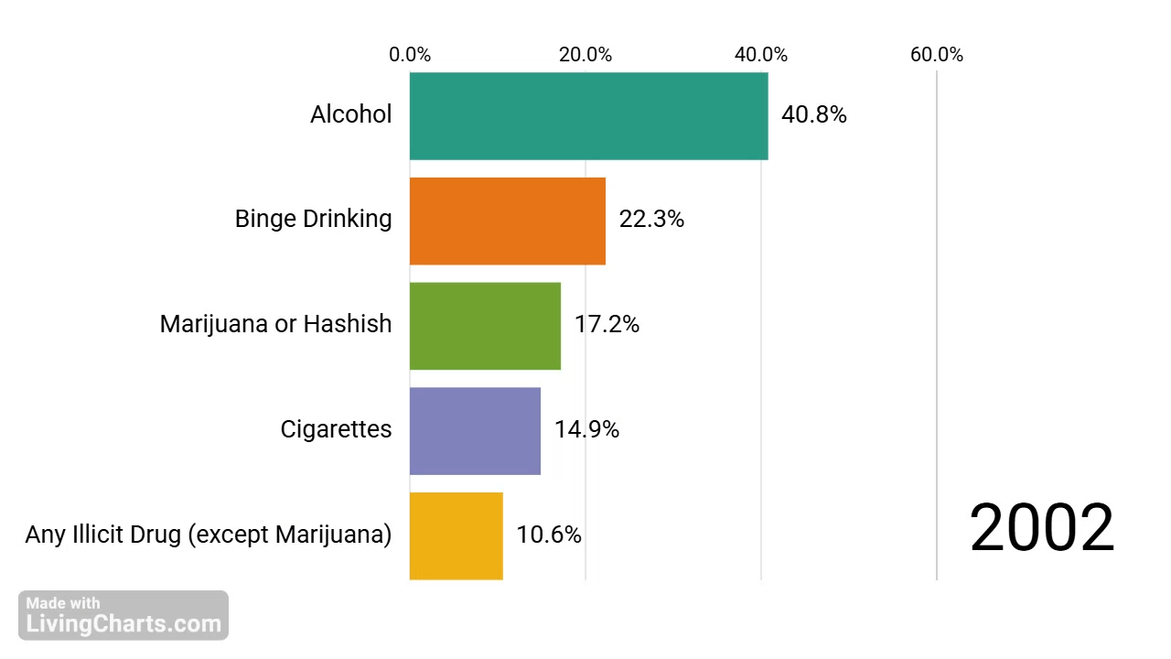
Past-30-Day Prevalence
High School | 2002 to 2025 Bar Race
7

Slide 8
Changes in Substance Use
Past-30-Day Prevalence for Grades 6 to 12
Alcohol
Cigarettes
2002 31.2%
10.2%
2025 8.3%
2002 11.4%
1.1%
2025 1.1%
2002 31.2%
10.2%
2025 8.3%
Vaping Nic
Marijuana
Other Illicit
2019 12.5%
6.6%
2025 5.1%
2002 12.1%
6.3%
2025 4.3%
2002 10.1%
3.7%
2025 3.0%
8

Slide 9
This long-term reduction in substance use is a remarkable improvement in the health behavior of Florida youth.
Many organizations—at the state, county, and local levels—have contributed.
Public health
Education
Law enforcement
Few people outside the health behavior data community know this story.
9

Slide 10
Alcohol
Past-30-Day Prevalence by Grade Cohort
10

Slide 11
Binge Drinking
5+ Drinks in Past 2 Weeks
11
Notes:
1. Define Binge Drinking
2. Similar reduction to past-30-day, just above 70%.

Slide 12
Blacking Out from Drinking
Lifetime Prevalence Among High School Students
On how many occasions (if any) in your lifetime have you woken up after a night of drinking alcoholic beverages and not been able to remember the things that you did or places that you went?
12

Slide 13
Cigarettes
Past-30-Day Prevalence by Grade Cohort
13

Slide 14
Any Vaping
Past-30-Day Prevalence
Middle School
High School
14
Notes:
Vaping has been a moving target.
Nicotine and marijuana vaping questions separated starting in 2019.
Among H.S. students, the vaping epidemic peaked in 2019, then steady decline.
Among M.S. students, vaping rates have no “strong” peak, but trend line from 2021 to 2024 is down.

Slide 15
Vaping Nicotine
Past-30-Day Prevalence
Middle School
High School
15
Notes:
HS steady decline since 2019.
MS decline starts in 2022.

Slide 16
Vaping Nicotine and Smoking Cigarettes
Past-30-Day Prevalence
Vaping
Smoking
In 2025, 6.8% of current nicotine vapers also smoke cigarettes. This rate was 8.3% in 2024.
In 2025, 33.1% of current smokers also vape nicotine. This rate was 54.3% in 2024.
16
Notes:
Little overlap between nicotine vaping and cigarette smoking.

Slide 17
Marijuana
Past-30-Day Prevalence by Grade Cohort
17
Notes:
Pattern is complex, but overall trend is of long-term reductions in youth marijuana use.
HS decline started in 2014, accelerated after 2020.
MS: 3 drops, 2 bumps

Slide 18
Florida Data vs. National Data
National substance use rates come from The University of Michigan’s Monitoring the Future (MTF) survey.
Both surveys are school-based and conducted in the spring.
How does the health behavior of Florida students compare to youth from across the county?
Comparing trend lines from two independent data collection projects provides a powerful data quality check.
18

Slide 19
Alcohol
Past-30-Day Prevalence for 8th, 10th, and 12th Graders
19
Notes:
Florida closed the gap.

Slide 20
Binge Drinking
5+ Drinks in Past 2 Weeks, 8th, 10th, and 12th Graders
20

Slide 21
Cigarettes
Past-30-Day Prevalence for 8th, 10th, and 12th Graders
21

Slide 22
Marijuana
Past-30-Day Prevalence for 8th, 10th, and 12th Graders
22

Slide 23
Changes in Attitudes Toward Substance Use
Attitudes are highly correlated with substance use in just about every data source.
Many prevention programs seek to change how youth think about substance use.
Comparing attitude trend lines to prevalence rate trend lines is an important data validation test.
23

Slide 24
Attitudes Toward Alcohol Use
Grades 6 through 12 | 2014 to 2025
2014
2016
2018
2020
2022
2024
2025
2014
2016
2018
2020
2022
2024
2025
2014
2016
2018
2020
2022
2024
2025
24
Notes:
2002 to 2004: Increase
2005 to 2010: Decrease
2011 to 2021: Increase
2022 to 2024: Decrease

Slide 25
Attitudes Toward Marijuana Use
Grades 6 through 12 | 2014 to 2025
2014
2016
2018
2020
2022
2024
2025
2014
2016
2018
2020
2022
2024
2025
2014
2016
2018
2020
2022
2024
2025
25
Notes:
2002 to 2004: Increase
2005 to 2010: Decrease
2011 to 2021: Increase
2022 to 2024: Decrease

Slide 26
Attitudes Toward Vaping Nicotine
Grades 6 through 12 | 2019 to 2025
26
Notes:
2002 to 2004: Increase
2005 to 2010: Decrease
2011 to 2021: Increase
2022 to 2024: Decrease

Slide 27
Florida students report very low rates for other illicit drugs.
This includes the unauthorized use of prescription drugs.
27

Slide 28
Past-30-Day ATOD Prevalence
Middle School
28
Notes:
Define past-30-day prevalence.
Alcohol and vaping nicotine two highest categories
Marijuana, vaping marijuana, and inhalants (MS) also among higher prevalence
Other categories, including cigarettes, are very low

Slide 29
Past-30-Day ATOD Prevalence
High School
29
Notes:
Alcohol highest
Marijuana moves to 2nd position
Cigarettes very low
Inhalants very low

Slide 30
Delta-8/10 THC and Kratom
Lifetime Prevalence among High School Students
Heard about Delta-8/10
Used
Delta-8/10
Heard about
Kratom
Used
Kratom
Used
Marijuana
30
Notes:
Reductions in Delta-8/10 use and Kratom use between 2023 and 2024.

Slide 31
Marijuana and Delta-8/10 THC
Lifetime Prevalence Among High School Students
Marijuana
Delta-8/10 THC
In 2025, 36.8% of H.S. students who had tried marijuana had also tried Delta-8/10 THC products. This rate was 40.8% in 2024.
In 2025, 86.5% of H.S. students who have tried Delta-8/10 THC products have also tried marijuana. This rate was 87.0% in 2024.
31
Notes:
Most Delta-8/10 users report marijuana use.
About 40% of marijuana users report Delta-8/10 use.

Slide 32
2025 FYSAS Key Finding:
Other youth health behaviors show shorter-term improvements.
32

Slide 33
Symptoms of Depression Trends
Percentage saying “yes” or “Yes!” | 2002 to 2025
33
Notes:
2002 to 2004: Increase
2005 to 2010: Decrease
2011 to 2021: Increase
2022 to 2024: Decrease

Slide 34
Symptoms of Depression Trends
Percentage saying “yes” or “Yes!” | 2002 to 2025
34
Notes:
2002 to 2004: Increase
2005 to 2010: Decrease
2011 to 2021: Increase
2022 to 2024: Decrease

Slide 35
Suicidal Ideation
Past-12-Month Prevalence, 2023-2025
Seriously Considered Suicide
Made a Suicide Plan
Attempted
Suicide
Attempt Requiring Medical Care
35
Notes:
Reductions in Delta-8/10 use and Kratom use between 2023 and 2024.

Slide 36
How Prevalent is Childhood Trauma?
ACEs Among High School Students
36

Slide 37
Number of Adverse Childhood Experiences
High School Students
37

Slide 38
Number of Adverse Childhood Experiences
High School Students
84.4%
15.6%
38

Slide 39
ACEs Trends
High School Students | 2020 to 2025
39
Notes:
Increase or flat from 2020 to 2022.
Most down from 2022 to 2024.

Slide 40
Between 2023 and 2025, Florida students reported increased awareness of prevention messaging.
40

Slide 41
“One Pill Can Kill”
Percentage of Students Who Have Heard or Seen this Message
41

Slide 42
988 Crisis Counseling Line
Percentage of Students Who are “Very Likely” to Use
42

Slide 43
“The Facts. Your Future.”
Percentage of Students Who Have Heard or Seen this Message
43

Slide 44
“One Pill Can Kill” and 988 Crisis
Grades 6 through 12
44

Slide 45

Bottom line, substance use among youth in Florida continues to decline.
45

Slide 46
Thank you!
Bert Rothenbach
bert@rothenbach-research.com
Florida Youth Survey information/support
floridayouthsurvey@icf.com

