Slide 1
Hillsborough child care town hall meeting
Presented by: kyle Teague and Chantal porte
Office of licensing, department of children and families

Slide 2
Department of children and families
Office of licensing
Child Care Licensing is one of three programs administered by the Office of Licensing at DCF
Our purpose is to ensure a healthy and safe environment for the children in child care settings and to improve the quality of their care through licensing inspections and consultation.
Statewide licensure of child care facilities, specialized child care facilities for the care of mildly ill children, large family child care homes and licensure or registration of family day care homes.
Notes:
s. 402.26 child care; legislative intent –
(3) To protect the health and welfare of children, it is the intent of the Legislature to develop a regulatory framework that promotes the growth and stability of the child care industry and facilitates the safe physical, intellectual, motor, and social development of the child

Slide 3
Major functions of child care licensing
Ensures licensing and school readiness requirements are met through on-going inspections and in collaboration with Early Learning Coalitions.
Ensure the health, safety, and well-being of children in care.
Provide quality assurance, guidance, and technical assistance.
Deliver consistent competency-based training.
Maintain statewide licensing and training database.
Support quality initiatives.

Slide 4
Local licensing
Pursuant to s. 402.306 Florida Statutes, five counties regulate child care through local licensing:
  Broward
  Hillsborough
  Palm Beach
  Pinellas
  Sarasota
Notes:
DCF administers child care in 62 of the 67 counties in the state.
Soon to be 63 counties as Hillsborough County has made the decision to not renew their contract with DCF and therefore the responsibilities will revert to the department to administer the child care program.
s. 402.306, F.S. local county to have licensing standards that meet or exceed state minimum standards. For the most part Hillsborough standards overlap DCF standards however there are additional standards that exceed the minimum standards that will go away when the program returns to DCF.

Slide 5
Hillsborough transition coming soon
June 30, 2023 - contract ends with Hillsborough County
July 1, 2023 - DCF will assume the administrative and regulatory functions of licensing for child care programs in Hillsborough County

Slide 6
What does that mean for Hillsborough providers?
Licenses issued by Hillsborough County will continue to be valid through expiration
  Administrative actions
  Voluntary closure by provider
  Licensed vs Registered (Homes)
Inspections will be completed by DCF staff
  Facility – 2 Routines and 1 Renewal
  Homes – 1 Routine and 1 Renewal
Inspections will monitor for DCF standards
Notes:
License –
However, administrative action towards the license could end the license of warranted. (ie: ESO or revocation)
If the county ordinance that requires license for family home operations is discontinued, home providers would then have the option to be either registered or licensed. It is the choice of the provider for a regular family day care home.
Large family child care homes are required to be licensed.
Inspection –
Unannounced visits conducted during providers operating hours.
In addition to the minimum visits listed, additional inspections could be warranted to confirm compliance with a standard that was previously cited (reinspection) or to investigate complaint allegations (complaint inspection).
Abbreviated inspections are used to replace routine inspections for eligible providers (facilities/homes) and only monitors subset of the full set of rules which includes key indicators, supplemental standards, and 5 random standards. Section 402.3115, F.S. states that all providers must be given an abbreviated inspection if they have not had any class 1 or 2 violations in the previous two consecutive years. An abbreviated inspection is the “right” of the provider and is conducted if the provider meets the criteria in the last 2 years.
School Readiness inspections are conducted during renewal inspections for licensed providers with SR designation. Licenses exempt providers with SR designation are inspected at least one time per year. Additional inspections may be needed to close the loop on prior violations or to investigate complaint allegations.

Slide 7
DCF standards
Facilities:
Homes:
s. 402.305, Florida Statutes (F.S.)
Chapter 65C-22, Florida Administrative Code (F.A.C.)
Child Care Facility Handbook (incorporated by reference in 65C-22.001(6), F.A.C.
s. 402.313 and 402.3131, Florida Statutes (F.S.)
Chapter 65C-20, Florida Administrative Code (F.A.C.)
Family Day Care Home and Large Family Child Care Home Handbook (incorporated by reference in 65C-20.008(7), F.A.C.
Notes:
Facilities:
In section 402.305 of the Florida Statutes, the Department was instructed by the Legislature to establish licensing standards for child care providers that addressed these three areas:
Health, sanitation, safety, and physical surrounds
Health and nutrition
Child developmental needs
402.305(1) LICENSING STANDARDS.—The department shall establish licensing standards that each licensed child care facility must meet regardless of the origin or source of the fees used to operate the facility or the type of children served by the facility.
(a) The standards shall be designed to address the following areas:
1. The health, sanitation, safety, and adequate physical surroundings for all children in child care.
2. The health and nutrition of all children in child care.
3. The child development needs of all children in child care.
Chapter 65C-22 of the Florida Administrative Code is the Department’s section of rule that provide requirements for Child Care Facilities, which includes School Age Child Care Facilities (65C-22.008)
In 65C-22.001(6), F.A.C. the Child Care Facility Handbook is incorporated by rule and the School Age Child Care Facility Handbook is incorporated in rule 65C-22.008, F.A.C.
Homes:
In section 402.313 of the Florida Statutes, the Department was instructed by the Legislature to establish licensing standards for family day care homes that address the following areas…
requirements for staffing, training, maintenance of immunization records, minimum health and safety standards, reduced standards for the regulation of child care during evening hours by municipalities and counties, and enforcement of standards.
In section 402.3131 of the Florida Statutes, the Department was instructed by the Legislature to establish licensing standards for large family child care homes that address the following areas…
requirements for staffing, maintenance of immunization records, minimum health standards, minimum safety standards, minimum square footage, and enforcement of standards.
Chapter 65C-20 of the Florida Administrative Code is the Department’s section of rule that provide the requirements for Family Day Care Homes and Large Family Child Care Homes.
In 65C-20.008(7), F.A.C. the Family Day Care Home and Large Family Child Care Home Handbook is incorporated by rule.
After the transition
DCF standards will be applicable
Hillsborough standards that exceeded DCF standards will no longer be applicable

Slide 8
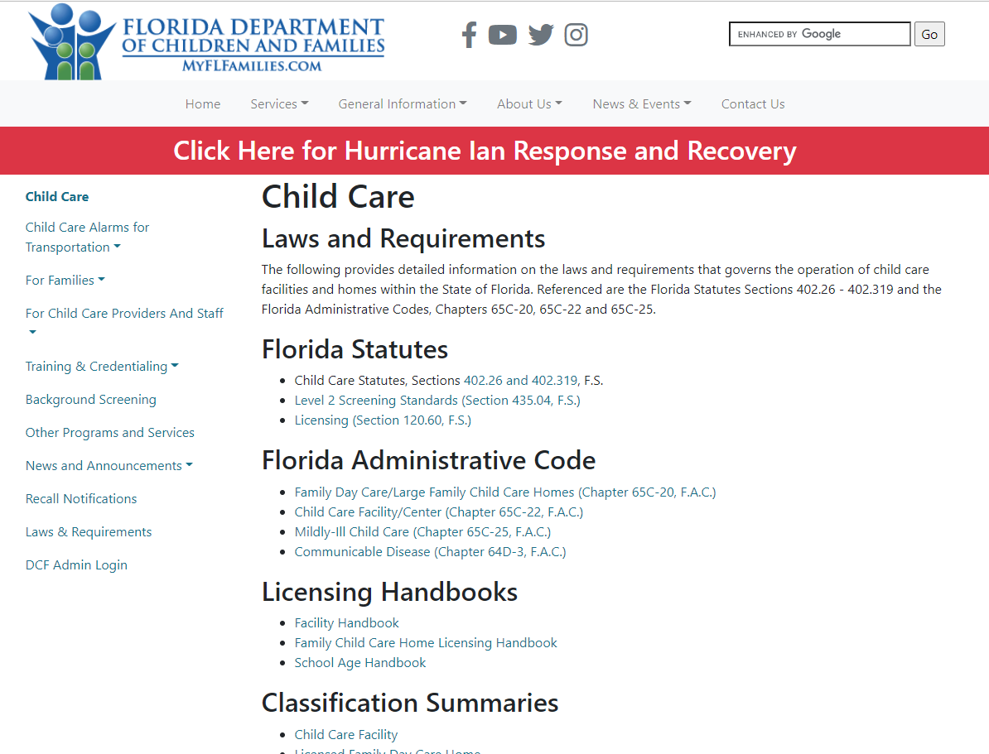
Where to find DCF statute/rule requirements
www.myflfamilies.com/childcare
Laws & Requirements
Statutes
Licensing Handbooks
Classification Summaries

Slide 9
What are the major differences?
Child care facilities
Supervision
  Swimming and water activities
Transportation
  Seat belts/Child restraints (including wheelchair occupants)
Facility Environment
  Documentation of daily inspection
  Guardrails/protective barriers
Food and Nutrition
  Catered food/Infant food
Health Requirements
  Medication administration
Notes:
Here are some of the areas where we’ve identified some differences between Hillsborough and DCF standards.
Differences for the most part are the result of recent rule changes or where the standard needed more specific details that are not adequately covered by a broader standard.
Use the classification summaries as your guide to inspection. This is the template for the inspection used by DCF Licensing Counselors.
Refer to cross walk for specifics (handout). Can direct staff to look for the NA in the first two columns which will be an indicator that there is no equivalent DCF standard to match the previous Hillsborough standard.
Note that some Hillsborough standards are listed at a different classification level for example Hillsborough facility standard 4.6 is a class 2 standard right now but when DCF takes over that standard would be listed as a class 3 standard

Slide 10
What are the major differences?
Family day care Homes/large family child care homes
Transportation
  Child restraints (including wheelchair occupants)
Background Screening documentation
  Clearinghouse roster/Out-of-state records
Staff Training
  Safe sleep/fire extinguisher/medication etc.
Health and Safety Requirements
  Carbon monoxide detectors [s. 553.885(1), F.S.]
  Swimming pool requirements
  Infant bottles/food

Slide 11
Next steps
Recruit licensing staff (ongoing)
Staff Training
  Wrap up administrative actions issued by Hillsborough
Provider Training

Slide 12

Thank you

Slide 13


DCF Child Care:
myflfamilies.com/childcare
Training/Registry Login:
childcare-training.myflfamilies.com
Send questions about the transition to:
SCR.Questions.HillsboroughChildCare@myflfamilies.com
Child Care Training Information Center
1-888-352-2842
Kyle Teague
Regional Licensing Manager
Kyle.Teague@myflfamilies.com
Chantal Porte
Regional Safety Program Manager
Chantal.Porte@myflfamilies.com

