Slide 1


Data Analysis Subcommittee
Commission on Mental Health and Substance Abuse
Data Analysis Subcommittee Updates | August 20, 2024

Slide 2

Data Analysis Subcommittee Members
Name | Title | Agency
Kathleen Moore, Commissioner, Chair | Executive Director, Research Professor | Florida Mental Health Institute (FMHI), USF Dept. of Mental Health Law & Policy, USF
Larry Rein, Commissioner | President and CEO | ChildNet
Jay Reeve, Commission Chair | President and CEO | Apalachee Center
Sue Gallagher, EdD | Chief Innovation Officer | Children’s Services Council (CSC) of Broward County
Heather Flynn, PhD | Professor and Chair | Department of Behavioral Sciences and Social Medicine, FSU
Annette Christy, PhD | Associate Professor | Dept of Mental Health, Law & Policy USF
Paul Stiles, JD, PhD | Associate Professor | Dept. of Mental Health Law and Policy, USF
Julie Jean, MS | Data Administrator for Substance Abuse | Florida Department of Corrections
Adam Wasserman, PhD | Data Administrator for Mental Health | Florida Department of Corrections
Stephen Lord, EdS | President and CEO | Circles of Care
Alexander Ford, BS | Chief of Data Analytics | Agency for Healthcare Administration
Laura Diaz de Arce, MA | Quality Control Supervisor | Mental Health America SE Florida
Carlos Butts, BS | Deputy Chief Information Officer | Florida Department of Children and Families
Giri Vasudevan, BTech | Director, Enterprise Data Management | Florida Department of Children and Families

Slide 3
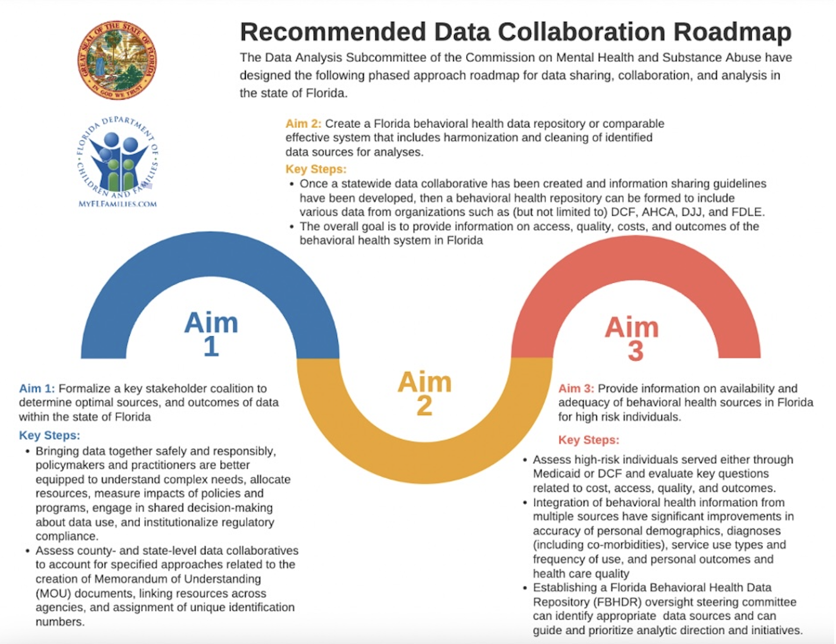

Slide 4





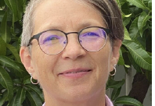
Behavioral Healthcare Data Repository Planning Session: Review Florida BH Data Integration Assets and Challenges 9/13/23 – Subject Matter Experts
Jessie Tenenbaum, PhD - Associate Professor at Duke University School of Medicine and Chief Data Officer (CDO) for the Department of Health and Human Services
Cassandra Dorius, PhD - Associate Professor at Iowa State University and Co-Director of Iowa’s Integrated Data System for Decision-Making (I2D2), focused on early childhood
Mark Humowiecki, PhD - Camden Coalition’s National Center for Complex Health and Social Needs
Sue Gallagher, EdD – Chief Innovation Officer at the Children’s Service Council of Broward County
Paul Stiles, JD, PhD – Associate Professor and Associate Chair at the University of South Florida’s (USF) Department of Mental Health Law & Policy
Heather Flynn, PhD - Professor at Florida State University (FSU), College of Medicine, Chair of Department of Behavioral Sciences and Social Medicine, Director of FSU Center for Behavioral Health Integration
Zhe He, PhD – Biostatistics, Informatics, and Research Design at FSU
Rick Burette, PhD – Associate Provost for Strategy and Analytics at FSU

Slide 5

Data Analysis Subcommittee Presentations
Legal, Ethical, and Structural Aspects of Data Sharing:
AISP Frameworks and Relevant Laws
4/10/24 Presentation by:
Paul Stiles, JD, PhD, USF’s Dept. of MHLP
Overview of the Northwest Regional Data Center 2/14/24 Presentation by:
    Rick Burnette, PhD - Sr Vice Provost & Chief Strategy Officer (FSU)
    Tim Brown, PhD – Assistant Vice President (FSU), Northwest Regional Data Center
    Jorge Vidal, BA – Sr Director for Data and Analytics, Information Technology Services (FSU)
Review of interim Report Recommendations
Quality Framework for Integrated Data Systems
Legal Considerations for Data Integration
  Authority and Structure
  Legal Agreements
    MOUs, DSAs, DULs and Consent
  Relevant Federal and State Laws
Resource Links

Slide 6
Aim 1
Key Steps:
Bring data together safely and responsibly, so policymakers and practitioners are better equipped to understand complex needs, allocate resources, measure the impacts of policies and programs, engage in shared decision-making about data use, and institutionalize regulatory compliance.
Recommendations:
Create Statewide Behavioral Health Data Stakeholder Coalition – define key stakeholders to identify expertise.
Implement a Pilot – Collect data that is already aggregated and merged between AHCA and DCF or another relevant dataset to create a roadmap for an analytic plan before expanding statewide.
Progress:
Data Subcommittee includes several key stakeholders that can serve as initial BH Data Stakeholder Coalition and will work to identify additional representation from Florida stakeholder groups.
Formalize a stakeholder coalition to determine optimal sources, uses, and outcomes of data

Slide 7
Aim 2
Key Steps:
Once a statewide data collaborative has been created and information-sharing guidelines have been developed, then a behavioral health repository can be formed to include various data from organizations such as DCF, AHCA, DJJ, and FDLE.
Overall goal is to provide information on access, quality, costs, and outcomes of the behavioral health system in Florida.
Recommendations:
Secure administrative authority and commitment from stakeholders to establish Florida Behavioral Healthcare Data Repository (FBHDR).
Determine structure of the repository as well as policies and protocols for data standardization, security and access.
Budget appropriate initial cost including a fiscal analysis of elements/components establishing and maintaining the repository and possible addition of a qualitative component and analysis.
Create a Florida behavioral health data repository or comparable effective data system that includes data harmonization and cleaning of identified data sources for analyses

Slide 8
Aim 2 (cont.)
Progress:
Subcommittee has been working with subject matter experts in data science, biostatistics and behavioral health care, as well as the Northwest Florida Regional Data Center (NWFRDC).
NWFRDC has capacity to acquire, manage, secure, and store behavioral health data from all relevant data sources in the state, including but not limited to state government health agencies such as DCF, ACHA, and FDOH as well as health system data.
With over 50 years of experience, NWRDC is renowned for its superior customer service, cost-effective solutions, cutting-edge technology, and steadfast commitment to customer satisfaction. In 2022, the Florida Legislature designated NWRDC as the new home for the State Data Center, further solidifying its dedication to meeting the IT needs of Florida’s public sector and educational institutions.
NWFRDC already houses major sources of behavioral health data, currently fragmented and un-coordinated, which leaves us set up for success in creating the FBHDR.
Create a Florida behavioral health data repository or comparable effective data system that includes data harmonization and cleaning of identified data sources for analyses

Slide 9
Key Steps:
Assess high-risk individuals served through Medicaid or DCF and evaluate key questions related to cost, access, quality, and outcomes.
Integration of behavioral health information from multiple sources should improve accuracy of demographics, diagnoses, service use types and frequency of use, and health care quality.
Recommendations:
Establish FBHDR oversight steering committee to identify behavioral health data sources that will guide analytic direction and initiatives.
Initially, focus will be on people served by public-funded services. In a later exploration, comparisons of the above outputs will be made among people covered by Medicaid versus Medicare versus Medicaid+Medicare versus private insurance versus uninsured.
Progress:
Specific FBHDR plans and initial fiscal analyses have been developed, including recommendations on the specific infrastructure and subject matter expertise required to feasibly accomplish Aim 3.
Aim 3
Provide information on availability and adequacy of behavioral health data sources in Florida for high-risk individuals served either through Medicaid or DCF and evaluate key questions related to cost, access, quality, and outcomes

Slide 10
Additional Recommendations:
Support and Enhance Aims
Implement a mixed-methods approach that includes a qualitative component to inform data
1
Implement innovative technology
2
Identify community resource “strengths and assets”
3
Create a Behavioral Health Network of Resources
4
Identify additional analysis points not being collected that should be collected for outcomes
5

Slide 11
Prospective Impact
FBHDR will be Florida's only statewide comprehensive, coordinated source of behavioral health data. It will provide information on behavioral health data sources in Florida and evaluate critical questions related to prevalence, cost, access, quality, and outcomes for behavioral health.
Data integration and expansion initiative can impact the state and local levels. Intentionally designing a state and local behavioral health data infrastructure and partnership from inception will allow:
Improvement of behavioral health outcomes
Maximization of state resources
Acceleration of innovation and incubation
Building capacity to leverage and use data grounded in science

Slide 12
Prospective Impact
Proposed Florida Behavioral Health Data Repository (FBHDR) will be an ongoing resource and serve various operational, evaluative, and research purposes. Positive outcomes may include:
Quantifying effectiveness and cost-effectiveness of mental health care
Identifying current innovative and best practices in the delivery of mental health services
Modeling of proposed service changes to improve behavioral health care for all populations
Describing prevalence and service continuum for mental health and substance use disorders:
What are the prevalence rates of various psychiatric disorders in the state, including comorbidities? What are the characteristics of individuals with these diagnoses, such as age gender, race/ethnicity geographic location, and rurality?
What are the array of service types that individuals with different psychiatric diagnoses are utilizing? What is the adequacy of services based on geographic regions with particular prevalence density?
What are the outcomes among individuals who access different service types? What are the costs associated with the service types?

Slide 13

Questions & Discussion

