Slide 1
Commission on Mental Health and Substance Use Disorder
Access to Care Subcommittee
August 20, 2024

Slide 2
Three Priority Areas
Barriers to Utilization
Solutions to Barriers
Acute Care Transports Options

Slide 3
Subcommittee Members
Name | Title | Agency
Clara Reynolds, Subcommittee Chair, Commissioner | President and CEO | Crisis Center of Tampa Bay
Jay Reeve, Commission Chair | CEO and President | Apalachee Center
Lee Fox, Commissioner | Care Coordinator | David Lawrence Center
Bill Prummell, Commissioner | Sheriff | Charlotte County Sheriff's Office
Austin Noll, Commissioner | Deputy Secretary | AHCA
Alexandra "Ali" Martinez | Crisis Center Director | Alachua County Crisis Center
Kenneth Gibson | Senior Director of Marketing & PR | Crisis Center of Tampa Bay
John Mikula | Director of Operations Transcare | Crisis Center of Tampa Bay
Amy McClellan | Family Member and Vice President, Board of Directors | Florida Mental Health Advocacy Coalition
Gayle Giese | Board Director | NAMI, Florida
Trinity Schwab | Chief Operations Officer | Central Florida Cares
Michael Martin | Director, 2-1-1 Northwest Florida | United Way of West Florida
Jennifer Johnson | Senior Director of Public Policy | Florida Behavioral Health Association
Melissa Leslie | SAMH SunCoast Regional Director | Florida Department of Children and Families
Charles Whitfield | Vice President of Community Care | CenterStone

Slide 4
Priority Area Membership
Barriers to Utilization | Solutions to Barriers | Acute Care Transports Options
Gayle Giese – Subject Matter Expert | Ken Gibson – Subject Matter Expert | John Mikula – Subject Matter Expert
Nicole Friedman - Footprint to Success Clubhouse | Commissioner Lee Fox - David Lawrence Center | Commissioner William - Prummell Charlotte County Sheriff’s Office
Commissioner Lee Fox - David Lawrence Center | Richard Shutes - Jewish Community Services | Silvia Quintana - Broward Behavioral Health Coalition
Jorge Passalacqua-Substance Abuse and Mental Health-DCF | Kay Meyer - 211 Big Bend | Alexandra Martinez - Alachua County Crisis Center
Nikki Wotherspoon- Substance Abuse and Mental Health-DCF | Jose Serrano - 211 Broward
Nancy O’Farrell - NAMI Tallahassee/FLMHAC | Carali McLean - NAMI
Caren Howard - MHA National/FLMHAC | Marilyn Ricci – NAMI
Mike Martin - 211-NW FL United Way | Carrie Zeisse-Tampa Bay Thrives

Slide 5
Priority Area Membership Continued
Barriers to Utilization | Solutions to Barriers
Amy McClellan - Florida Mental Health Advocacy Coalition | Sharanda Sipe - Intercoastal Healthcare Consulting/NAMI
Emil Caron- LaAmistad Orlando/FLMHAC | Jennifer Johnson - Florida Behavioral Health Association
Jennifer Johnson - Florida Behavioral Health Association | Lindsay Brown - Florida Behavioral Health Association
Alexandra Martinez - Community Support Services Crisis Center | Trinity Schwab - Central Florida Cares Health System
 | Amy McClellan - Florida Mental Health Advocacy Coalition
 | Sgt. Craig Brandon - Charlotte County Sheriff’s Office
 | Stephen Prestesater - United Way of West Florida
 | Amy Hood - Charlotte CBHC

Slide 6
Statutory Requirements
section 394.9086, Florida Statutes (F.S.)
Conduct an overview of the current infrastructure
Identify barriers
Provide recommendations
Partners to mobilize recommendations
Prospective positive impact
Notes:
Conduct an overview of the current infrastructure of the 988 Florida Suicide & Crisis Lifeline system and other components of the state’s crisis care continuum.
Identify barriers in the delivery of services and assess the adequacy of the current infrastructure of the 988 Florida Suicide & Crisis Lifeline system.
Provide recommendations on how to improve the effectiveness of existing practices, procedures, programs, and initiatives in mental health and substance use disorder services.
Evaluate and make recommendations to address gaps and barriers in service delivery, including solutions such as marketing campaigns to promote available resources (including 988) and alternatives to law enforcement transport under the Baker and Marchman Acts.

Slide 7
Barriers to Utilization
Recommendation 1
Increase Awareness and Knowledge of Local Behavioral Health Systems
Recommendation 2
Increase Funding to Expand Capacity of the 988 Suicide & Crisis Lifeline System
Recommendation 3
Share Best Practices on the use of de-stigmatizing person-first language and trauma-responsive care to improve patient experience and engagement in treatment
Notes:
Rec 1: Develop information to educate communities about their local behavioral health system of care, Disseminate the system of care map and the QR code to the general public, including stakeholders and agencies that interact with the behavioral health care system, Create and implement public awareness campaigns to educate individuals and families on recognizing and responding to mental health and substance use needs.
Rec 2: To ensure a 90% answer rate, secure recurring funding for Florida’s 988 Lifeline Centers, Enhance/strengthen 988 Suicide & Crisis Lifelines as a component of Florida’s behavioral health crisis system of care.
Rec 3: Include peers and family members to collaborate with providers on the use of de-stigmatizing language and behaviors.

Slide 8
Barriers to Utilization
Potential Mobilization Partners
DCF
AHCA
Managing Entities
Peer specialist organizations
United Way
Behavioral health hospitals
University programs
Provider organizations
988 Suicide & Crisis Lifeline centers
Counties and municipalities
Community behavioral health providers
Notes:
Nikki and Javy (DCF) participated in our workgroup.
Jennifer Johnson represented FBHA.
We included Ali Martinez who runs the Alachua 988 call center.
Austin Noll of AHCA has been informed.
I spoke directly several times with Broward’s United Way and BBHC (ME) on the trauma-responsive care piece.
I can reach out to Dr. Tammy Tucker at Memorial Regional Hospital and I can inform Mary Mayhew of the FL Hospital Association.
I have a contact at Nova Southeastern University - they have a robust BH program.
I can also inform Natalie Kelly of FAME.

Slide 9
Barriers to Utilization
Prospective Positive Impact
Faster early intervention, reducing crises and hospital admissions
Better understanding of mental health and need for ongoing treatment
Improved outcomes, lowering risks of homelessness and incarceration
Reduced trauma and stigma; better crisis management
Immediate support, de-escalating 95% of crises by phone
Anonymous, multilingual, veteran-specific support
Early treatment for youth; fewer Baker Acts and ER visits
Reduced 911 calls for behavioral health; better provider-patient relationships
Enhanced staff support and patient recovery
Notes:
Improved knowledge of the local behavioral health system would result in more quickly linking individuals to early intervention and treatment and fewer acute crisis episodes, e.g., Baker Acts and emergency room/hospital admissions.
Would also enhance understanding of mental illness and substance use disorders, including that some individuals require ongoing, lifelong treatment.
Increasing capacity of the free, 24/7 resource ensures Floridians get help when they need it, linking them to warm hand-offs and referrals, Mobile Response Teams, centralized receiving facilities and other crisis walk-in services, detox facilities, and other treatment providers. Most crises can be de-escalated on the phone, with about 95% of calls being resolved by 988 crisis counselors.

Slide 10
Solutions to Barriers
Recommendation 1
Mass Media and Advertising Campaigns
Recommendation 2
Awareness Campaign- Direct Messaging to Individuals and Family Members
Recommendation 3
Circle of Influence Engagement Campaign – Tailored Training to Empower Community Involvement
Notes:
Rec 1: Utilize peer testimonials/stories from everyday individuals who have received mental health/substance use services and have had positive outcomes. This would include services with common fear and stigma like mobile response and receiving facilities to build trust and transparency. Incorporate messaging to de-stigmatize and de-criminalize mental health conditions and substance use challenges and educate brain health, Behavioral health providers utilize local media to address behavioral health topics through interviews, op-eds, panel discussions, town halls, and webinars on social media platforms.
Rec 2: Lifeline call centers and county human services can utilize communication channels and local relationships to distribute messaging pertaining to availability of behavioral health resources.
Rec 3: Create opportunities for first responders, including dispatch and detention staff, to be educated about behavioral health resources and receive behavioral health training.

Slide 11
Solutions to Barriers
Potential Mobilization Partners
Florida Department of Children and Families
Florida Department of Health
NAMI (National) and local chapters
Mental Health America (MHA) and local affiliates
Florida Mental Health Advocacy Coalition (FLMHAC)
Florida Behavioral Health Association (FBHA)
Florida Association of Managing Entities (FAME) and ME C-Level groups
Recovery community organizations and Florida peer groups
Lifeline centers, 988 & 211 providers
Rehab and receiving facilities
Medicaid/Medicare HMOs
Behavioral health providers and large medical practices
Faith leaders, law enforcement, fire departments, EMS
Colleges, school districts, private schools
Local recreational and community centers, shelters
Notes:
The partners listed by our workgroup are recommended/suggested partners so there were not specific notifications.
However, we did have representation in the workgroup by NAMI, the Florida Behavioral Health Association, the Florida Mental Health Advocacy Coalition, one of the managing entities, and 211 and 988 providers.

Slide 12
Solutions to Barriers
Prospective Positive Impact
Peer and celebrity endorsements normalize behavioral health.
Educational initiatives (interviews, webinars) raise awareness.
Digital advertising drives action and provides access to support.
Increased awareness of resources like 988 and 211.
Targeted outreach to consumers and their households.
Training for trusted individuals to identify needs and connect to care.
Notes:
Increased awareness of behavioral health resources, including 988 and 211 by consumers/potential consumers of services and also those in their household who often have the greatest ability and motivation to take action on behalf of a loved one.
Training will help these individuals in identifying a need, communicating with the individual and taking action to help connect them to care.

Slide 13
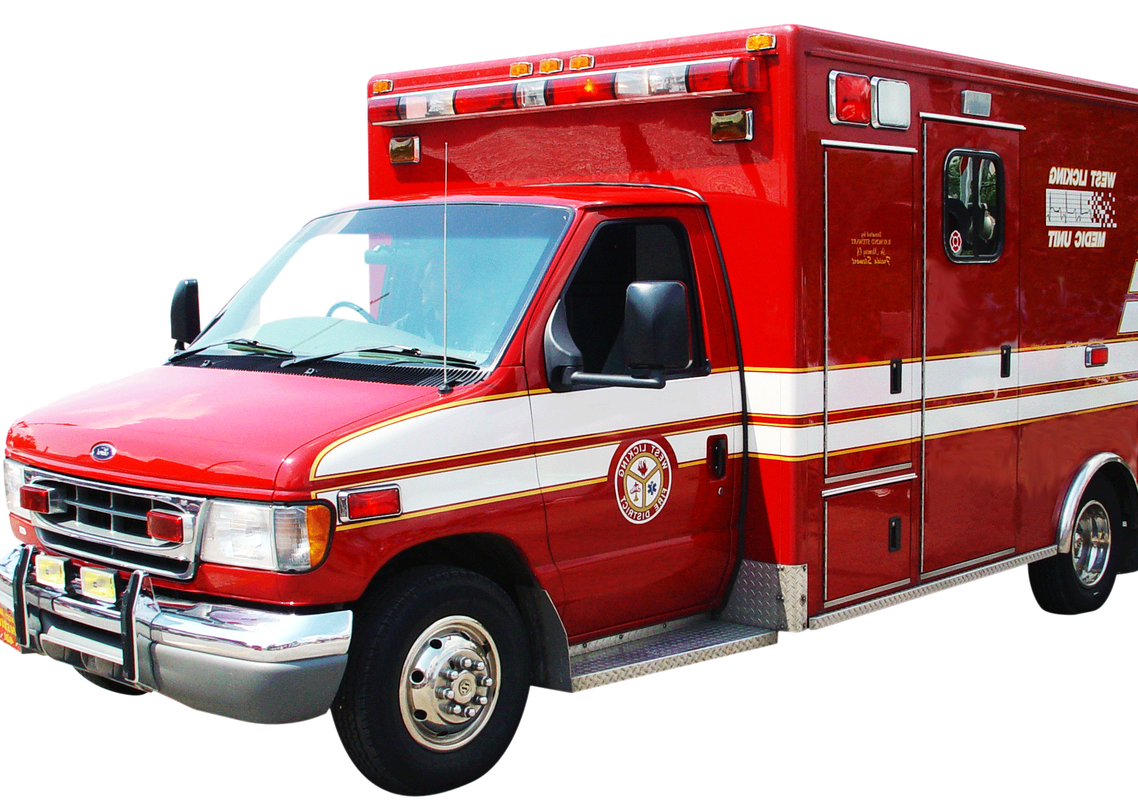
Acute Care Transports Options
Recommendations
Continue to evaluate county and circuit transportation plans for best practices.
Notes:
Rec 1: The Subcommittee suggested that the workgroup should not only continue its meetings but also expand its membership to include representatives from Managing Entities. These representatives would have access to county or circuit Transportation Exception Plans, which would allow the workgroup to review and learn from the various approaches and best practices implemented throughout the state.

Slide 14
Acute Care Transport
Potential Mobilization Partners
Law enforcement agencies Managing Entities Receiving facilities State and regional transportation authorities Mental health organizations
Notes:
Representatives of all partners have been made aware.

Slide 15
Acute Care Transport
Prospective Positive Impact
Improved coordination between law enforcement and Managing Entities could streamline transport.
Access to Transportation Exception Plans provides insights into best practices.
Reviewing different approaches can lead to more efficient transportation methods.
Understanding plan limitations and successes helps optimize resource use.
Greater knowledge of transportation options informs policy and funding decisions.
Notes:
Law enforcement may not be able to be removed entirely from the transportation of a person in a mental health crisis. There may be ways to lessen the burden for law enforcement and establishment of other mechanisms for transportation.

Slide 16
Questions???

Slide 17
HUGE TO THE SUBCOMMITTEE MEMBERS!!!!!

