Slide 1
Reimagining the Behavioral Healthcare Workforce
Nickie Zenn, Ed.S., NCSP
Licensed School Psychologist
Academic Programs Director
Associate Professor of Instruction
Dept. of Mental Health Law and Policy

Slide 2
College of Behavioral and Community Sciences (CBCS)
Department and Schools
  Child & Family Studies
  Communication Sciences & Disorders
  Criminology
  Mental Health Law & Policy
  School of Aging Studies
  School of Social Work
  Louis de la Parte Florida Mental Health Institute (FMHI)

Slide 3
DEPARTMENT OF MENTAL HEALTH LAW AND POLICY
Centers
  Baker Act Reporting Center
  Florida Center for Behavioral Health Improvements and Solutions - The Florida Behavioral Health Collaborative Pediatric Hotline – connecting child and adolescent psychiatrists and pediatric primary care providers.
  Johnson Laboratory – The Substance Misuse and Addictions Research Traineeship (SMART)and The Adolescent Cognitive Brain Development Study's Scientific Training in Addiction Research Techniques. (START)
  MYPATH Collaborative – A patient-centered Partnership Addressing Trauma and Healing.
  Policy and Services Research Data Center (PSRDC) Criminal Justice, Mental Health, and Substance Abuse Technical Assistance Center
  Stigma Action Research (STAR) Lab
  Voices of Behavioral Health (VBH) Lab

Slide 4
Bachelor of Science in Behavioral Healthcare
Concentrations:
  Applied Behavior Analysis
  Children’s Behavioral Healthcare
  Behavioral Healthcare Across the Life Span
  *Students are required to complete 120-hour field placement at an agency/behavioral healthcare for a semester (8-10 hours a week during the Fall & Spring semesters and 12-15 hours a week during the Summer semester.)
Minors:
  Behavioral Healthcare
  Children’s Behavioral Healthcare
  Forensic Behavioral Health

Slide 5
Concentration enrollment percentages
Applied Behavior Analysis 30%
Children’s Behavioral Healthcare 45%
BHC Across the Life Span 25%

Slide 6

USF Undergraduate Behavioral Healthcare Scholars
Undergraduate Scholars discipline fields:
  Psychology Nursing
  Social Work Health Sciences
  Gerontology Public Health
  Sociology Biomedical Sciences
Majors with a concentration in Behavioral Healthcare:
  Interdisciplinary Social Sciences
  General Studies
  Applied Sciences
  Health Sciences

Slide 7

Topics Our Behavioral Healthcare Students Study
Mental Illness, Addictions, Recovery, Resiliency, Behavioral Health Systems Delivery, System of Care, Managing Entities, CAT, FIT, SIPP, Wraparound, Child Welfare, Trauma-Informed Practices, Evidence-Based Practices, Motivational Interviewing, Intake Assessment and Screening, Smart Goals, Ethical Reasoning, Cultural Competency, Case Management, Child Development, School-Based Mental Health, Community Based Mental Health, Substance Use and Effective Treatments, Involuntary Examination, Older Adult Services, Applied Behavior Analysis, Research Methods, Co-Occurring Disorders, Drug Abuse Prevention and Treatment, Adult Psychopathology, Behavioral Health and the Family, Recovery Oriented Mental Health Services

Slide 8
Children’s Behavioral Healthcare courses
MHS 2031- Mental Health and Addictive Disorders –
Psychological First Aid and Active Listening Skills
Approximately 750 students are certified each year
MHS 4490 – Children’s Behavioral Healthcare – Behavioral Healthcare systems delivery
Systems of Care - Wraparound
Trauma-Informed Care and Trauma-Informed Systems
Florida – Behavioral healthcare systems delivery –
ME’s, SIPP, CAT, MRTs, FIT, Baker Act, Child Welfare,
DJJ, DOE, DCF, IDEA, Developmental Disabilities, MTSS,
MHS 4074 – Child Development and Trauma
MHS 4931 Behavioral Healthcare Crisis Intervention series -
Developed with Tampa Bay Crisis to address workforce and agency gaps

Slide 9

April 2021
BHC Seven Year Review
External Reviewer Comments
“This program is unique – there are few if any programs similar to it. The national footprint of the program could be strengthened. I would strongly encourage the department to take a proactive role in advertising the department offerings not only locally and within Florida, but also nationally. There is significant and growing need to train young people to enter the behavioral health care workforce.”
Amelia Arria, Ph.D.
Dept. of Behavioral and Community Health
University of Maryland School of Public Health

Slide 10
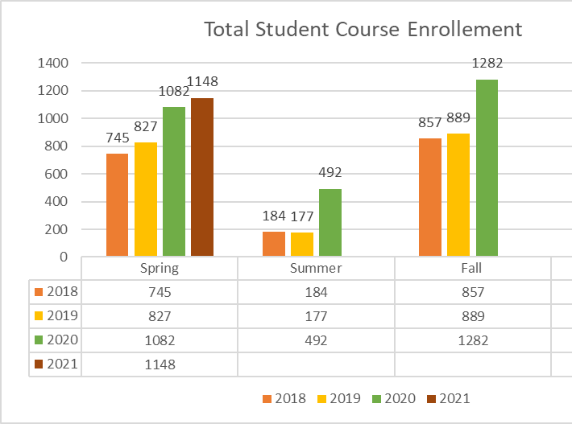
Enrollment continues to increase
Students are not finding their way to Behavioral Healthcare positions.

Slide 11
Reimagine the Behavioral Healthcare Workforce Workforce Challenges
Healthcare reform and focus on behavioral health wellness
  Increased access to behavioral health care
  Hospitals and health care provider expansion in the area of mental health and substance use services
  National economy and low unemployment rates create opportunities for behavioral health professionals in other sectors.
  High turnover rates for entry level direct care positions.
  Licensed Mental Health Practitioners unable to meet the increased demands
  University graduate training programs
  Employer recruitment of students of Behavioral Healthcare

Slide 12
Reimagine the Behavioral Healthcare Workforce
Certification
The Florida Certification Board
High School Diploma:
  Certified Recovery Peer Specialists
  Certified Behavioral Health Technician
  Certified Prevention Specialist
  Certified Recovery Support Specialist
  Certified Recovery Residence Administrator
  Certified Tobacco Treatment Specialist
Bachelor’s Degree:
  Certified Addiction Professional
  Certified Behavioral Health Case Manager
  Certified Behavioral Health Case Manager Supervisor
  Certified Prevention Professional
  Certified Mental Health Professional
Notes:
Discuss gaps- professional association, professional development, skills and training prior to entry into the work force

Slide 13
MHLP BHC Short-Term Goals
Strategic Partnerships
Workforce development roadmap
Targeted Skill development
Accelerated
B.S to M.S.
Clinical Rehabilitation and Mental Health Counseling
Behavioral Healthcare Direct Service Professionals Association
Career recruitment & informational events that include students from various disciplines of Behavioral Healthcare
Child Life Specialist concentration

Slide 14
MHLP BHC Long-Term Goals
Creating a Center for Behavioral Healthcare Workforce Development
Certification BHC Bachelor Level – Mobile Crisis Responder, Crisis line responder Intake, Certified Children’s Behavioral Health Referral and Support Specialist
Clinical Rehabilitation and Mental Health Counseling - Children’s Concentration
Accelerated B.S. to M.S. School Counseling
Accelerated B.S. to Ed.S School Psychology
Behavioral Healthcare Administration, M.S.
A.A. to B.S. in Behavioral Healthcare

Slide 15
Thank You!

