Slide 1
Behavioral Health Public Schools Integration Projects
BBHC & CFBHN network Collaboration
Broward, Pasco & Hillsborough Counties

Slide 2
How it All Began
In 2018, the Marjory Stoneman Douglas High School Public Safety Act (Senate Bill 7026) passed the Florida Legislature to make schools safer and to ensure mental health services for students. The Legislature allocated $125 million (2021-22) for school mental health.
Pasco and Hillsborough County School Board Districts use their school mental health funds to contract with local behavioral health managing entity, Central Florida Behavioral Health Network (CFBHN)
Managing Entities manage state/federal funds and use a network of local behavioral health organizations to provide mental health, substance use, prevention, family support, and many other services

Slide 3
Merging Two Systems: Schools & Mental Health
Approach
CFBHN works with school systems to assess student needs and service gaps, identify providers and additional resources, and meet reporting requirements
CFBHN organizes a system of care that ensures mental health services are delivered to children and families identified by the school system
Expands network to include organizations that provide needed services to students
Care coordinator is placed in each school district to ensure students are receiving needed services and to guarantee appropriate funds are used (including Medicaid or commercial insurance) prior to accessing the school mental health funds
In high needs schools, on-site therapists are designated to meet student needs

Slide 4
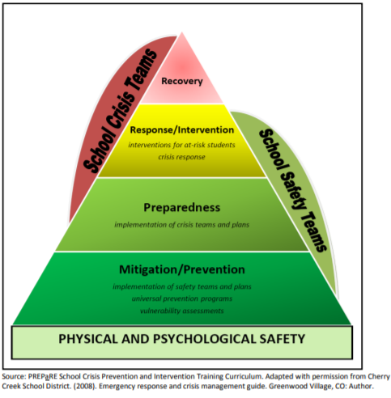
Multi-Tier Approach
School staff, District Clinician and the School Project Manager identify children and assess using a Multi-Tier approach
Services are delivered at the lowest possible level that meets child and family needs to prevent progression into higher, more intensive levels of service
Reporting outcomes include:
Days in school
Pre and Post functioning level
Screening and assessments
Statutorily required children’s mental health measures
Multi-Tier Approach

Slide 5
Results
CFBHN Contracted with community behavioral health providers for each school project:
Hillsborough County School District (HCSD)–9/Pasco County School District (PCSD)-11
HCSD identified high need schools and 5 Hillsborough contracted providers have therapists placed at those schools for individual and group counseling. Currently 118 high needs schools have onsite services.
CFBHN has formed a Steering Committee workgroup with contract providers, school district staff and CFBHN to identify barriers to services for student and strategies to mitigate the barriers
PCSD collaborated with Gulf Coast JFCS (Jewish Family Community Services) to provide intensive behavioral health services to students and families in the district. Total of 82 students served from the start of this expansion.
PCSD has formed a workgroup with community behavioral health providers, stakeholders and CFBHN as a community approach to suicide prevention

Slide 6
Quotes from the School District
“
“I wanted to share a quick testimonial with our first Safe at Home Referral. Today we had our first successful check-in with the student and some of his grades have gone up that were failing last qrt to B's and C's. This progress was surprisingly fast. I also wanted to share the student was able to self-reflect and communicate in a normal and respectful way. I know we have an amazing team that offers phenomenal support. Also, wanted to share that he is participating in his FBA self-advocating, though we have a long way to go we have made positive progress. The student was able to communicate appropriately and use appropriate dialog and self-reflect. I am so proud to be a part of our team and appreciate the small yet huge signs of progress with hopes of future success." - T. Vargas, School Social Worker​
"I have a female 9th grader diagnosed with depression, was skipping classes, and grades were low. Weekly sessions started mid to end of Sem 1. As of today zero referrals for skipping, grades have increased, student is doing well. She loves her therapist." - S. Williams, School Social Worker​

Slide 7
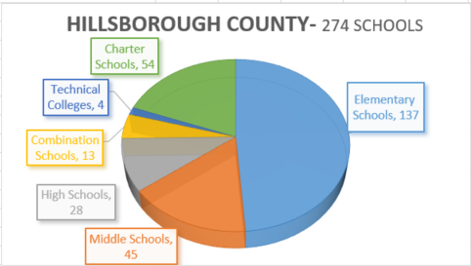
Data – Hillsborough School District
Enhanced Outcomes: Collected on all students served by CFBHN contract for 2021-2022 Q1 & Q2
Outcomes Description | Numbers
Percent of school days students served attended | 95.43%
Percent of students who maintain or improve their level of functioning | 88.52%
Total number of screenings and assessments | 1358
Percent of students that live in a stable housing environment | 99.61%
Average length of days served | 67
224,000 Students
Program Referrals- FY 22/23 2,639
Total Numbered Served- FY 22/23 2,935

Slide 8
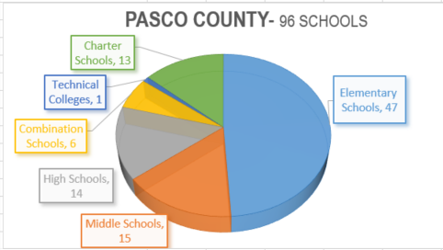
Data - Pasco School District
Enhanced Outcomes: Collected on all students served by CFBHN contract for 2021-2022 Q1 & Q2
Outcomes Description | Numbers
Percent of school days students served attended | 98.53%
Percent of students who maintain or improve their level of functioning | 88.52%
Total number of screenings and assessments | 172
Percent of students that live in a stable housing environment | 100%
Average length of days served by project | 55
81,641 Students
Program Referrals FY 22/23 662
Total Number Served FY 22/23 221

Slide 9
Program Referrals & Funds Utilized
Hillsborough
Program Referrals & Funds Utilized |  |  |  |  |  |  |  |  |  |  |  | TOTAL (Project-to-Date)
 |  |  |  | FY 19-20 | FY 20-21 | FY 21-22 | FY 22-23
 |  |  |  |  |  |  | Quarter 1 | Quarter 2 | Quarter 3 | Quarter 4 | TOTAL
Count of Referrals to the Program |  |  |  | 489 | 1385 | 1327 | 747 | 1172 | 720 |  | 2639 | 5,840
Total Numbered Served |  |  |  | 254 | 1050 | 1147 | 637 | 1028 | 1270 |  | 2935 | 5,386
Funds Utilized |  |  |  | $351,576 | $1,572,892 | $919,474 | $304,135 | $435,958 | $392,304 |  | $1,132,398 | $3,976,340
Pasco
Program Referrals & Funds Utilized |  |  |  |  |  |  |  |  |  |  |  |  | TOTAL (Project-to-Date)
 |  |  |  |  | FY 19-20 | FY 20-21 | FY 21-22 | FY 22-23
 |  |  |  |  |  |  |  | Quarter 1 | Quarter 2 | Quarter 3 | Quarter 4 | TOTAL
Count of Referrals to the Program |  |  |  |  | 118 | 204 | 445 | 97 | 147 | 418 |  | 662 | 1,429
Total Numbered Served |  |  |  |  | 35 | 144 | 254 | 52 | 64 | 105 |  | 2212 | 875
Funds Utilized |  |  |  |  | $24,790 | $116,107 | $218,273 | $30,761 | $26,346 | $41,137 |  | $98,244 | $457,414

Slide 10
What’s Next?
Identify gaps to expand and enhance services
Continue partnership with Carisk on data reporting needs
Continue growth of on-site services for high needs schools
Increase community education about the availability of wraparound services
Identify unique behavioral health services for students and add community providers to deliver appropriate treatment
Maintain and enhance relationship-building and communication with school districts and community providers
Share successes and help replicate project in additional school districts
Health and safety for ALL Florida schools…in partnership with your Managing Entity!

Slide 11
History & Background
Central Florida Behavioral Health Network (CFBHN) received the first contract from Pasco & Hillsborough School Boards for Behavioral Health Services
BBHC invited CFBHN to Broward’s Funders Forum to present on their school integrated initiative
Broward County Public Schools (BCPS) became interested in replicating this initiative with BBHC
BBHC developed an online portal that allows referrals to be submitted electronically. Additionally, this portal allows for BCPS referral sources, BBHC and the treatment provider to have real time information. This information includes statuses on assessments, treatment progress and discharges.

Slide 12
BCPS/BBHC Collaboration
The Broward Behavioral Health Coalition (BBHC) has established a valuable partnership with the School Board of Broward County to effectively address the mental health care needs of students throughout the district. Within this collaborative effort, dedicated school and district-level personnel play a crucial role in identifying and referring students who require mental health services to BBHC. By facilitating the coordination and oversight of mental health services provided by BBHC's network providers, this partnership significantly enhances the overall care coordination between the behavioral health and school systems. The collective efforts of BBHC and the School Board ultimately contribute to creating a nurturing and supportive educational environment that fosters the overall success and well-being of students.

Slide 13
Public Schools Collaboration
Benefits:
Reduced risk of students in need of mental health services falling through the cracks.
The close collaboration between BBHC and the School Board ensures that students are promptly connected with the appropriate mental health resources and support.
This proactive approach minimizes the chances of students' mental health needs going unnoticed or unaddressed.
By leveraging the expertise and resources of both organizations, the partnership creates a seamless and comprehensive system of care for students within the district.
Optimizing utilization of available mental health services and promotes a holistic approach to supporting students' mental well-being.
Development of an Online Portal (LTI) that allows real time monitoring of all referrals

Slide 14
Current Status of The Program
Since October 2022 thru May 2023 the project has received a total of 832 referrals
Demographic Specifics

Slide 15
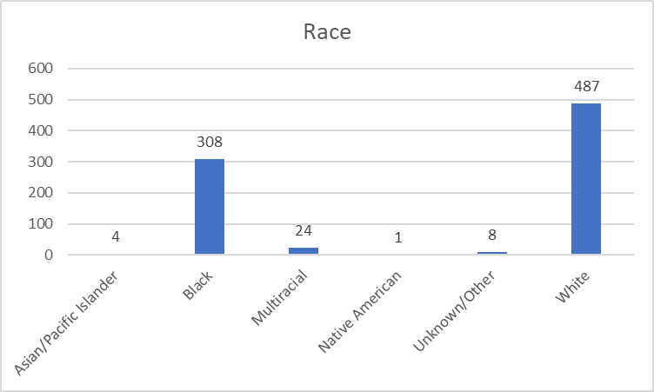
Current Status of The Program
Demographic Specifics (cont.)
Ethnicity
Caribbean | 5.98%
Hispanic | 44.23%

Slide 16
Success Stories BBHC and the School Board of Broward County partnership has enhanced care coordination of mental health services for students by ensuring students receive appropriate services and levels of care.
Success Story 1: One student was thought to have an eating disorder, and school staff asked BBHC to refer them to an eating disorder center. After BBHC’s Care Coordinator further assessed, it was determined that the student did not like the food as she migrated from Cuba and had adjustment challenges. BBHC connected the student and her family to services to assist with the student’s adjustment to the US.
Success Story 2: A student was referred to BBHC’s network provider for self-harm and suicidality as she experienced bullying in school. Since receiving services, the student and her parents reported that the student no longer engages in self-harm and reported no suicidal ideation. The student and her therapist continue to work on her self-esteem. However, her parents have stated they see a massive change in her mental health.
Success Story 3: A student was referred to BBHC’s network provider because she experienced panic attacks and high anxiety levels that prevented her from interacting with others and participating in activities. Since the student started therapy, the student has reduced her anxiety levels and the number of panic attacks she experiences. The student has been connected to social activities where she has made new friendships and developed a hobby for gardening and caring for plants.
Success Story 4: A student was successfully discharged from therapeutic services after being referred for depression and feeling unmotivated. After working with her therapist, she was able to decrease her depression, graduate high school and find a job overseas that would allow her to travel, which was her dream.

Slide 17
Comments & Questions

