Slide 1
Your Managing Entity
Marjory- Stoneman Douglas School Safety Programs
Pasco & Hillsborough County School Behavioral Health Project
Lizette Tabares
Special Projects Sr. Program Manager
WWW.CFBHN.ORG

Slide 2


How it All Began
In 2018, the Marjory Stoneman Douglas High School Public Safety Act (Senate Bill 7026) passed the Florida Legislature to make schools safer and to ensure mental health services for students. The Legislature allocated $125 million (2021-22) for school mental health.
Pasco and Hillsborough County School Board Districts use their school mental health funds to contract with local behavioral health managing entity, Central Florida Behavioral Health Network (CFBHN)
Managing Entities manage state/federal funds and use a network of local behavioral health organizations to provide mental health, substance use, prevention, family support, and many other services

Slide 3


Merging Two Systems: Schools & Mental Health
Approach
CFBHN works with school systems to assess student needs and service gaps, identify providers and additional resources, and meet reporting requirements
CFBHN organizes a system of care that ensures mental health services are delivered to children and families identified by the school system
Expands network to include organizations that provide needed services to students
Care coordinator is placed in each school district to ensure students are receiving needed services and to guarantee appropriate funds are used (including Medicaid or commercial insurance) prior to accessing the school mental health funds
In high needs schools, on-site therapists are designated to meet student needs

Slide 4
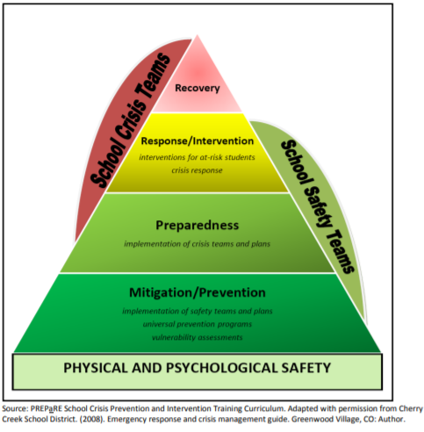
Multi-Tier Approach
School staff, District Clinician and the School Project Manager identify children and assess using a Multi-Tier approach
Services are delivered at the lowest possible level that meets child and family needs to prevent progression into higher, more intensive levels of service
Reporting outcomes include:
  Days in school
  Pre and Post functioning level
  Screening and assessments
  Statutorily required children’s mental health measures
Multi-Tier Approach

Slide 5
Results
CFBHN Contracted with community behavioral health providers for each school project:
Hillsborough County School District (HCSD)–9/Pasco County School District (PCSD)-10
HCSD identified high need schools and 4 Hillsborough contracted providers have therapists placed at those schools for individual and group counseling. Currently 119 high needs schools have onsite services.
CFBHN has formed a Steering Committee workgroup with contract providers, school district staff and CFBHN to identify barriers to services for student and strategies to mitigate the barriers
PCSD collaborated with Gulf Coast JFCS (Jewish Family Community Services) to provide intensive behavioral health services to students and families in the district. Total of 82 students served from the start of this expansion.
PCSD has formed a workgroup with community behavioral health providers, stakeholders and CFBHN as a community approach to suicide prevention

Slide 6
Quotes from the School District
“
“I wanted to share a quick testimonial with our first Safe at Home Referral. Today we had our first successful check-in with the student and some of his grades have gone up that were failing last qrt to B's and C's. This progress was surprisingly fast. I also wanted to share the student was able to self-reflect and communicate in a normal and respectful way. I know we have an amazing team that offers phenomenal support. Also, wanted to share that he is participating in his FBA self-advocating, though we have a long way to go we have made positive progress. The student was able to communicate appropriately and use appropriate dialog and self-reflect. I am so proud to be a part of our team and appreciate the small yet huge signs of progress with hopes of future success." - T. Vargas, School Social Worker​
"I have a female 9th grader diagnosed with depression, was skipping classes, and grades were low. Weekly sessions started mid to end of Sem 1. As of today zero referrals for skipping, grades have increased, student is doing well. She loves her therapist." - S. Williams, School Social Worker​

Slide 7

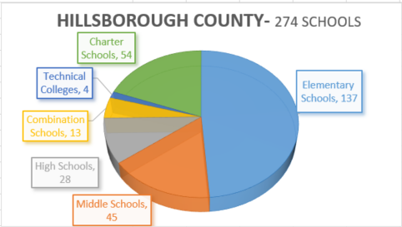
Data – Hillsborough School District
Enhanced Outcomes: Collected on all students served by CFBHN contract for 2021-2022 Q1 & Q2
Outcomes Description | Numbers
Percent of school days students served attended | 95.43%
Percent of students who maintain or improve their level of functioning | 88.52%
Total number of screenings and assessments | 1358
Percent of students that live in a stable housing environment | 99.61%
Average length of days served | 67
224,000 Students
Program Referrals- FY 22/23 2,639
Total Numbered Served- FY 22/23 2,935

Slide 8

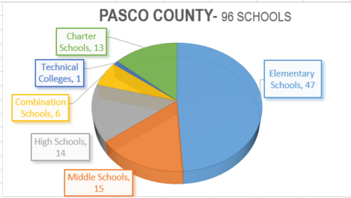

Data - Pasco School District
Enhanced Outcomes: Collected on all students served by CFBHN contract for 2021-2022 Q1 & Q2
Outcomes Description | Numbers
Percent of school days students served attended | 98.53%
Percent of students who maintain or improve their level of functioning | 88.52%
Total number of screenings and assessments | 172
Percent of students that live in a stable housing environment | 100%
Average length of days served by project | 55
81,641 Students
Program Referrals FY 22/23 863
Total Number Served FY 22/23 221

Slide 9



What’s Next?
Identify gaps to expand and enhance services
Continue partnership with Carisk on data reporting needs
Continue growth of on-site services for high needs schools
Increase community education about the availability of wraparound services
Identify unique behavioral health services for students and add community providers to deliver appropriate treatment
Maintain and enhance relationship-building and communication with school districts and community providers
Share successes and help replicate project in additional school districts
Health and safety for ALL Florida schools…in partnership with your Managing Entity!

Slide 10

“Coming together is a beginning, staying together is progress, and working together is SUCCESS.”
~Henry Ford
Contacts
Pasco Schools- Tanya Keene- tkeene@cfbhn.org
Hillsborough Schools- Lizette Tabares- ltabares@cfbhn.org

Slide 11


