Slide 1
Overview of Licensing
Module 1

Slide 2
Agenda
Unit 1.1: Introduction to Licensing
Unit 1.2: Licensing Laws
Unit 1.3: Overview of the Child Removal and Placement Process
Unit 1.4: The Role and Skills of the Licensing Specialist
Licensing 1.0.2

Slide 3
Unit 1.1
Introduction to Licensing
Licensing 1.1.1

Slide 4
Learning Objectives
Describe the goal of foster care licensing.
Describe the types of circumstances that would bring children into licensed care.
Explain the role of foster care licensing as it relates to the family-centered practice.
Recognize the importance of quality parenting and establishing a relationship with foster parents as partners.
Explain the role of the Foster Care Licensing Specialist with other members of the Child Welfare team.
Licensing 1.1.2

Slide 5
Activity A:
My Journey to Foster Care Licensing
Using the worksheet in the Participant Guide, take turns interviewing each other.
After ten minutes, provide a 60-second introduction of your partner without reading from your paper.
Licensing 1.1.3

Slide 6
Child Welfare Practice Model – Seven Professional Practices
Engaging the family
Partnering with all involved
Information gathering
Assessing and understanding information
Planning for child safety
Planning for family change
Monitoring and adopting Case Plans
Licensing 1.1.4

Slide 7
Activity B:
Seven Professional Practices for Licensing
As a group, using your assigned professional practice, discuss the following question:
  How are Licensing Specialists involved in these seven professional practices?
Licensing 1.1.5
Licensing 1.1.5

Slide 8
Family-Centered Practice
In order for the practice model to be effective, it is necessary to maintain family-centered practice, which supports respect and engagement.
Licensing 1.1.2
Licensing 1.1.6

Slide 9
Care of Children, Quality Parenting, and the Reasonable and Prudent Parent Standard
Prevention of separation
Allow children to remain safely in their own homes
Reunification of families
Provides alternative emergency or longer-term parenting arrangements
Focus on the well-being of the children
Permanency for children
Transition to independence and self-sufficiency for older children
Licensing 1.1.7

Slide 10

The Goal of Foster Care Licensing
To ensure the physical and emotional safety and overall
well-being of children that have been removed from their families and must be cared for by people with whom they have relative or no familial connection
Licensing 1.1.8

Slide 11
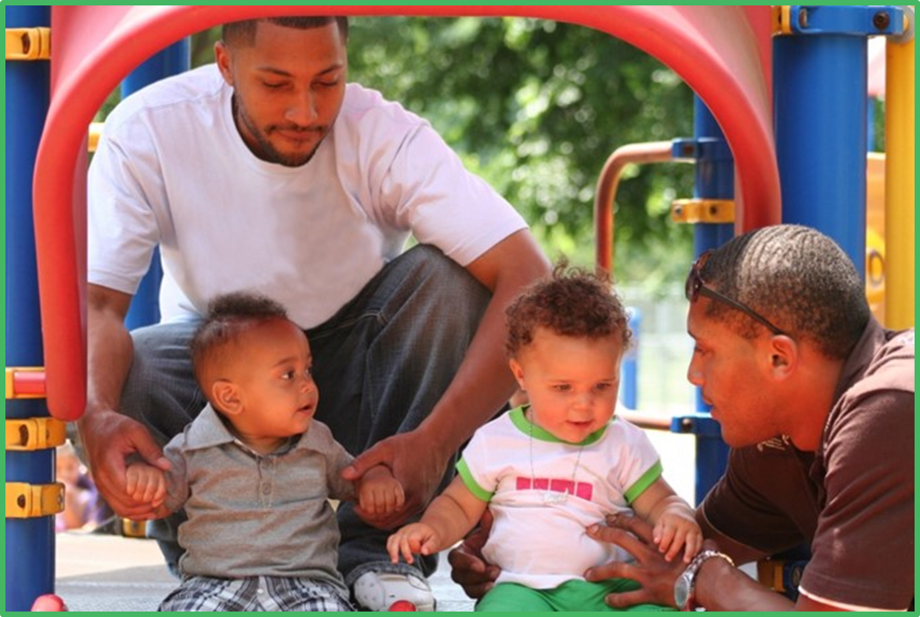
Quality Parenting Initiative
Licensing 1.1.9

Slide 12
Quality Parenting Initiative (QPI)
A child in foster care shall be placed only with a caregiver who:
has the ability to care for the child.
is accept responsibility for providing care.
is willing and able to learn about and be respectful of the child and the child’s background.
Licensing 1.1.10

Slide 13
Quality Parenting Initiative (QPI), cont.
The QPI operationalizes the quality parenting expectations and is one of Florida’s approaches to strengthening foster care.
The QPI was designed by the Youth Law Center and Eckerd Foundation in partnership with the Department of Children and Families and local CBCs.
The core premise is that the primary goal of the Child Welfare System is to ensure that children have effective, loving parenting.
Licensing 1.1.11

Slide 14
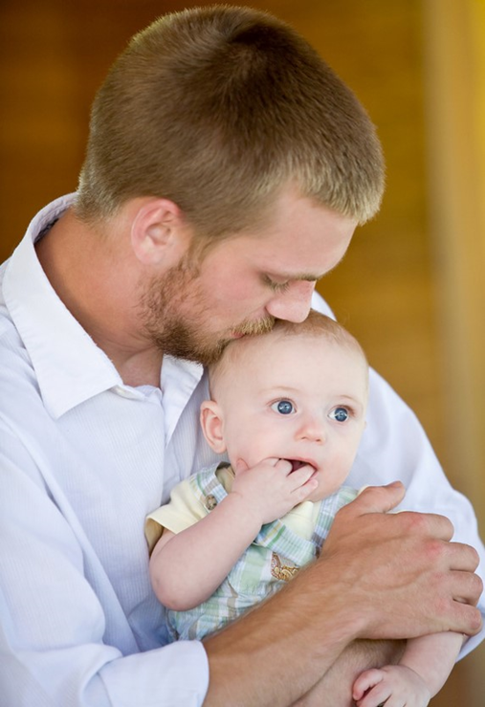
About the Quality Parenting Initiative
& Being a 21st Century Foster Parent
http://centervideo.forest.usf.edu/qpi/aboutqpi/overview.html
What are your overall impressions of the video?
What message does the video convey about foster parents, professionals, and partners?
Licensing 1.1.12

Slide 15
Four Key Components of QPI
Strengthening Communities
Respected Partners
Supporting Families
Nurturing Children
Licensing 1.1.13

Slide 16
Licensing Specialists - Seven Primary Roles
The Partner
The
Match-Maker
The Regulator
The Communicator
The Assessor
The Record Keeper
The Mentor
Licensing 1.1.14

Slide 17
Activity C:
Developing as a Licensing Specialist
Identify the qualities, skills, and knowledge a Licensing Specialist needs to successfully perform each role.
Licensing 1.1.15

Slide 18
Activity D:
My Strengths and Needs
Working independently, complete the worksheet by answering the following questions:
Given each role that a Licensing Specialist plays, what are your personal strengths and needs?
What are some ways you could turn your needs into strengths?
Licensing 1.1.16

Slide 19
Voices of Youth
http://centervideo.forest.usf.edu/dcf/voicesofyouth/fs.html
Why did they move so many times?
What did they share about how they want to be identified in a family?
What was characteristic of the homes they felt good about?
What made adjusting to foster care more difficult?
What did they need from professionals?
What did they need from foster parents?
What will you take with you from the video that will impact your work?
Licensing 1.1.17

Slide 20

Activity E:
The Big Picture
Based on the video we just watched and the information you recall from CORE training, what do you think are the feelings and behaviors of children who enter foster care?
Licensing 1.1.18

Slide 21

Collaboration
Case Manager
Child Protective Investigator
Adoption Specialist
Community Partners
Independent Living Specialist
Guardian ad Litem
Child Legal Services
Licensing 1.1.19

Slide 22
Child Protective Investigator
First responder
Provides supports
Removal, if necessary
Takes child to
safe place
Shelter Petition
Diligent search for placement
Attends Arraignment Hearing and Case Planning Conference
Licensing 1.1.20

Slide 23
Case Manager
Manages ongoing Safety Plans
Develops Case Plans
Addresses diminished caregiver protective capacities
Conducts ongoing assessments
Advocates for child
Attends hearings and prepares reports for court
Licensing 1.1.21

Slide 24
Adoption Specialist
Updates Case Plan
Prepares child
Creates child study
Conducts child-specific recruitment
Conducts adoptive home studies
Facilitates adoptive placement
Provides adoption assistance
Uses Adoption Review Committee
Provides post-adoption services
Licensing 1.1.22

Slide 25
Independent Living Specialist
Provides services for children in foster care (age 13 +)
Provides services for young adults formerly in foster care
Extended Foster Care
Postsecondary Education Services and Support (PESS)
Aftercare Services
Licensing 1.1.23

Slide 26

Children’s Legal Services (CLS)
Files legal paperwork
Starts the case in court
Licensing 1.1.24

Slide 27


Guardian ad Litem (GAL)
Assigned at time of arraignment
Works for child’s best interest in court
Serves as a resource for the foster parents, biological parents, and the child
Licensing 1.1.25

Slide 28

Community Partners
Healthcare Providers
Health Inspectors
Teachers/
Daycare Providers
Pastors
Licensing 1.1.26

Slide 29
Unit 1.2
Licensing Laws
Licensing 1.2.1

Slide 30
Learning Objectives
Explain how law and statute protect children in licensed care.
Identify the focus of the licensing requirements in Chapter 39, F.S.; Section 409.175, F.S.; Chapter 65C-45, F.A.C., and DCF Operating Procedures.
Describe how Chapter 65C-45, F.A.C., maintains the integrity of the licensing process.
Describe the different levels of licensure and placement types.
Licensing 1.2.2

Slide 31

Licensing Laws and Policies
Chapter 39, F.S.
s. 409.175, F.S.
65C-45, F.A.C.
Operating Procedures
Licensing 1.2.3

Slide 32
Multi-Ethnic Placement Act/Inter-Ethnic Placement Provision (MEPA)
Prohibits the delay or denial of any adoption or placement in foster care due to the race, color, or national origin of the child or of the foster or adoptive parents.
Requires states to provide for diligent recruitment of potential foster and adoptive families who reflect the ethnic and racial diversity of children for whom homes are needed.
Licensing 1.2.4

Slide 33
Chapter 65C-45, F.A.C., Sections
Background Screening Requirements
Parent Preparation Pre-Service Training
Initial Licensing and Home Study
Continuing Education
Changes During the Licensed Year
Re-Licensing
Standards for Licensed Out-of-Home Caregivers
Terms of a License
Babysitting, Overnight Care, Extended Overnight Care, and Other Supervision Arrangements
Foster Care Referrals and Investigations
Administrative Actions, Appeals, and Closures
Licensing 1.2.5

Slide 34

Types of Foster Care
  Levels of Licensure (409.175, F.S.)
Licensed Settings
Placement Types
Family Foster Home
Level I – Child-Specific Foster Home
Child Caring Agency
Level II – Non-Child Specific Foster Home
Level III – Safe Foster Home for victims of human trafficking
Level IV – Therapeutic Foster Home
Level V – Medical Foster Home
Licensing 1.2.6

Slide 35
Unit 1.3
Overview of the Child Removal and
Placement Process
Licensing 1.3.1

Slide 36
Learning Objectives
Review a generalized example of the Child Removal and Placement Process.
Licensing 1.3.2

Slide 37
Unified Home Study with Emergency Placement
  Child Removed
CPI removes a child and places him/her with a relative/non-relative /fictive kin.
Licensing 1.3.3

Slide 38
Unified Home Study with Planned Placement
  Child Removed
CPI removes a child and places him/her with a relative/non-relative /fictive kin.
Background Checks
CPI completes background checks of all household members over the age of 12 and frequent visitors over the age of 18 who provide sight and sound supervision under 65C-28, F.A.C. and 39.0138, F.S.
Licensing 1.3.4

Slide 39

Unified Home Study with Planned Placement
  Child Removed
Talk to Caregiver
CPI removes a child and places him/her with a relative/non-relative /fictive kin.
CPI explains the child’s special needs, available support, and danger threats creating the child’s need for out of home placement.
Background Checks
CPI completes background checks of all household members over the age of 12 and frequent visitors over the age of 18 who provide sight and sound supervision under 65C-28, F.A.C. and 39.0138, F.S.
Licensing 1.3.5

Slide 40
Unified Home Study with Emergency Placement
  Child Removed
Talk to Caregiver
CPI removes a child and places him/her with a relative/non-relative /fictive kin.
CPI explains the child’s special needs, available support, and danger threats creating the child’s need for out of home placement.
Background Checks
Home Evaluation
CPI completes background checks of all household members over the age of 12 and frequent visitors over the age of 18 who provide sight and sound supervision under 65C-28, F.A.C. and 39.0138, F.S.
CPI observes the home for possible dangers and discusses the child’s sleeping arrangements.
Licensing 1.3.6

Slide 41

Unified Home Study with Emergency Placement
  Child Removed
Talk to Caregiver
Verbal Supervisory Approval
CPI removes a child and places him/her with a relative/non-relative /fictive kin.
CPI explains the child’s special needs, available support, and danger threats creating the child’s need for out of home placement.
CPI obtains supervisor’s verbal approval for the placement before leaving the child in the care of the caregiver.
Background Checks
Home Evaluation
CPI completes background checks of all household members over the age of 12 and frequent visitors over the age of 18 who provide sight and sound supervision under 65C-28, F.A.C. and 39.0138, F.S.
CPI observes the home for possible dangers and discusses the child’s sleeping arrangements.
Licensing 1.3.7

Slide 42
Unified Home Study with Emergency Placement
  Child Removed
Talk to Caregiver
Verbal Supervisory Approval
CPI removes a child and places him/her with a relative/non-relative /fictive kin.
CPI explains the child’s special needs, available support, and danger threats creating the child’s need for out of home placement.
CPI obtains supervisor’s verbal approval for the placement before leaving the child in the care of the caregiver.
Background Checks
Home Evaluation
Child Placed
CPI completes background checks of all household members over the age of 12 and frequent visitors over the age of 18 who provide sight and sound supervision under 65C-28, F.A.C. and 39.0138, F.S.
CPI observes the home for possible dangers and discusses the child’s sleeping arrangements.
CPI places the child with a relative, non-relative, or fictive kin and finalizes the Unified Home Study.
Licensing 1.3.8

Slide 43

Unified Home Study with Emergency Placement
  Child Removed
Talk to Caregiver
Verbal Supervisory Approval
CPI removes a child and places him/her with a relative/non-relative /fictive kin.
CPI explains the child’s special needs, available support, and danger threats creating the child’s need for out of home placement.
CPI obtains supervisor’s verbal approval for the placement before leaving the child in the care of the caregiver.
Child Resides with Caregiver
Background Checks
Home Evaluation
Child Placed
CPI completes background checks of all household members over the age of 12 and frequent visitors over the age of 18 who provide sight and sound supervision under 65C-28, F.A.C. and 39.0138, F.S.
CPI observes the home for possible dangers and discusses the child’s sleeping arrangements.
CPI places the child with a relative, non-relative, or fictive kin and finalizes the Unified Home Study.
Licensing 1.3.9

Slide 44
Unified Home Study with Planned Placement
  Caregiver Identified
Talk to Caregiver
Supervisory Approval
Case manager identifies a relative or non-relative to place the child.
Case manager explains the child’s special needs, available support, and danger threats creating the child’s need for out of home placement.
Case manager’s supervisor approves the home study.
Child Resides with Caregiver
Background Checks
Home Evaluation
Child Placed
Case manager completes background checks of all household members over the age of 12 and frequent visitors over the age of 18 who provide sight and sound supervision.
Case manager observes the home for possible dangers and discusses the child’s sleeping arrangements.
Case manager places the child with the relative/non-relative
Licensing 1.3.10

Slide 45
Unit 1.4
The Roles and Skills of the
Licensing Specialist
Licensing 1.4.1

Slide 46
Learning Objectives
Define ongoing and mutual assessment.
Identify the phases of assessment and explain how these phases relate to the licensing process.
Recognize the importance of documentation and keeping a thorough and up-to-date file.
Licensing 1.4.2

Slide 47

Assessment and the Licensing Specialist
Licensing 1.4.3

Slide 48

What is Assessment?
Assessment is a mutual and ongoing process between the agency and family.
Licensing 1.4.4

Slide 49
The Stages of Assessment
Recruitment and Inquiry
Initial Licensing
Placement
Retention and Re-licensing
Licensing 1.4.5

Slide 50
The Skills and Knowledge of Assessment
Assessing and Inspecting
Interacting
Interpreting
Verifying
Documenting
Tools and Requirements
Child Welfare Knowledge
Interviewing
Licensing 1.4.6

Slide 51

Interpersonal Skills
Licensing 1.4.7

Slide 52
Interviewing Skills
Close-ended, Probing, or Yes/No Questions
Open-ended Questions
Supportive Responses/Active Listening
Clarification
Summarization/Redirection
Giving Options, Advice, or Suggestions
Confrontation
Licensing 1.4.8

Slide 53

Engagement
Licensing 1.4.9

Slide 54
Activity G:
Engagement Skills Practice
Role-play an interview as a Licensing Specialist interviewing a foster parent using the Phases of an Interview.
Practice introducing yourself and establishing a positive relationship with a foster parent.
When finished, the interviewee will provide feedback to the interviewer.
Licensing 1.4.10

Slide 55
Documentation
Licensing Specialists must come to conclusions:
Is this family right for fostering?
Is this family right for this child?
Does this family need help?
Are there red flags?
Licensing 1.4.11

Slide 56

Verifying Techniques
Check with references
Check with employers
Ask follow-up questions
Compare answers
Conduct background checks
Licensing 1.4.12

Slide 57
Purpose of Documentation
Guide the licensing process
Provide accountability for agency and Licensing Specialist
Provide accountability for the foster parents
Serve as a therapeutic tool for the caseworker and the foster parents
Organize the Licensing Specialist’s thinking about the work
Licensing 1.4.13

Slide 58
Quality Record-Keeping
The Licensing Specialist should:
Retain and update records to assure accuracy, relevancy, timeliness, and completeness.
Clearly describe strengths and needs as well as plans for support and development.
Maintain only objective information that is relevant and necessary to the agency’s purposes.
Record as much information as possible based on direct communication with clients.
Inform foster parents about the agency’s authority to gather information.
Licensing 1.4.14

Slide 59

Traditional Licensing File
Licensing 1.4.15

Slide 60
Requirements for a Traditional Licensing File
Application for License
Release of Information
Authorization for Release
Unified Home
Study
Proof of Income
Partnership Plan
Parent Preparation Training
Parent Preparation Biographical Profile
Water Safety Training
Confidentiality Agreement
Criminal History Screening
References
Family Documents
Family Foster Home Safety Documentation
Firearms Safety Requirements
Licensing 1.4.16

Slide 61

Navigating Potential Roadblocks
Licensing 1.4.17

