Slide 1

Unified Home Study Training
Initial Licensing or Re-licensing
Unified Home Study
Office of Child welfare
April/May 2018

Slide 2

Learning Objectives
Identify what information needs to be gathered and assessed in the Initial Licensing and Re-licensing Unified Home Studies.
Demonstrate how to gather the necessary information for the Initial Licensing and Re-licensing Unified Home Studies in accordance with laws and regulations.
Demonstrate how to document an Initial Licensing Unified Home Study using FSFN.
Unified Home Study 4.2

Slide 3

Foster Home Licensing
Unified Home Study 4.3

Slide 4
Parent Preparation Training
Training includes the following subjects:
Reasonable and prudent parenting standards
Social and emotional development of children and youth
The role of mentors and other helpers
Development of life skills for teens in care
Caregiver’s role in supporting and promoting the educational progress of the child
Trauma-informed care
Multiethnic Placement Act and Americans with Disabilities Act
Administration of psychotropic medication
Unified Home Study 4.4

Slide 5
Exemptions for Parent Preparation Training
A prospective foster parent can be exempt from completing the parent preparation training if they have successfully completed parent preparation training equivalent to the parent preparation training offered by the supervising agency.
If there have been changes or updates in the curriculum, the prospective foster parent is required to complete those portions of the course.
The Regional Licensing Authority must approve the exemption.
Unified Home Study 4.5

Slide 6

Documentation
Completion of the parent preparation training is documented in the provider notes in FSFN and a copy of the certificate is uploaded into the
Provider File Cabinet.
Unified Home Study 4.6

Slide 7
Completion of Parent Preparation Training
Once prospective foster parents have been identified and have completed the parent preparation training, Licensing Specialists continue their information gathering by speaking to the prospective foster parents to gather demographic information.
Unified Home Study 4.7

Slide 8
The UHS Interview Process
Goes beyond reading questions and documenting caregivers’ responses.
Requires information gathering beyond yes/no responses.
Qualitative interview skills must be used to gather the necessary information to assess the relative/non-relative caregiver(s).
Unified Home Study 4.8

Slide 9
The UHS Interview Process, con’t.
Opening
Phase
Planning
Phase
Information Gathering
Phase
Closing
Phase
Unified Home Study 4.9

Slide 10

FSFN Tutorial
Demographic Information
Unified Home Study 4.10

Slide 11
Demographic Information
Demographic information is needed in order to obtain and assess criminal and child abuse histories for the prospective foster parents and household members.
Unified Home Study 4.11

Slide 12
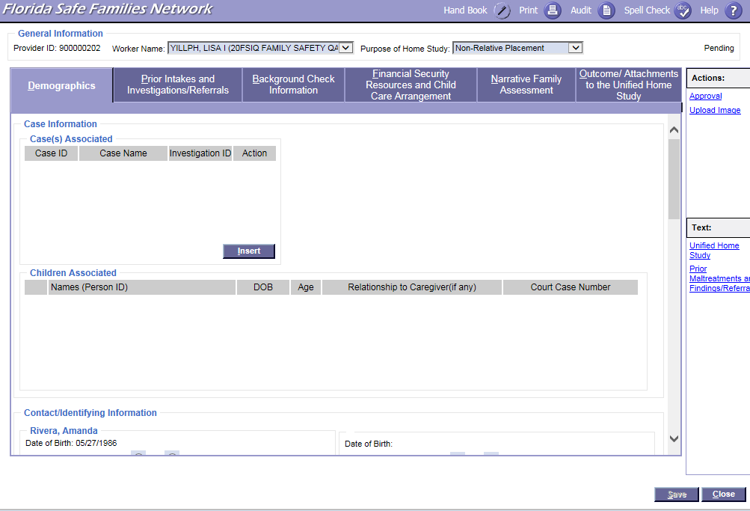

FSFN Screens
UHS Demographics tab:
Unified Home Study 4.12

Slide 13
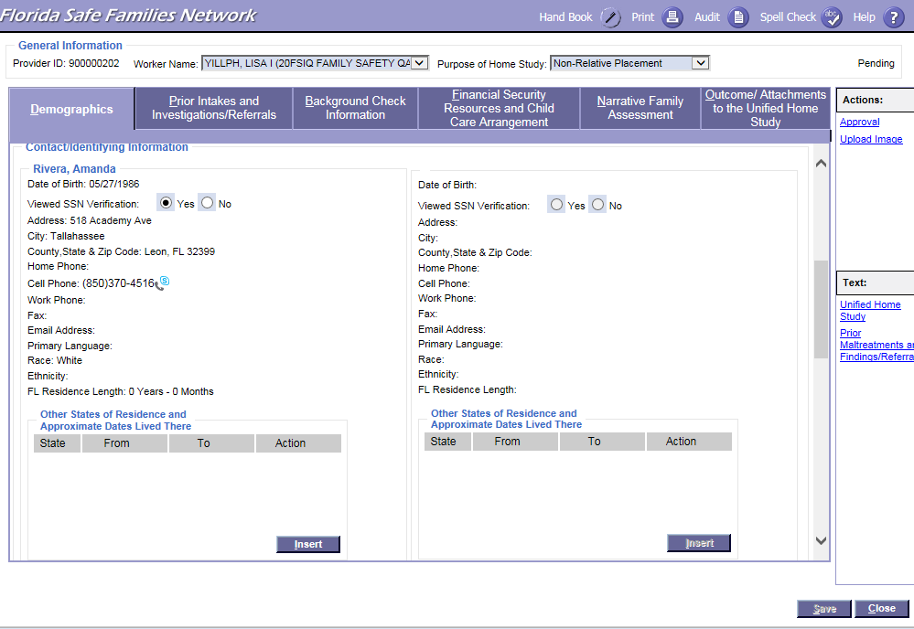
FSFN Screens
UHS Demographics tab:
Unified Home Study 4.13

Slide 14
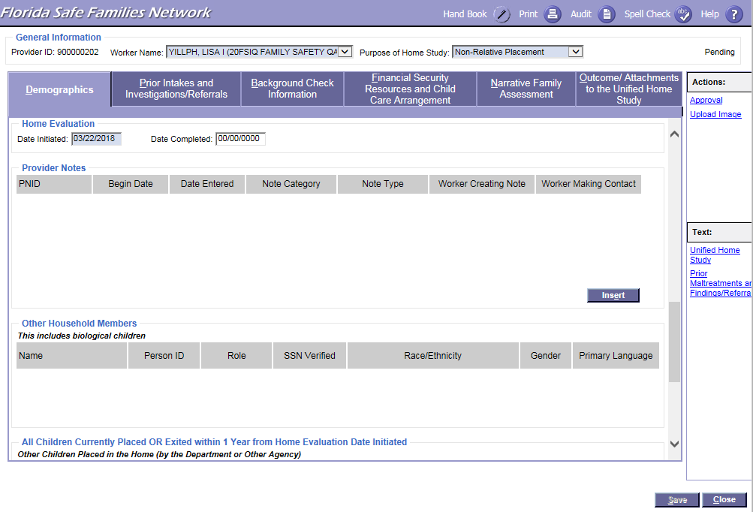
FSFN Screens
UHS Demographics tab:
Unified Home Study 4.14

Slide 15
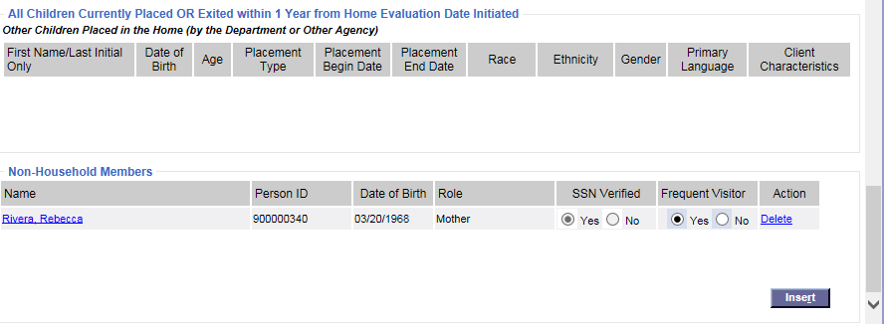
FSFN Screens
UHS Demographics tab:
Unified Home Study 4.15

Slide 16
FSFN Tutorial
Background
Checks
Unified Home Study 4.16

Slide 17
Background Checks
Licensing Specialists must obtain, verify, and assess background checks of all prospective foster parents and their household members over the age of twelve.
Background checks shall not be obtained through FSFN.
Unified Home Study 4.17

Slide 18
Background Checks, con’t.
Abuse/
neglect record checks
Local criminal checks and Juvenile Justice information
Fingerprint
Submission
Unified Home Study 4.18

Slide 19
Analysis of
Background Checks
A thorough review and analysis of all of the background information gathered provides Licensing Specialists with the insight needed to ensure that the prospective foster parent will qualify to become a licensed foster home.
When reviewing the criminal, abuse and/or neglect records obtained, Licensing Specialists must assess for patterns of criminal or other negative behavior. Foster parents are screened under Chapter 435 for Level II offenses.
Unified Home Study 4.19

Slide 20
Documentation
Within FSFN, Licensing Specialists must document the records obtained and their thorough analysis of the background check results within the Background Check Information page.
Unified Home Study 4.20

Slide 21
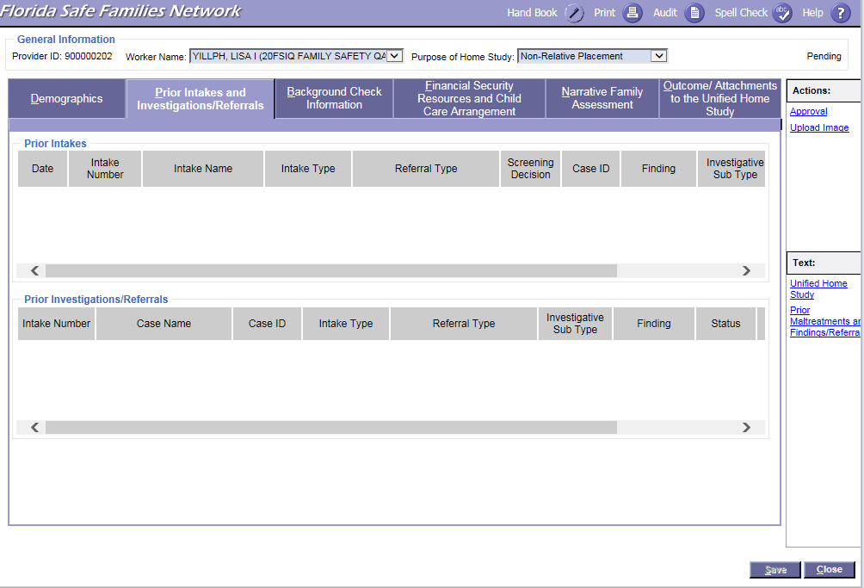
FSFN Screens
Prior Intakes Investigations/Referrals:
Unified Home Study 4.21

Slide 22
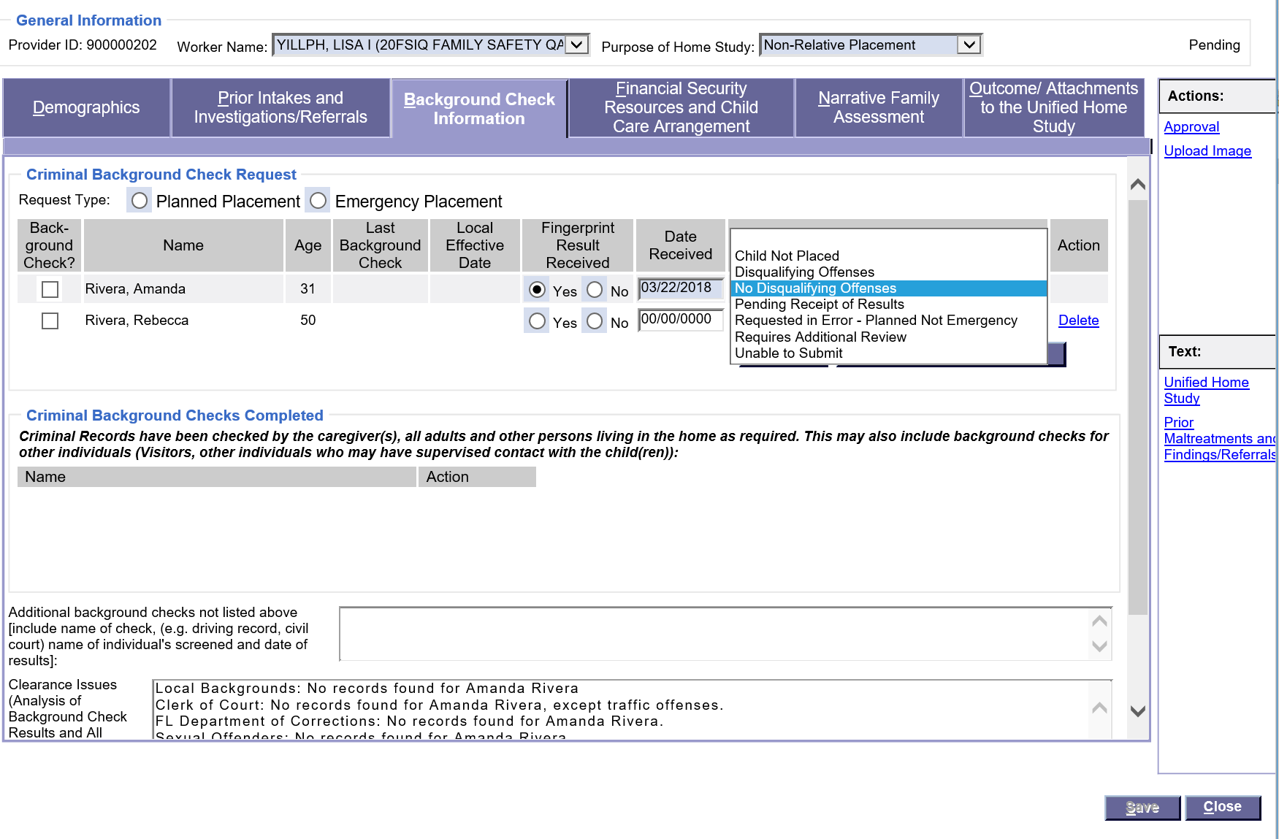
FSFN Screens
How to locate document dates and statuses for background histories received on the Background Check information tab:
Unified Home Study 4.22

Slide 23
FSFN Screens
Where to document the background analysis in the Clearance Issues text box:
Unified Home Study 4.23

Slide 24
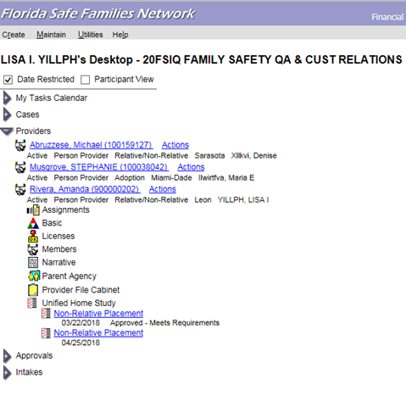
FSFN Screens
Updating criminal history dates:
Unified Home Study 4.24

Slide 25
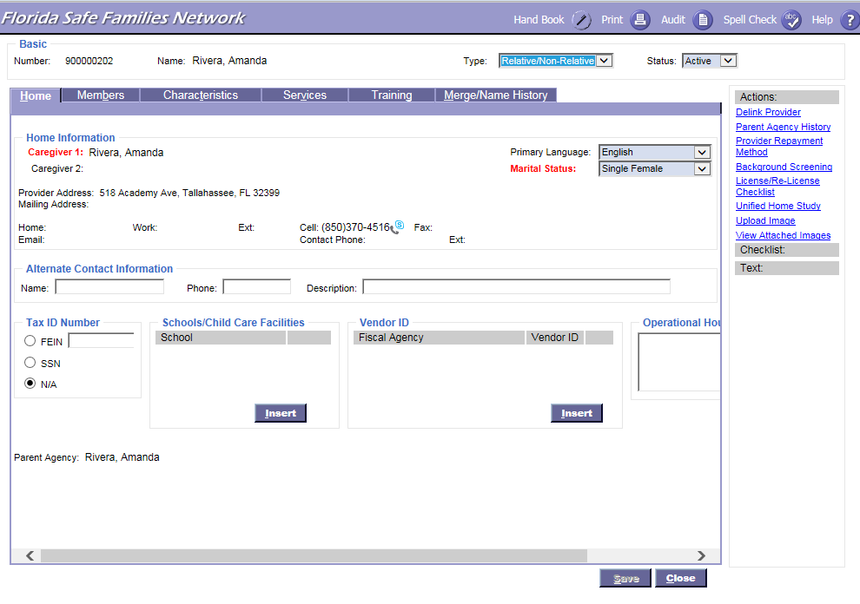
FSFN Screens
Updating criminal history dates:
Unified Home Study 4.25

Slide 26
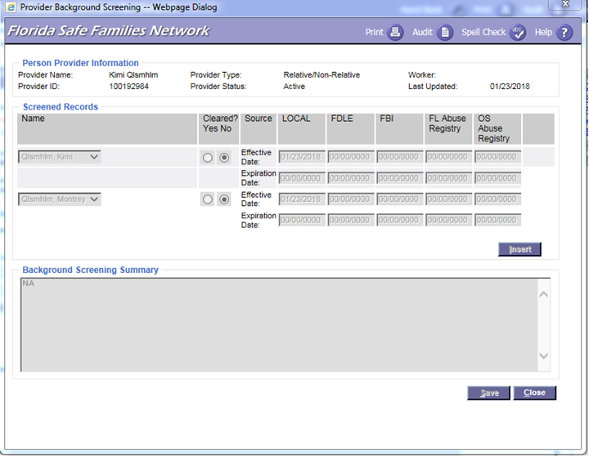
FSFN Screens
Where to insert clearance from different sources:
Unified Home Study 4.26

Slide 27
Foster Care Supports
Foster Care Board Payment
Medicaid for Child
Foster Adoptive Parent Association/
Support Groups
Child Care Referral
Licensing Supports
Unified Home Study 4.27

Slide 28
FSFN Tutorial
Financial Security Resources and Child Care Arrangements
Unified Home Study 4.28

Slide 29
Financial Security, Resources, and Child Care Arrangements
Financial Breakdown
Additional Monthly Support
Monthly Expenses
Family Situation
Unified Home Study 4.29

Slide 30
Prospective Foster Parent Employment
While completing the financial information, Licensing Specialists may learn that the prospective foster parent or a household member is an employee of the Department, county sheriff’s offices, community-based care lead agencies and/or their subcontracted providers.
Unified Home Study 4.30

Slide 31
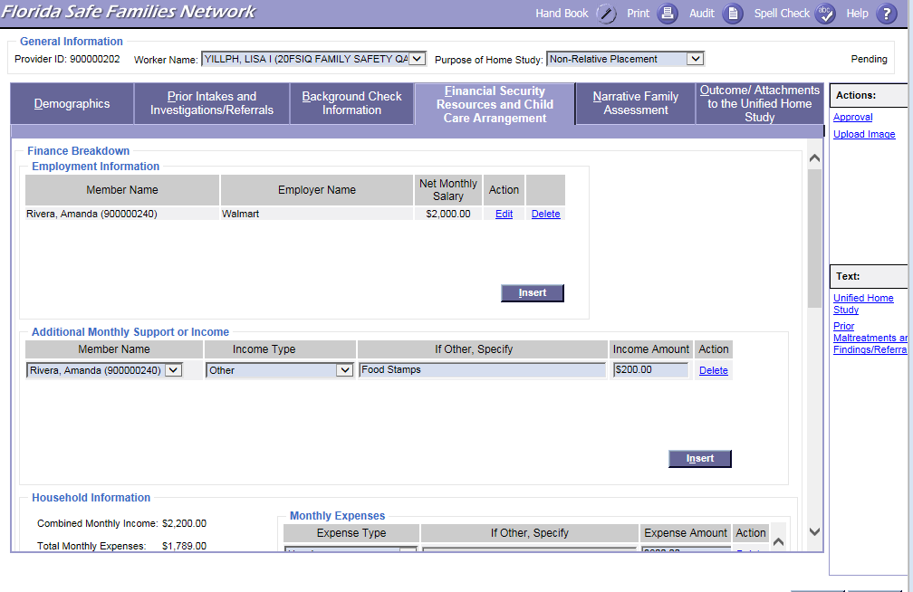
FSFN Screens
Employment Information:
Unified Home Study 4.31

Slide 32
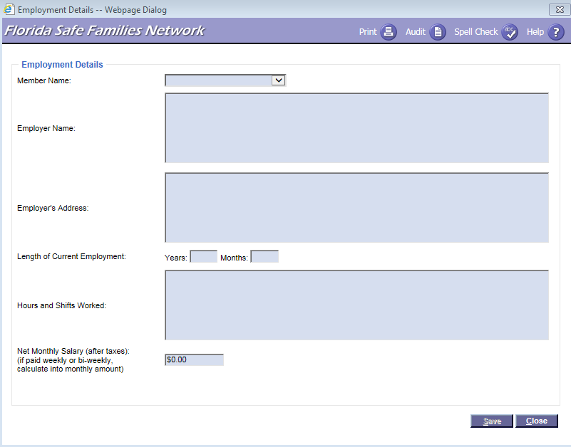
FSFN Screens
Adding Employment Details:
Unified Home Study 4.32

Slide 33
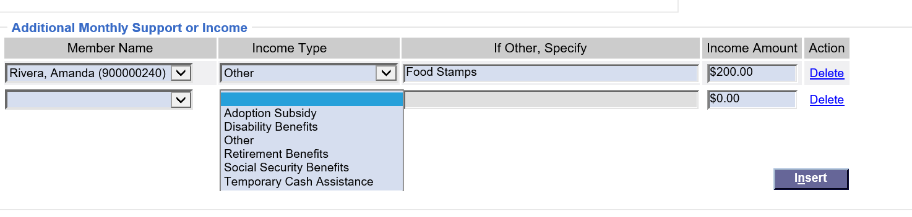
FSFN Screens
Adding Additional Monthly Support or Income:
Unified Home Study 4.33

Slide 34
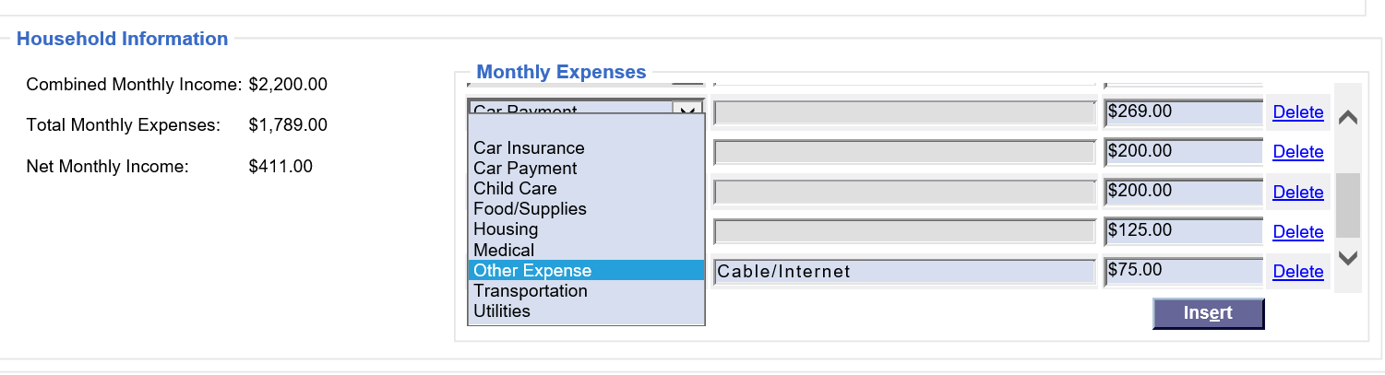
FSFN Screens
Adding Monthly Expenses:
Unified Home Study 4.34

Slide 35
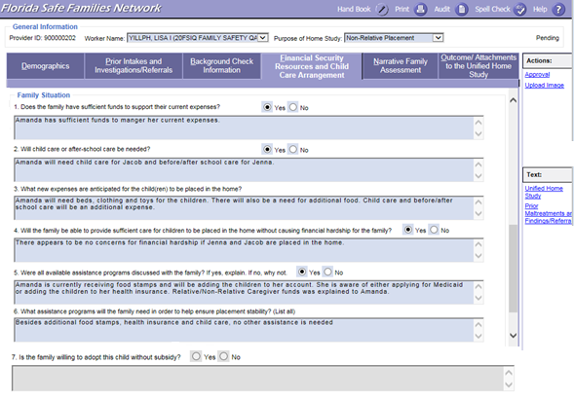
FSFN Screens
Family Situation:
Unified Home Study 4.35

Slide 36
FSFN Tutorial
Narrative Family Assessment
Unified Home Study 4.36

Slide 37
Narrative Family Assessment
Licensing Specialists conduct a narrative family assessment and gather the needed information to fully evaluate the caregiver’s ability to provide a safe and nurturing environment for the child.
Information should be gathered through an interview process.
Unified Home Study 4.37

Slide 38
Narrative Family Assessment, con’t.
The Narrative Family Assessment is split up into nine areas:
Assess Caregiver
Family History
Child History
Motivation
Children to Be Placed Interviews
Physical Environment
Education and Employment
References and Reviews
Family Support and Resources
Unified Home Study 4.38

Slide 39
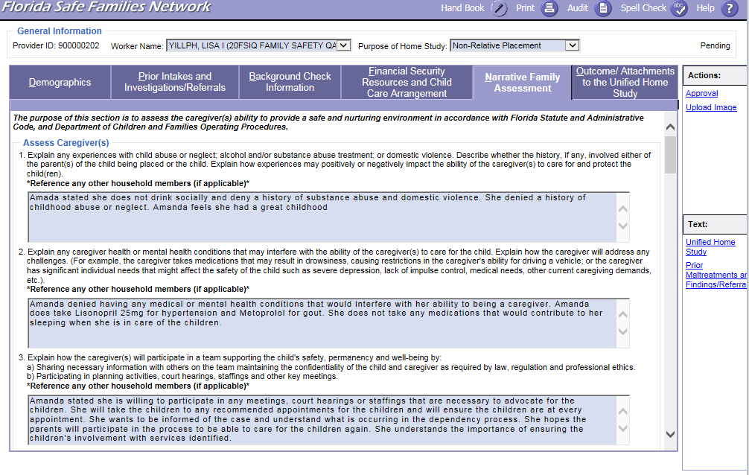
FSFN Screens
Narrative Family Assessment – Assess Caregiver(s) Questions:
Unified Home Study 4.39

Slide 40
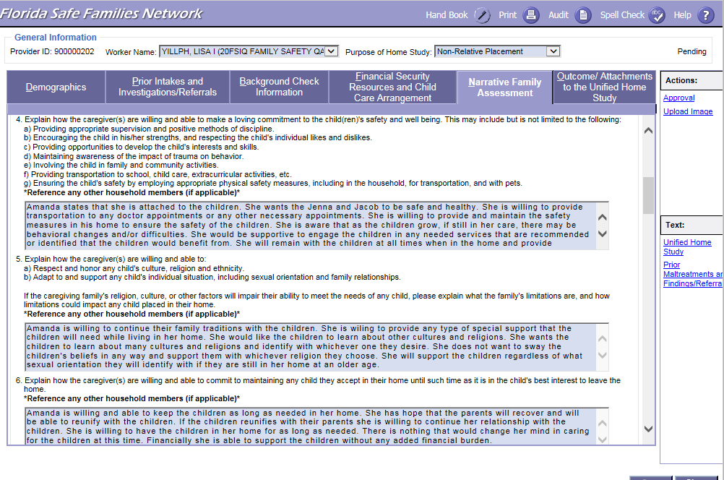
FSFN Screens
Narrative Family Assessment – Assess Caregiver(s) Questions:
Unified Home Study 4.40

Slide 41
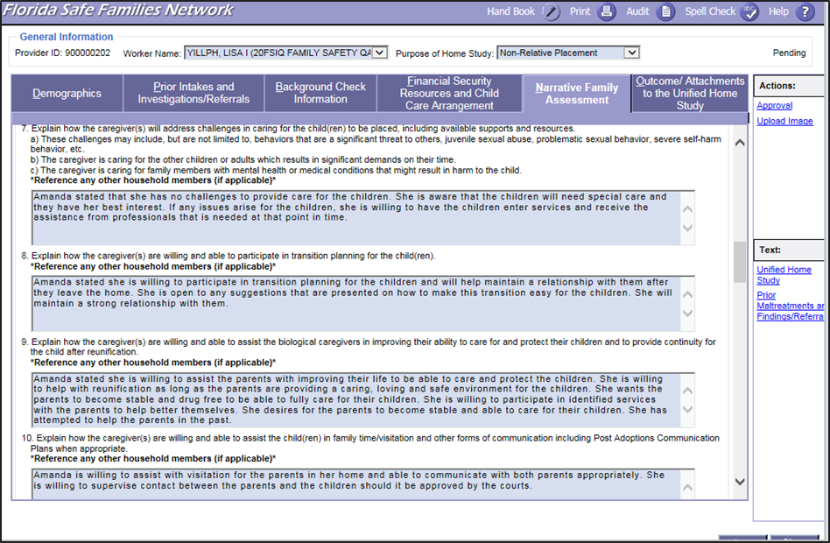
FSFN Screens
Narrative Family Assessment – Assess Caregiver(s) Questions:
Unified Home Study 4.41

Slide 42
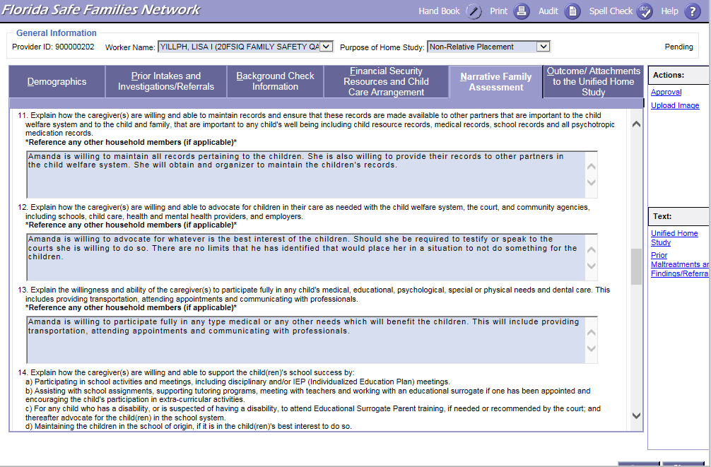
FSFN Screens
Narrative Family Assessment – Assess Caregiver(s) Questions:
Unified Home Study 4.42

Slide 43
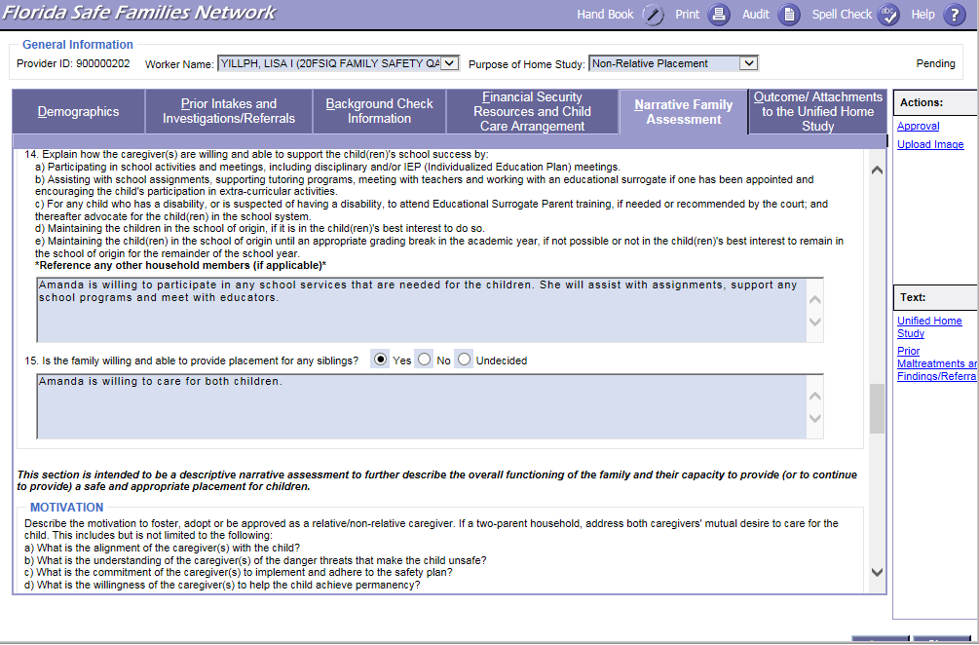
FSFN Screens
Narrative Family Assessment – Assess Caregiver(s) Questions:
Unified Home Study 4.43

Slide 44
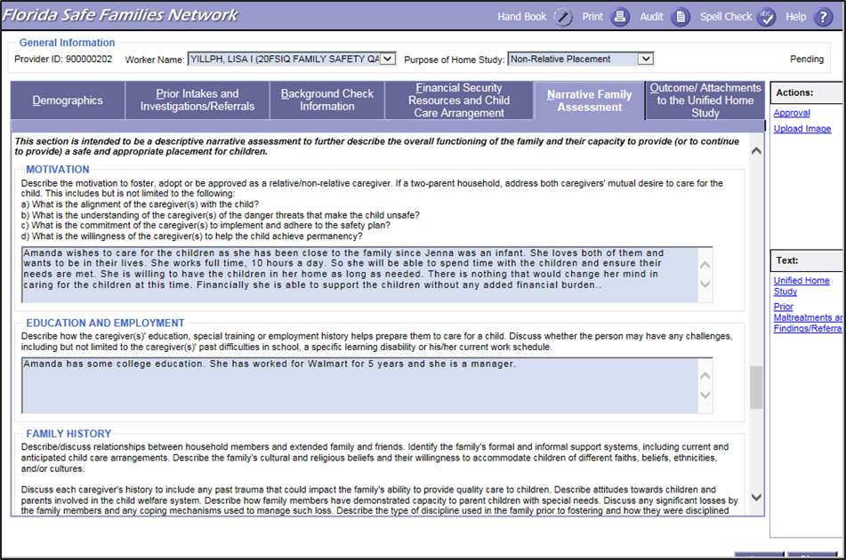
FSFN Screens
Narrative Family Assessment –
Motivation and Education and Employment:
Unified Home Study 4.44

Slide 45
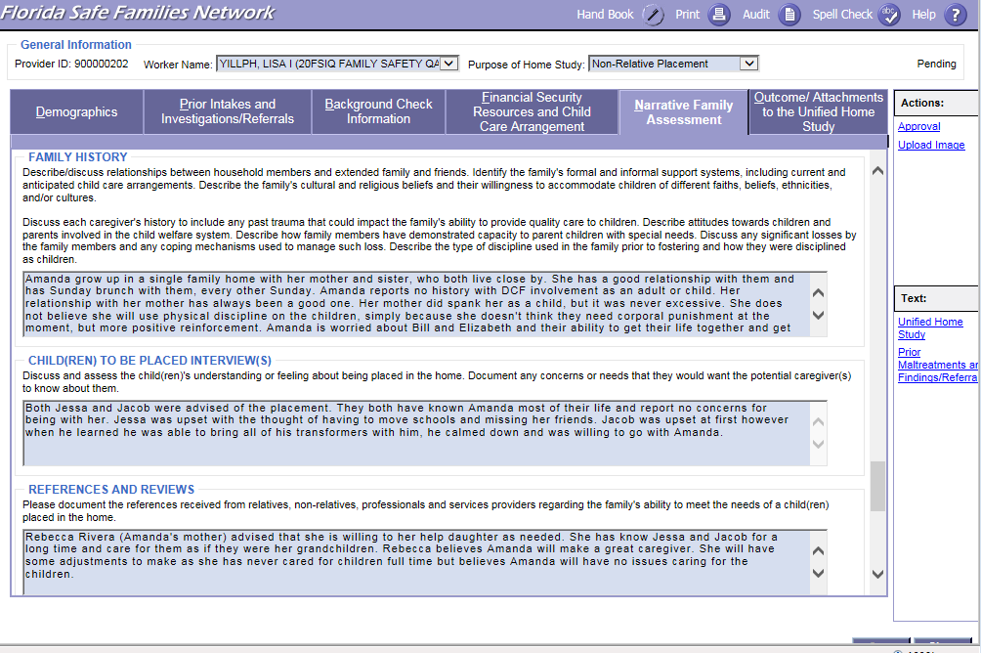
FSFN Screens
Narrative Family Assessment – Family History,
Child(ren) To Be Placed Interview(s), and References and Reviews:
Unified Home Study 4.45

Slide 46
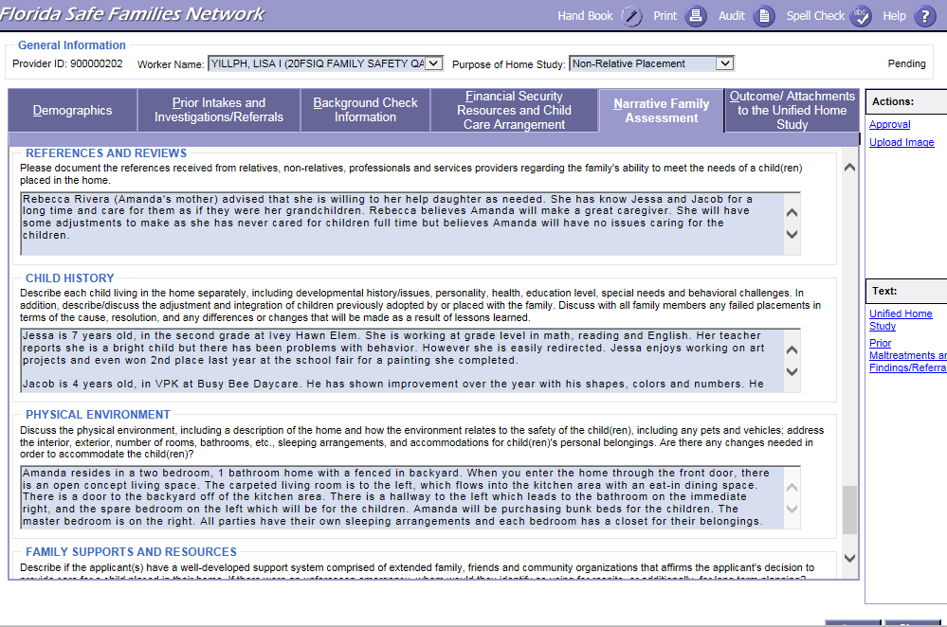
FSFN Screens
Narrative Family Assessment –
Child History and Physical Environment:
Unified Home Study 4.46

Slide 47
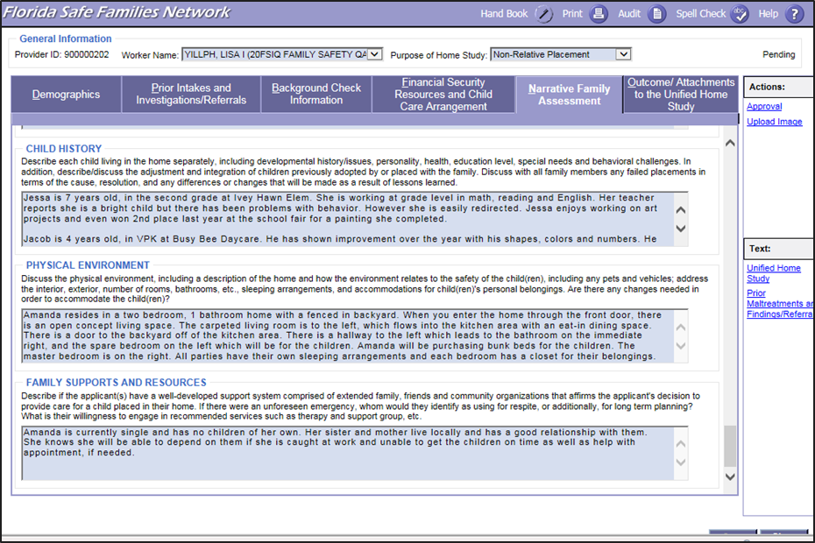
FSFN Screens
Narrative Family Assessment – Family Supports and Resources:
Unified Home Study 4.47

Slide 48
Activity A: Part 1
Amanda Wants To Be a Foster Parent!
Read the scenario.
Select who will be the Licensing SPecialist/Interviewer and who will be the Caregiver/Interviewee.
The interviewer must select up to five of the narrative assessment questions and using the four interview phases gather the needed information from the caregiver.
Unified Home Study 4.48

Slide 49

Finalizing the Licensing UHS
Unified Home Study 4.49

Slide 50
FSFN Tutorial
Attachments
Unified Home Study 2.50

Slide 51
Attachments
Attachments provide verification of information gathered and evidence of information shared with the caregivers.
The Outcome/ Attachments is the tab used to upload documents externally to the UHS and/or FSFN.
The attachments that are required depend on the type of Unified Home Study being completed.
Unified Home Study 4.51

Slide 52
UHS vs Provider Filing Cabinet
Attachments | Upload Requirements for UHS
Affidavit of firearm safety | Required: Signed Acknowledgement of Firearms/Safety Requirements
Water Addendum | Optional to Upload Information Provided to Caregiver
Affidavit of Good Moral Character | N/A, Upload to Provider File Cabinet
Personal References | N/A, Upload to Provider File Cabinet
Adoption-Subsidy Acknowledgement form | N/A
Adoption-Child Study | N/A
Consent to Release Information | N/A
Florida Adoption Assistance Program | N/A
Information Packet Sent-Adoptive Home | N/A
Information Packet Sent-Foster Home | N/A
Florida Adoption Reunion Registry | N/A
TANF information | N/A
Relative Caregiver Program Information | N/A
Referrals | N/A
Receipts of Rights and responsibilities | N/A
Receipt of Grievance Brochure | N/A
Referrals | N/A
Unified Home Study 4.52

Slide 53
Withdrawal of
Licensing Request
Voluntary withdrawals must be documented in FSFN and do not require final action by DCF.
Unified Home Study 4.53

Slide 54
Signatures and Recommendations
Once all information required has been gathered and assessed, Child Welfare Professionals must ask the caregiver to review and sign the home study.
If known, it is at this time that Child Welfare Professionals inform the caregiver of any concerns or changes that might affect the anticipated outcome of the home study.
Signatures
Unified Home Study 4.54

Slide 55
Signatures and Recommendations, con’t.
Once signed by the caregiver(s), Licensing Specialists, and supervisors, the entire UHS, including the signature page, must be uploaded into the UHS page in FSFN within two business days.
Signatures
Unified Home Study 4.55

Slide 56
Signatures, Recommendations, and Final Approvals, con’t.
In the Recommendation group box on the FSFN UHS page, the Child Protection Investigator selects an appropriate recommendation from the Recommendation drop-down choices:
Application Withdrawn
Denied - Criminal Disqualifier
Duplicate - Created
in Error
Approved - Meets Requirements
Denied - FSFN Disqualifier
Approved - Review Comments
Denied - Review Comments
Recommendations
Unified Home Study 4.56

Slide 57
Signatures, Recommendations, and Final Approvals, con’t.
The supervisor reviews the home study in FSFN to determine that appropriate interviews, background checks and analysis, and assessment of caregiver(s) have been completed.
For the approval/denial process, Child Welfare Professionals and supervisors must enter a justification for approval or denial in the
Outcome text box.
Final Approvals
Unified Home Study 4.57

Slide 58
Signatures, Recommendations, and Final Approvals, con’t.
The supervisor has the authority to approve or deny a completed home study regardless of a Child Welfare Professional’s recommendation.
Final Approvals
Unified Home Study 4.58

Slide 59
Final Approvals, con’t.
In the Outcome group box on the FSFN UHS page, the supervisor selects an appropriate conclusion from the Outcome drop-down choices:
Application Withdrawn
Denied - Criminal Disqualifier
Duplicate - Created
in Error
Approved - Meets Requirements
Denied - FSFN Disqualifier
Denied - Court Approved
Approved - Review Comments
Denied - Review Comments
Unified Home Study 4.59

Slide 60
Final Approvals, con’t.
The Child Welfare Professional Supervisor must approve their outcome by completing the approval routing process.
If the Child Welfare Professional’s supervisor is not available, they can choose an alternate supervisor.
Child Welfare Professionals cannot approve their own
home study.
Unified Home Study 4.60

Slide 61
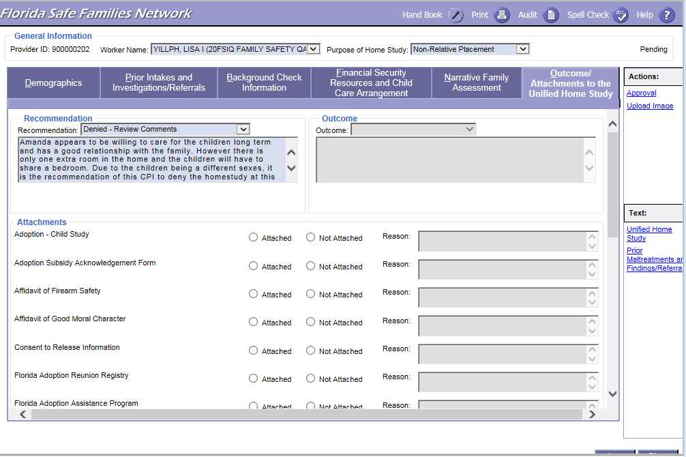
FSFN Screens
Outcome/Attachments, Recommendations, and Approval:
Unified Home Study 4.61

Slide 62
Attestation Documents and the Licensing File
Once all of the interviews have been conducted, documents have been gathered, and the UHS has been completed, the application file must be submitted in accordance with the traditional or attestation model for licensure. For attestation, the Licensing or Re-licensing UHS must be approved in FSFN.
Unified Home Study 4.62

Slide 63
Licensing/Re-licensing Checklist
It assists in ensuring all of the licensing requirements are met.
It replaces the paper form outlined in Administrative Code.
It will create a faster reviewing process for DCF approval.
The provider can only have one pending checklist at a time.
Unified Home Study 4.63

Slide 64
FSFN Tutorial
Copy Function
Unified Home Study 4.64

Slide 65
Copy Function
The information that will copy over includes:
Purpose of home study
Narrative Family assessment information, except for non-required questions
Finance Breakdown, Additional Monthly Support or Income, and Household Information from the Financial Security Resources tab
Other states of residence
Background check narrative
FSFN will now have the functionality to copy over selected fields from the MOST RECENT APPROVED home study in FSFN.
If there is already a pending home study, a validation message will appear to ensure a new one is needed.
Unified Home Study 4.65

Slide 66
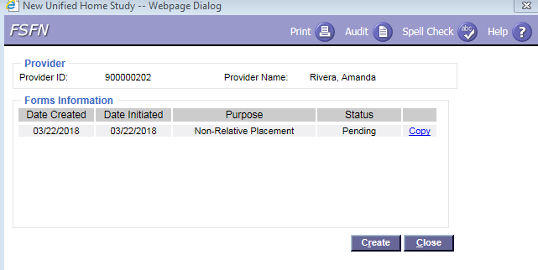
FSFN Tutorial
Copy Function:
Unified Home Study 4.66

Slide 67
FSFN Tutorial
Addendum – Not Adoption
Unified Home Study 4.67

Slide 68
Addendum - Not Adoption
Addendum addresses all changes that have occurred in the home within the past year.
Examples:
Move to new home (change location)
Change in household circumstances
New household members
Annual renewal of UHS
Law enforcement involvement
Unified Home Study 4.68

Slide 69
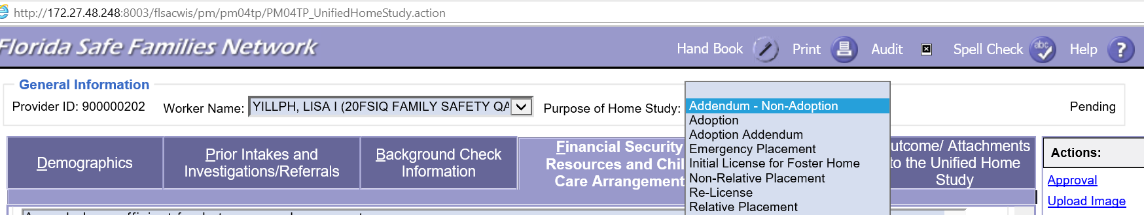
FSFN Screens
How to Select Documents for the Addendum-Not Adoption UHS:
Unified Home Study 4.69

Slide 70
Re-licensing
The Re-licensing UHS is completed when a license is set to expire and the foster parent wishes to continue to be a licensed placement.
The assessment includes all of the elements similar to what was assessed during the Initial Licensing UHS.
Unified Home Study 4.70

Slide 71
Re-licensing, con’t.
The re-licensing file has to be submitted to the licensing authority at least 30 calendar days prior to expiration of the current license.
Foster Parents requesting to be re-licensed must complete the “Application for License to Provide Out-of-Home Care for Dependent Children,” and provide documentation of at least eight hours of continuing education annually, a current driver’s license, driving record, and auto insurance coverage information,
as applicable.
Unified Home Study 4.71

Slide 72
Additional FSFN Changes
Organizational Providers:
No longer allows the user to say FEIN or Tax ID
Person Address Maintenance:
New provider address maintenance page to maintain all provider addresses
Ability to insert additional address records
Change in address leads to end of license
Unified Home Study 4.72

Slide 73
Additional FSFN Changes, con’t.
Person Management:
Ability to make changes to Caregiver 2 without changing Caregiver 1
Inability to overlap licensing dates except:
  Assessment decision withdrawn or denied
  Additional licensing action Approved-Made in Error and Not Approved
Physical address required to create or modify license
Outliner for providers now displays both license and approval status
Unified Home Study 4.73

Slide 74
Activity A: Part 2
Amanda Wants To Be a Foster Parent!
Read the scenario.
Discuss the information needed to be collected and complete the UHS template.
Choose a spokesperson to share questions, what the group felt was easy and/or difficult about completing the UHS. Address questions and areas of difficulty.
Unified Home Study 4.74

Slide 75

Questions

Slide 76

FSFN Tutorial
Unified Home Study 4.67

