Slide 1

Unified Home Study Training
ADOPTION UNIFIED HOME STUDY
Office of Child welfare
April/May 2018

Slide 2

Learning Objectives
Identify what information needs to be gathered and assessed in Adoption and Adoption Addendum Home Studies.
Demonstrate how to gather the necessary information for Adoption and Adoption Addendum Home Studies in accordance with laws and regulations.
Demonstrate how to document Adoption and Adoption Addendum Home Studies using FSFN.
Unified Home Study 5.2

Slide 3

Adoption Unified Home Study
Unified Home Study 5.3

Slide 4
Possible Adoptive Placement
The Adoption UHS must include the current and projected future needs of the child, consideration of the birth family’s medical and mental health history, as well as the strengths of the potential adoptive family to meet the child’s needs.
Unified Home Study 5.4

Slide 5
Possible Adoptive Placement, con’t.
Grandparents
There are various types of prospective adoptive parents that must be considered by Adoption Specialists when determining the best placement possibility for the child. These include:
Current caregiver
Relatives and non-relatives
Family new to the child
Unified Home Study 5.5

Slide 6
Adoption Training
The prospective adoptive parents’ initial inquiry to the Department, CBC or subcontractor staff, either written or verbal, must receive a written or telephonic response within seven business days and they must be referred to an approved adoptive parent training program.
Once the prospective adoptive parents completes an approved adoptive parent training program, a UHS can be completed for prospective adoptive parents.
Unified Home Study 5.6

Slide 7
The UHS Interview Process
Goes beyond reading questions and documenting caregivers’ responses.
Requires information gathering beyond yes/no responses.
Qualitative interview skills must be used to gather the necessary information to assess the relative/non-relative caregiver(s).
Unified Home Study 5.7

Slide 8
The UHS Interview Process, con’t.
Opening
Phase
Planning
Phase
Information Gathering
Phase
Closing
Phase
Unified Home Study 5.8

Slide 9

FSFN Tutorial
Demographic Information
Unified Home Study 5.9

Slide 10
Demographic Information
Adoption Specialists must gather demographic information on all household members and others who may frequent the home and provide any supervision of the child.
Unified Home Study 5.10

Slide 11
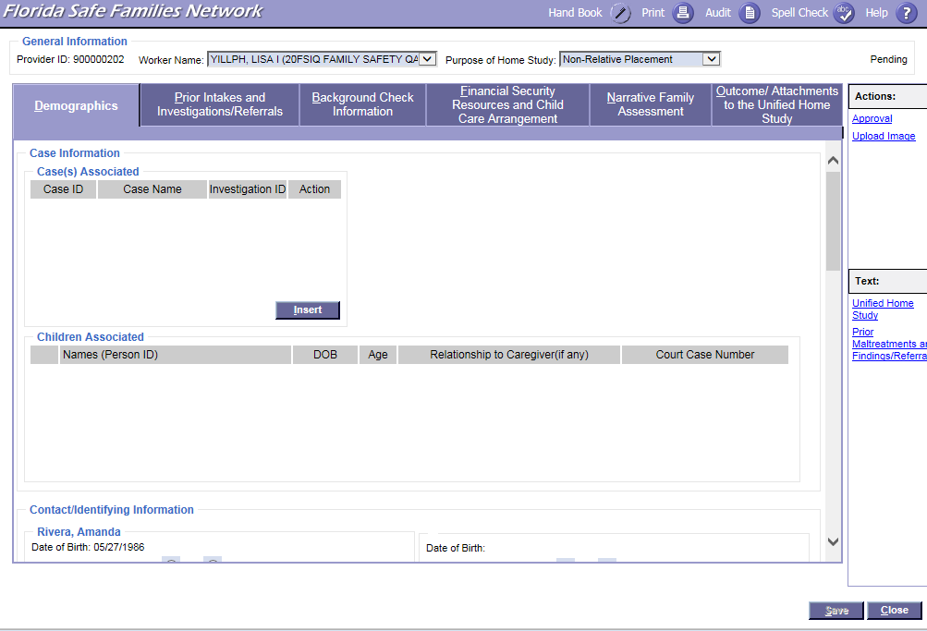

FSFN Screens
UHS Demographics tab:
Unified Home Study 5.11

Slide 12
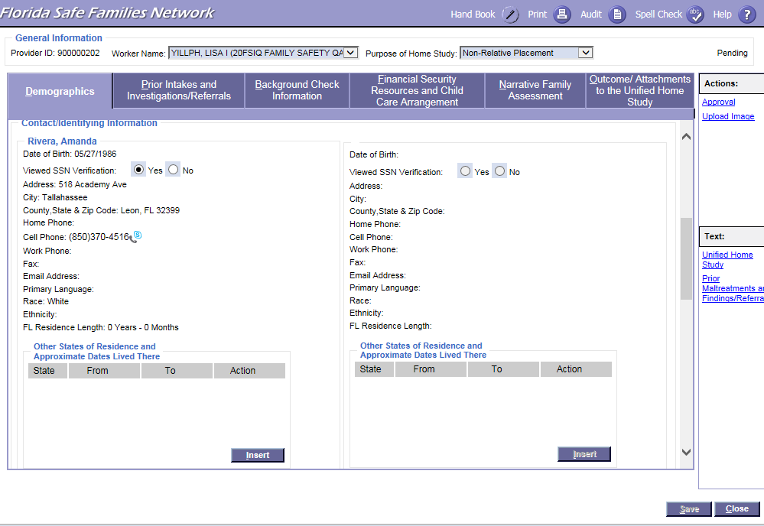
FSFN Screens
UHS Demographics tab:
Unified Home Study 5.12

Slide 13
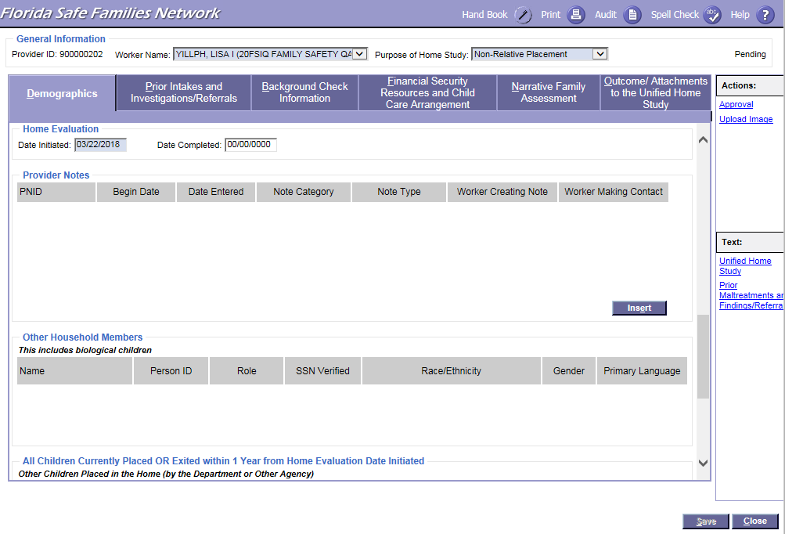
FSFN Screens
UHS Demographics tab:
Unified Home Study 5.13

Slide 14
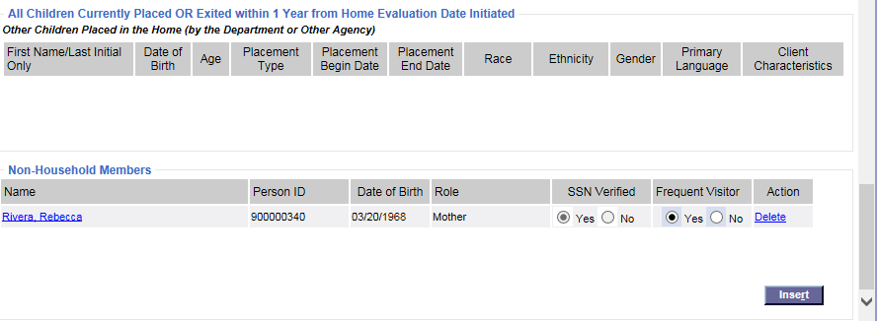
FSFN Screens
UHS Demographics tab:
Unified Home Study 5.14

Slide 15
FSFN Tutorial
Background
Checks
Unified Home Study 5.15

Slide 16
Background Checks
Adoption Specialists must obtain and assess background checks for all household members over the age of twelve. Adoption Specialists request a background check via fingerprints submission. Background checks shall not be obtained through FSFN when completing an Initial Adoption or Adoption Addendum UHS.
Unified Home Study 5.16

Slide 17
Background Checks, con’t.
Abuse/
neglect record checks
Local criminal checks
Juvenile Justice information
Fingerprint
Submission
(state and national checks)
Unified Home Study 5.17

Slide 18
Analysis of
Background Checks
A thorough review and analysis of all of the background information gathered provides Adoption Specialists with the insight needed in order to ensure that the BEST possible placement is made for the child.
When reviewing the criminal, abuse, and/or neglect records obtained, Adoptions Specialists must assess for patterns of criminal behavior that may place the child in danger.
When accessing a prospective adoptive parent, patterns of criminal history, abuse, or neglect should be to referred to an Adoption Applicant Review Committee.
Unified Home Study 5.18

Slide 19
Disqualifiers
While performing background checks, Child Welfare Professionals may find information that automatically disqualifies a person from being a placement candidate.
Unified Home Study 5.19

Slide 20
Disqualifiers, con’t.
Offenses that disqualify a person include:
Child abuse, abandonment,
or neglect
Child pornography or other felony involving a child
Domestic violence
Homicide, sexual battery, or other felony involving violence
Unified Home Study 5.20

Slide 21
Disqualifiers, con’t.
Children cannot be placed with a person who has been convicted of a felony, within the last five years, within the following categories:
Assault
A drug-related offense
Battery
Resisting arrest with violence
Unified Home Study 5.21

Slide 22
Documentation
Within FSFN, Adoption Specialists must document the records obtained and their thorough analysis of the background check results within the Background Check Information page.
Unified Home Study 5.22

Slide 23
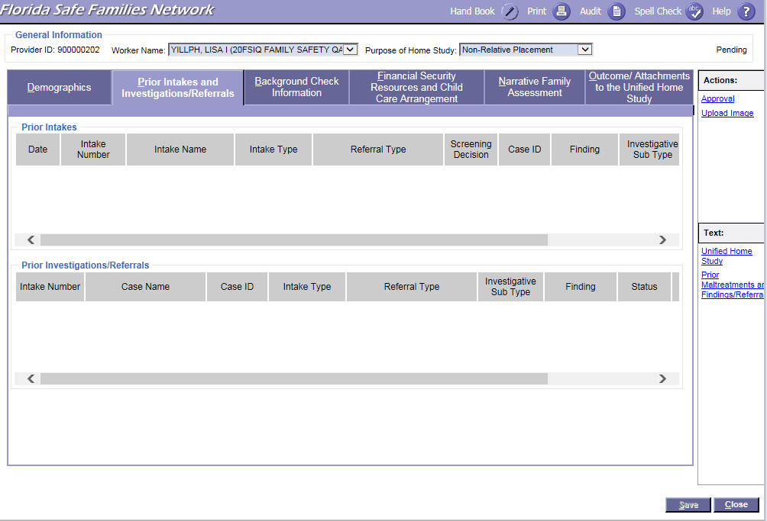
FSFN Screens
Prior Intakes Investigations/Referrals:
Unified Home Study 5.23

Slide 24
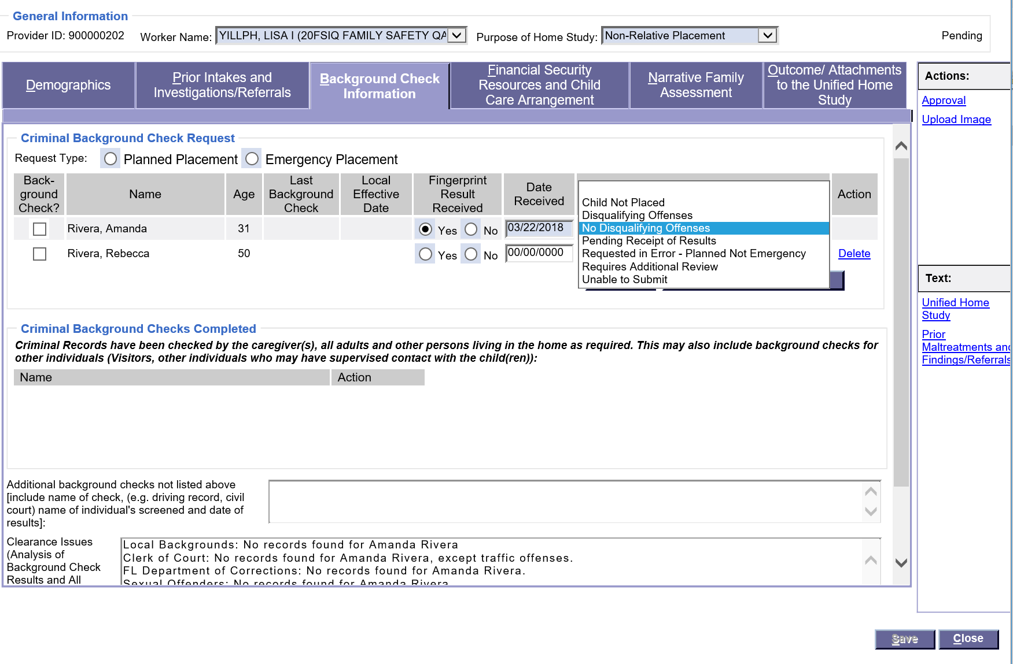
FSFN Screens
How to locate document dates and statuses for background histories received on the Background Check information tab:
Unified Home Study 5.24

Slide 25
FSFN Screens
Where to document the background analysis in the Clearance Issues text box:
Unified Home Study 5.25

Slide 26
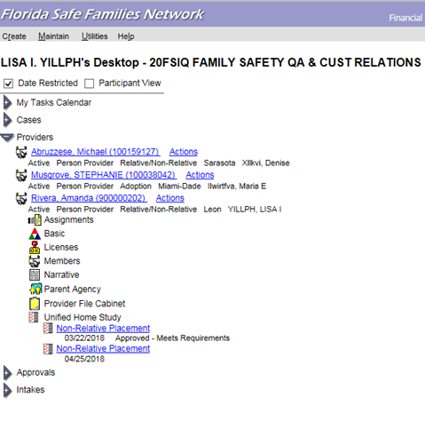
FSFN Screens
Updating criminal history dates:
Unified Home Study 5.26

Slide 27
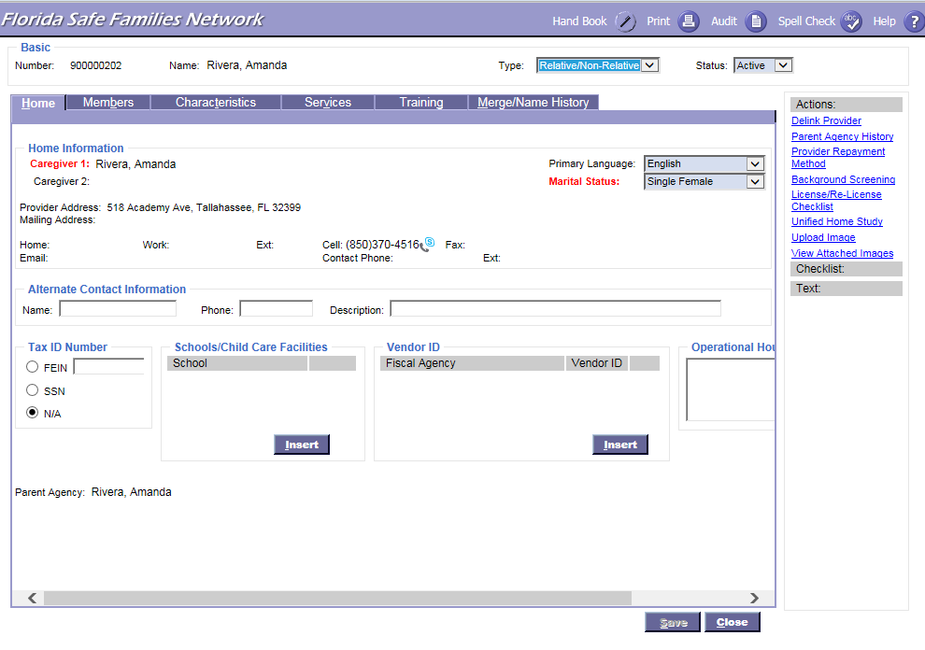
FSFN Screens
Updating criminal history dates:
Unified Home Study 5.27

Slide 28
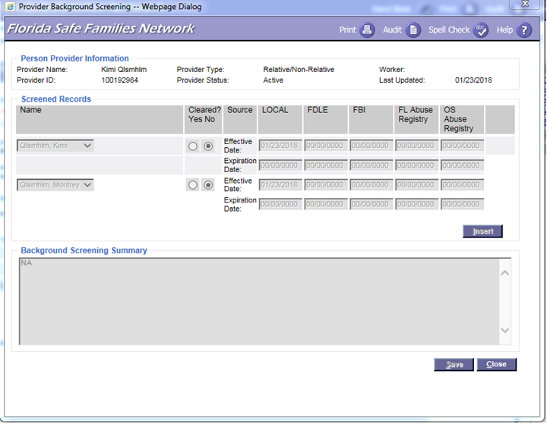
FSFN Screens
Where to insert clearance from different sources:
Unified Home Study 5.28

Slide 29
Legal Staffing
If the child is already placed in the home, a legal staffing must be requested when it is learned that a household member, another visitor, or a paramour of a household member has had verified findings of sexual abuse or has been found guilty of any of the serious crimes listed in this section.
Unified Home Study 5.29

Slide 30
Caregiver Supports
Supporting adoptive parents helps children achieve stability, well-being, and permanency.
Adoption Specialists responsible for completing the Adoption UHS must discuss with the prospective adoptive parent the following supports that are available.
Unified Home Study 5.30

Slide 31
Caregiver Supports, con’t.
Adoption Subsidy
Post Adoption Services and Supports
Medical Assistance
Reimbursement for
Non-Recurring Adoption Expenses
Federal Adoption Tax Credit
DCF Tuition and Fee Exemption
State Employee Benefits Program
State Parks Program
Unified Home Study 5.31

Slide 32
FSFN Tutorial
Financial Security Resources and Child Care Arrangements
Unified Home Study 5.32

Slide 33
Financial Security, Resources, and Child Care Arrangements
Financial Breakdown
Additional Monthly Support
Household Information
Family Situation
Unified Home Study 5.33

Slide 34
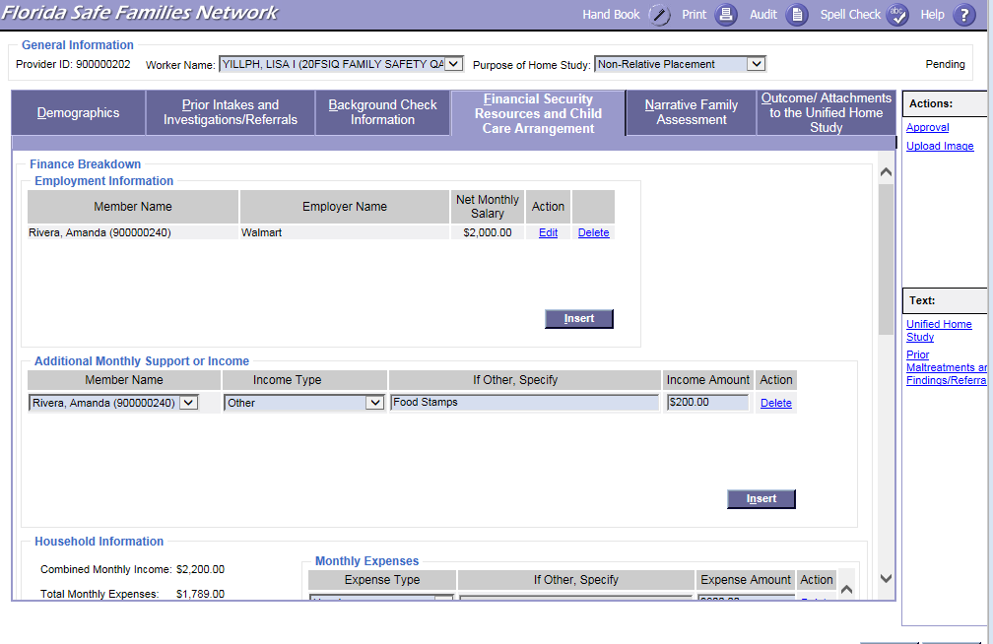
FSFN Screens
Employment Information:
Unified Home Study 5.34

Slide 35
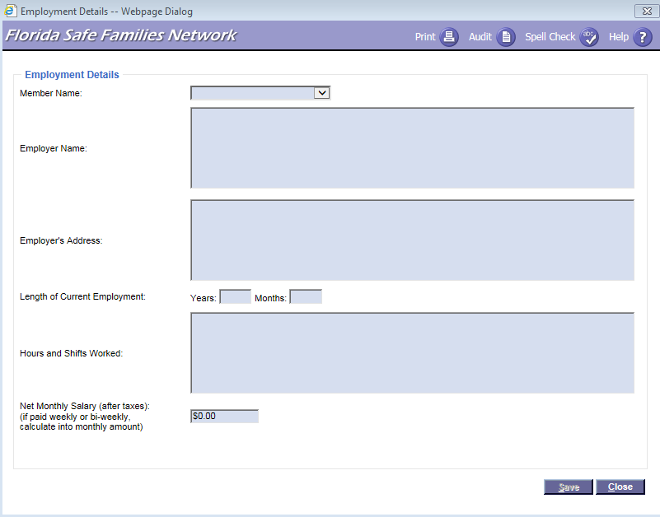
FSFN Screens
Adding Employment Details:
Unified Home Study 5.35

Slide 36
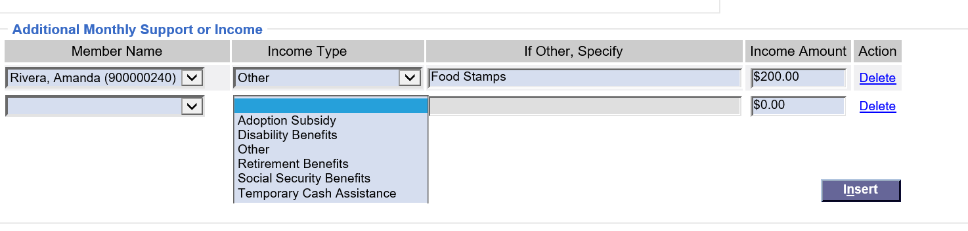
FSFN Screens
Adding Additional Monthly Support or Income:
Unified Home Study 5.36

Slide 37
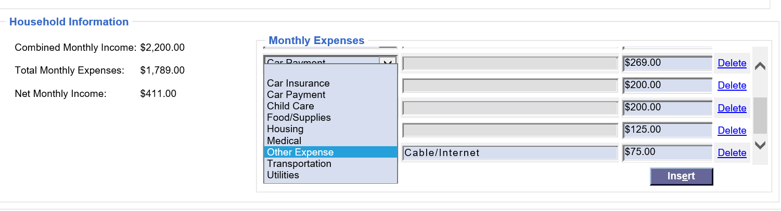
FSFN Screens
Adding Monthly Expenses:
Unified Home Study 5.37

Slide 38
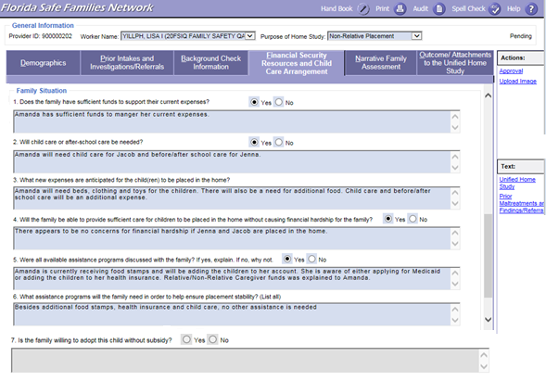
FSFN Screens
Family Situation:
Unified Home Study 5.38

Slide 39
Adoption Subsidy
Adoption Specialists are required to ask the prospective adoptive parent(s) if they are willing to adopt with or without subsidy and document their response in the narrative field provided.
The narrative field needs to be updated every time a home study is updated.
Unified Home Study 5.39

Slide 40

Narrative Family Assessment
FSFN Tutorial
Unified Home Study 5.40

Slide 41
Narrative Family Assessment
Adoption Specialists must conduct a narrative family assessment and gather the needed information to fully evaluate the caregiver’s ability to provide a safe and nurturing environment for the child.
Information is gathered through interviews with the prospective adoptive parent, household members, and the child or children who are being placed or are already placed in the home.
This assessment is not limited to just prospective adoptive parents and needs to be reflective of all household members.
Unified Home Study 5.41

Slide 42
Narrative Family Assessment, con’t.
The Narrative Family Assessment is split up into nine areas:
Assess Caregiver
Family History
Child History
Motivation
Children to Be Placed Interviews
Physical Environment
Education and Employment
References and Reviews
Family Support and Resources
Unified Home Study 5.42

Slide 43
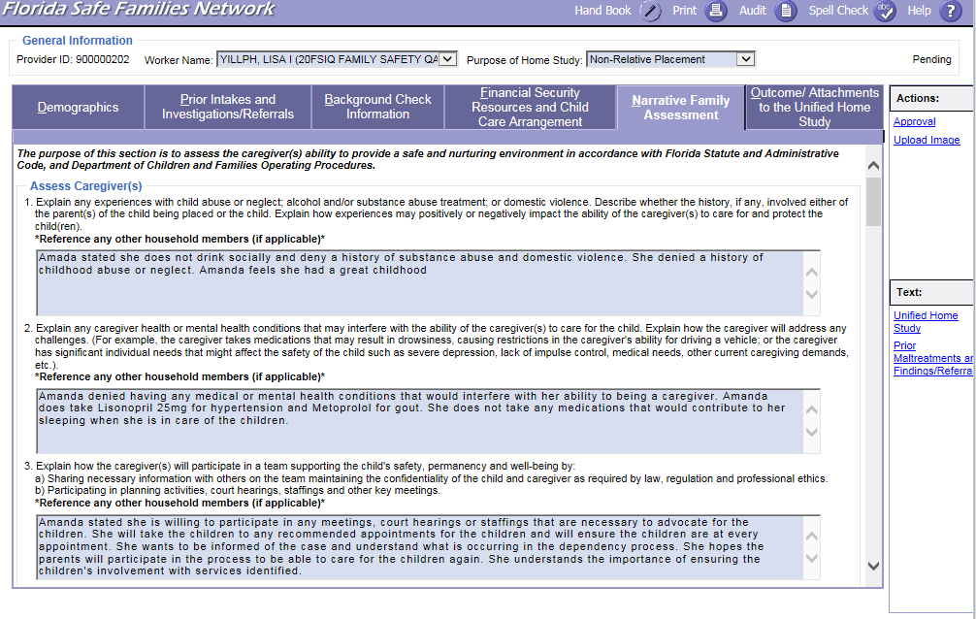
FSFN Screens
Narrative Family Assessment – Assess Caregiver(s) Questions:
Unified Home Study 5.43

Slide 44
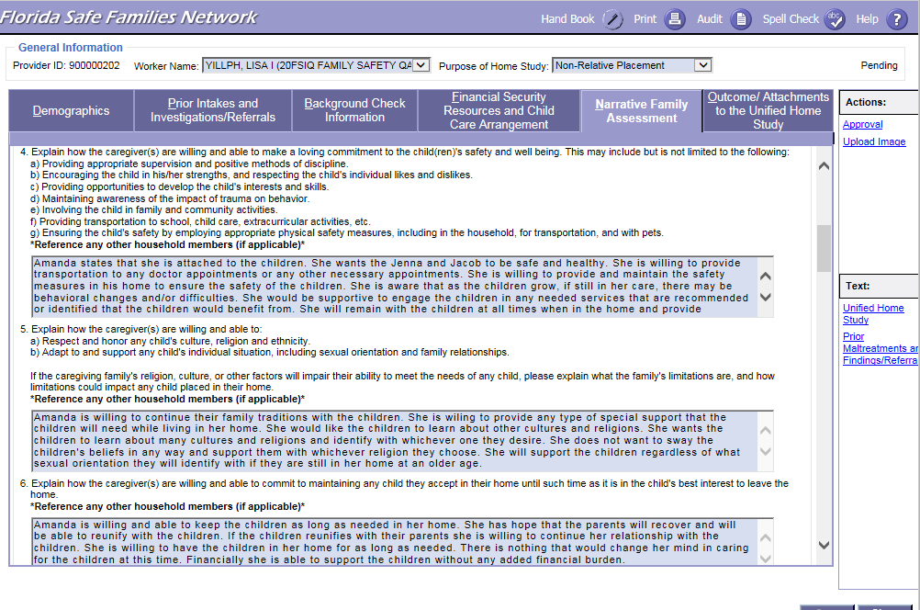
FSFN Screens
Narrative Family Assessment – Assess Caregiver(s) Questions:
Unified Home Study 5.44

Slide 45
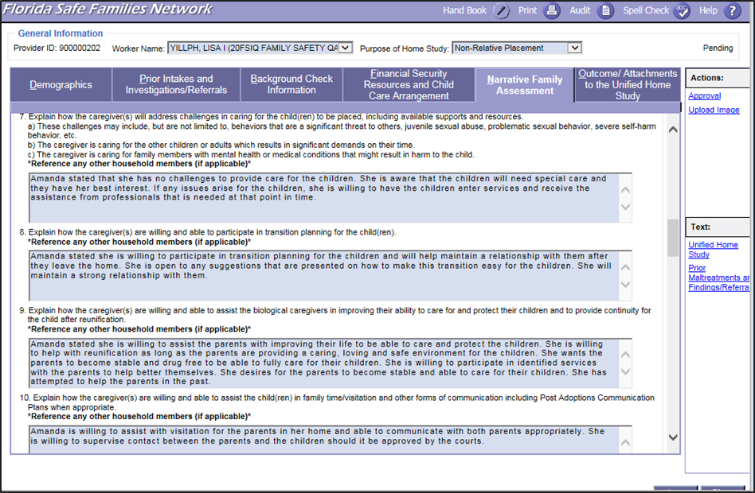
FSFN Screens
Narrative Family Assessment – Assess Caregiver(s) Questions:
Unified Home Study 5.45

Slide 46
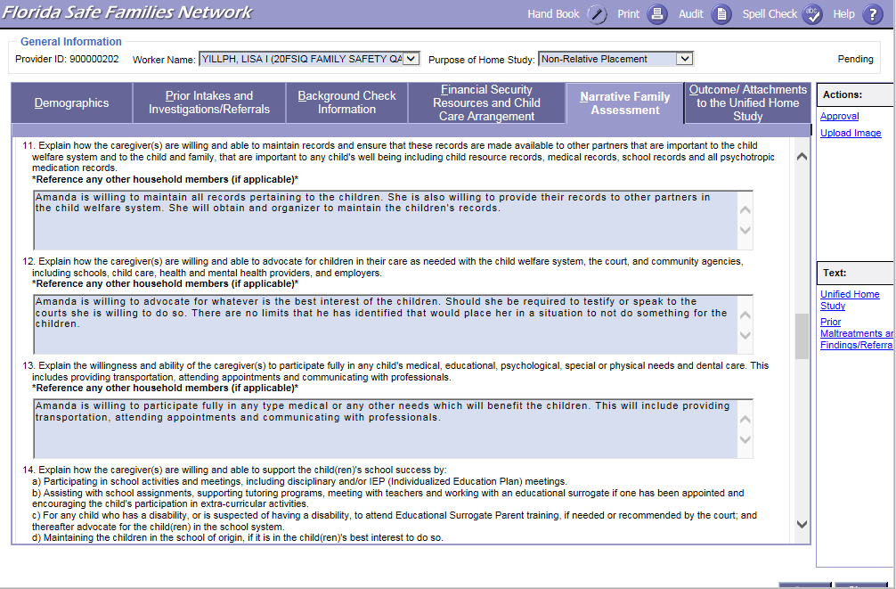
FSFN Screens
Narrative Family Assessment – Assess Caregiver(s) Questions:
Unified Home Study 5.46

Slide 47
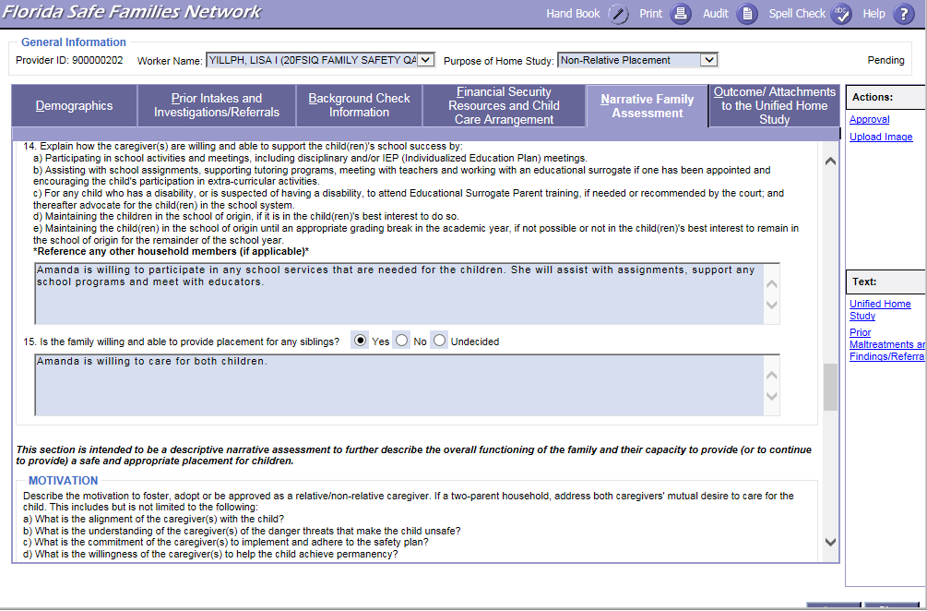
FSFN Screens
Narrative Family Assessment – Assess Caregiver(s) Questions:
Unified Home Study 5.47

Slide 48
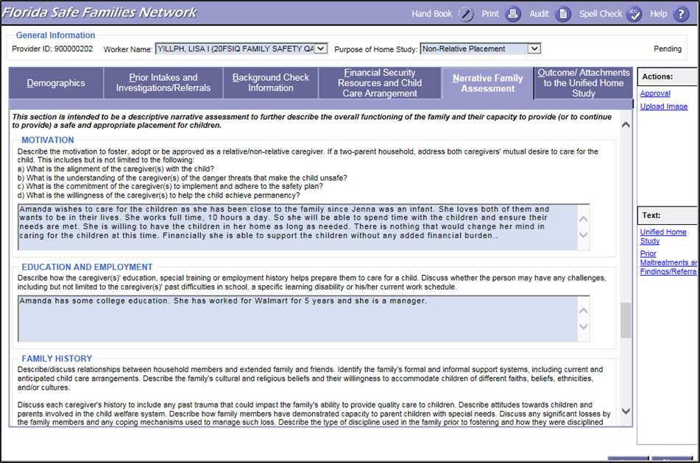
FSFN Screens
Narrative Family Assessment –
Motivation and Education and Employment:
Unified Home Study 5.48

Slide 49
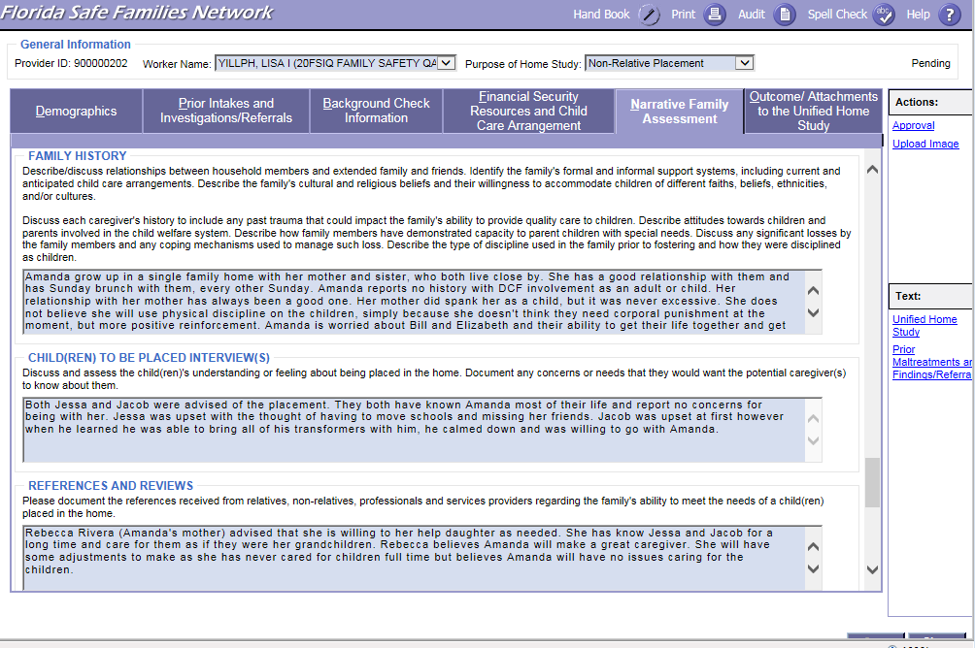
FSFN Screens
Narrative Family Assessment – Family History,
Child(ren) To Be Placed Interview(s), and References and Reviews:
Unified Home Study 5.49

Slide 50
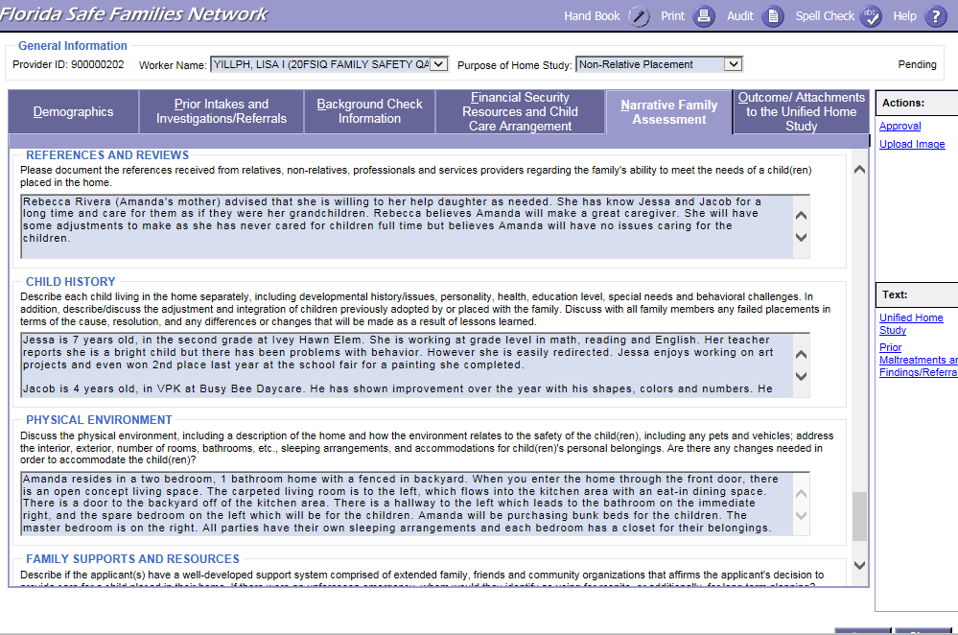
FSFN Screens
Narrative Family Assessment –
Child History and Physical Environment:
Unified Home Study 5.50

Slide 51
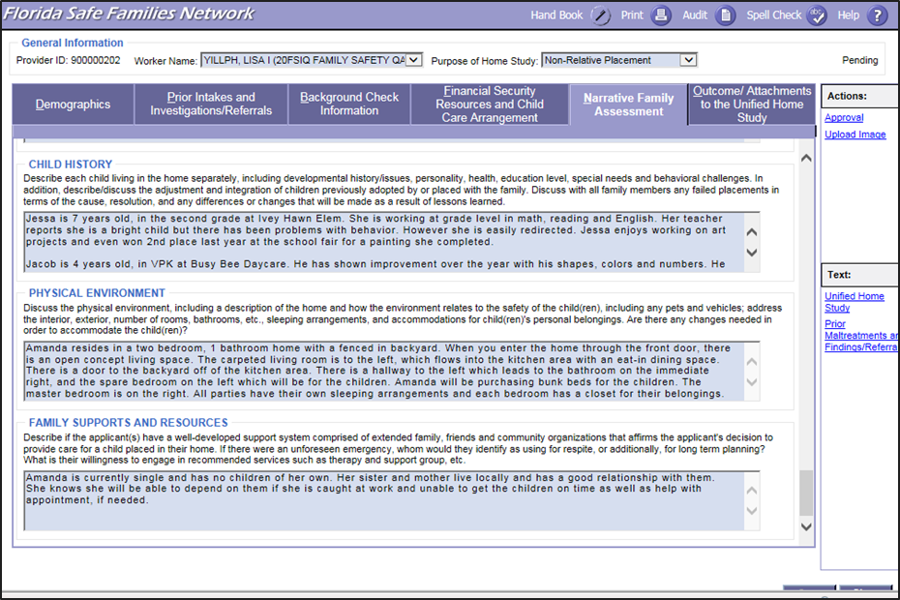
FSFN Screens
Narrative Family Assessment – Family Supports and Resources:
Unified Home Study 5.51

Slide 52
Activity A: Part 1
Jacob and Jenna Are Getting Adopted!
Read the scenario.
Select who will be the interviewer, observer, and caregiver in each group.
Select one narrative assessment question and gather information.
Switch roles and select a different question.
Discuss what your group observed.
Unified Home Study 5.52

Slide 53

Finalizing the Adoption UHS
Unified Home Study 5.53

Slide 54
FSFN Tutorial
Attachments
Unified Home Study 5.54

Slide 55
Attachments
Attachments provide verification of information gathered and evidence of information shared with the prospective adoptive parent.
The Outcome/ Attachments is the tab used to upload documents externally to the UHS and/or FSFN.
The attachments that are required depend on the type of Unified Home Study being completed.
Unified Home Study 5.55

Slide 56
Upload Requirements
Attachments | Upload Requirements for UHS
Adoption- Child Study | Required for Child Specific Home Studies
Affidavit of firearm safety | Required: Signed Acknowledgement of Firearms/Safety Requirements
Consent to Release Information | Required: Use Agency Specific Release
Personal references | Required
Referrals | Optional to Upload Information Provided to Caregiver
Receipts of Rights and responsibilities | Optional to Upload Information Provided to Caregiver
Receipt of Grievance Brochure | Optional to Upload Information Provided to Caregiver
Water Addendum | Optional to Upload Information Provided to Caregiver
Information Packet Sent-Adoptive Home | Optional to Upload Information Provided to Caregiver in Parent Preparation Class
Adoption-Subsidy Acknowledgement form | N/A
Affidavit of Good Moral Character | N/A
Florida Adoption Assistance Program | N/A
Information Packet Sent-Foster Home | N/A
Florida Adoption Reunion Registry | N/A
TANF information | N/A
Relative Caregiver Program Information | N/A
Unified Home Study 5.56

Slide 57
Signatures and Recommendations
Once all information required has been gathered and assessed, Child Welfare Professionals must ask the caregiver to review and sign the home study.
If known, it is at this time that Child Welfare Professionals inform the caregiver of any concerns or changes that might affect the anticipated outcome of the home study.
Signatures
Unified Home Study 5.57

Slide 58
Signatures and Recommendations, con’t.
Once signed by the caregiver(s), Adoption Specialists, and supervisors, the entire UHS, including the signature page, must be uploaded into the UHS page in FSFN within two business days.
Signatures
Unified Home Study 5.58

Slide 59
Signatures, Recommendations, and Final Approvals, con’t.
In the Recommendation group box on the FSFN UHS page, the Child Protection Investigator selects an appropriate recommendation from the Recommendation drop-down choices:
Application Withdrawn
Denied - Criminal Disqualifier
Duplicate - Created
in Error
Approved - Meets Requirements
Denied - FSFN Disqualifier
Approved - Review Comments
Denied - Review Comments
Recommendations
Unified Home Study 5.59

Slide 60
Signatures, Recommendations, and Final Approvals, con’t.
The supervisor reviews the home study in FSFN to determine that appropriate interviews, background checks and analysis, and assessment of caregiver(s) have been completed.
For the approval/denial process, Child Welfare Professionals and supervisors must enter a justification for approval or denial in the
Outcome text box.
Final Approvals
Unified Home Study 5.60

Slide 61
Signatures, Recommendations, and Final Approvals, con’t.
The supervisor has the authority to approve or deny a completed home study regardless of a Child Welfare Professional’s recommendation.
Final Approvals
Unified Home Study 5.61

Slide 62
Final Approvals, con’t.
In the Outcome group box on the FSFN UHS page, the supervisor selects an appropriate conclusion from the Outcome drop-down choices:
Application Withdrawn
Denied - Criminal Disqualifier
Duplicate - Created
in Error
Approved - Meets Requirements
Denied - FSFN Disqualifier
Denied - Court Approved
Approved - Review Comments
Denied - Review Comments
Unified Home Study 5.62

Slide 63
Final Approvals, con’t.
The Child Welfare Professional Supervisor must approve their outcome by completing the approval routing process.
If the Child Welfare Professional’s supervisor is not available, they can choose an alternate supervisor.
Child Welfare Professionals cannot approve their own
home study.
Unified Home Study 5.63

Slide 64
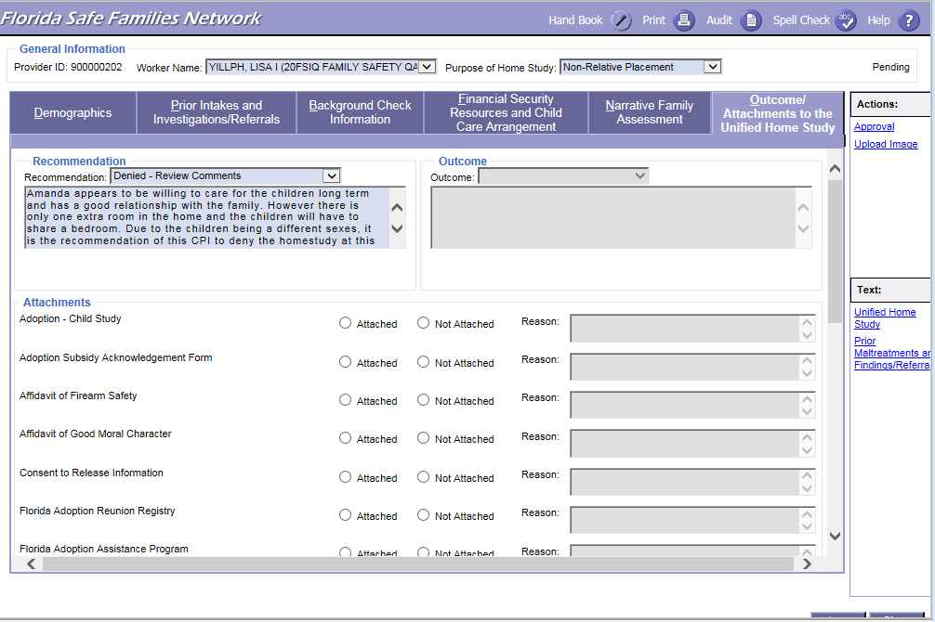
FSFN Screens
Outcome/Attachments, Recommendations, and Approval:
Unified Home Study 5.64

Slide 65
FSFN Tutorial
Copy Function
Unified Home Study 5.65

Slide 66
Copy Function
The information that will copy over includes:
Purpose of home study
Narrative Family Assessment information, except for non-required questions
Finance Breakdown, Additional Monthly Support or Income, and Household Information from the Financial Security Resources tab
Other states of residence
Background check narrative
FSFN will now have the functionality to copy over selected fields from the MOST RECENT APPROVED home study in FSFN.
If there is already a pending home study, a validation message will appear to ensure a new one is needed.
Unified Home Study 5.66

Slide 67
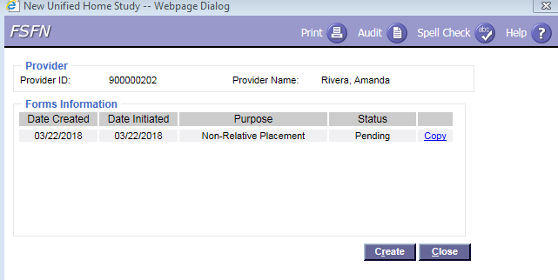
FSFN Screens
Unified Home Study 5.67

Slide 68
Adoption Addendum
The Adoption Addendum Home Study type is an updated Adoption Unified Home Study that captures the factors outlined in Chapter 65C-16.005, F.A.C., and is initiated when the items below have occurred:
The home study has expired (over a year).
Prospective adoptive parent(s) want to adopt again.
There have been significant changes regarding the prospective adoptive parent(s).
A family has now been matched to adopt a specific child.
Unified Home Study 5.68

Slide 69
Adoption Addendum, con’t.
Prior approval of a family to adopt does not automatically mean that this family is appropriate to adopt again. Consideration of any family for placement of another child requires the previous Adoption UHS to be updated through an Adoption Addendum UHS.
Unified Home Study 5.69

Slide 70
Activity A: Part 2
Jacob and Jenna Are Getting Adopted!
Read the scenario.
Discuss the information needed to be collected and complete the UHS template.
Choose a spokesperson.
Unified Home Study 5.70

Slide 71

Questions

