Slide 1

Module 6
Understanding Child Maltreatment
Notes:
6.0.1

Slide 2
Agenda
Unit 6.1: Maltreatment: Overview
Unit 6.2: Neglect
Unit 6.3: Physical Abuse
Unit 6.4: Sexual Abuse
Unit 6.5: Mental Injury
Unit 6.6: Substance Abuse
Unit 6.7: Domestic Violence
Pre-Service Curriculum Module 6.0.2
Notes:
6.0.2

Slide 3
Unit 6.1
Maltreatment Overview
Pre-Service Curriculum Module 6.1.1
Notes:
6.1.1

Slide 4

Learning Objectives
Pre-Service Curriculum Module 6.1.2
Notes:
6.1.2

Slide 5

What is Maltreatment?
Pre-Service Curriculum Module 6.1.3
Notes:
6.1.3

Slide 6

Child Maltreatment
Allegation Index
Pre-Service Curriculum Module 6.1.4
Notes:
6.1.4

Slide 7
Maltreatment Index
Definition
Examples of Maltreatment
Factors to Consider in Assessment of Maltreatment
Assessing for Frequently Associated Maltreatments
Excluding Factors
Information Necessary to Support a Verified Finding
Pre-Service Curriculum Module 6.1.5
Notes:
6.1.5

Slide 8

Activity
Child Maltreatment Index
Pre-Service Curriculum Module 6.1.6
Notes:
6.3.16

Slide 9
Abandonment
… a situation in which the parent(s) or legal custodian(s) of a child or, in the absence of a parent or legal custodian, the caregiver(s), while being able, makes no provision for the child’s support and has failed to establish or maintain a substantial and positive relationship with the child.
s. 827.10, F.S.
Pre-Service Curriculum Module 6.1.7
Notes:
6.1.6

Slide 10
Threatened Harm
… a behavior that is not accidental and which is likely to result in harm to the child.
The preventable death of one child provides reason to suspect that another child is at risk, or
The caregiver’s children are currently in out-of-home care or parental rights have been terminated.
Pre-Service Curriculum Module 6.1.8
Notes:
6.1.7

Slide 11
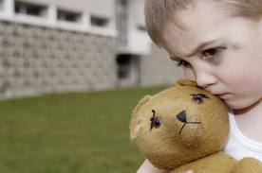
Assessing Warning Signs to Determine if a Child is Unsafe
Pre-Service Curriculum Module 6.1.9
Notes:
6.1.11

Slide 12
Unit 6.2
Neglect
Pre-Service Curriculum Module 6.2.1
Notes:
6.2.1

Slide 13
Learning Objectives
Pre-Service Curriculum Module 6.2.2
Notes:
6.2.2

Slide 14
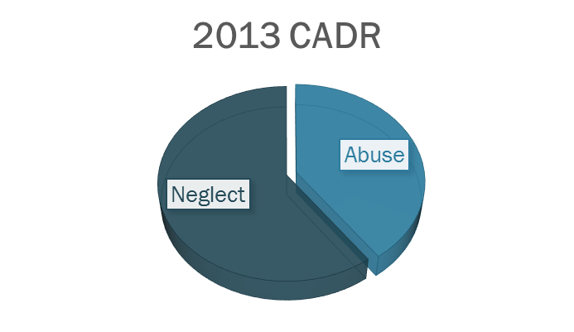
2013: CADR Florida Neglect Causes of Child’s Death
Pre-Service Curriculum Module 6.2.3
Notes:
6.2.4

Slide 15
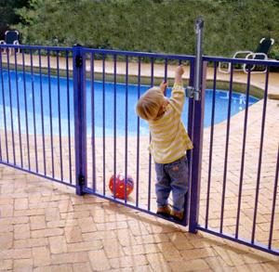
Pool Safety
Pre-Service Curriculum Module 6.2.4
Notes:
6.2.11

Slide 16

High Temperatures and Hot Cars
s. 316.6135, F.S.
Pre-Service Curriculum Module 6.2.5
Notes:
6.2.12

Slide 17
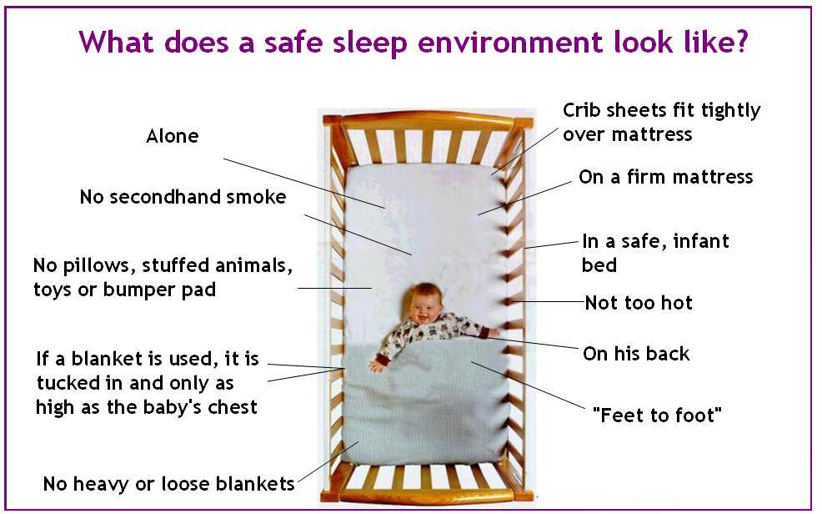
Safe Sleeping
https://www.youtube.com/watch?v=0zoQ7n3omqQ
Pre-Service Curriculum Module 6.2.6
Notes:
6.2.13
Video 6:20
https://www.youtube.com/watch?v=0zoQ7n3omqQ
Since January 2014, 27 alleged reports of babies dying due to unsafe sleep have been called in to the Florida Abuse Hotline.
These tragedies could have been prevented, and now Florida government agencies, state officials, non-profit organizations and first responders are coming together to launch The Safe Sleep Campaign. The campaign includes public outreach as well as free online training and materials for Florida's first responders in an effort to prevent unsafe sleep during routine calls and interactions with the public.
The most common safety action previously taken by CPIs or CMs with parents of infants who subsequently died in “roll- over” deaths or in other unsafe sleep arrangements was to provide the mother (but often not the father) with information regarding the danger of co-sleeping and to elicit from the mother a written and/or verbal promise not to engage in co-sleeping with her infant. Nevertheless, mothers, fathers and boyfriends frequently ignored professional advice, or broke their promises, regarding co-sleeping. Giving information regarding co- sleeping (once) to drug addicted parents, or to substance abusing parents not established in a recovery process, and having these parents sign agreements to refrain from co-sleeping with infants, is a highly risky and questionable basis for safety planning.
The campaign also encourages the public to donate new pack n plays (portable cribs) to designated locations, which will be distributed to needy families by local coalitions.
Safe Sleep PSA Florida
https://www.youtube.com/watch?v=Hdz62Z9z33w&feature=youtu.be

Slide 18
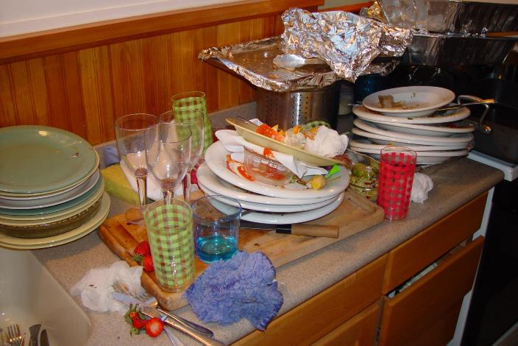
Chapter 39.01(44), F.S.
permitted to live in an environment when such deprivation or environment causes the child’s physical, mental, or emotional health to be significantly impaired or to be in danger of being significantly impaired
Pre-Service Curriculum Module 6.2.7
Notes:
6.2.7

Slide 19


Not neglect
Pre-Service Curriculum Module 6.2.8
Notes:
6.2.8
Questions regarding the name of the organized church and any other pertinent information regarding the religion must be asked.
If there is any question if the religion and/or religious belief is well organized and/or recognized, the agency attorneys must be consulted.

Slide 20

The court can…
Pre-Service Curriculum Module 6.2.9
Notes:
6.2.9

Slide 21
Child Maltreatment Index
Inadequate Supervision A-22
Environmental Hazards A-13
Pre-Service Curriculum Module 6.2.10
Notes:
6.2.15
Brainstorm and write responses to the following question on a flipchart:
What evidence would you look for to decide if neglect is occurring?
Neglect must always be proven using the elements of the law.

Slide 22
Child Maltreatment Index
Failure to Thrive A-17
Malnutrition/Dehydration A-25
Medical Neglect A-26 (s. 39.3068, F.S.)
Pre-Service Curriculum Module 6.2.11
Notes:
6.2.15
Brainstorm and write responses to the following question on a flipchart:
What evidence would you look for to decide if neglect is occurring?
Neglect must always be proven using the elements of the law.

Slide 23
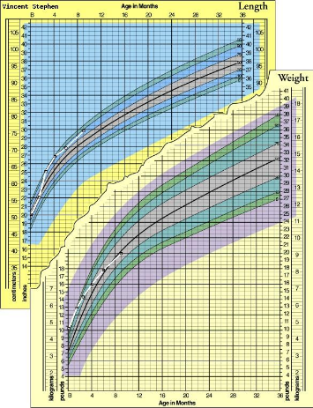
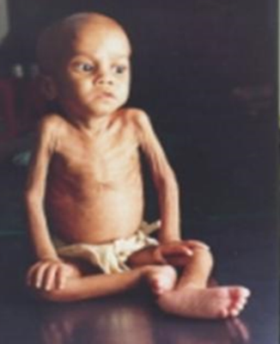
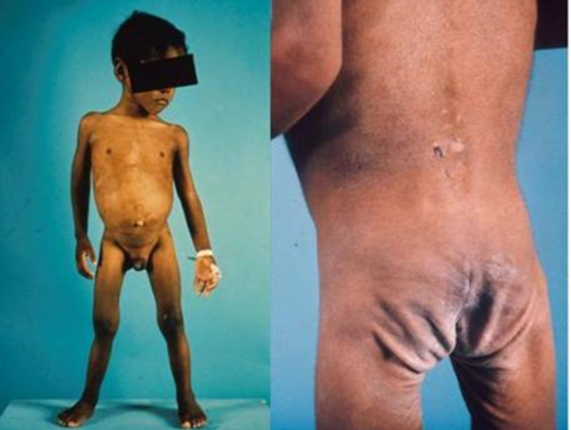
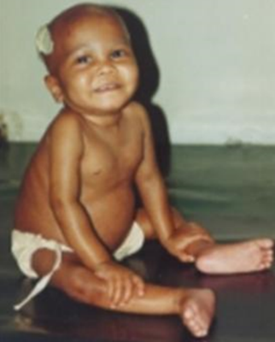
Failure to Thrive
Pre-Service Curriculum Module 6.2.12
Notes:
6.2.16
Failure to thrive (2 types: organic (biological) or psychosocial – not gaining properly, brain not growing, etc.)
More common ‘failure to thrive’ is psychosocial or social failure to thrive due to lack of caregiving by parent to child: stimulus/response patterns.
Define and describe malnutrition and dehydration, and how they fall under the category of ‘failure to thrive.’
A lot of failure to thrive is discussed in physical abuse module.

Slide 24
Situational vs. Chronic Neglect
Situational
Chronic
crisis/situational
parent/caretaker fundamentally able to cope but temporarily overwhelmed
enduring
parent with continued and serious child-rearing difficulties
Pre-Service Curriculum Module 6.2.13
Notes:
6.2.18
Refer to earlier review of “The Science of Neglect” and discriminate between chronic and situational impacts.
Explain the differences between situational and chronic neglect.
Situational: crisis/situational, parents fundamentally able to cope but temporarily overwhelmed
Chronic: parent with continued and serious child rearing difficulties
Activity: The Impact of Neglect

Slide 25
The Gavin Family
What indicators suggest the Gavins are suffering from chronic neglect?
Does the age of the child matter?
Pre-Service Curriculum Module 6.2.14
Notes:
6.2.19 What indicators suggest the Gavins are suffering from chronic neglect?
condition of the furniture
dirty and clean laundry strewn about
rotting food, dirty dishes, rancid canned meat left open
mother depressed; rarely moves from sofa
mother was not parented by her mother
mother verbally abusive to the children
children frequently miss school
children failing in school
11-year-old child wanders the city/truant from school
strained relationship with the father of the children
referred to the agency many times in the last several years
strained relationship with maternal grandmother
Discuss additional points:
Mrs. Gavin appears to be depressed and suffers from the neglect and rejection she experienced from her mother.
She lacks basic parenting skills and yet professes a deep love for the children and strongly resists any suggestion of foster care for them.
She has no obvious supports/friends.

Slide 26

Situational vs. Chronic Neglect
Situational neglect may be addressed in shorter term intervention.
Chronic/enduring neglect takes longer intervention to yield sustained change.
Pre-Service Curriculum Module 6.2.15
Notes:
6.2.20
The Impact of Neglect
Refer to earlier review of “The Science of Neglect” and discriminate between chronic and situational impacts.
Explain the differences between situational and chronic neglect.
• Situational: crisis/situational, parents fundamentally able to cope but temporarily overwhelmed
• Chronic: parent with continued and serious child rearing difficulties
Activity: The Impact of Neglect
Refer to earlier review of “The Science of Neglect” and discriminate between chronic and situational impacts.

Slide 27

The Impact of Neglect on the Child
Pre-Service Curriculum Module 6.2.16
Notes:
6.2.21
Refer to the article on the Science of Neglect from first two TEAMS field weeks. Reiterate key points.
http://www.youtube.com/watch?v=bF3j5UVCSCA
See December 2012 “the science of neglect: the persistent absence of responsive care disrupts the developing brain.
Extensive biological and developmental research shows significant neglect—the ongoing disruption or significant absence of caregiver responsiveness—can cause more lasting harm to a young child's development than overt physical abuse, including subsequent cognitive delays, impairments in executive functioning, and disruptions of the body's stress response. This edition of the InBrief series explains why significant deprivation is so harmful in the earliest years of life and why effective interventions are likely to pay significant dividends in better long-term outcomes in learning, health, and parenting of the next generation.
This 6-minute video provides an overview of The Science of Neglect: The Persistent Absence of Responsive Care Disrupts the Developing Brain, a Working Paper from the National Scientific Council on the Developing Child.
Activity: The Impact of Neglect
After large group discussion based on participant review of “The Science of Neglect”, critically evaluate several cases in light of what they learned in identifying the long-term impact of neglect on children.

Slide 28
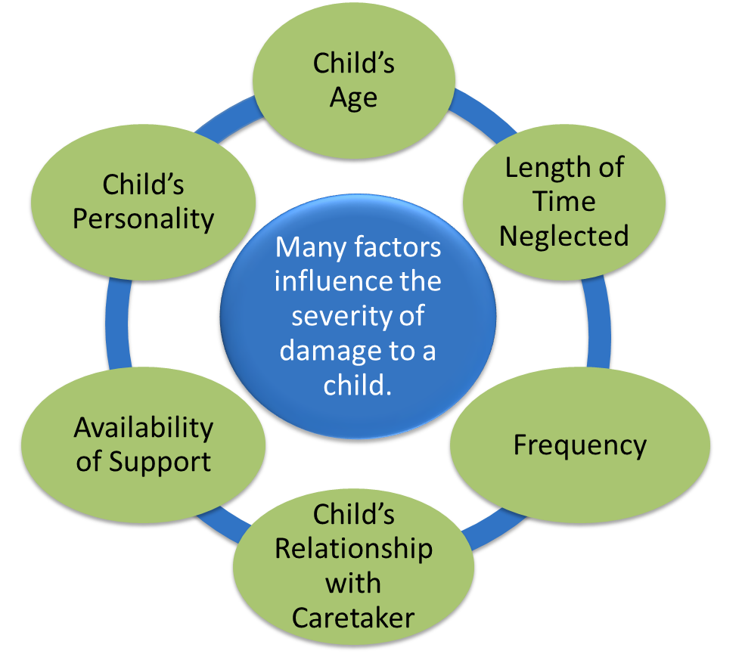
Factors
Pre-Service Curriculum Module 6.2.17
Notes:
6.2.22
?What kind of factors impact the severity of damage that children suffer as a result of neglect? Does the age of child matter?
To identify the effects of neglect, accurately assess, and properly intervene, you must be familiar with the normal developmental stages of in four areas:
motor
mental
language
social
Neglect can significantly affect a child‘s development in any or all of these areas.
•Distribute PG, Common Effects of Child Neglect and discuss each age group.

Slide 29

Behavioral & Emotional Effects of Neglect
Pre-Service Curriculum Module 6.2.18
Notes:
6.2.23
Review the following key points:
Neglect has an impact on every facet of the family and, consequently, its effects are manifested in many different ways.

Slide 30
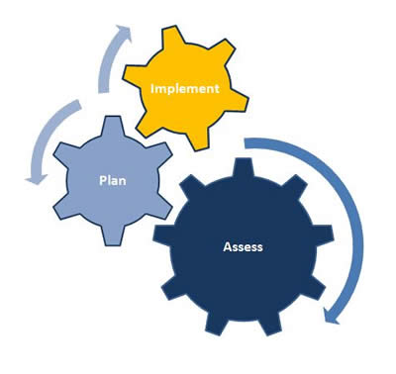
Knowledge Assessment
Pre-Service Curriculum Module 6.2.19
Notes:
11.2.43
This is the page we will use to signify that there will be brief check-in’s to review information, where appropriate. Don’t expect there to be that many of these, as knowledge demonstration will be combined with skill acquisition.

Slide 31
Unit 6.3
Physical Abuse
Pre-Service Curriculum Module 6.3.1
Notes:
11.3.44

Slide 32
Learning Objectives
Pre-Service Curriculum Module 6.3.2
Notes:
6.3.2

Slide 33

Maltreatment Index and Physical Abuse
Pre-Service Curriculum Module 6.3.3
Notes:
6.3.4

Slide 34
Abuse: Chapter 39.01(2), F.S.
  “…any willful act or threatened act that results in any physical, mental, or sexual injury or harm that causes or is likely to cause the child's physical, mental, or emotional health to be significantly impaired. Abuse of a child includes acts or omissions…”
Pre-Service Curriculum Module 6.3.4
Notes:
6.3.5

Slide 35
Child Maltreatment Index
Categories
Asphyxiation
Bone Fractures
Burns
Internal Injuries
Physical Injury
  Cuts, Punctures and Bites
  Bruises, Welts
  Dislocation
  Skull Fracture, Brain or Spinal Cord Damage,
  Intra-Cranial Hemorrhage
Pre-Service Curriculum Module 6.3.5
Notes:
6.3.6

Slide 36
Child Maltreatment Index
Categories (continued)
Physical Injury
  Other, including:
    Munchausen Syndrome by Proxy
    Abrasions and Blinding/Eye Damage
    Injury to Teeth and Jaws, Mouth and Lips
    Damage to Ears/Hearing, Hair Pulling
Pre-Service Curriculum Module 6.3.6
Notes:
11.3.50

Slide 37
Added Physical Abuse Discussion Items
Excessive Corporal Punishment: Beatings
  Battered Child Syndrome
Poisoning
Bizarre Punishment
Malnourishment/Dehydration
Pre-Service Curriculum Module 6.3.7
Notes:
6.3.8

Slide 38
Asphyxiation
Florida Maltreatment Index (6/1/10)
  “…the alteration in consciousness by a willful act of the caregiver(s) that may include suffocation and strangulation.”
Pre-Service Curriculum Module 6.3.8
Notes:
6.3.9

Slide 39
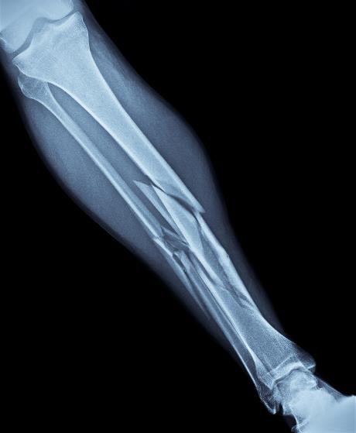
Bone Fractures
Florida Maltreatment Index (6/1/10)
  “…any broken bone in a child that is caused by the willful action of a caregiver(s).”
Pre-Service Curriculum Module 6.3.9
Notes:
6.3.10

Slide 40
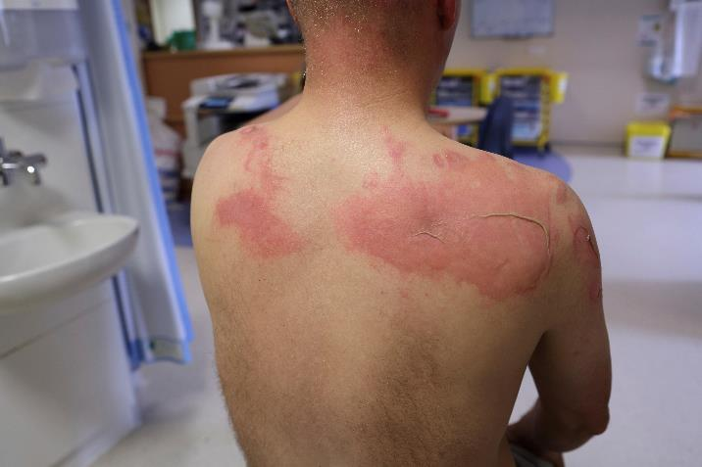
Burns
Florida Maltreatment Index (6/1/10)
  “Injury resulting in damage to the skin through the willful action of the caregiver(s).”
Pre-Service Curriculum Module 6.3.10
Notes:
6.3.11

Slide 41
Internal Injuries
Florida Maltreatment Index (6/1/10)
  “…an injury to the organs occupying the thoracic (chest) or abdominal cavities that is not visible from the outside. Internal injuries may be accompanied by other external injuries. A person so injured may be pale, cold, perspiring freely, have an anxious expression, seem semi-comatose, or exhibit other symptoms, such as lethargy, disorientation, blood in bowel movements or urine, and/or loss of consciousness.”
Pre-Service Curriculum Module 6.3.11
Notes:
6.3.12

Slide 42
Physical Injury
Florida Maltreatment Index (6/1/10)
  “Physical injury includes any physical maltreatment of a child which is not covered by other abuse maltreatments that results in permanent or temporary disfigurement, permanent or temporary loss or impairment of a bodily part or function, or is a willful act or threatened act which causes or is likely to cause the child’s physical health to be impaired.”
Pre-Service Curriculum Module 6.3.12
Notes:
6.3.13

Slide 43
Bizarre Punishment
Florida Maltreatment Index (6/1/10)
  “Bizarre punishment is caused by a willful act of a caregiver(s) that includes inflicting or subjecting a child to intense physical or mental pain, suffering, or agony that is repetitive, increased, prolonged, or severe. Bizarre punishment also includes confinement, torture, and inappropriate/excessive use of restraints or isolation.”
Pre-Service Curriculum Module 6.3.13
Notes:
6.3.14

Slide 44
Malnutrition/Dehydration
Florida Maltreatment Index (6/1/10)
  “Malnutrition is a lack of necessary or proper nutrition or liquids in the body caused by lack of access to food, inadequate food, lack of food or liquids, or insufficient amounts of protein, minerals or vitamins.”
Pre-Service Curriculum Module 6.3.14
Notes:
6.3.15

Slide 45
Activity
Ask the Experts
Pre-Service Curriculum Module 6.3.15
Notes:
6.3.16

Slide 46

Child Physical Abuse
Critical Indicators
Pre-Service Curriculum Module 6.3.16
Notes:
6.3.17

Slide 47

Physical Abuse, Law Enforcement and the Child Protection Team
Pre-Service Curriculum Module 6.3.17
Notes:
6.3.18

Slide 48
CPT Referrals
Any sexually transmitted disease in a prepubescent child
Injuries to the head, bruises to the neck or head, burns, or fractures in a child of any age.
Bruises anywhere on a child five years of age or younger.
Any report alleging sexual abuse of a child.
Reported malnutrition or failure of a child to thrive.
Reported medical neglect of a child.
Symptoms of serious emotional problems in a child when emotional or other abuse, abandonment, or neglect is suspected.
A sibling or other child remaining in a home where one or more children have been pronounced dead on arrival or have been injured and later died as a result of suspected abuse, abandonment or neglect.
Pre-Service Curriculum Module 6.3.18
Notes:
6.1.15

Slide 49

CPT Services
Medical diagnosis and evaluation
Nursing assessments
Child and family assessments
Multidisciplinary staffings
Psychological and psychiatric evaluations
Specialized and forensic interviews
Expert court testimony
Pre-Service Curriculum Module 6.3.19
Notes:
6.1.16

Slide 50
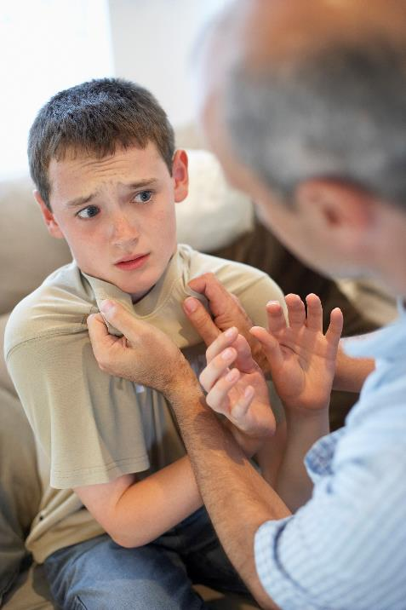
Assessing Situations for Physical Abuse
Pre-Service Curriculum Module 6.3.20
Notes:
6.3.19

Slide 51
Activity
Assessing Situations for Physical Abuse
Pre-Service Curriculum Module 6.3.21
Notes:
6.3.20

Slide 52

The Role of the CPT with Physical Abuse Investigations
Pre-Service Curriculum Module 6.3.22
Notes:
6.3.21

Slide 53
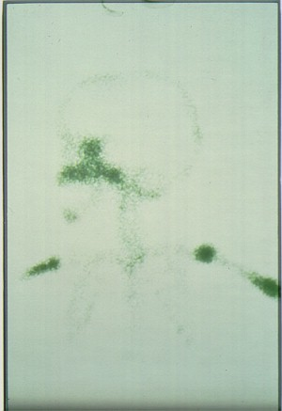
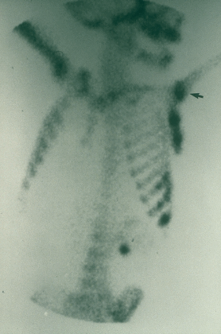
    Skeletal “bone scan” showing numerous old injuries.
Dark patches indicate calcification.
Pre-Service Curriculum Module 6.3.23
Notes:
6.3.22

Slide 54
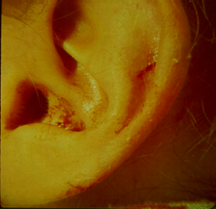
Child’s ear pinched and cut by thumbnail
Pre-Service Curriculum Module 6.3.24
Notes:
6.2.23

Slide 55
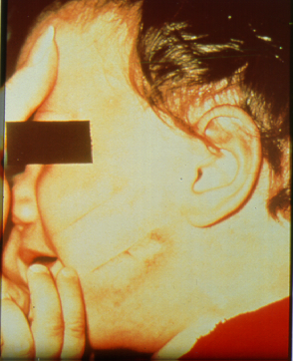
“Slap bruising” to face, showing lines between fingers, also bruising to outer ear.
Pre-Service Curriculum Module 6.3.25
Notes:
6.2.24

Slide 56
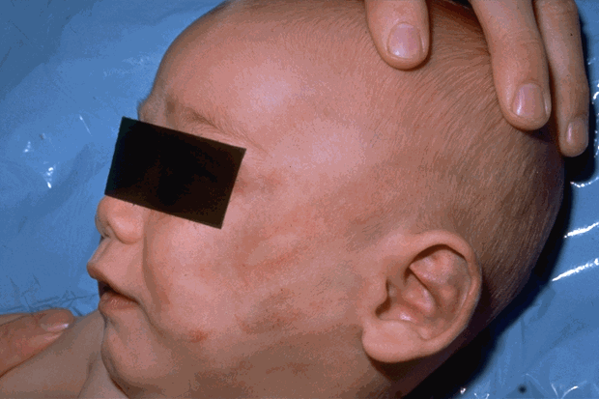
Slap mark on infant - Outline of human hands can be seen
Pre-Service Curriculum Module 6.3.26
Notes:
6.3.25

Slide 57
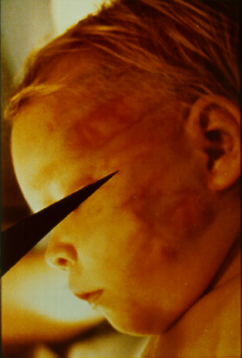
“Slap mark” bruises on child’s face
Pre-Service Curriculum Module 6.3.27
Notes:
6.3.26

Slide 58
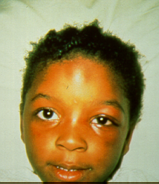
Lump on forehead - and injury to left eye- indicating more than one “event”
Pre-Service Curriculum Module 6.3.28
Notes:
6.3.27

Slide 59
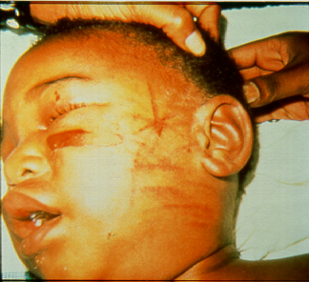
Bruises under left eye and criss-crossing marks from beating with a “switch”
Pre-Service Curriculum Module 6.3.29
Notes:
6.3.28

Slide 60
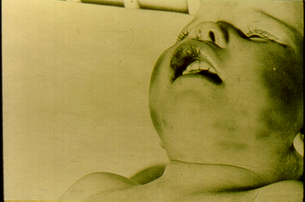
“Battered Infant” with swollen upper lip and facial bruises
Pre-Service Curriculum Module 6.3.30
Notes:
6.3.29

Slide 61
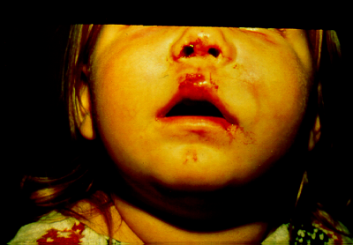
Battered child with bloody nose and lip and swollen face
Pre-Service Curriculum Module 6.3.31
Notes:
6.3.30

Slide 62
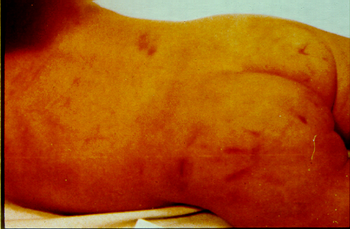
Bruised buttocks (with handprint) of child who was anally assaulted
Pre-Service Curriculum Module 6.3.32
Notes:
6.3.31

Slide 63
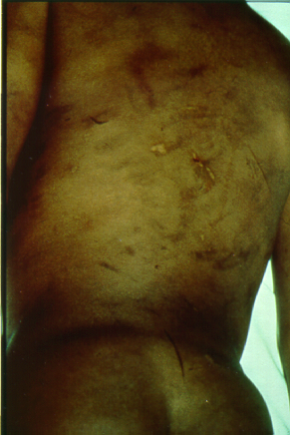
Child’s back with multiple injuries in different stages of healing
Pre-Service Curriculum Module 6.3.33
Notes:
6.3.32

Slide 64
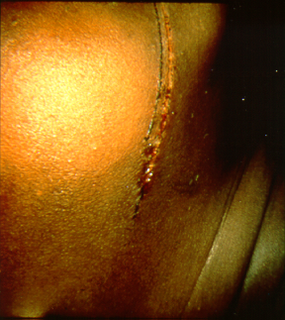
Fresh lacerations on child’s jaw and neck
Pre-Service Curriculum Module 6.3.34
Notes:
6.3.33

Slide 65
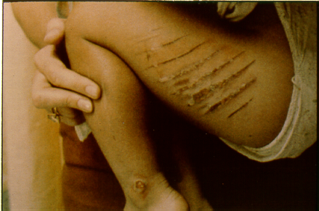
Parallel lacerations on upper left thigh, caused by beating with an electrical cord with bare wires sticking out of the chord
Pre-Service Curriculum Module 6.3.35
Notes:
6.3.34

Slide 66
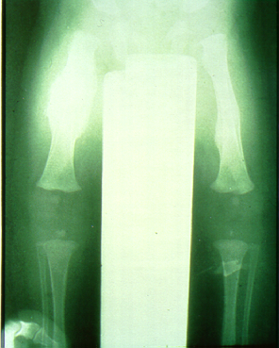
X-rays showing old calcification of broken leg (on left)
Pre-Service Curriculum Module 6.3.36
Notes:
6.3.35

Slide 67
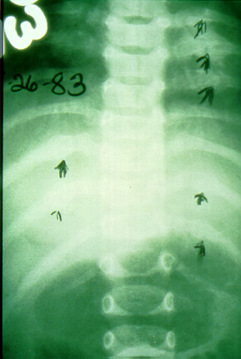
Arrows on the x-ray pointing to old calcified broken ribs, typical of a child’s rib cage squeezed in abusive “bear hug.”
Pre-Service Curriculum Module 6.3.37
Notes:
6.3.36

Slide 68
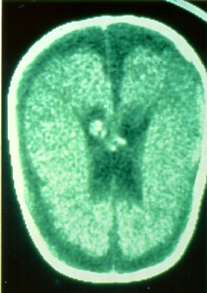
Brain Scan showing dark area of Subdural Hematoma
Pre-Service Curriculum Module 6.3.38
Notes:
6.3.37

Slide 69
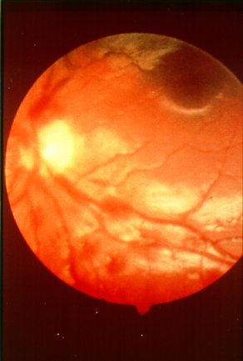
Retinal bleeding in back of the eye of a shaken and battered infant
Pre-Service Curriculum Module 6.3.39
Notes:
6.3.38

Slide 70
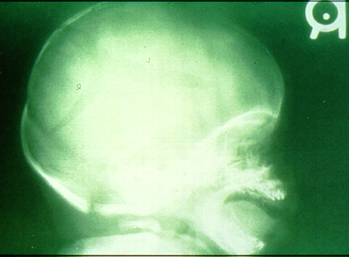
X-ray of skull fracture to base of skull from severe blow
Pre-Service Curriculum Module 6.3.40
Notes:
6.3.39

Slide 71
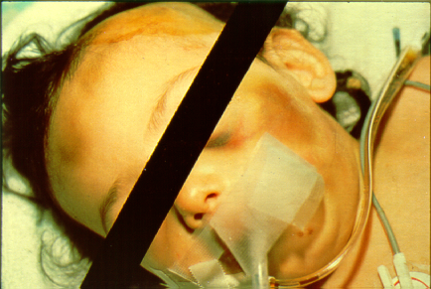
Battered infant on life-support with potentially lethal injuries
Pre-Service Curriculum Module 6.3.41
Notes:
6.3.40

Slide 72
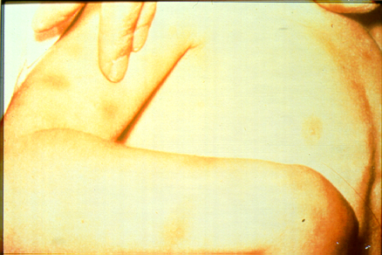
Encirclement fingertip bruises on child’s upper arm and forearm- “Look for similar injuries on other arm” ie: bilateral injuries typical of child held and shaken
Pre-Service Curriculum Module 6.3.42
Notes:
6.3.41

Slide 73
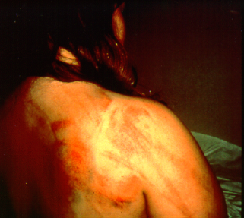
Bruising and lacerations on back caused by a beating with a broom
Pre-Service Curriculum Module 6.3.43
Notes:
6.3.42

Slide 74
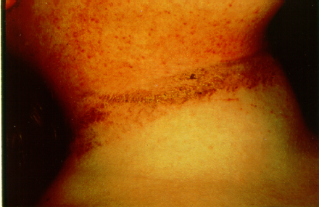
Encirclement rope marks on child’s neck. Tied by neck as a form of discipline
Pre-Service Curriculum Module 6.3.44
Notes:
6.3.43

Slide 75
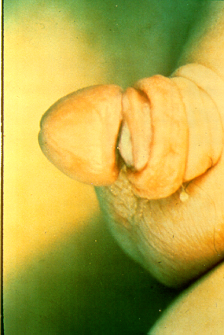
Penis nearly severed, resulting from dental floss tied around as a form of “toilet training”
Pre-Service Curriculum Module 6.3.45
Notes:
6.3.44

Slide 76
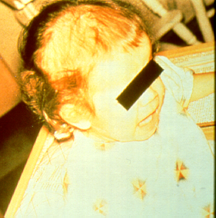
Child’s hair thin in front from being pulled out as a punishment
Pre-Service Curriculum Module 6.3.46
Notes:
6.3.45

Slide 77
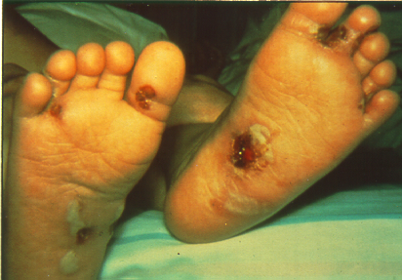
Cigarette burns on child’s feet
Pre-Service Curriculum Module 6.3.47
Notes:
6.3.46

Slide 78
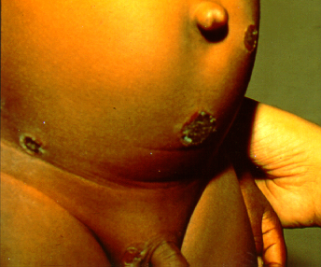
Cigarette burns on child’s stomach and groin
Pre-Service Curriculum Module 6.3.48
Notes:
6.3.47

Slide 79
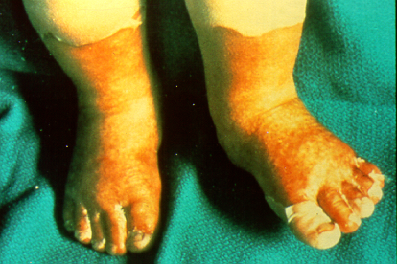
“Stocking” immersion burns to infant’s feet
Pre-Service Curriculum Module 6.3.49
Notes:
6.3.48

Slide 80
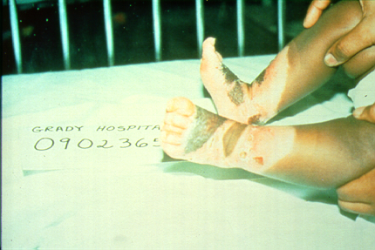
“Stocking” immersion burns to infant’s feet
Pre-Service Curriculum Module 6.3.50
Notes:
6.3.49

Slide 81
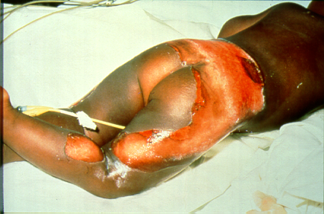
“Doughnut” immersion burn – buttocks are pressed to bottom of cast iron tub- they are spared being burned
Pre-Service Curriculum Module 6.3.51
Notes:
6.3.50

Slide 82
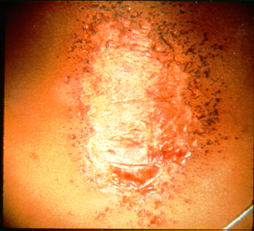
“Splash burn” caused by lye being thrown on child
Pre-Service Curriculum Module 6.3.52
Notes:
6.3.51

Slide 83

The Short- and Long-Term Impacts of Physical Abuse
Pre-Service Curriculum Module 6.3.53
Notes:
6.3.52

Slide 84
Unit 6.4
Sexual Abuse
Pre-Service Curriculum Module 6.4.1
Notes:
6.4.53

Slide 85
Learning Objectives
Pre-Service Curriculum Module 6.4.2
Notes:
6.4.55

Slide 86

What is Sexual Abuse?
Sexual Battery
Sexual Molestation
Sexual Exploitation
Sexual Abuse –
Other Child
Pre-Service Curriculum Module 6.4.3
Notes:
6.4.56

Slide 87
Five Phases of Sexual Abuse
Engagement
Sexual Interactions
Secrecy
Suppression
Disclosure
Pre-Service Curriculum Module 6.4.4
Notes:
5.3.50

Slide 88
Activity
Sexual Abuse – Does it Meet the Legal Definition ?
Pre-Service Curriculum Module 6.4.5
Notes:
6.4.58

Slide 89

Indicators of Child Sexual Abuse
Pre-Service Curriculum Module 6.4.6
Notes:
6.4.59

Slide 90
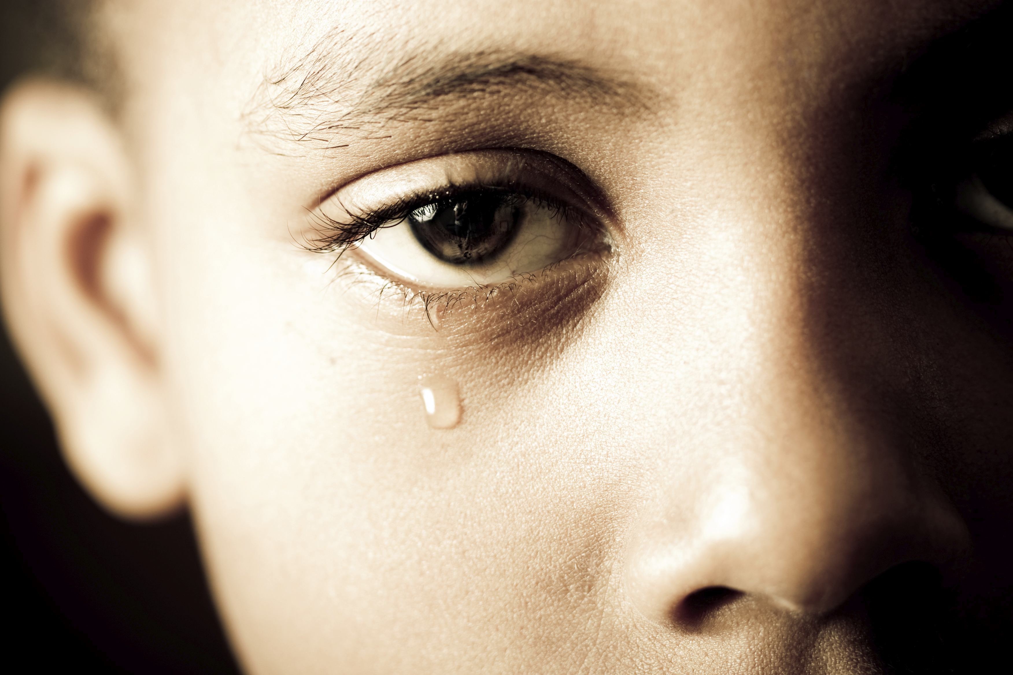
Sexual Maltreatment, Sexual Development & Behavior
Ages 2-12
Pre-Service Curriculum Module 6.4.7
Notes:
6.4.60

Slide 91
Activity
What are the Indicators in These Situations?
Pre-Service Curriculum Module 6.4.8
Notes:
6.4.61

Slide 92

Why Children Recant
Pre-Service Curriculum Module 6.4.9
Notes:
6.4.62

Slide 93
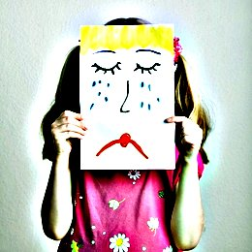
The Family Response to Disclosed Sexual Abuse
Pre-Service Curriculum Module 6.4.10
Notes:
6.4.63

Slide 94
Activity
Grappling with Potential Sexual Abuse Cases
Pre-Service Curriculum Module 6.4.11
Notes:
6.4.63

Slide 95
Unit 6.5
Mental Injury
Pre-Service Curriculum Module 6.5.1
Notes:
6.5.64

Slide 96
Learning Objectives
Pre-Service Curriculum Module 6.5.2
Notes:
6.5.65

Slide 97
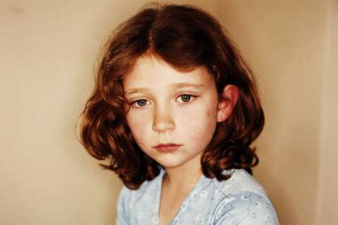
What is Mental Injury?
F.S. 39.01(42)
Pre-Service Curriculum Module 6.5.3
Notes:
6.5.66

Slide 98

Myths about Verbal Abuse
Pre-Service Curriculum Module 6.5.4
Notes:
6.5.67

Slide 99
Emotional Abuse
You are too stupid to….
Pattern of behavior attacking a child’s emotional development and sense of self-worth.
I wish you were never born
You are nothing!
You’ll never amount to anything!
Pre-Service Curriculum Module 6.5.5
Notes:
6.5.68

Slide 100
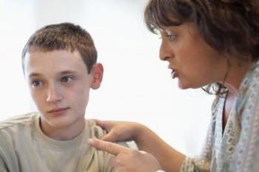
Characteristics of Emotionally Abusive Parents
Negative
Unrewarding
Own feelings
Pre-Service Curriculum Module 6.5.6
Notes:
6.5.69

Slide 101
Types of Mental Injury
Spurning
Terrorizing
Exploiting/corrupting
Isolating
Denying emotional responsiveness (ignoring)
Mental health, medical and educational neglect
Pre-Service Curriculum Module 6.5.7
Notes:
6.5.70

Slide 102
Activity
Types of Mental Injury
Pre-Service Curriculum Module 6.5.8
Notes:
6.5.71

Slide 103

Legal Requirements to Prove Mental Injury
Direct Cause and Effect
Significant Impairment
Professional Evaluation
Substantial, Observable
Identifiable Parental Behavior
Causal link
Pre-Service Curriculum Module 6.5.9
Notes:
6.5.72

Slide 104
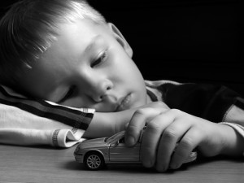
Indicators of Mental Injury
Behavioral
Physical
Caregiver
Pre-Service Curriculum Module 6.5.10
Notes:
6.5.73
What are some difficulties in establishing a case involving mental injury?
Do you think statistics reporting substantiated cases of mental injury might be underrated in terms of percentages of occurrence? Why or why not?
Why does mental injury have a life-long damaging impact?

Slide 105

Margaret
What did you observe that might indicate mental injury?
Is there a direct link between the caregiver‘s actions or lack of actions and the child‘s suffering?
What else must you do to support your observations?
Pre-Service Curriculum Module 6.5.11
Notes:
6.5.74

Slide 106
What
would you say
Instead?
Pre-Service Curriculum Module 6.5.12
Notes:
6.5.75

Slide 107
Unit 6.6
The Dynamics of Substance Abuse
Pre-Service Curriculum Module 6.6.1
Notes:
5.1.4

Slide 108
Learning Objectives
Pre-Service Curriculum Module 6.6.2
Notes:
5.1.5

Slide 109

Substances and their Effects
    Why People use Drugs
    The Spectrum of Addiction
    Physical and Psychological Effects of Substance Use
Pre-Service Curriculum Module 6.6.3
Notes:
5.1.8

Slide 110

Why People Use Alcohol and Drugs
Behavioral
Social
Environmental
Risk vs. Protective
Biological Risk and Protective
Unique Combinations
Pre-Service Curriculum Module 6.6.4
Notes:
5.1.9

Slide 111
Risk Factors vs. Protective Factors
Risk Factors | Domain | Protective Factors
Early Aggressive Behavior | Individual | Self-Control
Lack of Parental Supervision | Family | Parental Monitoring
Substance Abuse | Peer | Academic Competence
Drug Availability | School | Anti-drug Use Policies
Poverty | Community | Strong Neighborhood Attachment
Pre-Service Curriculum Module 6.6.5
Notes:
5.1.10

Slide 112


Spectrum of Addiction
Experiment
Use
Abuse
Dependence
Pre-Service Curriculum Module 6.6.6
Notes:
5.1.11

Slide 113

Addiction
A disease
  Progressive
  Potentially fatal
  Incurable
Pre-Service Curriculum Module 6.6.7
Notes:
5.1.12

Slide 114

Personal-Professional Dimensions of Substance Use
Views and experiences
Your viewpoint affects others
Unique
Discuss your issues
Pre-Service Curriculum Module 6.6.8
Notes:
5.1.13

Slide 115
Criteria for Substance Dependence
  Tolerance
  Withdrawal
  Large amounts, longer period
  Desire to cut back
  Other activities given up or reduced
  Continued use despite knowledge of problem
Pre-Service Curriculum Module 6.6.9
Notes:
5.1.14

Slide 116

Effects of Substance Abuse on the User
Physical and Psychological Effects
Brain Chemistry of Addiction
Prescription Drugs
Ability to Parent
Pre-Service Curriculum Module 6.6.10
Notes:
5.1.15

Slide 117

Physical and Psychological Effects of Substance Use
http://fadaa.org/resource_center/just_the_facts/PSYCHO1.pdf
Alcohol
Methamphetamine
Cocaine
Hallucinogens
Marijuana
http://www.fadaa.org/resource_center/justFacts.php
Pre-Service Curriculum Module 6.6.11
Notes:
5.1.16

Slide 118

Prescription Drug Abuse
“The use of a prescription medication in a way not intended by the prescribing doctor. Prescription drug abuse includes everything from taking a friend's prescription painkiller for your backache to snorting ground-up pills to get high.”
-The Mayo Clinic (2011)
Pre-Service Curriculum Module 6.6.12
Notes:
5.1.17

Slide 119












Florida 10 Year Trend Upward in Prescription Drug Abuse
40 %
35 %
30 %
25 %
20 %
15 %
10 %
00 %
Alcohol Marijuana Crack/Cocaine Heroin Other Opiates Meth Prescription Other Drugs
% of Total Admissions
FY 01-02 FY 02-03 FY 03-04 FY 04-05 FY 05-06 FY 06-07 FY 07-08 FY 08-09 FY 09-10 FY 10-11
Pre-Service Curriculum Module 6.6.13
Notes:
5.1.18

Slide 120




Different substances affect parenting differently
Pre-Service Curriculum Module 6.6.14
Notes:
5.1.20

Slide 121

Effects of Prenatal Exposure
  Neurological and behavioral differences
  Cognitive and communication/language difficulties
Pre-Service Curriculum Module 6.6.15
Notes:
5.1.21

Slide 122

Fetal Alcohol Spectrum Disorder
Pre-Service Curriculum Module 6.6.16

Slide 123

http://www.c2law.com/links/cerebral-palsy-information/critical-periods-of-fetal-development/CP1.jpg

Slide 124

Effects of Substance Use on the Family
Impact on the Child
Family Disease
Family Roles
Pre-Service Curriculum Module 6.6.18
Notes:
5.1.22

Slide 125

Substance Abuse Does Not Occur in a Bubble
Pre-Service Curriculum Module 6.6.19
Notes:
5.1.23

Slide 126

Impact on the Child
Pre-Service Curriculum Module 6.6.20
Notes:
5.1.24
When parents become preoccupied with drugs, or any other activity which dominates and monopolizes their time and energy, the children become emotional and sometimes physical cripples as a result of deprivation. Though the children are innocent they still become partners locked into this problem. Their coping skills become frustrated and their needs are invariably short-circuited. Such children carry these inappropriate adaptive behaviors with them into adulthood and create an inter-generational cycle of maladaptive coping techniques,‖ (Briggs, 1970).
Briggs, D.C. (1970). Your child's self-esteem. New York: Doubleday.
At the same time that the ACE Study was being done, parallel research on kids’ brains found that toxic stress physically damages a child’s developing brain.
When children are overloaded with stress hormones, they’re in flight, fright or freeze mode. They can’t learn in school. They often have difficulty trusting adults or developing healthy relationships with peers (i.e., they become loners). To relieve their anxiety, depression, guilt, shame, and/or inability to focus, they turn to easily available biochemical solutions — nicotine, alcohol, marijuana, methamphetamine — or activities in which they can escape their problems — high-risk sports, proliferation of sex partners, and work/over-achievement. (e.g. Nicotine reduces anger, increases focus and relieves depression. Alcohol relieves stress.) ACE STUDY’ http://acestoohigh.com/got-your-ace-score/

Slide 127

The Substance Abuser’s Child May:
Appear unkempt
Be frequently sleepy
Be late to school
Have unexplained bruises
Know too much about drinking
Appear withdrawn/depressed
Display behavioral problems
Be frequently absent
Complain of stomachaches
Pre-Service Curriculum Module 6.6.21
Notes:
5.1.25

Slide 128

Family Disease
a constant strain
unemployment
increasing stress levels
arguing and hostility
overall chaos
anxiety, confusion, and conflict among the children
Pre-Service Curriculum Module 6.6.22
Notes:
5.1.26

Slide 129
Reassignment of Roles and Responsibilities
Overburdened
Increased Responsibilities
Less Support
Re-assigned Responsibilities
Pre-Service Curriculum Module 6.6.23
Notes:
5.1.28

Slide 130

Family Roles in Substance Abusing Families
Rescuer/Enabler
Hero/Caretaker
Adjuster/Lost Child
Scapegoat/Rebel
Mascots/Pleasers
Pre-Service Curriculum Module 6.6.24
Notes:
5.1.29

Slide 131
Activity
Family Sculpture
Pre-Service Curriculum Module 6.6.25
Notes:
5.1.30

Slide 132
Triggers
Colic/ Crying
Awakening at night
Separation anxiety
Exploratory behavior
Negativism
Poor appetite
Toilet-training resistance
Typical Kid Stuff!
Pre-Service Curriculum Module 6.6.26

Slide 133

Breastfeeding Death
April 4, 2014 - Stephanie Greene. Greene, 39, faces 20 years to life in prison when she is sentenced for killing her 6-week-old daughter with what prosecutors say was an overdose of morphine delivered through her breast milk.
Pre-Service Curriculum Module 6.6.27

Slide 134

Child has consumed drugs or alcohol due to the caregiver(s) actions or neglect.
Pre-Service Curriculum Module 6.6.28

Slide 135

Poisoning
Did the caregiver(s) give or cause a harmful substance to be given to the child?
Were the actions of the caregiver(s) intentional?
Pre-Service Curriculum Module 6.6.29

Slide 136

Substance Abuse and Family Violence
Pre-Service Curriculum Module 6.6.30
Notes:
5.1.31

Slide 137
Unit 6.7
The Dynamics of Domestic Violence
Pre-Service Curriculum Module 6.7.1
Notes:
5.2.32

Slide 138
Learning Objectives
Pre-Service Curriculum Module 6.7.2
Notes:
5.2.33

Slide 139

What is Domestic Violence?
Pre-Service Curriculum Module 6.7.3
Notes:
5.2.34

Slide 140

Who Is the Batterer?
Pre-Service Curriculum Module 6.7.4
Notes:
5.2.38

Slide 141

Wheel of Power and Control
Pre-Service Curriculum Module 6.7.5
Notes:
5.2.39

Slide 142

The Likelihood that a Batterer Will Kill
Pre-Service Curriculum Module 6.7.6
Notes:
5.2.41

Slide 143
If the Woman Is Able to Leave…& Your Responsibility
Chapter 39 FS - Injunctions
Florida Coalition Against Domestic Violence (FCADV)
Toll-free number, 1-800-500-1119
  Connect to the domestic violence center nearest you
  www.fcadv.org/centers for your local certified domestic violence center
Pre-Service Curriculum Module 6.7.7
Notes:
5.2.42

Slide 144

What If She Cannot or Will Not Leave?
Pre-Service Curriculum Module 6.7.8
Notes:
5.2.43

Slide 145

Why It Matters
Pre-Service Curriculum Module 6.7.9
Notes:
5.2.45

Slide 146

How might children be neglected in families where domestic violence is occurring?
Pre-Service Curriculum Module 6.7.10

Slide 147
Activity
Dynamics of Domestic Violence in the Andersen Family
Pre-Service Curriculum Module 6.7.11
Notes:
5.2.44

Slide 148

Criminal Background Checks and Domestic Violence
Pre-Service Curriculum Module 6.7.12

Slide 149

Domestic Violence Victim Advocates and Child Welfare Professionals
Pre-Service Curriculum Module 6.7.13

