Slide 1

Communication Skills Lab 2
Exploring Skills
Notes:
1.0.1

Slide 2
Agenda
Unit 2.1: Attending Behaviors
Unit 2.2: Reflections and Reframing
Unit 2.3: Opening Phases of Interview
Unit 2.4: Wrap-up and Preparing for Field Shadowing
Core Pre-Service Curriculum – Lab 2.0.2
Notes:
1.0.2

Slide 3
Lab Unit 2.1
Attending Behaviors
Core Pre-Service Curriculum – Lab 2.1.1
Notes:
1.1.1

Slide 4
Learning Objectives
Describe the types of attending behaviors.
Identify effective and ineffective attending behaviors of child welfare professional.
Identify non-verbal behavior of family members interviewed.
Core Pre-Service Curriculum – Lab 2.1.2
Notes:
9.2.16

Slide 5
Engagement Skills Continuum
Core Pre-Service Curriculum – Lab 2.1.3

Slide 6
Physical Attending
Use of environment
Use of body language
Core Pre-Service Curriculum – Lab 2.1.4

Slide 7


Physical Attending: Use of Environment
Which person would you rather be
in a conversation with?
Core Pre-Service Curriculum – Lab 2.1.5

Slide 8
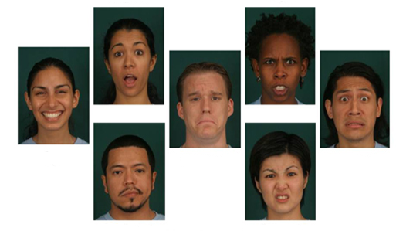

Physical Attending: Use of Body Language
Expressions you might encounter…
Core Pre-Service Curriculum – Lab 2.1.6

Slide 9
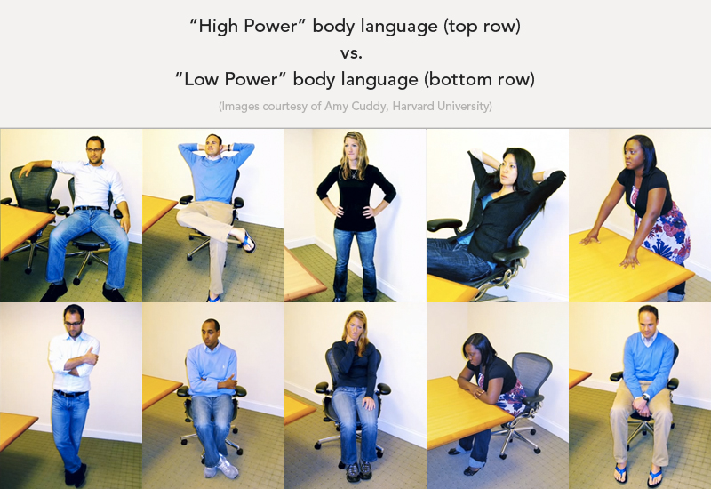
Physical Attending: Use of Body Language

Slide 10

Psychological Attending: Use of Body Language
What does this picture convey?
Core Pre-Service Curriculum – Lab 2.1.8

Slide 11

Psychological Attending: Use of Body Language
Core Pre-Service Curriculum – Lab 2.1.9

Slide 12

Lab Activity 1:
Determining Meaning of Non-verbal Behaviors
Core Pre-Service Curriculum – Lab 2.1.10
Notes:
9.1.8

Slide 13
Psychological Attending
Observation of family members’:
  Congruence
  Use of voice
  Non-verbal behavior
Responding to family members:
  Verbal following
  Minimal encouragers
  Congruence with family member
Core Pre-Service Curriculum – Lab 2.1.11

Slide 14
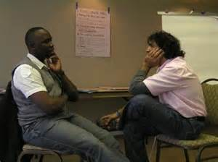
Psychological Attending: Responding with Congruence
Core Pre-Service Curriculum – Lab 2.1.12

Slide 15

Psychological Attending
What does this picture convey?
Core Pre-Service Curriculum – Lab 2.1.13

Slide 16
Communication Skills Lab 2
Unit 2.2, Reflections and Reframing
Core Pre-Service Curriculum – Lab 2.2.1
Notes:
1.0.1

Slide 17
Learning Objectives
Describe the different purposes of reflections, reframing and silence.
Identify effective use of reflections, silence and reframing, and opportunities missed, in interviewing videos.
Demonstrate use of reflections, silence and reframing.
Core Pre-Service Curriculum – Lab 2.2.2

Slide 18
Engagement Skills Continuum
Core Pre-Service Curriculum – Lab 2.2.3

Slide 19
Purpose of Exploring Skills
How do you see yourself and this situation?
How might you see it differently?
Core Pre-Service Curriculum – Lab 2.2.4

Slide 20
Purposes of Reflections
Reflects back information & gives
person interviewed an opportunity to
affirm and offer more information about:
Content
Emotions
Content and feelings
Core Pre-Service Curriculum – Lab 2.2.5

Slide 21

Reflecting
Content and Feelings
Core Pre-Service Curriculum – Lab 2.2.6

Slide 22
Lab Activity 2:
Reflecting Content and Emotions
Core Pre-Service Curriculum – Lab 2.2.7
Notes:
9.1.8

Slide 23
Interviewing
Dangers to Avoid
Stereotyped reactions
Pretending understanding
Overreaching
Under-reaching
Long-windedness
Inattention to non-verbal cues
Core Pre-Service Curriculum – Lab 2.2.8

Slide 24
Lab Activity 3:
Demonstrating Reflection Skills
Core Pre-Service Curriculum – Lab 2.2.9
Notes:
9.1.8

Slide 25

Reframing
Reframing is an empathetic reflection of a purposeful, positive intention
Core Pre-Service Curriculum – Lab 2.2.10

Slide 26
Positive Reframes
Defiant = Independent, Persistent
Bossy = Natural Leader
Sneaky = Inventive
Attention-seeking = Communicates Needs
Core Pre-Service Curriculum – Lab 2.2.11

Slide 27
Lab Activity 4:
Reframing Child Attributes
Core Pre-Service Curriculum – Lab 2.2.12
Notes:
9.1.8

Slide 28
Reframing
Focusing on the most positive meaning of the behavior or what the person’s most positive intent is with the behavior may be quite useful.
Core Pre-Service Curriculum – Lab 2.2.13

Slide 29


Reframing An Adult’s Behavior
Positive
characteristic?
Positive intent?
Core Pre-Service Curriculum – Lab 2.2.14

Slide 30

Exploring Feelings
“I am so mad.”
Hurt
Shame
Doubt
Ambivalence
Fear
Core Pre-Service Curriculum – Lab 2.2.15

Slide 31
Three Step Process of Connecting with Emotions
Emotions
anger
fear
Physical response
jaw tightens
foot taps
Behavior
kick the dog
yell
beat the child
Core Pre-Service Curriculum – Lab 2.2.16

Slide 32
Lab Activity 5:
Developing Reframes
Core Pre-Service Curriculum – Lab 2.2.17
Notes:
9.1.8

Slide 33
Exception-Finding Questions
Exception-finding “questions” explore, “Tell me about the times when the problem does not occur.”
Core Pre-Service Curriculum – Lab 2.2.18

Slide 34
The Skill of Silence
“The most basic and powerful way to connect to another person is to listen. Just listen. Perhaps the most important thing we ever give each other is out attention.”
Rachel Naomi Remin
Core Pre-Service Curriculum – Lab 2.2.19

Slide 35
Lab Activity 6:
Demonstrating Exploring Skills
Core Pre-Service Curriculum – Lab 2.2.20
Notes:
9.1.8

Slide 36
Communication Skills Lab 2
Unit 2.3: Opening Phase of the Interview
Core Pre-Service Curriculum – Lab 2.3.1
Notes:
1.0.1

Slide 37
Learning Objectives
Demonstrate how to establish rapport.
--Introduce self
--Provide a personal expression
2. Demonstrate the steps in establishing a working relationship
--Purpose of visit
--Address immediate concerns
Core Pre-Service Curriculum – Lab 2.3.2
Notes:
9.2.16

Slide 38
Opening Phase of Interview
Core Pre-Service Curriculum – Lab 2.3.3

Slide 39
Opening Script
1. Establish rapport
  Respectful greeting
  State your name, title and agency
  Provide a personal expression
2. Establish a working relationship
  Explain purpose & outcome of contact
  Address immediate concerns
    Recognize and normalize feelings
Core Pre-Service Curriculum – Lab 2.3.4

Slide 40
Words to Build Rapport
Core Pre-Service Curriculum – Lab 2.3.5

Slide 41
Lab Activity 7:
Building Rapport
Core Pre-Service Curriculum – Lab 2.3.6
Notes:
9.1.8

Slide 42
Lab Activity 7:
Building Rapport, Worker A
(To be embedded week of 1-19-15)
Core Pre-Service Curriculum – Lab 2.3.6a

Slide 43
Lab Activity 7:
Building Rapport, Worker B
(To be embedded week of 1-19-15)
Core Pre-Service Curriculum – Lab 2.3.6b

Slide 44
Communication Skills Lab 2
Unit 2.4: Wrap-up and Preparing for Field Shadowing
Core Pre-Service Curriculum – Lab 2.4.1
Notes:
1.0.1

Slide 45
Learning Objectives
Review the interviewing outcomes associated with exploring skills.
Discuss personal attitude.
Review the exploring skills proficiency scale.
Review expectations for field observations of exploring skills.
Core Pre-Service Curriculum – Lab 2.4.2
Notes:
9.2.16

Slide 46
Engagement Skills Continuum
Core Pre-Service Curriculum – Lab 2.4.3

Slide 47
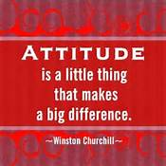
Attitude
Core Pre-Service Curriculum – Lab 2.4.4

Slide 48
Lab Activity 8:
Self-Assessment
Core Pre-Service Curriculum – Lab 2.4.5
Notes:
9.1.8

Slide 49
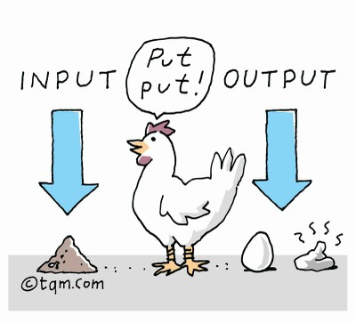
Quality Listening=Quality Information
Core Pre-Service Curriculum – Lab 2.4.6

Slide 50
Exploring Skills Proficiency
Core Pre-Service Curriculum – Lab 2.4.7

Slide 51
Preparing to Observe in the Field
Develop working agreement with person you are shadowing.
Record your observations of exploring skills prior to attending Communications Lab 3.
  Record behaviorally specific notes!
Core Pre-Service Curriculum – Lab 2.4.8

Slide 52

Congratulations!
Core Pre-Service Curriculum – Lab 2.4.9

