Slide 1



Behavioral Healthcare
Data Repository Planning Session
Data Analysis Subcommittee –
Commission on Mental Health and Substance Abuse
Data Repository Planning Session | September 13, 2023

Slide 2

Call to order

Slide 3
1) Welcome Introductions & Purpose
Welcome from Florida State University Provost
  Dr. Jim Clark
Opening Remarks
  Dr. Jay Reeve, Commission Chair
Purpose of Planning Session
  Dr. Kathleen Moore, Commissioner and Data Analysis Subcommittee Chair
  Dr. Heather Flynn, Florida State University
  Dr. Paul Stiles, University of South Florida

Slide 4
2) Review of Goals/Objectives of
Behavioral Health Data Repository

Slide 5
Aim 1
Key Steps:
Bring data together safely and responsibly, policymakers and practitioners are better equipped to understand complex needs, allocate resources, measure impacts of policies and programs, engage in shared decision-making about data use, and institutionalize regulatory compliance.
Recommendations:
Create a Statewide Coalition – defining key stakeholders and expansion
Conduct a gap analysis to identify expertise needed when identifying key stakeholders for the Statewide Coalition
Implement a Pilot – Collect data that is already aggregated and merged between AHCA and DCF or another relevant dataset to create a roadmap for an analytic plan before expanding statewide
Formalize a stakeholder coalition to determine optimal sources, uses, and outcomes of data

Slide 6
Aim 2
Key Steps:
Once a statewide data collaborative has been created and information sharing guidelines have been developed, then a behavioral health repository can be formed to include various data from organizations such as (but not limited to) DCF, AHCA, DJJ, and FDLE.
The overall goal is to provide information on access, quality, costs, and outcomes of the behavioral health system in Florida.
Recommendations:
Secure the administrative authority and commitment from stakeholders/agencies to establish the state-wide Florida Behavioral Healthcare Data Repository (FBHDR).
Determine structure of the repository (centralized, federated, etc.) as well as policies and protocols for data standardization, security and access.
Budget appropriate initial cost for the initiative including a fiscal analysis of elements/components (associated costs) of establishing and maintaining the repository and the possible addition of a qualitative component and analysis.
Create a Florida behavioral health data repository or comparable effective data system that includes data harmonization and cleaning of identified data sources for analyses

Slide 7
Key Steps:
Assess high-risk individuals served either through Medicaid or DCF and evaluate key questions related to cost, access, quality, and outcomes.
Integration of behavioral health information from multiple sources have significant improvements in accuracy of personal demographics, diagnoses (including co-morbidities), service use types and frequency of use, and personal outcomes and health care quality.
Recommendations:
Establish a FBHDR oversight steering committee that will identify appropriate behavioral health data sources and will guide and prioritize analytic direction and initiatives. Membership should include representatives from major stakeholders.
Initially, this level of research will focus on people served by public-funded services and supports.
In a later exploration, comparisons of the above outputs will be made among people covered by Medicaid versus Medicare versus Medicaid+Medicare versus private insurance versus uninsured.
Aim 3
Provide information on availability and adequacy of behavioral health data sources in Florida for high-risk individuals served either through Medicaid or DCF and evaluate key questions related to cost, access, quality, and outcomes

Slide 8
Additional Recommendations (unrelated to aims)
Implement a mixed-methods approach that includes a qualitative component to inform/contextualize the data
Implement innovative technology
Identify community resource “strengths and assets”
Create a Behavioral Health Network of Resources
Identify additional analysis points and information that are not being collected that should be collected for outcomes

Slide 9
3) Experiences of Subject Matter Experts Outside and Within Florida

Slide 10

Jessie Tenenbaum, PhD
Jessie is an Associate Professor at Duke University School of Medicine and serves as the Chief Data Officer (CDO) for the Department of Health and Human Services, assisting the Department in developing a strategy to use information to inform and evaluate policy and improve the health and well-being of residents of North Carolina. Before taking on the CDO role, Tenenbaum was a founding faculty member of the Division of Translational Biomedical Informatics within Duke University's Department of Biostatistics and Bioinformatics. Her research applies data standards and electronic health records expertise to stratify mental health disorders and enable precision medicine.

Slide 11

Cassandra Dorius, PhD
Cass is an Assistant Professor at Iowa State University and is Co-Director of Iowa’s Integrated Data System for Decision-Making (I2D2), focused on early childhood. As a demographer and sociologist, she proudly uses data for the public good and drives change by developing a robust data integration platform. She recently led a project in Iowa to develop a Health Information Platform for the Department of Public Health. She also facilitated the Linkage to Care Advisory Board, which included hospital administrators, law enforcement, public health professionals, and others to identify what should be included in the data system.

Slide 12
3) Experiences of Subject Matter Experts Outside and Within Florida
Purpose and structure of data repository systems
Process used to implement data repository system
Management structure (e.g., what worked and what we should avoid)
Outcome of efforts
Insights and challenges

Slide 13

Lunch Break

Slide 14
4) Review Florida BH Data Integration Assets and Challenges

Slide 15
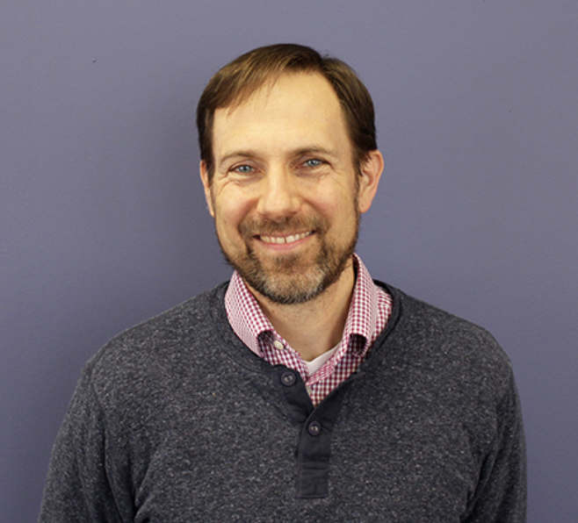
Mark Humowiecki, JD
Mark leads the Camden Coalition’s National Center for Complex Health and Social Needs initiative that seeks to coalesce a new field of healthcare and build a national movement to improve outcomes for individuals with the most complex needs. Previously Mark led the Coalition’s advocacy, communications, and governance efforts. Before joining the Coalition, Mark served as deputy executive director of the New York State Workers’ Compensation Board and spent six years practicing employment and civil rights law. Mark earned his bachelors and law degrees from Yale University.

Slide 16
4) Review Florida BH Data Integration Assets and Challenges
Additional experts include:
  Dr. Cass Dorius, Iowa State University and I2D2
  Dr. Sue Gallagher, Children’s Services Counsel of Broward County, Chief Innovation Officer
  Dr. Heather Flynn, Florida State University
  Dr. Paul Stiles, University of South Florida
  Dr. Zhe He, Florida State University (Biostatistics, Informatics, and Research Design)
  Dr. Rick Burnette, Florida State University, Associate Provost for Strategy and Analytics

Slide 17
4) Review Florida BH Data Integration Assets and Challenges
Prior integration process – DCF and AHCA
Legislative and agency engagement

Slide 18

15 Minute Break

Slide 19
5) Development of Initial Florida Behavioral Healthcare Data Repository Plan

Slide 20
5) Development of Initial Florida Behavioral Healthcare Data Repository Plan
Guest Experts: Mark Humowiecki, Cass Dorius, Kathleen Moore, Paul Stiles, and Heather Flynn
Action Steps (What/How)
  Connection, Engagement, and Implementation
Responsibility (Who)
Calendar Sequence (When)

Slide 21

Public Comment
&
Closing Remarks

