Slide 1


Data Analysis Subcommittee Update
Commission on Mental Health and Substance Abuse
Data Analysis Subcommittee | August 15, 2023

Slide 2
Goals and Strategies of Data Analysis Subcommittee
The primary goal of the Data Analysis Subcommittee is to enable the Commission’s evaluation and recommendations for improving mental health and substance use outcomes of all Floridians. The Subcommittee will develop a data strategy that addresses statute-directed aspects of mental health care (§394.9086, F.S.)
A secondary goal of the Data Analysis Subcommittee is to explore emerging information technology resources and methods that enable the Commission’s blueprint

Slide 3
Aim 1
Key Steps:
Bring data together safely and responsibly, policymakers and practitioners are better equipped to understand complex needs, allocate resources, measure impacts of policies and programs, engage in shared decision-making about data use, and institutionalize regulatory compliance.
Recommendations:
Create Statewide Coalition – defining key stakeholders and expansion
Conduct gap analysis to identify expertise needed when identifying key stakeholders for the Statewide Coalition
Implement Pilot – Collect data already aggregated and merged between AHCA and DCF or another relevant dataset to create a roadmap for an analytic plan before expanding statewide
Formalize a stakeholder coalition to determine optimal sources, uses, and outcomes of data

Slide 4
Aim 2
Key Steps:
Once statewide data collaborative has been created and information sharing guidelines developed, then a behavioral health repository can be formed to include data from organizations such as (but not limited to) DCF, AHCA, DJJ, and FDLE.
Overall goal is to provide information on access, quality, costs, and outcomes of the behavioral health system in Florida.
Recommendations:
Secure administrative authority and commitment from stakeholders/agencies to establish the state-wide Florida Behavioral Healthcare Data Repository (FBHDR).
Determine structure of repository (centralized, federated, etc.) as well as protocols for data standardization, security and access.
Budget appropriate cost for initiative including fiscal analysis of elements/components of establishing and maintaining repository and possible addition of a qualitative component and analysis.
Create a Florida behavioral health data repository or comparable effective data system that includes data harmonization and cleaning of identified data sources for analyses

Slide 5
Key Steps:
Assess high-risk individuals served either through Medicaid or DCF and evaluate questions related to cost, access, quality, and outcomes.
Integration of behavioral health information from multiple sources have significant improvements in accuracy of personal demographics, diagnoses (including co-morbidities), service use types and frequency of use, and personal outcomes and health care quality.
Recommendations:
Establish FBHDR oversight steering committee that will identify appropriate behavioral health data sources and prioritize analytic direction and initiatives.
Initially, this level of research will focus on people served by public-funded services and supports.
Comparisons of the above outputs will be made among people covered by Medicaid versus Medicare versus Medicaid+Medicare versus private insurance versus uninsured.
Aim 3
Provide information on availability and adequacy of behavioral health data sources in Florida for high-risk individuals served either through Medicaid or DCF and evaluate key questions related to cost, access, quality, and outcomes

Slide 6
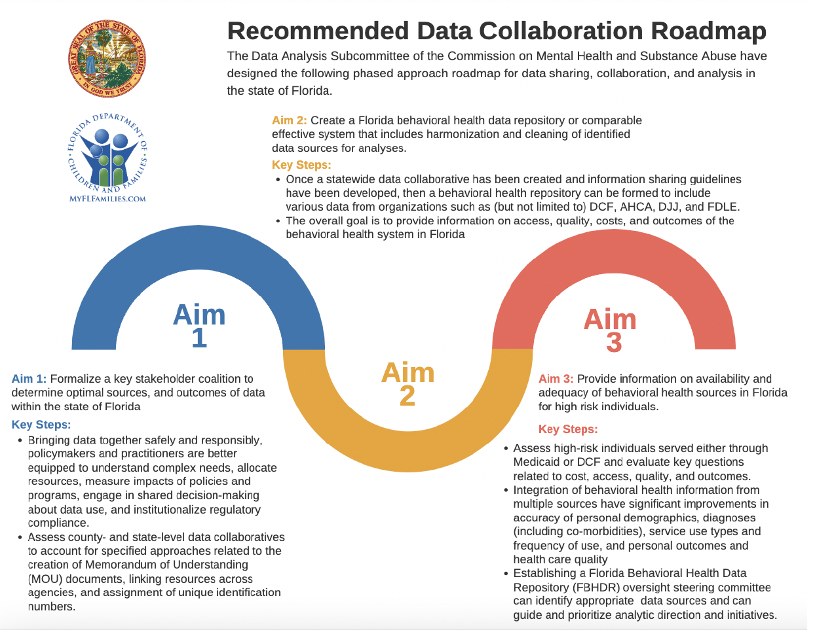

Slide 7
Additional Recommendations (unrelated to aims)
Implement a mixed-methods approach that includes a qualitative component to inform/contextualize the data
Implement innovative technology
Identify community resource “strengths and assets”
Create a Behavioral Health Network of Resources
Identify additional analysis points and information that are not being collects that should be collected for outcomes

Slide 8
Next Steps…
Data Analysis Subcommittee planning session will be held:
  Location: Florida State University (FSU)
  Date: Wednesday, September 13, 2023
  Time: 9:00am-5:00pm
Discussion will focus on the development of a statewide “Behavioral Healthcare Data Repository”
Subject Matter Experts:
  Cass Dorius, PhD – Assistant Professor, Iowa State University
  Jessie Tenenbaum, PhD – Chief Data Officer, North Carolina Department of Health and Human Services
  Mark Humowiecki, JD – General Counsel and Senior Director of National Initiatives, Camden Coalition of Healthcare Providers
  Sue Gallagher, EdD – Chief Innovation Officer, Children’s Services Council of Broward County

Slide 9
Agenda Items
Welcome Introductions/ Purpose of Planning Session
Review of goals/objectives of Behavioral Health Data Repository
Experiences of Subject Matter Experts outside and within Florida
Review Florida BH data integration assets and challenges
Development of Florida Behavioral Healthcare Data Repository Plan
Public Comment/Closing Remarks

Slide 10

Questions and Discussion

