Slide 1
Florida Behavioral Health Association
Commission on Mental Health and Substance Use Disorder
Melanie Brown-Woofter, President and CEO
August 15, 2023

Slide 2
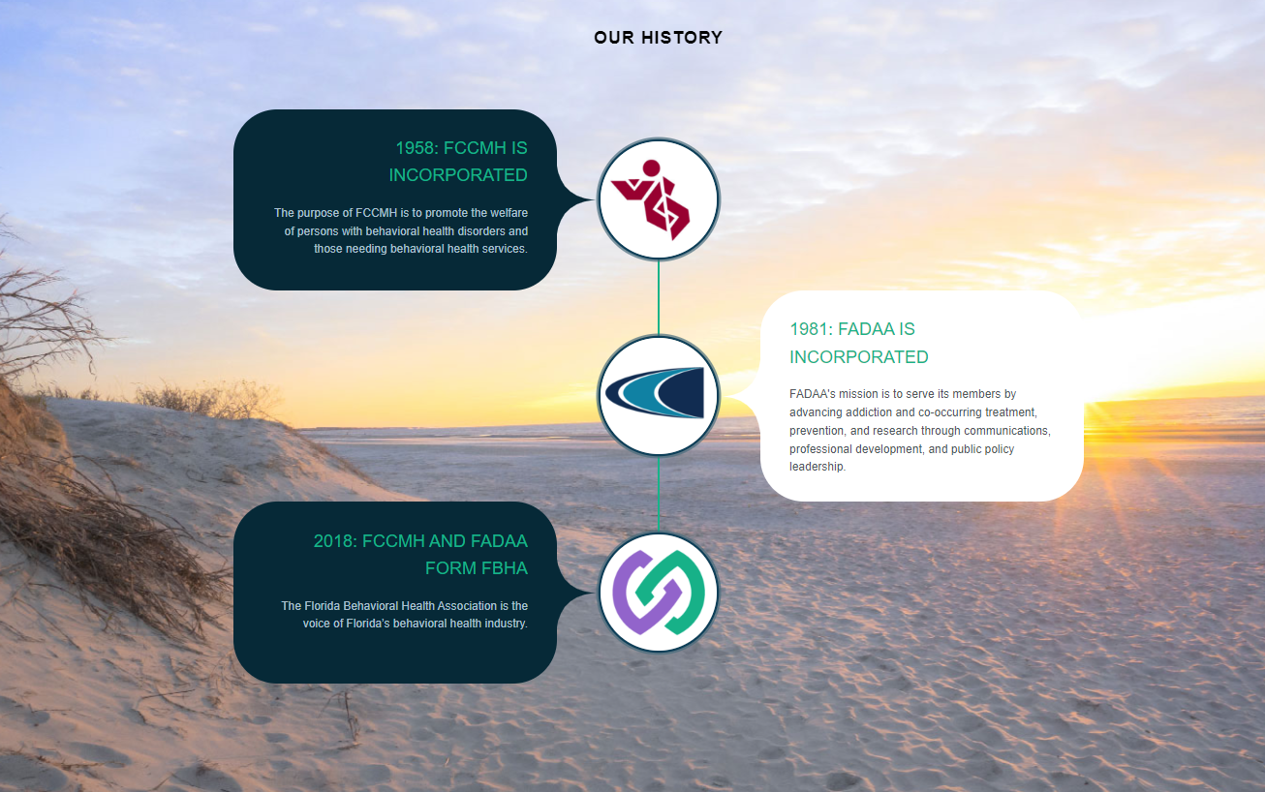
Florida’s Largest Trade Association Representing Community Behavioral Health Providers
Inform – Provide training, education, and awareness on mental illness and substance use disorder
Innovate – Provide opportunities for members of our community and the state to network, share best practices, and develop innovative ideas for treating Floridians
Influence – Use a unified voice to advocate for better behavioral health prevention, treatment, and recovery services
Notes:
We inform. FBHA provides training, education and awareness on mental illness and substance use disorders. We innovate. We create opportunities for members of our community and the state to network, share best practices and develop innovative ideas for treating Floridians. We influence. We use our united voice to advocate for better behavioral health prevention treatment and recovery services.

Slide 3
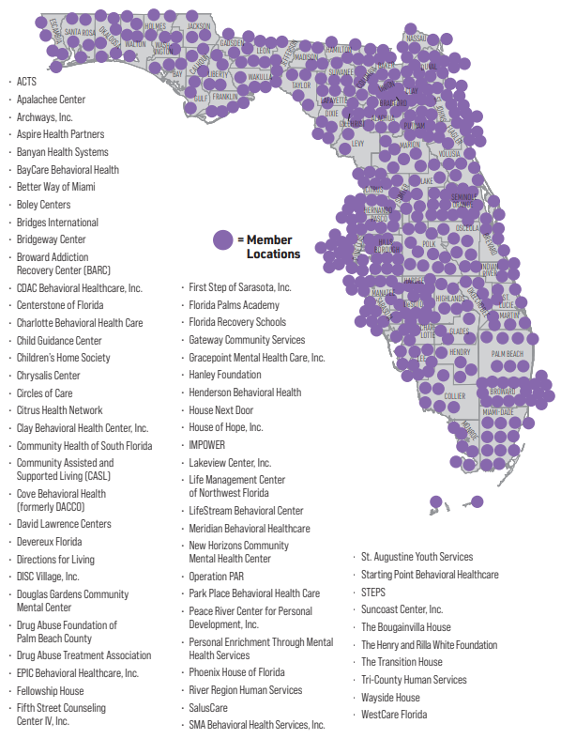
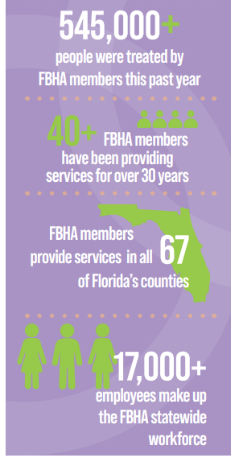

Slide 4
Advancing Florida’s System of Care
Implemented innovative models and evidence-base practices
CAT, FACT, FIT, and MRT
Expanded Medication-Assisted Treatment and enhanced provider prescribing capacity
Advocated to safeguard and expand central receiving system with recurring funding

Slide 5
Advancing Florida’s System of Care
System transformation: integrating behavioral health and primary care (CCBHC)
Implementing measurement-based care
Promoting value-based purchasing in managed care
Advocating for policy and funding solutions to address behavioral health workforce crisis
Strengthening community crisis response system and links to ongoing treatment
Enhancing services and infrastructure in the fight against the opioid epidemic

Slide 6
Working Together to Improve the System
FBHA values its partnerships with state agencies and other stakeholders
Innovating together is the key to success

