Slide 1
Ways
Managing Entities
10
are Transforming Behavioral Health Care
Presented by Natalie Kelly, CEO

Slide 2
Presenters:
Alan Davidson
Central Florida Behavioral Health
Network
Dr. Christine Cauffield
LSF Health Systems
John Newcomer, M.D.
Thriving Mind South Florida
Silvia Quintana
Broward Behavioral Health Coalition
Commissioner representing the Managing Entities:
Ann Berner
Southeast Florida Behavioral Health Network

Slide 3

Payment for Behavioral Health Services
Complex system utilizing the private market
Private Pay
Private Insurance
Medicaid
Special coverage: Veterans, School MH (Dept of Education)
Other resources (local, DJJ, DoC, DCF, DoEA, Opioid)
Managing Entities’ Safety Net System

Slide 4
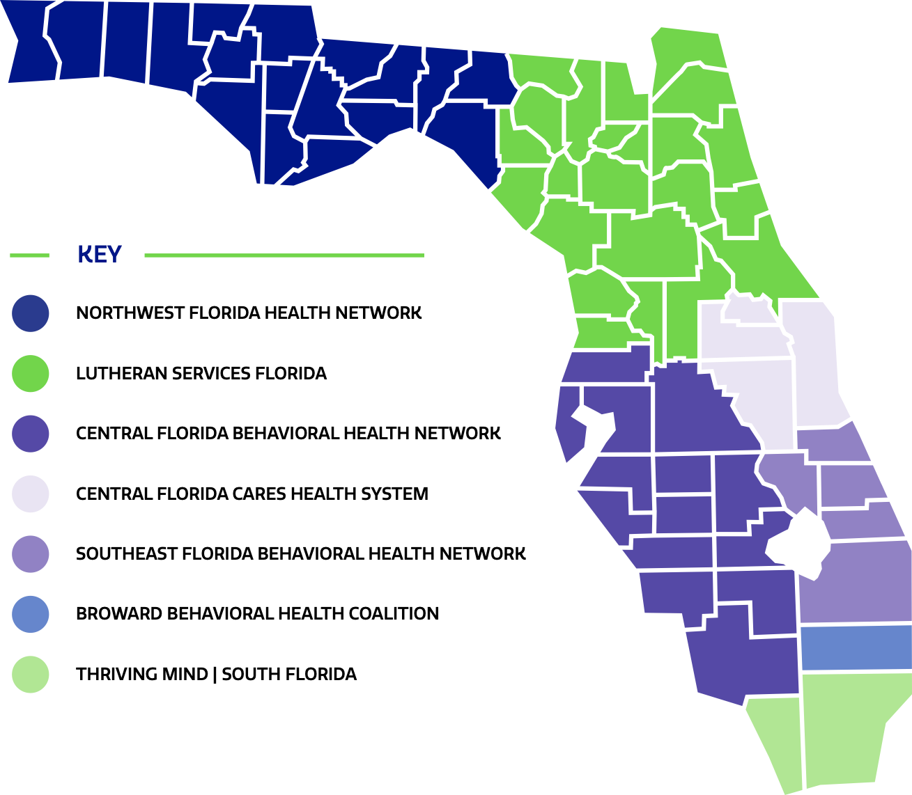

What are Behavioral Health Managing Entities?
Created by the Legislature to develop a behavioral health safety net system and to serve the uninsured and underinsured
Statewide in 2013
DCF contracts with 7 MEs
Private, Nonprofit
Community driven

Slide 5
What do
Managing Entities Do?
Florida TaxWatch April 2023
“Nationally accredited Managing Entities implement evidence-based programs, increase service capacity, and monitor and hold accountable a network of local providers for the services contracted.
Managing Entities manage, administer and ensure accountability and transparency of state and federal funds for mental health and substance misuse services within a network of approximately 300 providers.

Slide 6
Services Provided in the Managing Entity Network
Crisis Stabilization
Inpatient Services
Outpatient Services
Community Support Services
Specialty Programs for Children and Families
Detox, Baker Act, Marchman Act assessment and treatment
Psychiatric and substance misuse treatment for children and adults
Mental health and substance misuse counseling, Medication-Assisted Treatment, day treatment, drop-in centers, FACT teams
Case management, care coordination, respite, supported employment, supported housing, specialty courts (Mental Health Court and Drug Court, Criminal Justice Reinvestment Grants), 2-1-1, 9-8-8, clubhouses, teletherapy, suicide prevention, peers, and many more
CAT teams, FIT teams, Mobile Response Teams

Slide 7
Population Served —Uninsured, Underinsured
Authority of specialized populations:
We support those who cannot manage their own care
Individuals with a
Serious Mental Illness
Injecting drug users
Individuals with Opioid use disorders including IV injecting
Pregnant women with substance use disorders
Families in the foster care system
Individuals who are Chronically Homeless
Veterans
Students/Families
Youth in the Juvenile Justice System
Individuals involved in criminal justice

Slide 8
10
Focus on Floridians by tailoring services to local needs
Support stronger families.
Invest in services to help Floridians get back on their feet and to live life to their fullest potential.
Offer a holistic approach by funding wrap-around services that may not covered by other resources.
Local MEs Board of Directors / management / stakeholders
Community determined services in response to the unique needs of community and individuals.
Needs assessment every year to determined needed services in the community.

Slide 9
9
Manage sustainable and viable network of community base organizations and key stakeholders
Manage approx. 300 community-based organizations around the state that provide a broad and diverse array of services:
    Traditional: community mental health providers
    Nontraditional: child welfare, school districts, law enforcement, veterans, faith-based, telehealth, supportive housing, supportive employment, peers, transportation, and prevention, etc.
Most providers are accredited or meet accredited standards

Slide 10
Safeguard our network:
    Pay providers immediately
    Do NOT compete with providers: MEs do not provide direct services. MEs contract with providers because they are the experts in providing services; MEs are the experts in managing a system of care.
      Offer trainings, capacity building, technical assistance.
Coordinate an immediate crisis response to community disasters: Hurricanes Ian and Michael * COVID-19 * Marjory Stoneman Douglas * Pulse Night Club * Miami Beach condo collapse.
Provide a stable system - Two major interventions:
        Continuity of operations
        Financial viability

Slide 11
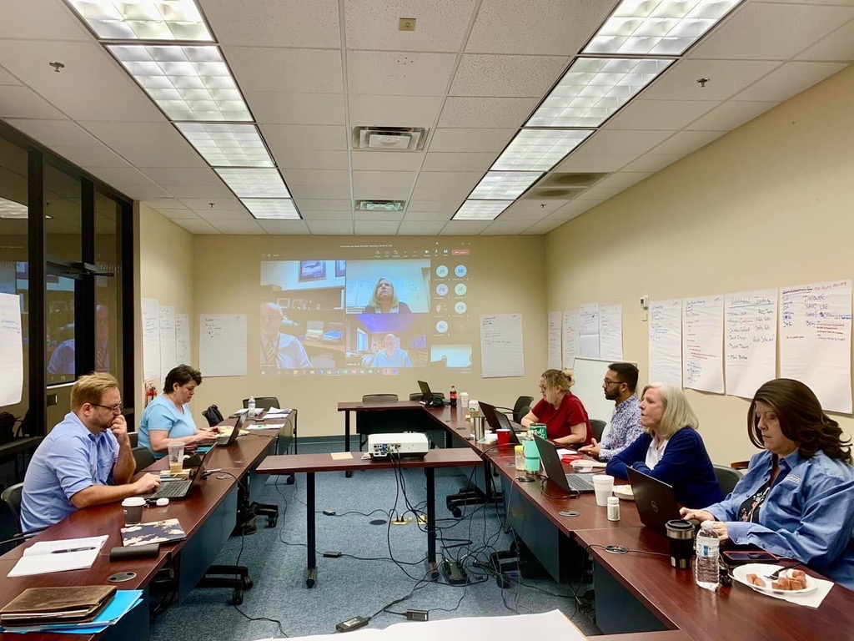

Example: Hurricane Ian
Immediately launched a Recovery Operation Center (ROC).
Lead mtgs twice a day with our network to identify needs:
  power, workforce, supplies.
Leveraged relationships for resources: Senator Rouson/leaders, FAME, providers not impacted.
Deployed additional support from other MEs: 3 Managing Entities’ staff drove staff back/forth to support; NWFHN created telehealth utilizing former Hurricane Michael victims as peers to those negatively impacted by Hurricane Ian. (Sec Harris)
Donation drives by staff.
Great partnership with DCF, immediate response.
All but one organizations in our network were up and working within two weeks.

Slide 12
8
Break silos:
Work across systems of care
Silos are major barriers to a system of care and lead to gaps in services. MEs are committed to eliminating silos.
Partner with other systems including child welfare, housing, law enforcement, local governments, veterans, and school districts
Examples: Pasco, Hillsborough & Broward contract with MEs to ensure School Districts- School Mental Health program.
      Assuring high risk children receive timely services with feedback to their school.
      Help student connect with their managed care.
      Student receive services; refer to resources; family services

Slide 13
7
Assure access to services:
No wrong door model
Direct Access to Behavioral Healthcare Providers
Community and Self Referrals to Various Portals of System Entry
911 – Crisis Intervention Teams (CIT), other special programs
988 – formerly National Suicide Prevention Lifeline, related crisis lines
Mobile Response Teams (MRT) – trained clinical staff

Slide 14
Suicide In the United States
130 suicides per day in the United States on average (2018-2022)
According to the Centers for Disease Control (CDC), suicide was the twelfth leading cause of death in the United States in 2021, claiming more than 45,900 lives
Estimated 1.2 million people attempt suicide annually
Suicide is the second leading cause of death in children ages 10-14 and young adults ages 24-34
Stone DM, Mack KA, Qualters J. Notes from the Field: Recent Changes in Suicide Rates, by Race and Ethnicity and Age Group — United States, 2021. MMWR Morb Mortal Wkly Rep 2023;72:160–162. DOI: http://dx.doi.org/10.15585/mmwr.mm7206a4

Slide 15


A report of the Committee on Psychiatry and the Community for the Group for the Advancement of Psychiatry
Jacqueline Maus Feldman MD co-chair
Ken Minkoff, MD co-chair
Published by the National Council for Behavioral Health

Slide 16











Alignment of crisis services toward common goals care in the least restrictive (and least costly) setting
Easy access for police = Connection to care instead of arrest
(Sequential Intercept Model 0 and 1)
Result:
Decreased Use
of jail, ER, hospital
911 integration
Collaborative responses
5-10 min drop-off
No refusal policy
Inpatient
Post-Crisis Care
Person
in
Crisis
Crisis Line
988
Mobile
Crisis
Acute Crisis
Facilities
60-70% discharged
to the community
Post-crisis wraparound
Crisis Residential
& Crisis Respite
80% resolved
on the phone
70% resolved
in the field
85% remain stable
in community-based care > 45 days
LEAST Restrictive = LEAST Costly
Services are easily accessible with a no-wrong door culture across the continuum, e.g., walk-ins at crisis facilities, police or mobile drops-offs to crisis residential, etc.
Adapted from: Balfour ME, Hahn Stephenson A, Delaney-Brumsey A, Winsky J, & Goldman ML (2020). Cops, Clinicians, or Both? Collaborative Approaches to Responding to Behavioral Health Emergencies. Psychiatric Services. Epub ahead of print Oct 20, 2021. https://ps.psychiatryonline.org/doi/10.1176/appi.ps.202000721. (Community stabilization rates are based on FY2019 data from the Southern Arizona region and were provided courtesy of Johnnie Gasper at Arizona Complete Health/Centene)
Adapted from: Balfour ME, Hahn Stephenson A, Delaney-Brumsey A, Winsky J, & Goldman ML (2020). Cops, Clinicians, or Both? Collaborative Approaches to Responding to Behavioral Health Emergencies. Psychiatric Services. Epub ahead of print Oct 20, 2021. https://ps.psychiatryonline.org/doi/10.1176/appi.ps.202000721.
(Community stabilization rates are based on FY2019 data from the Southern Arizona region and were provided courtesy of Johnnie Gasper at Arizona Complete Health/Centene)

Slide 17

De-escalation
Safety Planning
Follow up
Referral to MRT or 911 for Voluntary/Involuntary Dispatch
Abuse Reporting
Connection to Community Resources

Slide 18
6
Leaders at “payer-level”
care coordination
Care Coordination – Payer-level vs. Provider-level
Payer-level Care Coordination improves access to care.
Linkage to needed services based on individual need.
Available services include a multi-provider system of care.
Available resources include ME partnerships with key stakeholders, e.g. housing, schools, law enforcement.

Slide 19




Care Coordination Collaboration:
Payer and Provider Data Sharing
Schools
988/MRT/Fire Rescue
(trained helpline operators supervised by licensed clinical social workers)
Law
Enforcement
Payer-level Managing Entity Care Coordinators
System Supervision and Management
Provider-level Care Coordinators & Peers
PROVIDER 1
Provider-level Care Coordinators & Peers
PROVIDER 2
Provider-level Care Coordinators & Peers
PROVIDER 3
Provider-level Care Coordinators & Peers
PROVIDER 4
Provider-level Care Coordinators & Peers
PROVIDER 5

Slide 20

One of the greatest challenges facing the mental health system is care coordination… too many times, service providers do not work together. It is an approach that includes coordination at the funder level, through data surveillance, information sharing across regional and system partners, partnerships with community stakeholders (i.e. housing providers, judiciary, primary care, etc.).
Payer-Level
Care Coordination

Slide 21

Provider-Level Care Coordination Study
Program effects on hospital re-admission were not statistically significant
Primary outcome measure was 180-day re-admission rate
Commentary (Dr. Jeffrey Brenner - Camden Coalition)
  “Largely lacking housing, addiction, and mental health services”
  “The bottom line is, we built a brilliant intervention to navigate people to nowhere”

Slide 22
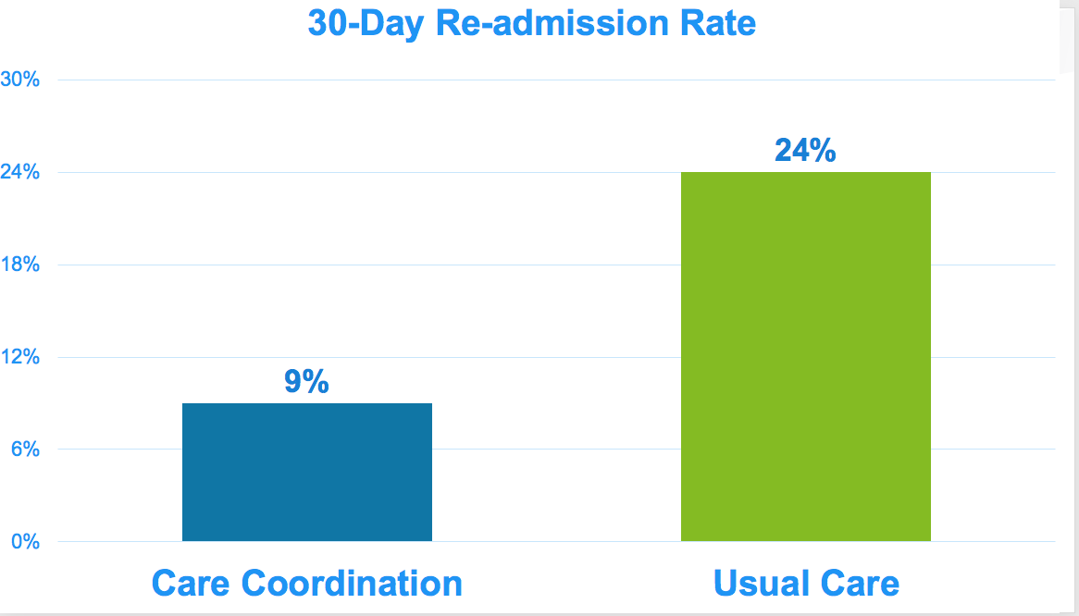
Proctor SL, Gursky-Landa B, Kannarkat JT, Guimaraes J, Newcomer JW. Payer-Level Care Coordination and Re-admission to Acute Mental Health Care for Uninsured Individuals. J Behav Health Serv Res. 2022 Jul;49(3):385-396. doi: 10.1007/s11414-022-09789-1. Epub 2022 Feb 22. PMID: 35194730.

Slide 23
5
Maximize resources:
Diversify funding streams to increase services
  Largest expansion of SAMH services: increased 84% from FY 2015-16 through FY 2022-23.
  Masters at blending and braiding funds, and leveraging public-private partnership e.g. Clubhouses
  Single funders for many programs (no private nor Medicaid) such as: Diversion of state hospitals, MRTs, CAT, FIT, SA prevention

Slide 24

Secure outside grants for additional services that have improved service delivery for our network:
    $30 million FY 22-23
    $128,013,707 past 5 years
Florida TaxWatch
“Managing Entities (MEs) ensure data driven reimbursement and serve as a payment sorting mechanism to optimize and protect state dollars. Additionally, MEs provide cost efficiencies through decreased administrative costs and their unique ability to work with providers and communities to leverage more services for less money.”

Slide 25
4
Champions accountability and transparency
Accountability and transparency sets ME model apart from other models.
Good fiscal stewards of taxpayer dollars.
Funding is matched to performance.
Note: Managing Entities have also been working to eliminate “red tape” towards a more flexible payment structure and streamline reporting process.

Slide 26
Dedicated to own accountability and transparency
All MEs are nationally accredited: CARF, COA
Operate with an average of 3.7% (July 2023)

Slide 27
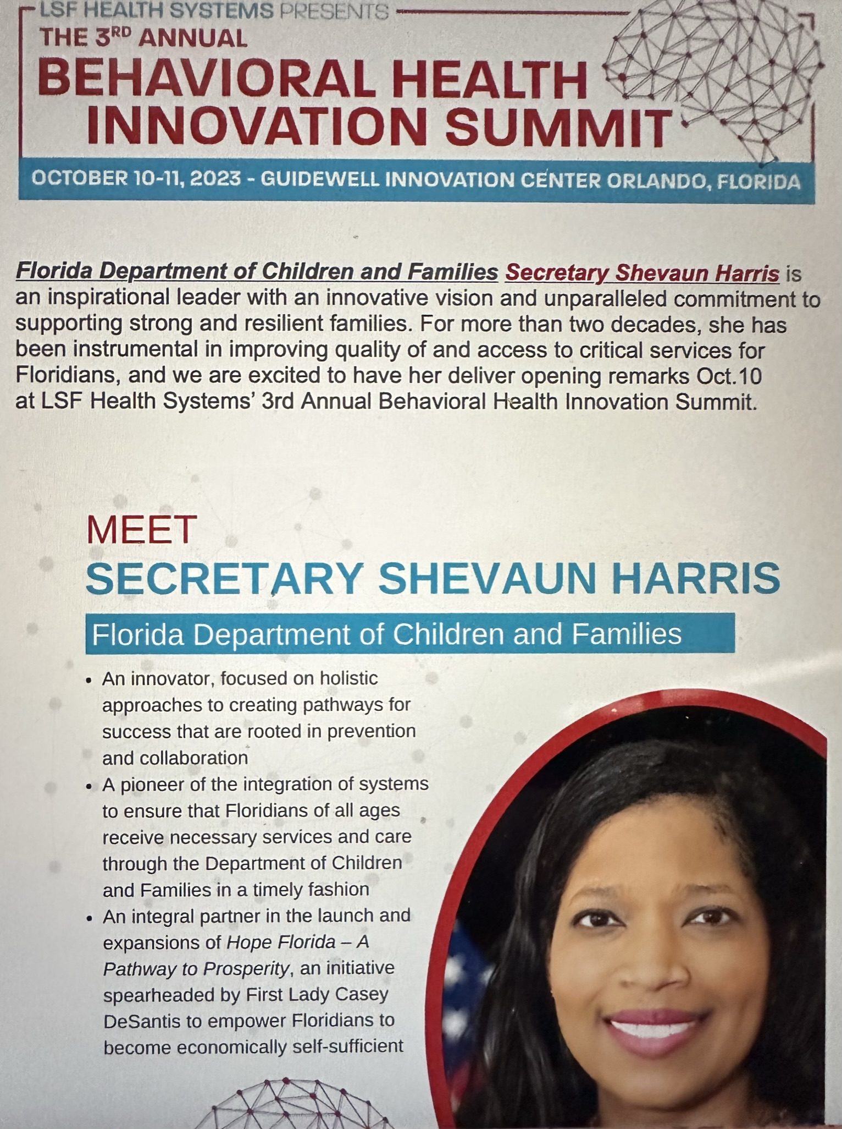

3
Foster an environment that is nimble, unique, and innovative
Drive for innovation that will encourage bold changes
Create pilot programs; share successful outcomes with MEs to implement in their region.
Attempt to serve individuals in rural and under served areas. Example: Uplift
Continue cutting edge and unique services to serve more individuals.
Example: Innovation Summit

Slide 28
2
Power of Peers
Peers are the linchpin for quickly connecting to those in need of recovery services.
Provide peer training to increase the availability of certified recovery peer specialists.
Example: Secured grants to expand training opportunities and sites for peers

Slide 29
1
Support stronger families:
Focus on Children
Goals: promoting safety, preventing trauma, intervening with youth in crisis.
  CAT - Community Action Teams
  FIT - Family Intensive Treatment
  MRTs- Mobile Response
  HB 945 (2020) creating a coordination of care for children.
  Children Care Coordination

Slide 30
Children & Youth Baker Act in Florida
According to Southern Poverty Law Center, in Florida more than 37,000 children and youth are “Baker Acted” yearly
Children as young as 5 years old are being handcuffed by police to psychiatric hospitals
Baker Act has become the “normal” behavioral management tool in Florida classrooms, schools and foster care facilities.
This is used even with:
  children with developmental disabilities including autism
  Children with diagnosed mental illness who could be treated at a less restrictive setting
  Children with disruptive, merely disobedient behaviors
Baker Acts are at times an inappropriate intervention and is being used excessively.

Slide 31
BBHC C-CCT
To address the Baker Act crisis, BBHC developed the Children Care Coordination Teams (C-CCT) which serves children and their families in the process of transitioning from specific high levels of care until they are effectively connected with services and support needed to transition. The C-CCT will ensure that the children are effectively connected with the services and supports they need to transition successfully from higher levels of care to effective community-based care avoiding frequent readmissions.
Care Coordination connects systems including behavioral health, primary care, peer and natural supports, housing, education, vocation, and the justice systems. It is time-limited, with a heavy concentration on engaging, educating and empowering the family served and provides a single point of contact until a family is adequately connected to the care that meets their needs.
It will also assist the families of these children to support and guide them through the process. This includes services and supports that affect both the children and family’s well-being, such as primary physical health care, housing, and social connectedness.

Slide 32
Children’s Care Coordination Team’s Focus
Youth discharged from a Baker Act who do not follow through with discharge plan
Youth returning from a State Inpatient Psychiatric Placement (SIPP) who do not have services in place
Youth diverted from a Baker Act by MRT who do not follow through with recommendations

Slide 33
Children’s Care Coordination Teams (C-CCT) Focusing on Transitions from Receiving Facilities
819 youth discharged from a Baker Act have been connected to C-CCT
49% of those youth had Medicaid and were connected to their MMA behavioral health care manager
100% youth did not have readmissions while enrolled in C-CCT
78% of youth connected to C-CCT did not have a readmission a year after discharged from C-CCT

Slide 34
Children’s Care Coordination Teams (C-CCT) Focusing on Transitions SIPP
SIPP Care Coordination has been able to work with 28 families
100% of those families that had Medicaid and were linked with their MMA Care Coordinator
100% of youth connected to SIPP Care Coordination did not have a readmission to a SIPP after warm handoff to community-based care

Slide 35

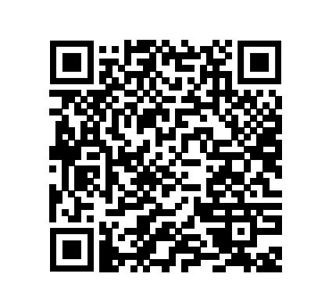
More Information
Natalie Kelly, Chief Executive Officer
Florida Association of Managing Entities
122 S. Calhoun St.
Tallahassee, FL 32301
natalie@flmanagingentities.com
(850) 570-5747

