Slide 1

Commission on Mental Health and Substance Use Disorder
August 15, 2023

Slide 2











FLORIDA’S HOSPITAL SYSTEM
320 Hospitals [71,000 Beds]
228 Community Acute Care
[41 Teaching, 24 Rural, 4 Children, 36 Trauma]
37 Behavioral
28 Rehabilitation
27 Long-Term Acute Care
297,197 FTEs
2.5 Million Inpatient Admissions
10.3 Million ED Visits
216,550 Births
$1.6 Billion Charity Care

Slide 3






ROLE OF FHA IN STRENGTHENING AND BUILDING THE behavioral HEALTH system
FLORIDA HOSPITALS in BEHAVIORAL HEALTH AT A GLANCE
Data represents Florida Hospitals that provide behavioral health services.
37
Behavioral Health Hospitals
78
Hospitals are Baker Act Receiving Facilities
27
General hospitals
(separate psychiatric units)
108
Outpatient Mental Health Facilities
149,912
Emergency
Department visits
205,712
Inpatient Admissions
71,000
Available Beds out of
320 Hospitals
58
(1,360 Licensed Beds)
Crisis Stabilization Units
8,030
Total Psychiatric Beds

Slide 4



Behavioral health—inpatient psychiatric beds per children population
708 Beds
FOR
4.1 Million
Children
OR
🔴 17.1 BEDS
—PER—
⚫100,000 Children
ONE DOT = 10 CHILDREN

Slide 5

Behavioral health—inpatient psychiatric beds per Adult population
7,322 Beds
FOR
17.4 Million
Adults
🔴 40.8 BEDS
—PER—
⚫100,000 ADULTS
ONE DOT = 10 ADULTS
OR

Slide 6
Building a Full Continuum of Behavioral Health

Slide 7
Health Care Expectations
TIMELY
ACCESS
HIGH-QUALITY
ACCOUNTABILITY
GREAT OUTCOMES
EFFICIENT UTILIZATION
COST EFFECTIVE
SUSTAINABILITY
MODERN

Slide 8
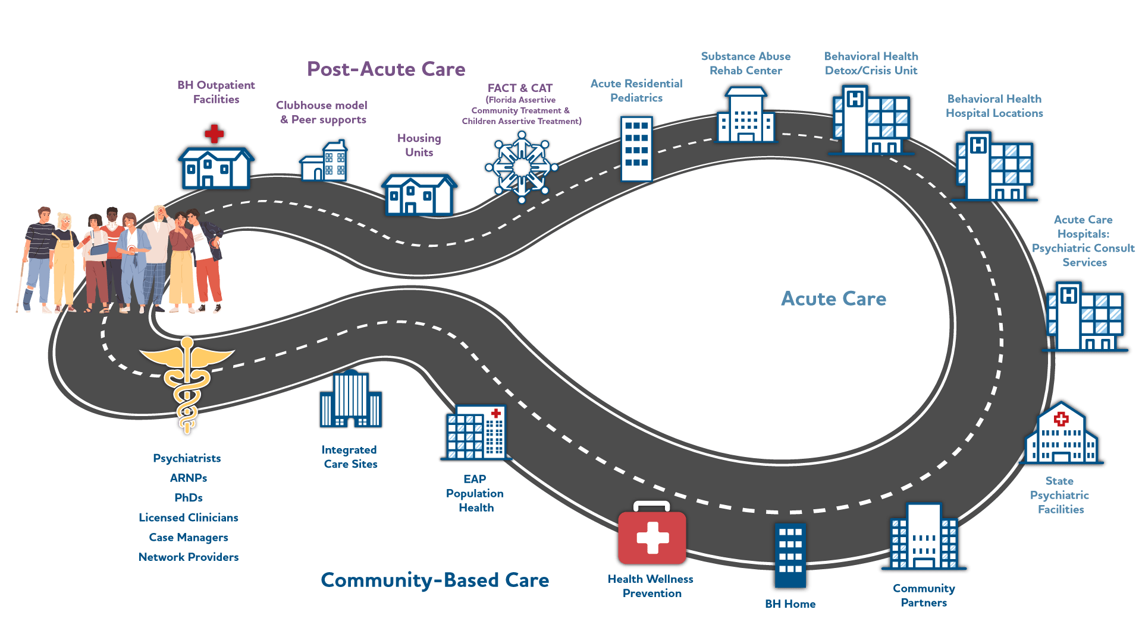
Continuum of Care model
right care,
right time,
right place

Slide 9
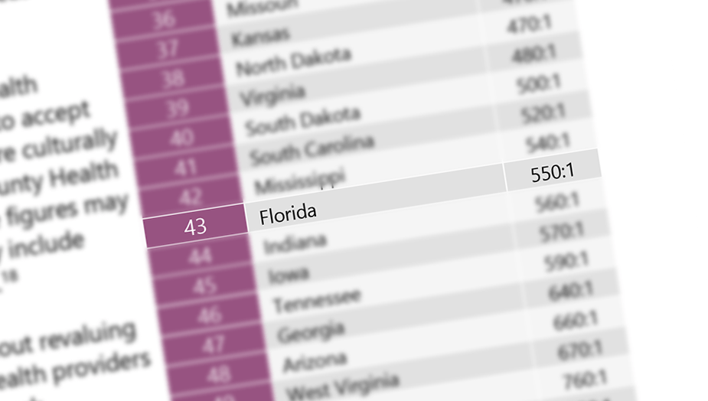
Behavioral health—Workforce
Florida Ranks
43rd in Mental Health Workforce Availability
State Ratios of the
Mental Health Workforce
#1 STATE
140:1
#43 FLORIDA
550:1
Source: Mental Health America: 2023 State of Mental Health in America Report

Slide 10
FLORIDA by the numbers
FLORIDA’S AGING POPULATION
FLORIDA’S
POPULATION
22,276,132
Nearly 20% of the population is Age 65 and up!
+737,945 | Increase from 2020–2022
FLORIDA INSURANCE COVERAGE
Uninsured
Non-Group
Military
Florida is the
3rd largest state
Medicaid
v
Employer
Medicare

Slide 11












COVID-19 IMPACT ON MEDICAID ENROLLMENT IN FLORIDA
Medicaid enrollment has increased by over 1.9 million recipients
Since the start of the COVID-19 pandemic—March 2020, Medicaid enrollment is 5.7M
1 in 4 people in Florida are on Medicaid
TOTAL ENROLLMENT

Slide 12
Medicaid in Mental Health
Medicaid is the largest payer for mental health services in the United States
Source: Commonwealth Fun-Behavioral Health Care in the United States & Agency for Healthcare Administration Discharge Data

Slide 13



Medicaid Enrollment & Children
66%
of Children 18 and under in Florida
are enrolled in Medicaid & CHIP
Out of all Medicaid enrollees, 59% are children
*Source: SFY 2019-2020 data (AHCA Medicaid Eligibility Presentation)

Slide 14




Behavioral health
Percentage Of Children With A Major Depressive Episode That Did Not Receive Treatment
Florida Average 61.8%
Florida ranks
38th worst in
the country
National Average
59.8%
Source: Mental Health America: 2023 State of Mental Health in America

Slide 15
2021 MENTAL HEALTH inpatient ADMISSIONS STATEWIDE VS Broward & Flagler
STATEWIDE
Population: 21,538,226
BROWARD
Population: 1,944,376 (9.0%)
FLAGLER
Population: 126,705 (0.6%)
205,712
Mental Health Admissions in 2021
+7,214 (3.6%) since 2020
7.3%
of all statewide inpatient admissions
20,360
Mental Health Admissions in 2021
+947 (4.9%) since 2020
9.2%
of all Broward inpatient admissions
37
Mental Health Admissions in 2021
-2 (-5%) since 2020
0.4%
of all Flagler inpatient admissions
PAYER DISTRIBUTION
Source: AHCA Hospital Discharge Data 2021

Slide 16
2021 mental health inpatient admissions – adults
STATEWIDE
Adults represent 84.0% of all admissions
BROWARD COUNTY
Adults represent 79.7% of all admissions
FLAGLER COUNTY
Adults represent 100% of all admissions
2021 Admissions
172,861
+1,676 (1%)
2020 Admissions
171,185
2021 Admissions
16,235
+50 (.3%)
2020 Admissions
16,185
2021 Admissions
37
-2 (-5%)
2020 Admissions
39
Top 5 reasons for a behavioral health admission 2021
Major depressive disorder, recurrent, severe
5,744 Admissions
492 Admissions
0 Admissions
Unspecified psychosis not due to a substance
3,090 Admissions
214 Admissions
0 Admissions
Schizoaffective disorder, bipolar type
2,781 Admissions
359 Admissions
0 Admissions
Bipolar Disorder, unspecified
2,265 Admissions
178 Admissions
0 Admissions
Schizophrenia, unspecified
2,381 Admissions
494 Admissions
0 Admissions
Statewide
Broward
Flagler
Source: AHCA Hospital Discharge Data 2021

Slide 17
2021 mental health inpatient admissions – children
STATEWIDE
BROWARD COUNTY
FLAGLER COUNTY
Children represent 16.0% of all admissions
Children represent 20.3% of all admissions
Children represent 0% of all admissions
2021 Admissions
32,827
+5,553 (20%)
2020 Admissions
27,274
2021 Admissions
4,123
+897 (28%)
2020 Admissions
3,226
2021 Admissions
0
(-)
2020 Admissions
0
Top 5 reasons for a behavioral health admission 2021
Disruptive mood dysregulation disorder
6,507 Admissions
1,007 Admissions
0 Admissions
Major depressive disorder
6,263 Admissions
1,045 Admissions
0 Admissions
Unspecified mood (affective) disorder
1,132 Admissions
194 Admissions
0 Admissions
Bipolar Disorder, unspecified
1,041 Admissions
113 Admissions
0 Admissions
Oppositional defiant disorder
630 Admissions
12 Admissions
0 Admissions
Statewide
Broward
Flagler
Source: AHCA Hospital Discharge Data 2021

Slide 18
Top 10 Behavioral Health inpatient diagnoses Q3 2021 to q3 2022
STATEWIDE
BROWARD COUNTY
FLAGLER COUNTY
2022 Q3 Admissions
50,739
+299 (0.6%)
2021 Q3 Admissions
50,440
2022 Q3 Admissions
5,092
+91 (1.8%)
2021 Q3 Admissions
5,001
2022 Q3 Admissions
11
+7 (175%)
2021 Q3 Admissions
4
Top 5 reasons for a behavioral health admission in Q3 2022
Major depressive disorder, recurrent, severe
5,744 Admissions
492 Admissions
0 Admissions
Unspecified psychosis not due to a substance
3,090 Admissions
214 Admissions
0 Admissions
Schizoaffective disorder, bipolar type
2,781 Admissions
359 Admissions
0 Admissions
Bipolar Disorder, unspecified
2,265 Admissions
178 Admissions
2 Admissions
Schizophrenia, unspecified
2,381 Admissions
494 Admissions
0 Admissions
Statewide
Broward
Flagler
Source: AHCA Hospital Discharge Data 2021/2022

Slide 19
Emergency department 2021 data – statewide vs BROWARD & Flagler
OF THE 8.6M PATIENTS WHO VISITED THE ED STATEWIDE, 149,912 PATIENTS(1.7%) VISITED BECAUSE OF A BEHAVIORAL HEALTH CONDITION IN 2021
UP 13,317 (+10%) PATIENTS SINCE 2020
OF THE 149K MENTAL HEALTH EMERGENCY DEPARTMENT VISITS, 14,664 PATIENTS (9.8%) VISITED A BROWARD COUNTY EMERGENCY DEPARTMENT
UP 1,343 (+10%) PATIENTS SINCE 2020
OF THE 149K MENTAL HEALTH EMERGENCY DEPARTMENT VISITS, 394 PATIENTS (0.26%) VISITED A FLAGLER COUNTY EMERGENCY DEPARTMENT
UP 1 (+0.25%) PATIENTS SINCE 2020
PAYER DISTRIBUTION
Source: AHCA Hospital Discharge Data 2021

Slide 20
behavioral Health Emergency Department Visits - Q3 2021 to q3 2022
STATEWIDE
BROWARD COUNTY
FLAGLER COUNTY
2022 Q3 Visits
36,771
-1,158 (-3%)
2021 Q3 Visits
37,929
2022 Q3 Visits
3,456
-225 (-6%)
2021 Q3 Visits
3,681
2022 Q3 Visits
81
-5 (-6%)
2021 Q3 Visits
86
Top 3 Admissions (as a %) by Diagnoses in 2022 Q3
Anxiety disorder
23%
24%
44%
Alcohol abuse with intoxication
16%
12%
23%
Depression
8%
14%
2%
Statewide
Broward
Flagler
Source: AHCA Hospital Discharge Data 2021/2022

Slide 21
Potentially preventable mental health emergency department visits
Depression and Anxiety Disorders
Substance Use Disorders
Suicidal Ideation or Attempts
Childhood Behavioral and Emotional Disorders
Post-Traumatic Stress Disorder (PTSD)
Eating Disorders
Stress-Related Disorders
STATEWIDE
BROWARD
FLAGLER
2021 Visits
164,876
+16,610
2020 Visits
148,266
2021 Visits
15,877
+1,035
2020 Visits
14,842
2021 Visits
342
-18
2020 Visits
360
1.9%
Of all ED visits
2.3%
Of all ED visits
1.0%
Of all ED visits
11.2%
Increase in potentially preventable Mental Health visits since 2020
7.0%
Increase in potentially preventable Mental Health visits since 2020
5.0%
Decrease in potentially preventable Mental Health visits since 2020
Source: AHCA Hospital Discharge Data 2021

Slide 22
Mental Health Spending per Capita by state
$362.75
$251.12
$174.98
$113.37
$36.05
$45.23
Source: American Addiction Centers: Mental Health Spending By State Across the US

Slide 23
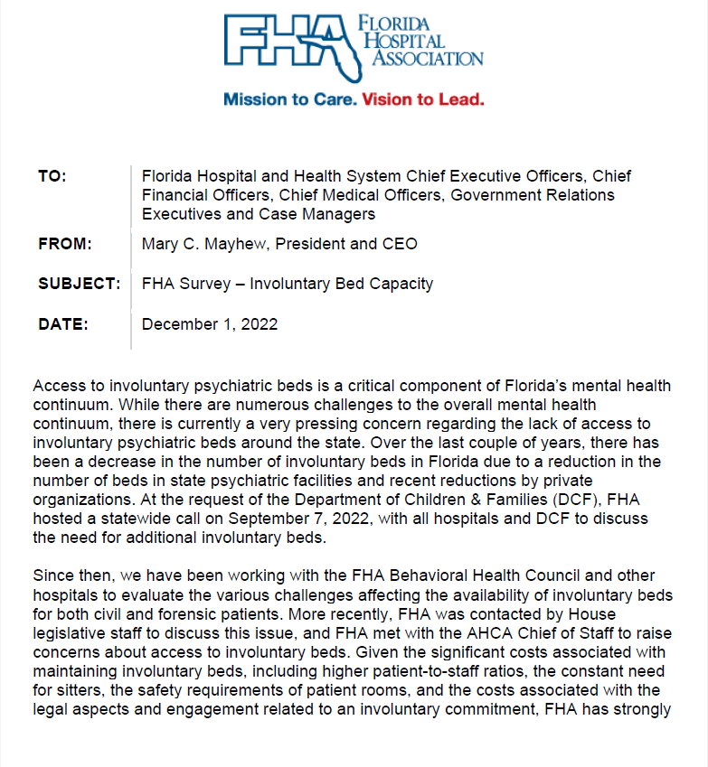
Behavioral health
Involuntary Bed Capacity
Access to involuntary psychiatric beds is a critical component of Florida’s mental health continuum.
There is currently a very pressing concern regarding the lack of access to involuntary psychiatric beds around the state.
Over the last couple of years, there has been a decrease in the number of involuntary beds in Florida due to a reduction in the number of beds in state psychiatric facilities and recent reductions by private organizations.
FHA developed a survey to capture the statewide capacity of involuntary beds and the performance of the system as it relates to occupancy and cost for the most recent twelve-month period.

Slide 24
Behavioral health- Involuntary Bed Survey
Baker Act Facilities
Admissions & Cost | Average Cost Reimbursed
Involuntary Admissions 74,197 | Medicaid 42%
Average per discharge cost $7,741 | Medicare 60%
 | Commercial 61%
Non-Baker Act Facilities
Admissions & Cost | Average Cost Reimbursed
Involuntary Admissions 3,537 | Medicaid 42%
Average per discharge cost $6,808 | Medicare 60%
 | Commercial 61%
Facilities w/Psychiatric Beds
Have Psychiatric Beds | Average Occupancy Rate | Average cost reimbursed
Total Response Beds 14,612 | Total 67% | Medicaid 42%
Total Beds in Florida 22,122 | Adult 63% | Medicare 56%
% of beds 40% | Children 49% | Commercial 72%

Slide 25
Investment in Behavioral Health

Slide 26

State Legislature Investment in Behavioral Health
There is an overall
24% increase
of DCF’s total budget and a
47% increase
to the Community Substance Abuse and Mental Health Services from last year
29.7M increase
To the rate for Medicaid behavioral health services
Central Receiving Facilities - $31M additional investment from the existing 19.8M for facilities that assess and evaluate voluntary and involuntary admissions for mental health or substance use disorder. FHA supports this model to provides a coordinated system of entry for an array of behavioral health services.
State Mental Health Facilities Forensic Beds - $77.9M to sustain and expand forensic bed capacity to support mental health facilities and reduce the waitlist for admission. A substantial increase from last year $20million investment.
Enhance Medicaid Reimbursement Rates – AHCA’s budget includes a $29.7M rate increase for Medicaid behavioral health services in the Medicaid Community Behavioral Health Fee Schedule , effective October 1.
Community-Based Mental Health and Substance Abuse in Block Grants - 156.3M provided
Opioid Treatment, Prevention, and Recovery from Opioid Settlement Funds- $173.5 M & 22 positions (last year $35.9Min Opioid funding)
Maternal Substance Abuse Services- $10M (consistent from last year) for the expansion of services for pregnant women, mothers and affected families.
Continued investment into community response teams: FACT, CAT, FIT, and mobile response teams. An additional 12M for FIT Teams and Florida Assertive Community Treatment (FACT) Teams.
Homeless Housing funding increased 74%.
There is proviso that requires AHCA to collaborate with DCF and Community Behavioral Health Providers to develop a plan to implement certified community behavioral health clinics as a Medicaid covered service.

Slide 27




Evidence-Based Teams & Hospitalization
Increases access to behavioral health care services.
Improves health outcomes of patients with mental illness or substance use disorders.
Reduces the costs to the patient
Decrease the number of high–utilizers in hospital emergency rooms
Since the inception of assertive community treatment(ACT) nearly 30 years ago, research has repeatedly demonstrated that it reduces hospitalization, increases housing stability, and improves the quality of life for individuals with SMI.
Source: Substance Abuse and Mental Health Services Administration- ACT Team Evidence

Slide 28


Expanding these services will help patients achieve the right care, in the right setting, at the right time.
Community Mental Health
Expanding Florida's commitment to the Community Mental Health models will help secure crucial behavioral health treatment for Floridians who need it most. Florida currently ranks 43rd in the U.S. with a behavioral health patient-to-provider ratio of 550:1.
Community Mental Health Models like Certified Community Behavioral Health Centers (CCBHCs) provide 24/7 coordinated comprehensive behavioral health services to communities.
Team Leader
Peer Specialist
Community Mental Health Teams
Florida Assertive Community Treatment (FACT)
Community Action Teams (CAT)
ARNP
Substance Abuse Specialist
COVID-19 increased the number of Floridians experiencing mental illness. Adequately funding these programs will address this increase and improve the overall health of our state.
Mobile Response Teams (MRT)
Family Intensive Treatment (FIT)
Registered Nurse
Vocational Specialist

Slide 29

The Clubhouse Model
A clubhouse is an integrated approach to support the recovery of people living with serious mental illness (SMI) by promoting greater integration across service providers.
The Clubhouse model provided access to wrap-around services that include crisis–invention services, treatment, employment, housing, counseling, education, and daily meals.
The concept of a clubhouse, which was pioneered by Fountain House in the 1940s — starts with the idea that “community is therapy.”
17
Clubhouse Models in Florida
Source: Fountain House Clubhouse Model

Slide 30


Slide 31









HIE: True Health Information Exchange
Healthcare Communities
Hospitals
Hospital Labs
Patients
Health information technology can help to improve behavioral health care and can further enable care coordination and integration, increase information sharing, and support prevention, treatment, and recovery activities. Access to and the exchange and use of behavioral health information as part of routine care can help to improve continuity in care services and support efforts toward achieving an interoperable health care system across the continuum.
Physician Practices
Health
Information
Exchange
Community Labs
National Health Information Network
Pharmacies
National Partners
Regional Hospitals
Health Plans
Regional Partners
Physician Practices

Slide 32
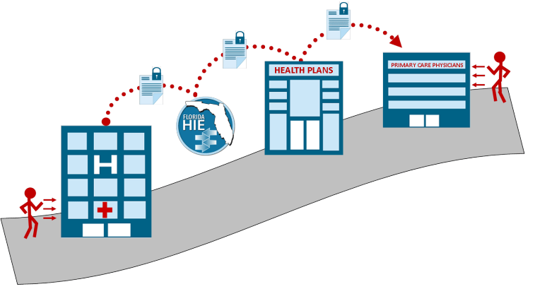
Florida Health Information exchange
Barriers to Florida HIE
Voluntary usage of the ENS system
No mandate for a unified data-sharing system
Technology is challenged in rural areas because of expenditure outlay.
Delayed updates by providers
Only reports patient encounters– no detailed report of a patient’s medical history, hospital admission, or primary care visit.
Behavioral Health providers lack the funding opportunities to participate in HIE programs.
Only 3.69% of Behavioral Health providers currently participate in FHIE
ENS
ENS
ENS
97%
86%
Acute Care Hospital Beds
Rehab Hospital Beds
Behavioral health providers’ participation varies due to privacy concerns.
Source: Florida HIE Services: ENS Participants

Slide 33
State & regional Quality Collaboratives
Advance the use of HIE through engagement with stakeholders, including hospitals, ambulatory practices, behavioral health providers, public health, organizations, and other State agencies
By developing state & regional collaboratives with HIE
  Create and implement up-to-date privacy and security requirements for HIE
  Coordinate with Medicaid and state public health programs to establish an integrated approach
  Monitor and track meaningful use of HIE capabilities in their state
  Set a strategy to meet gaps in HIE capabilities
  Ensure consistency with national standards

Slide 34
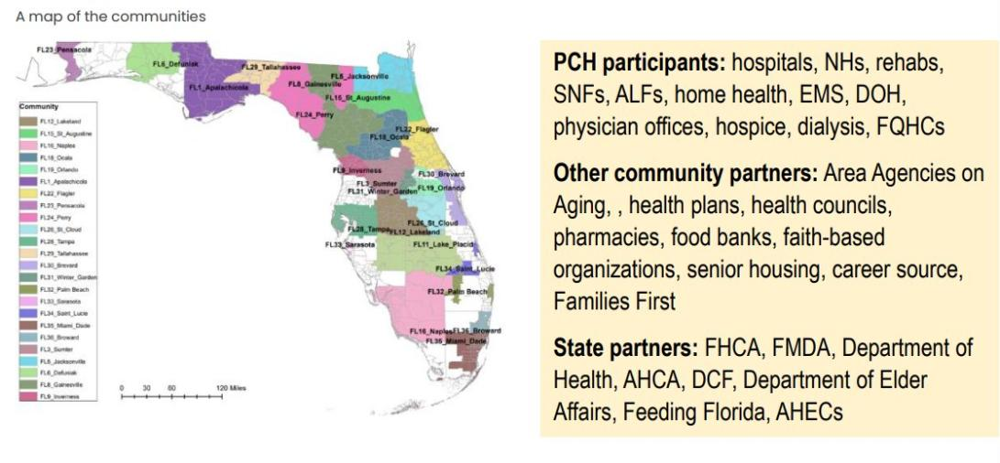
State & regional Quality Collaboratives

Slide 35
Continuum of Care model
right care,
right time,
right place

Slide 36
Mary C. Mayhew,
President and CEO
Florida Hospital Association
Visit FHA.org
or follow us at
FLHospitalAssn
FloridaHospitals
Florida Hospital Association
flhospitalassociation

