Slide 1
Baker Act Data Overview
Amanda Regis
Statewide Baker Act and Marchman Act Coordinator
Florida Department of Children and Families
Office of Substance Abuse and Mental Health

Slide 2
BaKER ACT
The Baker Act is a Florida law that enables families, health care providers, law enforcement officers, or other professionals to seek emergency mental health services and temporary detention for people who are impaired because of their mental illness, and who are unable to determine their own needs for treatment.

Slide 3
Criteria FOR BAKER ACT
The individual are mentally or emotionally impaired to the extent they cannot control their own actions or understand reality.
The individual has refused voluntary examination, or, because of a mental illness, they cannot understand that an examination is necessary.
Without treatment, the individual may suffer personal neglect or may cause harm to themselves or others.

Slide 4
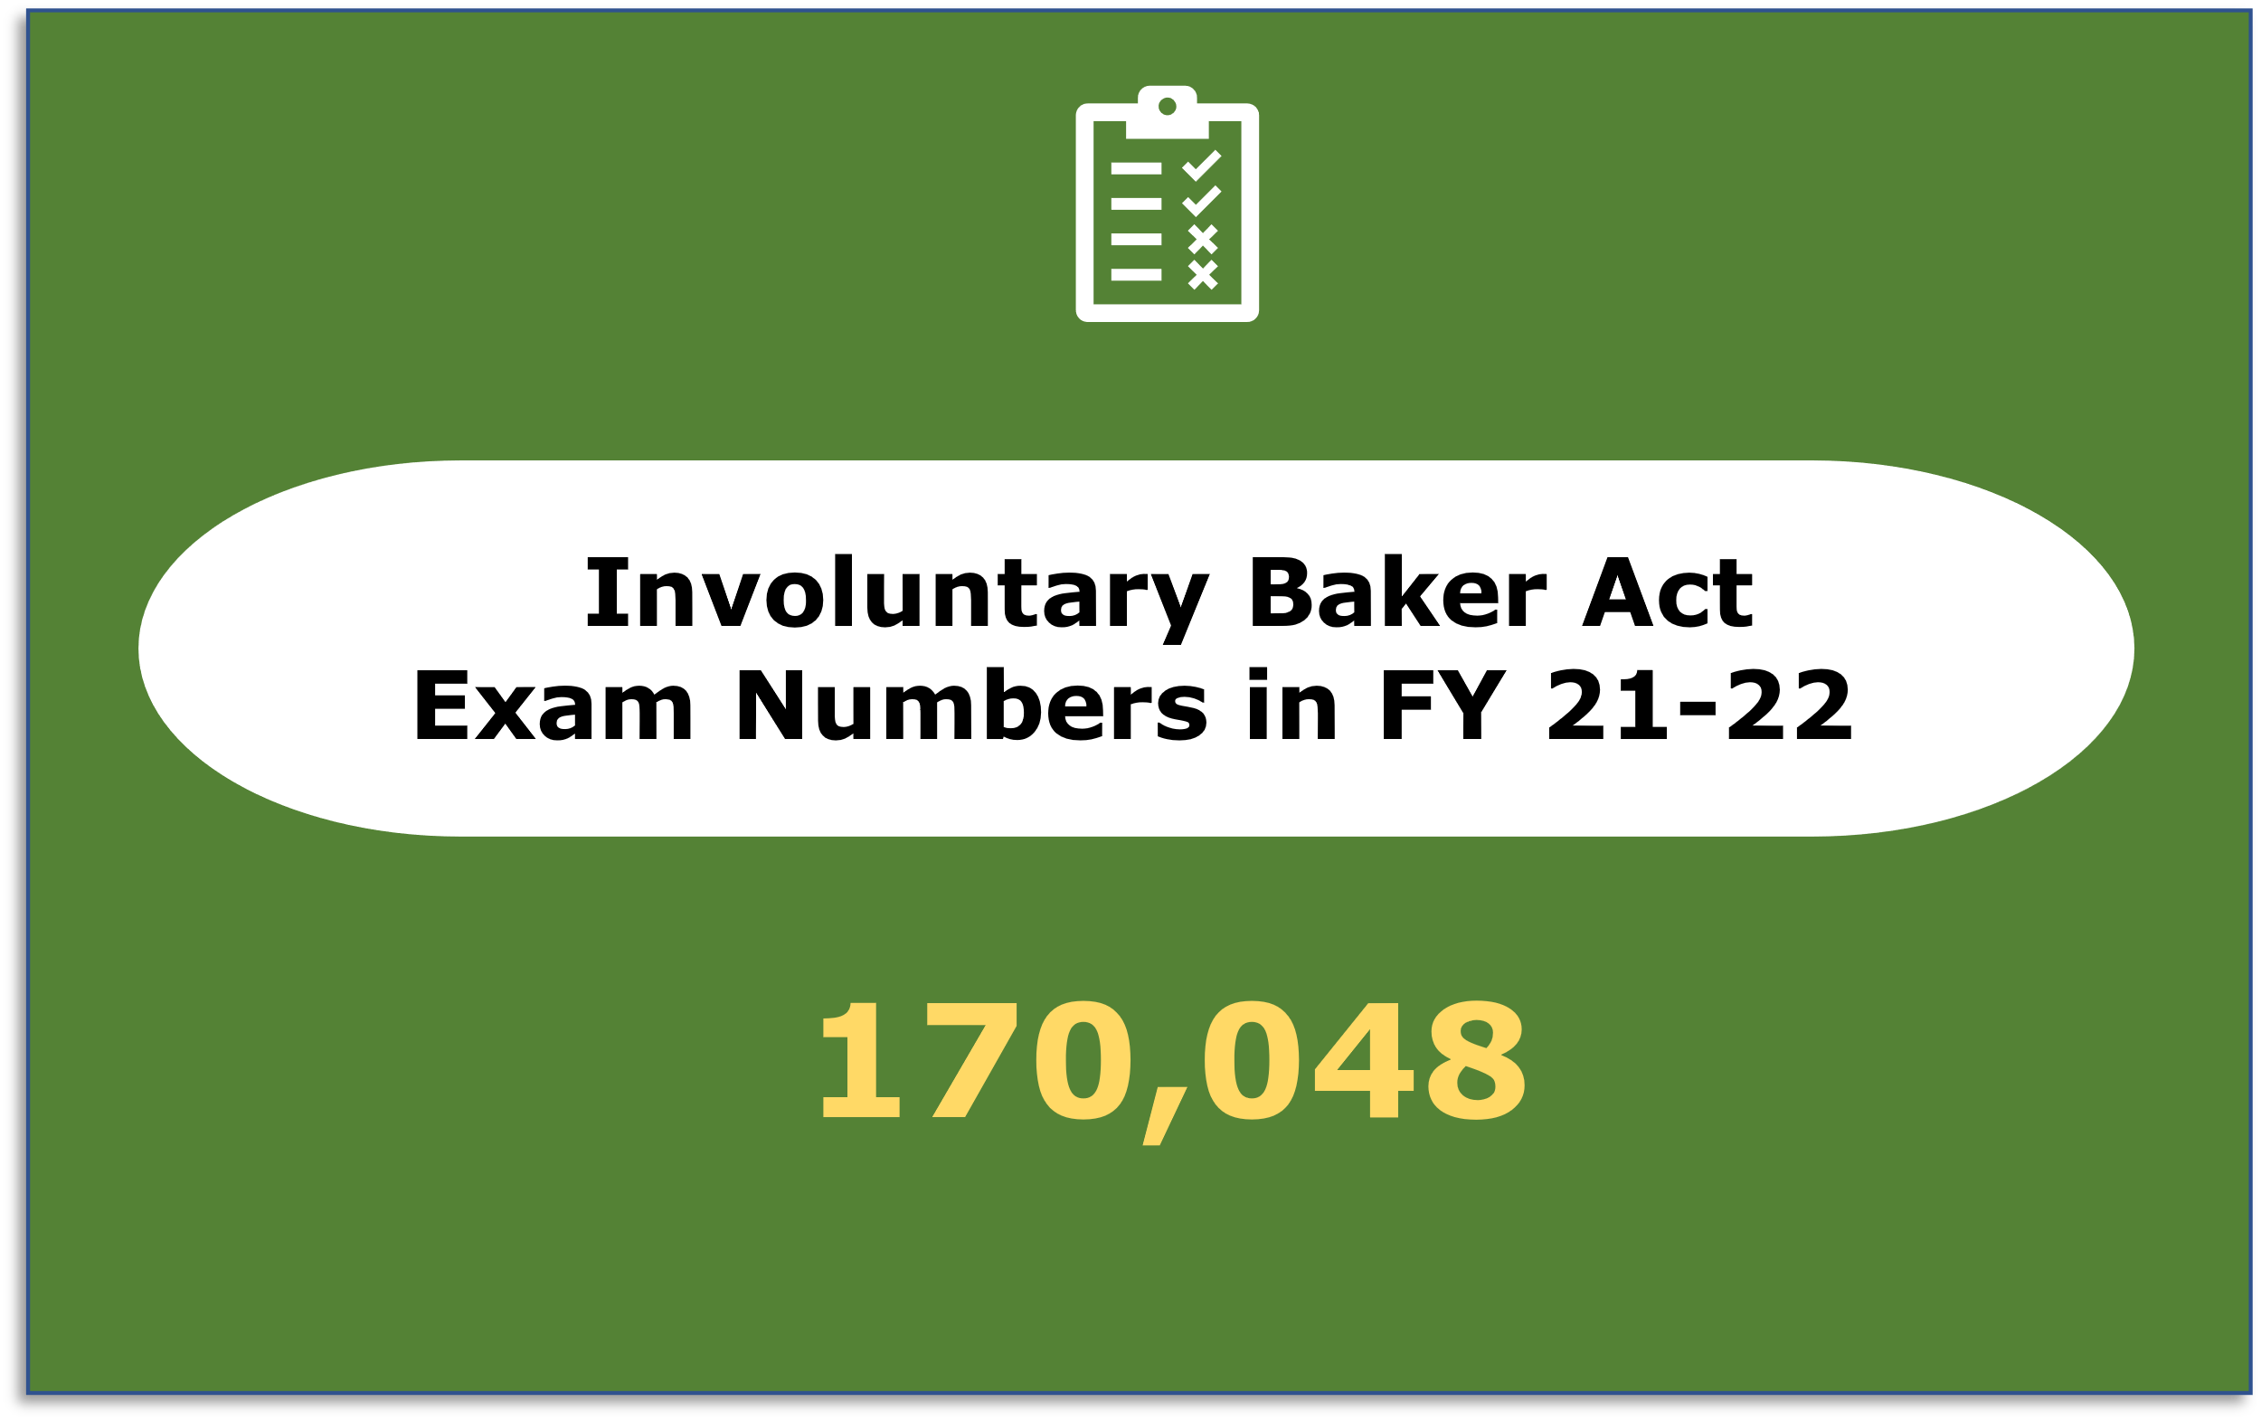
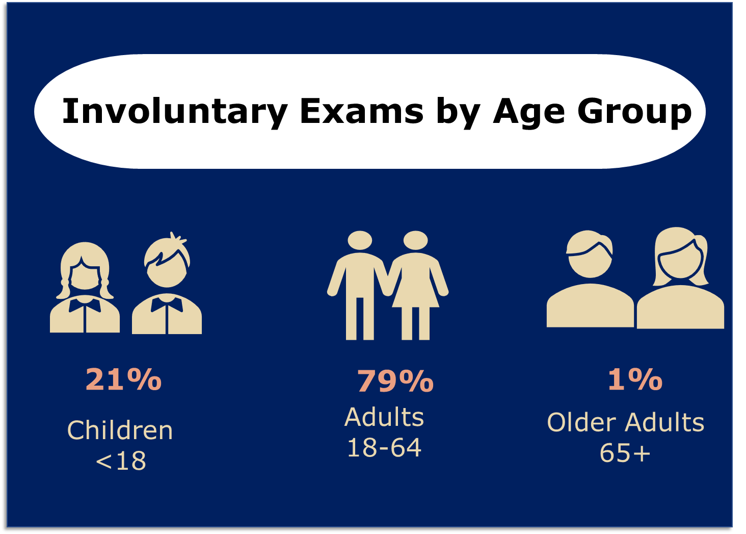
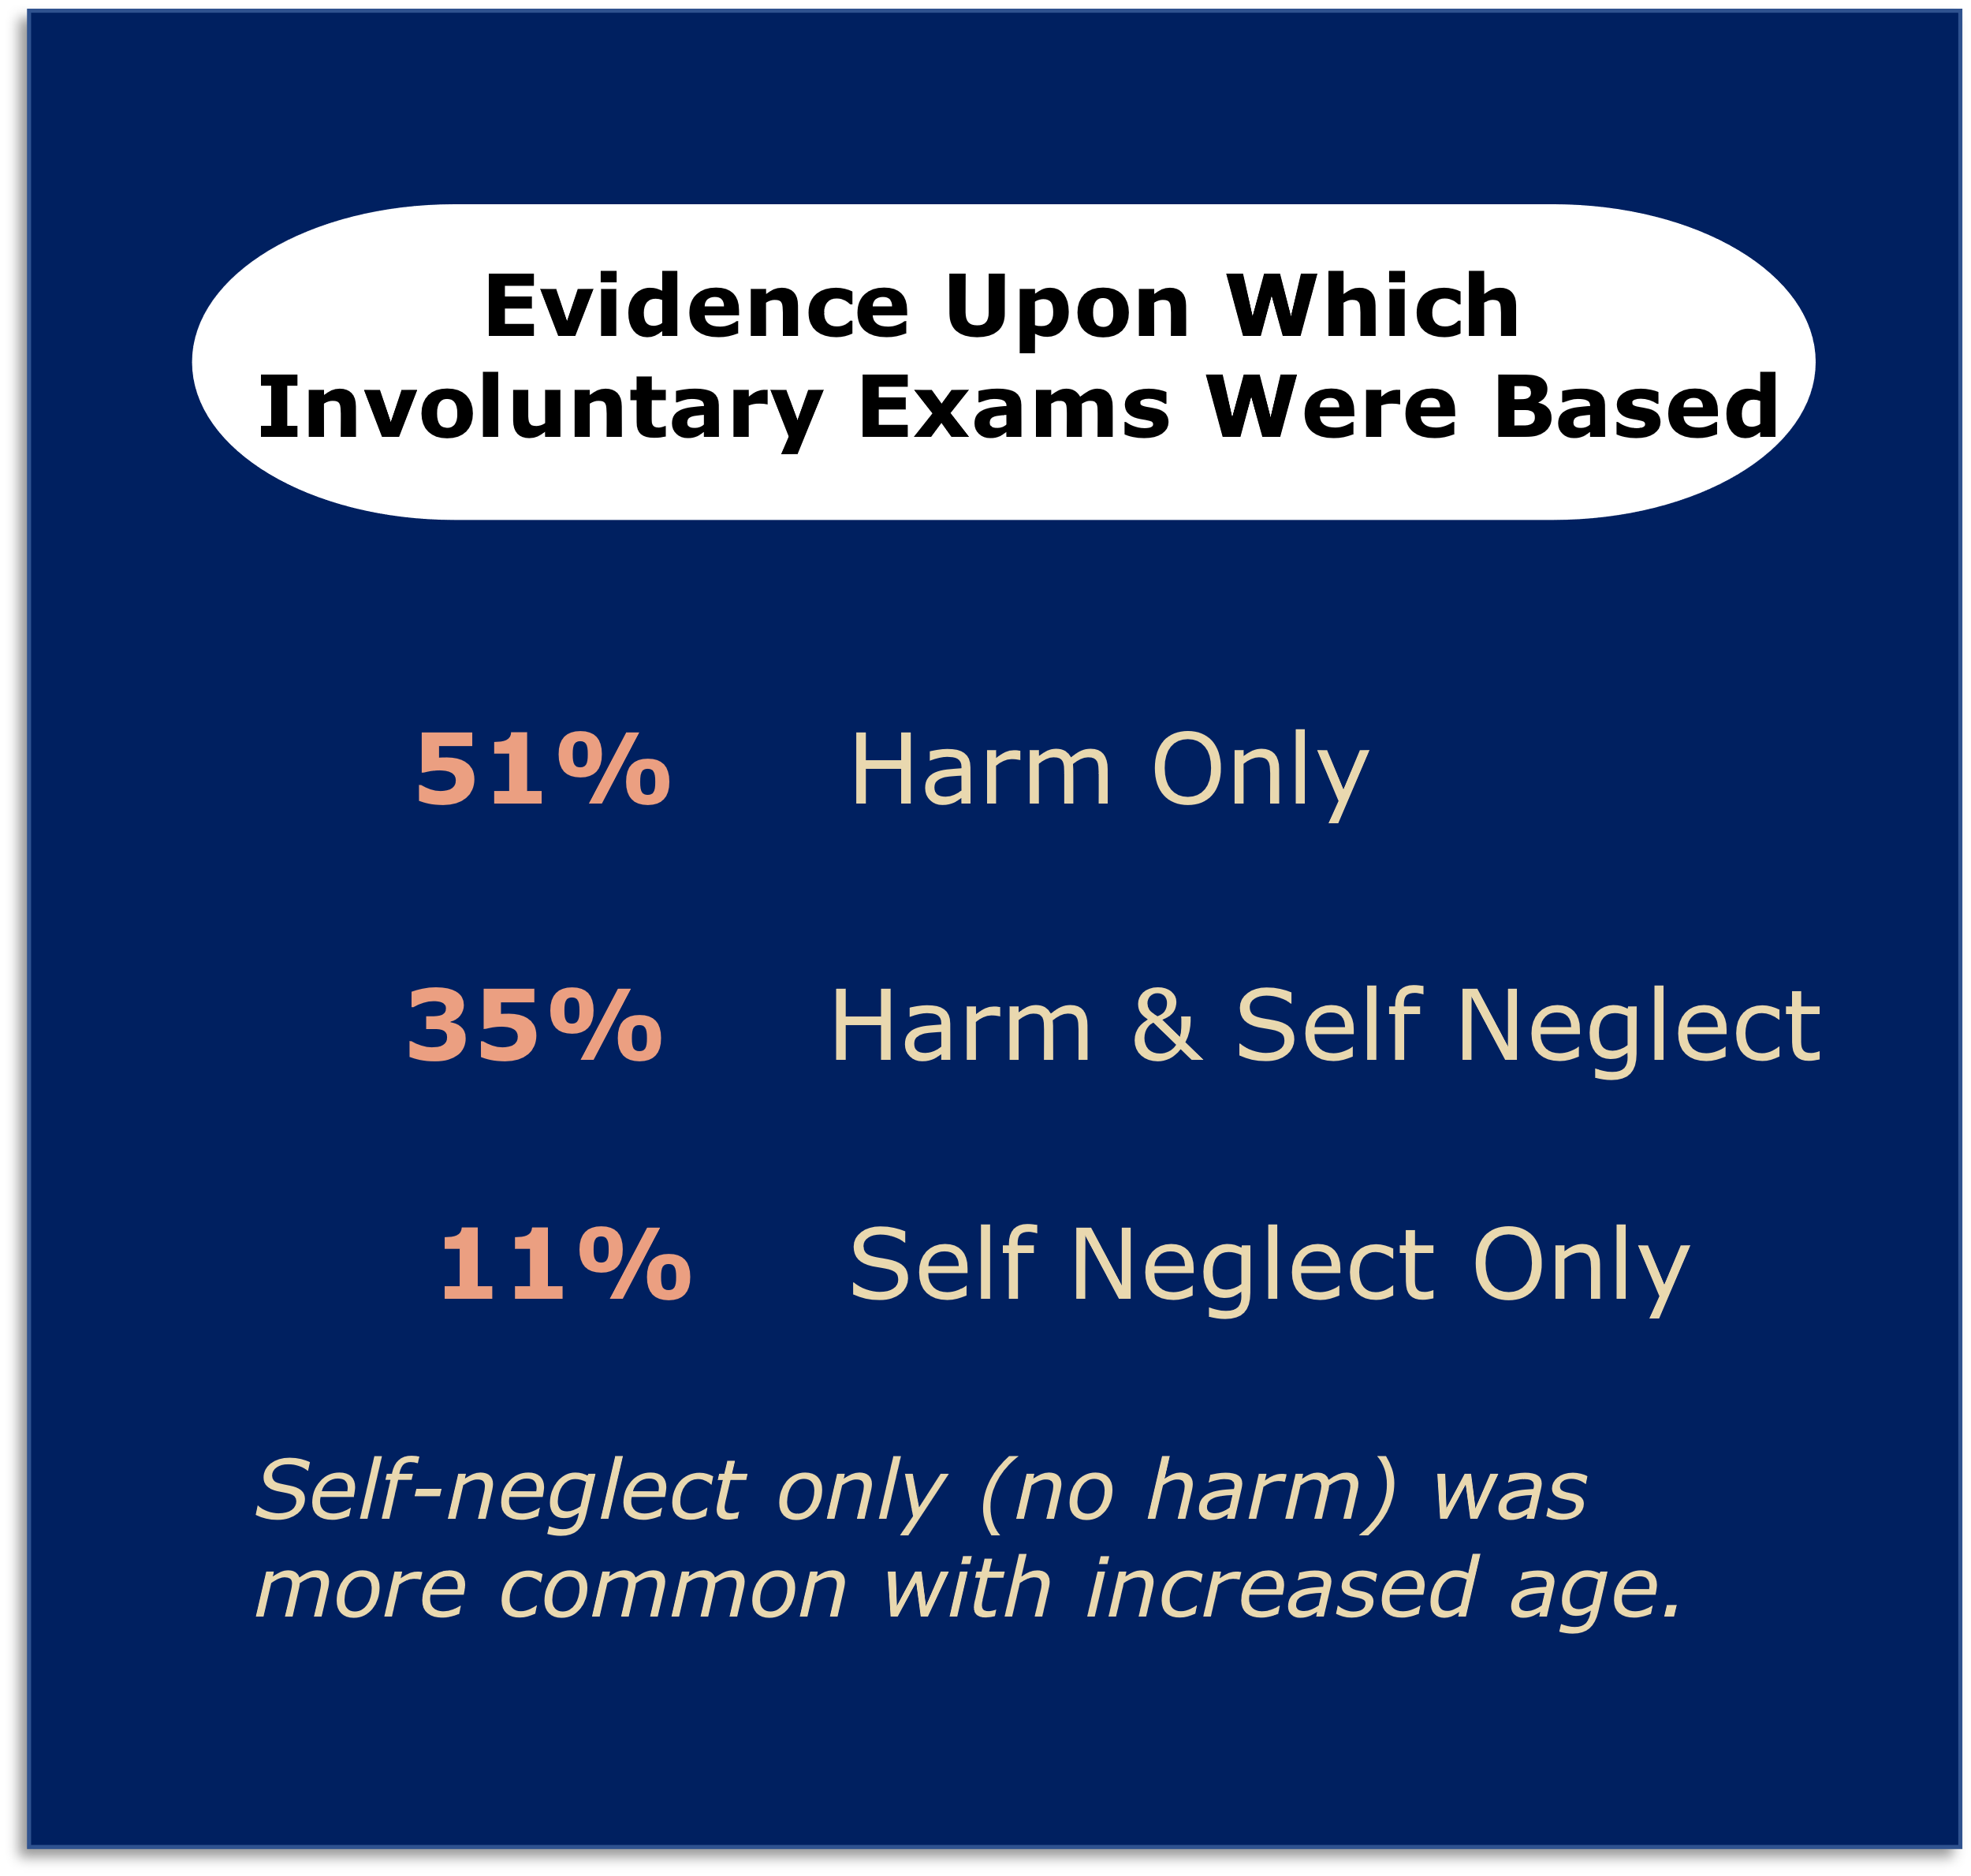
Fiscal Year 2021-2022 FLORIDA BAKER ACT DATA

Slide 5
FLORIDA BAKER ACT HISTORICAL DATA

Slide 6
REPEAT Baker acts
1 Year

Slide 7
Broward County profile
Florida Assertive Community Treatment (FACT) teams
Coordinated Specialty Care Program (First Episode Psychosis)
Community Action Teams
Care Coordination
Central Receiving Center
Urban
Population: 1,947,026
Total Baker Acts: 11,198
Drop-in centers
Wraparound Case Management
Recovery Community Organizations
Co-Responder Model
Broward Behavioral Health Coalition Innovation
In-county
Mobile Response Team
Crisis Intervention Training (CIT)
Peer Navigation

Slide 8
elements of a modern crisis care system
Addresses Recovery Needs
Significant Role of Peers
Safety/Security for Staff and People in Crisis
Crisis Response Partnerships with Law Enforcement, Dispatch, and Emergency Medical Services
Zero Suicide/Safer Suicide Care
Trauma-Informed Care

Slide 9
CORE elements of a THRIVING COMMUNITY*
Clubhouse Model
Engaging Law Enforcement/CIT
Recovery Community Organizations
Teaming Models
Supports for individuals with dual diagnoses (e.g., persons with disabilities)
Rapid Access to Care at Every Level
No wrong door Central Receiving Center
Education and training (e.g., hub and spoke model)
Enhanced Health Information Exchange Data
Access to Comprehensive Primary Behavioral Healthcare
Cellular service and high-speed internet
Subcommittee Discussion*

