Slide 1
Certified Community Behavioral Health Clinics (CCBHCs)
Chuck Ingoglia, President & CEO
Rebecca Farley David, Senior Advisor
National Council for Mental Wellbeing

Slide 2

What are we solving for?
What are the most pressing problems facing Floridians with mental health or substance use challenges, and the systems that serve them?
Please share your answers in the chat!

Slide 3
Inconsistent access & quality
Workforce shortages
Burden falls on other systems
We don’t pay for what works
Inconsistent availability of evidence-based practices (EBPs)
Losing staff to other industries
Service gaps
People can’t get the right service at the right time
Inability to do engagement with people in need of services
Persistent, high levels of unmet need
Inadequate data/technology infrastructure

Slide 4
CCBHCs: Supporting the Clinical Model with Effective Financing
Standard definition
Raises the bar for service delivery
Evidence-based care
Guarantees the most effective clinical care for consumers and families
Quality reporting
Ensures accountability
Prospective payment system
Covers anticipated CCBHC costs

Slide 5
But what IS a CCBHC?
A nonprofit clinic…
…that meets new standards for services, technology, partnerships, and data reporting…
…to provide more and better care, serve more people, and alleviate the burden on partner entities.
Supported by reimbursement and quality incentives that advance these goals

Slide 6
CCBHC requirements reflect best practices
Requires greater scope of services than most clinics previously provided
Establishes standards and expectations related to active collaboration with health and non-health partners, aimed at producing measurable improvements in clients’ lives
Requires and supports improved coordination and integration across partner organizations
Supports delivery of services outside the four walls of the clinic… with innovative use of clinical and non-clinical staff to engage with individuals in the right place at the right time
Standardizes and aligns quality reporting with national model (with options for state customization)
Introduces risk (and flexibility) into provider pay via encounter-based payment
Offers opportunities for partner provider organizations to participate in the financial
model under the umbrella of the CCBHC

Slide 7
Options for states via Medicaid
Federal CCBHC Medicaid demonstration
  10 current or previous participant states*
Medicaid State Plan Amendment (SPA) with PPS
  5 SPAs approved
Other Medicaid mechanism
  2 states
10 states may join the demo every 2 years (2024, 2026, 2028, etc.); receive enhanced FMAP
States may implement at any time; does not come with enhanced FMAP
*Pennsylvania and Minnesota have both left the demonstration but continue their investment in the model (in PA, CCBHCs are now known as ICWCs).

Slide 8
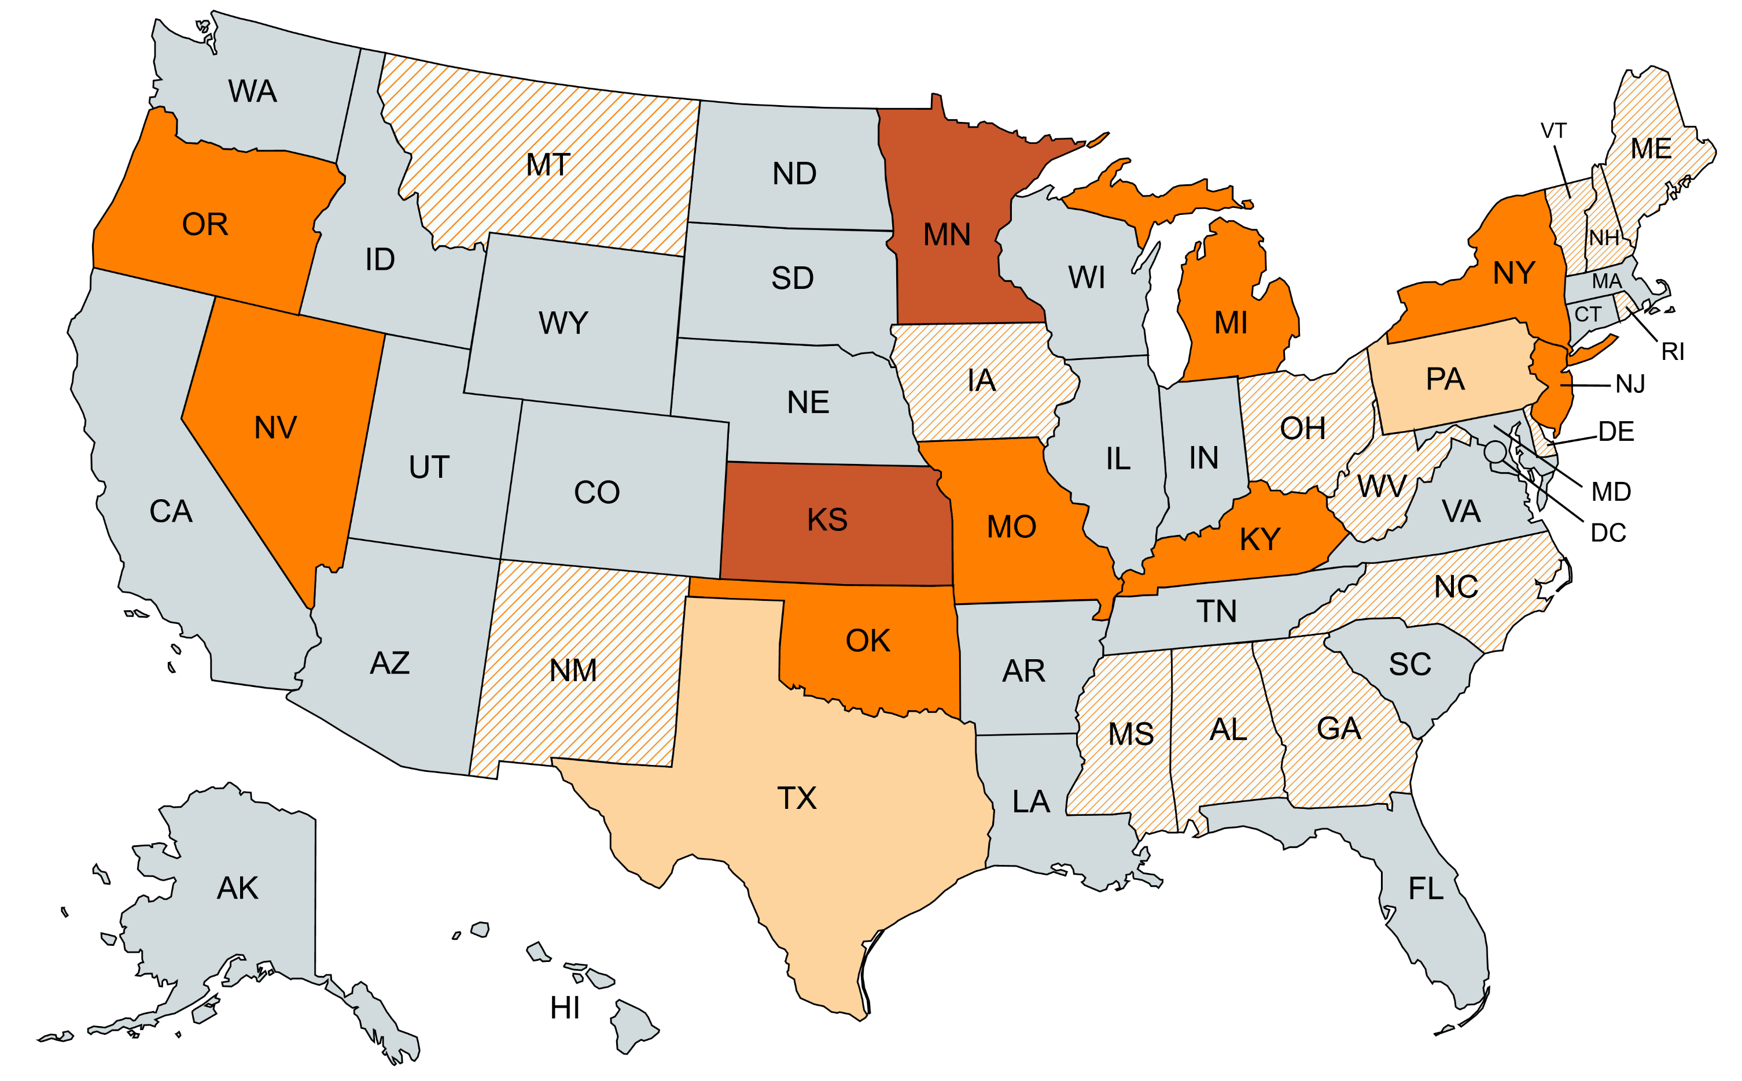
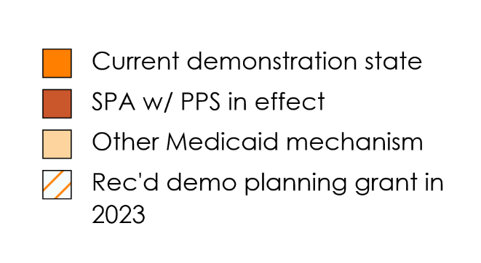
State CCBHC Implementation Landscape
*
*Also received a 2023 planning grant

Slide 9

Two types of CCBHCs
CCBHC expansion grantees (CCBHC-IA and CCBHC-PDI)
  Funded through SAMHSA grants, $4M over 4 years
  Grant funding is time-limited, supplements but does not supplant other payment
  Grantees are not “certified” – they self-attest to SAMHSA that they meet program requirements
State-certified CCBHCs
  Clinics participating in their state’s CCBHC model (demo, SPA)
  CCBHCs receive Medicaid prospective payment
  CCBHCs are certified by their states through state-developed certification processes in alignment with federal framework
23 CCBHC grantees in Florida

Slide 10
Financial model aligned with states’ clinical, quality, and VBP goals
Medicaid Prospective Payment System (PPS) = bundled rate inclusive of all CCBHC services & activities
State flexibility to design PPS aligned with value-based payment (VBP) goals:
  Monthly or daily payment model
  Stratification of payment rate by client risk level (“special populations”) in monthly model
  Inclusion of services or activities targeted to states’ access and quality goals
  Use of quality bonus payments (QBPs), metrics tied to QBPs, QBP thresholds and amount
  Definitions of special population categories, “qualifying visit” → load different levels and types of risk onto clinics
  Ability to administer PPS through managed care or as a wraparound payment
  Frequency of rate re-calculations (“rebasing”)
Data from CCBHC demo shows convergence of rates with CCBHC costs over time

Slide 11
Alignment with 988 & crisis systems development
Prevention
Early engagement in care
Crisis Response
24/7 mobile teams
Post-crisis care
Discharge/release planning, support & coordination
Crisis prevention planning
Outreach & support outside the clinic
Crisis stabilization
Withdrawal mgmt
Coordination with law enforcement & hospitals
Comprehensive outpatient MH & SUD care
Suicide prevention
CCBHCs are not intended to supplant their communities’ existing crisis response networks. Crisis response may be delivered directly by the CCBHC or by a Designated Collaborating Organization (DCO) partnering with the CCBHC.

Slide 12
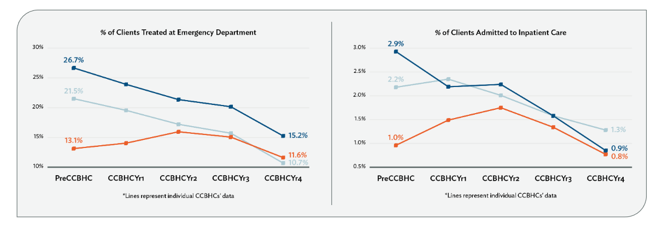
OK data snapshot

Slide 13
Outcomes at GRAND Mental Health, OK
Inpatient hospitalizations among GRAND adult clients at any Oklahoma psychiatric hospital fell from 959 (2015) to 66 (2021), a reduction of 93.1%.
Inpatient hospitalizations among GRAND adult client at Wagoner Hospital fell from 841 (2015) to 0 (2021), a reduction of 100%.
Inpatient bed days among GRAND adult clients at Wagoner Hospital fell from 1,115 (2015) to 0 (2021), a reduction of 100%.
From 2016-2021, decreases in inpatient hospitalizations saved more than $62 million dollars.
The number of adult clients served increased by 163.5% from 4,326 (2015) to 11,401 (2021).
Law enforcement in seven counties saved 576 days in time spent transporting clients.
Law enforcement in seven counties saved over $718,000 from reductions in time and
distance and spent transporting clients

Slide 14
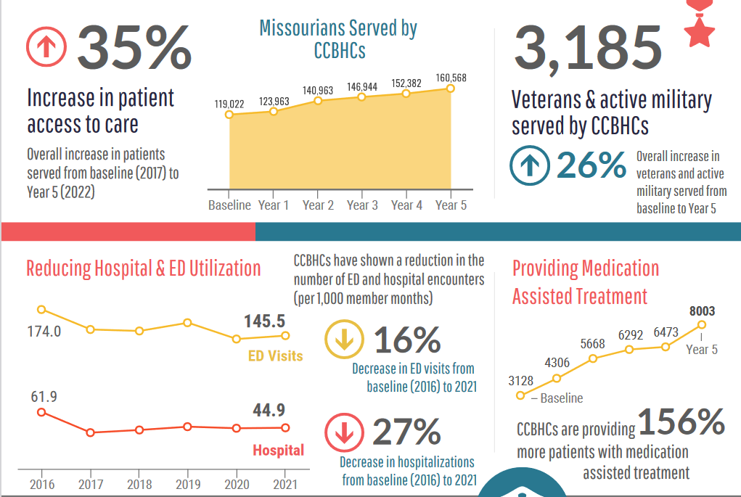
Missouri data snapshot

Slide 15

Florida activities
FBHA has established a Learning Collaborative with the 23 grant awardees in Florida
Meet on a regular basis to discuss barriers to implementation and factors for success
Working to standardize data collection and outcome measures across grantees
Planning a cost reporting effort to inform rate development methodology

Slide 16

Questions and discussion
Chuck Ingoglia
President & CEO
chucki@thenationalcouncil.org
Rebecca Farley David
Senior Advisor
rebeccad@thenationalcouncil.org

