Slide 1

Module 6
Family Engagement Standards – Preparation and Introduction
Notes:
4.0.1

Slide 2

Agenda
6.1: Family Functioning Assessment-Ongoing
6.2: Overview of Preparation
6.3: Overview of Introduction
Pre-Service CM Specialty Module 6.0.2

Slide 3
Unit 6.1
Family Functioning Assessment-Ongoing
Notes:
5.1.4

Slide 4

Learning Objectives
Describe the philosophy of the Family Functioning Assessment-Ongoing.
Identify the participants who should be included in the Family Functioning Assessment–Ongoing.
Pre-Service CM Specialty Module 6.1.2

Slide 5
Family Functioning Assessment-Ongoing
The purpose of the
Family Functioning Assessment-Ongoing
is to evaluate family conditions and how these conditions are influencing danger threats, child needs, and caregiver protective capacities.
Pre-Service CM Specialty Module 6.1.3

Slide 6
Safety Management Practice Responsibilities
FFA-Ongoing
Engage
Raise Awareness
Focus Treatment
Caregiver Protective Capacities
and Child Needs
Pre-Service CM Specialty Module 6.1.4

Slide 7
Family Functioning Assessment–Ongoing Decisions
Are danger threats being managed with a sufficient safety plan?
How can existing protective capacities – STRENGTHS – be built upon to make changes?
What is the relationship between danger threats and the diminished caregiver protective capacities – what must change?
Pre-Service CM Specialty Module 6.1.5

Slide 8
Family Functioning Assessment–Ongoing Decisions, cont.
What is the parent’s perspective or awareness of his/her caregiver protective capacities?
What are the child’s needs and how are the parents meeting or not meeting those needs?
Pre-Service CM Specialty Module 6.1.6

Slide 9
Family Functioning Assessment–Ongoing Decision, cont.
What are the parent(s) ready and willing to work on in the case plan to change their behavior?
What are the areas of disagreement with the parent(s) as to what needs to change?
What change strategy will be used to address the diminished protective capacities?
Pre-Service CM Specialty Module 6.1.7

Slide 10
FFA-Ongoing Participants
How do you determine who needs to be assessed and who needs to be included?
  Ask yourself…who provides care, parenting, quality time, and/or discipline for the children.
Learn by observing the family interacting and gather information from the children, parents, household members, extended family members, and friends who are familiar with how the family functions.
Pre-Service CM Specialty Module 6.1.8

Slide 11

Activity A:
Determining the Focus of Your Family Functioning Assessment-Ongoing
Instructions:
Read the scenarios and determine how many FFA’s-Ongoing should be created and who should be on each FFA-Ongoing.
Refer back to your CFOP for assistance.
Be prepared to discuss.
Pre-Service CM Specialty Module 6.1.9

Slide 12
Family Engagement Standards
Safety Management and Enhancing Caregivers Protective Capacities
Preparation
Introduction
Exploration
Case Planning
Developing Strategy for Engagement
Engagement
Determine What Must Change Through Information Collection
Develop Strategies for Change Case Plan Outcomes
Caregiver Protective Capacity Assessment
Child Needs
Danger Statement
Family Goal
Motivation for Change
Complete FFA Ongoing
Case Plan
Pre-Service CM Specialty Module 6.1.10

Slide 13
Unit 6.2
Overview of Preparation
Notes:
5.1.4

Slide 14
Learning Objectives
Identify the tasks that must be accomplished during the Family Engagement Standard for Preparation.
Review the stages of change and identify the indicators for each stage.
Pre-Service CM Specialty Module 6.2.2

Slide 15
Preparation
Preparation is the process of preparing for information collection and contact with the family.
The purpose of the preparation family engagement standard is to ensure that you
are as informed as possible about information already known about the family,
able to identify gaps and discrepancies that must be reconciled, and
are able identify strategies for family engagement.
Pre-Service CM Specialty Module 6.2.3

Slide 16
Special Circumstances and
Family Conditions
Domestic Violence
Parents childhood history of abuse or neglect
Substance abuse
Mental illness
Condition or circumstance of parent that will require assistance with verbal or written communication
Criminal behaviors
Developmental delays and special needs of children in the home (includes mental, learning disabilities, deaf and hard of hearing).
Pre-Service CM Specialty Module 6.2.4

Slide 17
Areas of Critical Evaluation for Intervention Standards: Preparation
Sufficiency of information known – identify information gaps.
Sufficiency of safety plans to control for danger.
Identify information that is relevant.
Baseline information regarding Caregiver Protective Capacities from CPI.
Information that must be known – what information is needed to inform the Caregiver Protective Capacity and Child Needs Assessments.
Pre-Service CM Specialty Module 6.2.5

Slide 18
Identifying Strategies for Family Engagement
Using the information you have learned to plan the:
  Location
  Timing
  Circumstances where contact should be made with both the caregivers and the children
Pre-Service CM Specialty Module 6.2.6

Slide 19
Sandler/Braun
What do you remember about the Sandler/Braun family? What are the danger threats? What was the safety plan?
What were some of the discrepancies that were found, what were the gaps of information needed?
What information do you want to try to gather from the family when you meet them?
Pre-Service CM Specialty Module 6.2.7

Slide 20
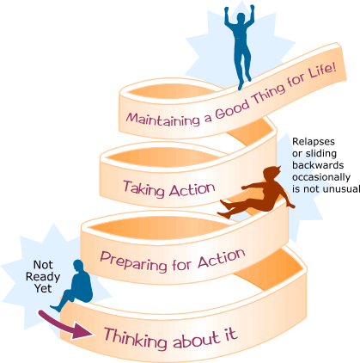
Stages of Change
Pre-Service CM Specialty Module 6.2.8

Slide 21
Appropriate Motivational Strategies for Each Stage of Change
Client's Stage of Change | Appropriate Motivational Strategies
Stage 1: Precontemplation The client is not yet considering change or is unwilling or unable to change. | Establish rapport, ask permission, and build trust. Raise doubts or concerns in the client about behavior patterns Express concern and keep the door open
Pre-Service CM Specialty Module 6.2.9

Slide 22
Client's Stage of Change | Appropriate Motivational Strategies
Stage 2: Contemplation The client acknowledges concerns and is considering the possibility of change but is ambivalent and uncertain. | Normalize ambivalence. Help the client "tip the decisional balance scales" toward change. Elicit and summarize self-motivational statements of intent and commitment from the client. Elicit ideas regarding the client's perceived self-efficacy and expectations regarding treatment.
Pre-Service CM Specialty Module 6.2.10

Slide 23
Client's Stage of Change | Appropriate Motivational Strategies
Stage 3: Preparation The client is committed to and planning to make a change in the near future but is still considering what to do. | Explore treatment expectancies and the client's role. Clarify the client's own goals. Negotiate a change--or treatment--plan and behavior contract. Consider and lower barriers to change. Help the client enlist social support.
Pre-Service CM Specialty Module 6.2.11

Slide 24
Client's Stage of Change | Appropriate Motivational Strategies
Stage 4: Action The client is actively taking steps to change but has not yet reached a stable state. | Engage the client in treatment and reinforce the importance of remaining in treatment. Acknowledge difficulties for the client in early stages of change. Help the client identify high-risk situations through a functional analysis and develop appropriate coping strategies to overcome these.
Pre-Service CM Specialty Module 6.2.12

Slide 25
Client's Stage of Change | Appropriate Motivational Strategies
Stage 5: Maintenance The client has achieved initial goals such as abstinence and is now working to maintain gains. | Support lifestyle changes. Affirm the client's resolve and self-efficacy. Help the client practice and use new coping strategies to avoid a return to use. Develop a "fire escape" plan if the client resumes old behavior patterns. Review long-term goals with the client.
Pre-Service CM Specialty Module 6.2.13

Slide 26
Client's Stage of Change | Appropriate Motivational Strategies
Relapse The client has experienced a recurrence of symptoms and must now cope with consequences and decide what to do next. | Help the client reenter the change cycle and commend any willingness to reconsider positive change. Explore the meaning and reality of the recurrence as a learning opportunity. Assist the client in finding alternative coping strategies. Maintain supportive contact.
Pre-Service CM Specialty Module 6.2.14

Slide 27
Activity B:
The Stages of Change and You
Instructions:
Part 1:
Working alone, identify something in your life you are currently in the process of changing or thinking about changing.
Next, answer the questions on the “Stages of Change and You” worksheet based on the change you have identified.
Part 2:
Review your responses with a partner. Look for any commonalities or differences in their path through the change process.
Pre-Service CM Specialty Module 6.2.15

Slide 28
Unit 6.3
Overview of Introduction
Notes:
5.1.4

Slide 29
Learning Objectives
Identify the tasks that must be accomplished during initial contact with the family.
Demonstrate using rapport building skills learned in CORE.
Pre-Service CM Specialty Module 6.3.2

Slide 30
Introduction
Introduction is the act of introducing you as the change agent and the agency representative, the agency’s role, what case management is and is not, and providing clarification as to the role of the ongoing Case Manager.
Pre-Service CM Specialty Module 6.3.3

Slide 31

Engagement Standard: Introduction
Objectives of Introduction for Case Manager:
  Begin to establish rapport with family; get to know them.
  Establish a working relationship with the family.
  Provide clarification and process with family for ongoing case management.
Pre-Service CM Specialty Module 6.3.4

Slide 32
Activity C:
What Would YOU Want to Know?
Instructions:
As you listen to the scenario being read, place yourself into the role of the parent. Think about what you as the parent would be feeling as a parent going into ongoing case management with a child in placement.
Make a list of the specific things that you (as the parent) would want to know from the Case Manager. Be spontaneous and write down the essence of what you would want to know.
Be prepared to discuss with the class.
Pre-Service CM Specialty Module 6.3.5

Slide 33
Introduction Standard
Focus of Introduction Activities
Building rapport
Learning about the family
Providing information to the family
Developing a trust-based working relationship
Pre-Service CM Specialty Module 6.3.6

Slide 34
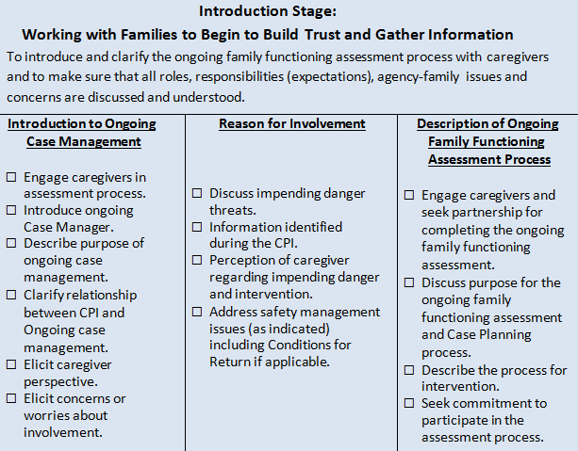
Pre-Service CM Specialty Module 6.3.7

Slide 35
Activity D:
Observation of the Introduction
Instructions:
  Read the Russell case scenario.
  Watch scenes one and two of the Russell case.
  Answer the questions regarding the case.
Pre-Service CM Specialty Module 6.3.8

Slide 36
Activity E:
Introduction with the Sandler/Braun Family
Instructions:
Take notes of your case information as the family reveals themselves through the intervention stages.
Group members will then role-play for the Sandler/Braun family:
  Melanie and Bruce Braun
  Case Manager
  Observer
Practice Introduction for Melanie and Bruce separately, therefore conduct two interviews total.
Pre-Service CM Specialty Module 6.3.9

Slide 37
Sandler/Braun Family
Exercise Debrief and Case Worker Conclusions Based on Introduction
Pre-Service CM Specialty Module 6.3.10

