Slide 1

Lab 1:
Courtroom Testimony
Notes:
1.0.1

Slide 2

Agenda
Learn fundamentals of preparation, appearance and testimony.
Practice the skills used during testimony with a case example.
Preservice CM Specialty – Lab 1.2
Notes:
1.0.2

Slide 3
Courtroom Testimony
The Fundamentals
Preservice CM Specialty – Lab 1.3
Notes:
1.1.1

Slide 4

Learning Objectives
Discuss activities necessary for preparation for court testimony.
Explain “hearsay” and how this legal term is likely to be surface in child welfare hearings.
Demonstrate appropriate responses to questions asked during testimony.
Discuss tactics used by parent attorney and demonstrate appropriate response.
Preservice CM Specialty – Lab 1.4

Slide 5
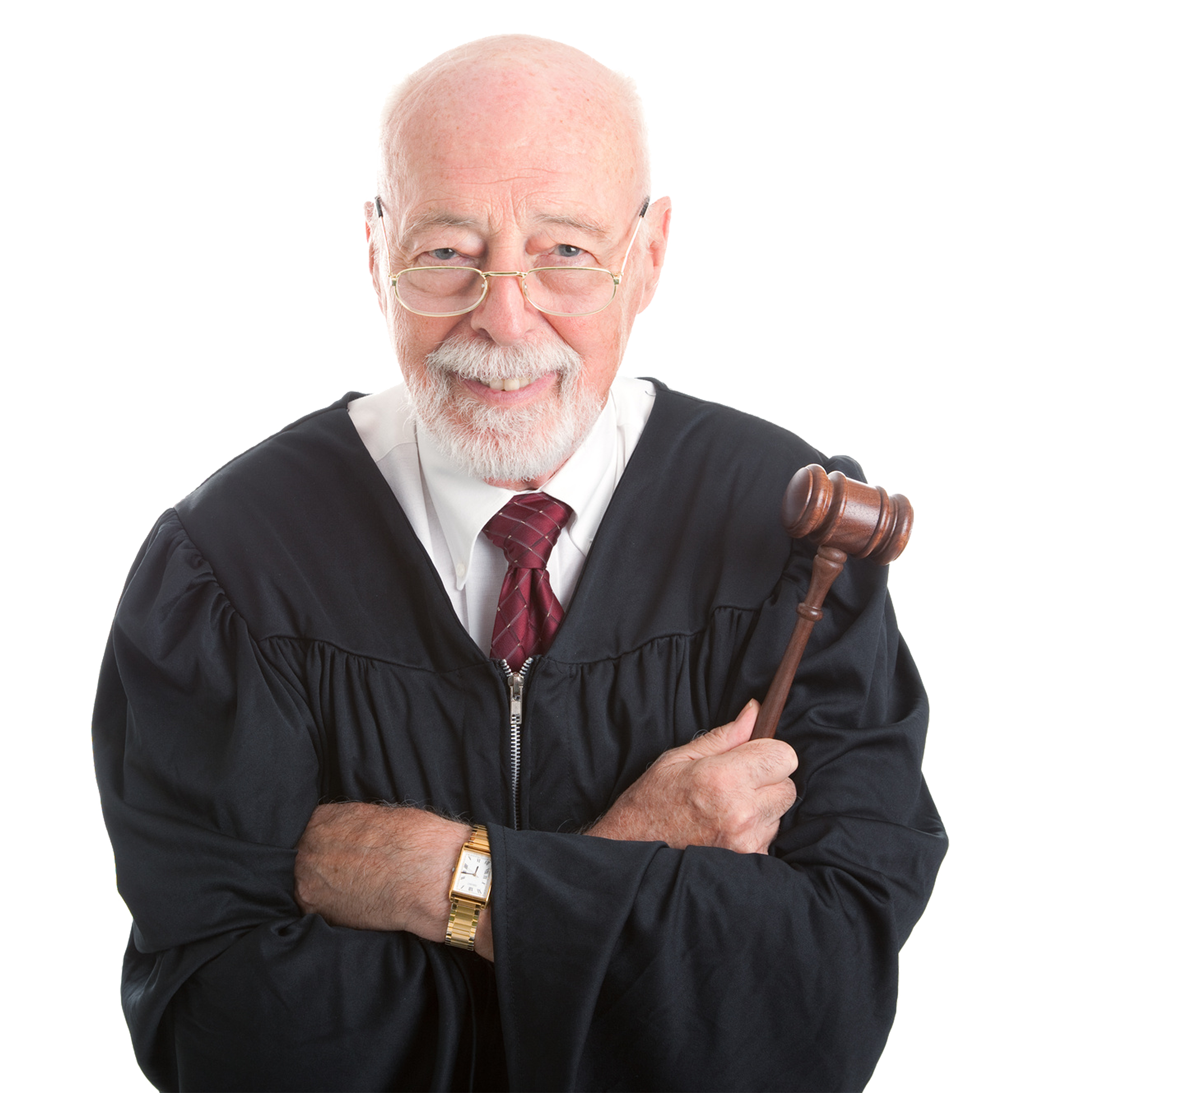
The Role of Courts
Preservice CM Specialty – Lab 1.5
Notes:
16.1.6

Slide 6

The Power of Courts
The power to subpoena
witnesses, documents
and records.
The power to assist child welfare investigations.
The power to make negative “reasonable efforts” determinations.
The power to hold individuals in contempt.
The power to
order treatment.
Inherent power of the position.
Preservice CM Specialty – Lab 1.6
Notes:
16.1.7

Slide 7
The Rights of
Parents and Children
The right of
family integrity.
The power to notice
of the proceedings.
The right to a hearing.
The right to a jury trial.
The right to counsel and a Guardian ad Litem.
The entitlement to reasonable efforts.
Preservice CM Specialty – Lab 1.7
Notes:
16.1.8

Slide 8

Understanding Judge’s Expectations
Know the law and follow court rules.
Prepare effective documentation
and testimony.
Engage clients in
the court process.
Work effectively
with others.
Arrive on time.
Follow court decorum.
Follow appropriate court orders.
Preservice CM Specialty – Lab 1.8
Notes:
16.1.39

Slide 9

Children’s Legal Services
Power to subpoena witnesses.
Power to subpoena documents and records.
Power to assist child welfare investigations.
Preservice CM Specialty – Lab 1.9

Slide 10
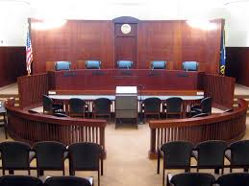
Courtroom Presentation
Success in Court is a part of your job.
Knowledge of basic court preparation.
Knowledge of basic court rules and practices.
You are a professional witness.
Preservice CM Specialty – Lab 1.10
Notes:
HOW MANY TIMES DOES IT TAKE TO RUIN YOUR REPUTATION.
HOW MANY TIMES DOES IT TAKE TO REHABILITATE YOUR REPUTATION
HANDOUT – TIPS FOR EFFECTIVE TESTIMONY

Slide 11
Reputation
Preservice CM Specialty – Lab 1.11
  How you present in court reflects on:
  Your personal reputation,
  Your agency’s reputation, and
  The State’s reputation.
Notes:
HOW MANY TIMES DOES IT TAKE TO RUIN YOUR REPUTATION.
HOW MANY TIMES DOES IT TAKE TO REHABILITATE YOUR REPUTATION
HANDOUT – TIPS FOR EFFECTIVE TESTIMONY

Slide 12

Preparing for Court
Meet with CLS lawyer
  Know all the facts of your case.
  Share all information – the good, the bad, and the ugly.
  Know everything that everyone on the team did on the case (supervisors, previous CPI/CM, other expertise).
Preservice CM Specialty – Lab 1.12

Slide 13
Preparing for Court
Know your case, know the facts!
  Current child functioning information
    how they are doing in school,
    special medical needs, etc.
  Parent information (adult functioning, parenting)
    cooperation with safety plan/case plan,
    case plan compliance,
    behavior change, unusual issues.
Preservice CM Specialty – Lab 1.13

Slide 14

Courtroom Behavior and Decorum
Wear tasteful and appropriate clothing.
Rise when judge enters and when court adjourns.
No talking.
No food or drink.
No cameras or recording.
Phones turned off.
No inappropriate facial gestures.
Avoid repeated entrances and departures.
Preservice CM Specialty – Lab 1.14

Slide 15

Activity A:
Courtroom Etiquette
Instructions:
View the video on Courtroom Etiquette.
Make note of any questions you may have.
Be prepared to discuss.
https://www.youtube.com/watch?v=4lPnG1HMkBg
Preservice CM Specialty – Lab 1.15

Slide 16
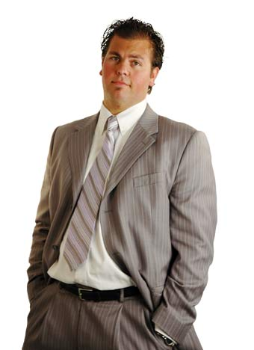

Courtroom Presentation, Attire-Men
Trial – All business… shirt and tie, jacket preferred
Hearings/Judicial
Review –
Business casual…
button-down or
polo shirt
Preservice CM Specialty – Lab 1.16
Notes:
Business casual - Slacks, button down shirt (no tie)
Slacks and a Polo shirt.

Slide 17


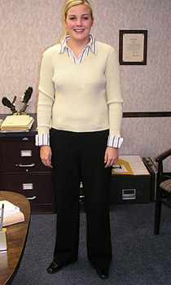

Courtroom Presentation,
Attire-Women
  Trial- All business
    Skirt or pants suit.
    Skirts should not be more than
    2 inches above knee.
    No sandals. Open-toed shoes ok
    but closed-toe preferred
        Hearings/Judicial Reviews –
        Business Casual
        Skirt or slacks.
        Blouse or button down shirt.
        No sleeveless shirt unless
    wearing a jacket.
Preservice CM Specialty – Lab 1.17

Slide 18
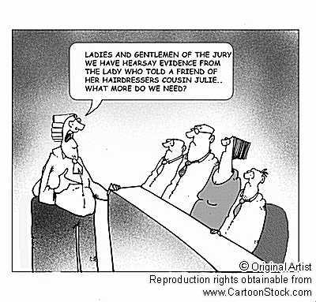
Hearsay
Preservice CM Specialty – Lab 1.18

Slide 19
Courtroom Testimony,
The Short List
Be normal.
Be truthful.
Be courteous.
Be compassionate.
Be complete.
Be succinct.
Preservice CM Specialty – Lab 1.19

Slide 20
Be Prepared to Answer
What education and training do you have?
What experience do you have?
How do you know this child(ren)?
What brought this case to dependency court.
Preservice CM Specialty – Lab 1.20

Slide 21
Courtroom Testimony
“I do not remember” or “I do not know” may be valid answers in certain situations.
If you need to refer to your notes it is ok.
  May I review my notes or case file?
  Lawyer should ask if your recollection is refreshed. Do not read from the notes after you have reviewed unless you are asked to do so.
Preservice CM Specialty – Lab 1.21

Slide 22
Courtroom Testimony
Direct Examination- friendly?
Cross Examination – not so friendly?
  Defense
  Judge
Preservice CM Specialty – Lab 1.22

Slide 23
Courtroom Testimony
You have to answer all questions (except disclosure of reporter information).
You have no right to refuse or object to a question, that is the attorney’s job.
Preservice CM Specialty – Lab 1.23

Slide 24
Courtroom Testimony
Avoid expressions such as:
  “I assume”
  “I guess”
  “I suppose” or
  “Maybe….”
Avoid all efforts at conjecture or hypothesis
Preservice CM Specialty – Lab 1.24

Slide 25
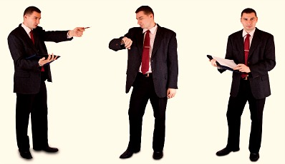
Courtroom Testimony
Control your body language:
  Temper
  Demeanor
Offer professional courtesy at all times.
Preservice CM Specialty – Lab 1.25

Slide 26
Activity B:
Cross-Examination
Instructions:
View the video on Cross-Examination.
Make note of any strategies and tactics being used.
Be prepared to discuss.
The Devil’s Advocate
https://www.youtube.com/watch?v=GLNb1udBbsw
Preservice CM Specialty – Lab 1.26

Slide 27
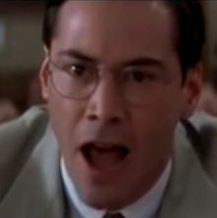
EVERY THING YOU SAY
CAN AND WILL BE HELD
AGAINST YOU
Preservice CM Specialty – Lab 1.27

Slide 28
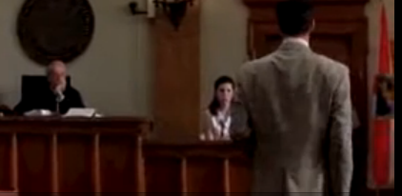
Defense Strategies
The friend
The confidant
The bully
Preservice CM Specialty – Lab 1.28

Slide 29
Activity C:
Skills Practice
Instructions:
Write down any questions you may have for the Children’s Legal Services representative.
Preservice CM Specialty – Lab 1.29

Slide 30
Supporting the Child
Who Will Testify
CLS is responsible for preparing child to testify.
CPI/CM is responsible for:
  Helping child stay calm.
  Sharing child worries that are known.
  Sharing any language assessment information.
  Working with CLS as to practice times and logistics.
  Reinforcing the expectation that child is expert, not anyone asking child questions.
Preservice CM Specialty – Lab 1.30

Slide 31
Final Note…
Do not engage in off-the-record conversations with opposing counsel.
Do not discuss the case with opposing counsel.
Do not engage in ex-parte communication with the judge.
Preservice CM Specialty – Lab 1.31

Slide 32
Summary
Tell CLS everything-
the good, the bad, and the ugly.
Know your case!
Attire.
Demeanor.
Know your case!
Did I say know your case?
Preservice CM Specialty – Lab 1.32

Slide 33

Treat Every Case
Like it is Going to TRIAL
REMEMBER THAT CHILD DEPENDS
ON YOU!
Preservice CM Specialty – Lab 1.33

Slide 34
Preparing to Observe the Court Process in Action
Know when and where Dependency Court proceedings occur in your area.
Record your observations of the court proceedings.
Prepare to have a classroom discussion about your court experiences.
Preservice CM Specialty – Lab 1.34

