Slide 1


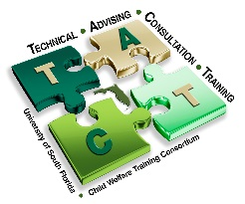
Technical Advising Consultation Training (TACT) · University of South Florida · Child Welfare Training Consortium

Slide 2

Developed by TACT:
Pamela E. Aeppel, M.A.
Shawna L. Thomas, B.A.
Chief Visual Designer: Kayvrie Vega
Child Welfare Training Consortium
University of South Florida
Technical Advising Consultation Training (TACT) · University of South Florida · Child Welfare Training Consortium

Slide 3
Introductions
Name/role and how long have you been working cases in the new Practice Model?
What is an area of documentation within assessments that works well for you and you think you have grasped pretty well?
What is an area of struggle or challenge in regard to documentation?
Technical Advising Consultation Training (TACT) · University of South Florida · Child Welfare Training Consortium

Slide 4

Opening Discussion
Reasons for Documentation
Technical Advising Consultation Training (TACT) · University of South Florida · Child Welfare Training Consortium

Slide 5

Lisa’s Story

Slide 6
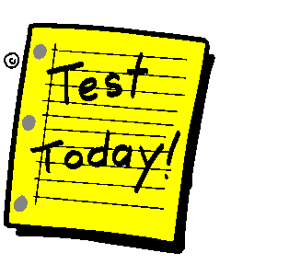
Pre-Test
Technical Advising Consultation Training (TACT) · University of South Florida · Child Welfare Training Consortium

Slide 7

What Can Be Expected?
Technical Advising Consultation Training (TACT) · University of South Florida · Child Welfare Training Consortium

Slide 8
Information Collection Competencies
I know what information I must learn about a family. I know what information I must collect on each case I am assigned.
I understand the purposes or reasons for needing to know this information.
I demonstrate the ability to gather the information.
I demonstrate awareness that everything I do to reconcile and validate information influences the overall quality of the information.
I can discuss and write about information I collected logically, succinctly, and in a way that justifies my conclusions
Technical Advising Consultation Training (TACT) · University of South Florida · Child Welfare Training Consortium

Slide 9
Learning Objectives
Distinguish the role and purpose of documentation assessment instruments and develop a Present Danger Assessment summary that reflects practice standards.
Define and develop how the elements of information organization of case facts and written presentation supports a logical, objective and coherent flow of information within the FFA.
Construct and author an analysis, using the key components of the Practice Model to express and defend how danger threats, protective capacities and child vulnerability are reflected and evaluated within a domain, contributing to a justifiable and supported safety decision.
Technical Advising Consultation Training (TACT) · University of South Florida · Child Welfare Training Consortium

Slide 10
Learning Objectives
Distinguish the role and purpose of documentation assessment instruments and develop a Present Danger Assessment summary that reflects practice standards.
Define and develop how the elements of information organization of case facts and written presentation supports a logical, objective and coherent flow of information within the FFA.
Construct and author an analysis, using the key components of the Practice Model to express and defend how danger threats, protective capacities and child vulnerability are reflected and evaluated within a domain, contributing to a justifiable and supported safety decision.
Technical Advising Consultation Training (TACT) · University of South Florida · Child Welfare Training Consortium

Slide 11
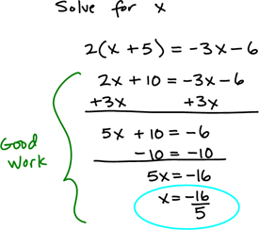
Methodology is like Math:
How do you “show your work” for the job that you do?
How do you “give yourself credit” for the work you do?

Slide 12
Purpose of Notes:
Purpose is to document who we saw, what they said, what we did, and how we conducted our data gathering for our assessments.
The notes are about the CPI tasks, actions and duties.
It is a log of contacts, phone numbers, addresses, telephone contacts, referrals and general communications needed to obtain information.
Avoid overuse of excessive fillers such as “stated, reported, indicated, and said” whenever possible.

Slide 13
Purpose of PDA:
The purpose of the Present Danger Assessment is exactly what it sounds like.
It is to assess for present danger. It happens when we have seen the child/children or have enough information to determine there is or is not present danger.

Slide 14
Present Danger Assessment Summary:
“The child was not hurt. The mom was at grandma’s house. Nobody does drugs in the house and the children are not afraid of anybody according to the children. Dad was not home when it happened. The oldest child gets home earlier than the younger kids so it was okay. The oldest child was home when it happened. No present danger.”

Slide 15
Critique of PDA Summary:
Do you know what happened? Do you know what didn’t happen?
Do you know who was involved?
Do you know age of the child or how many children we are talking about?
Do you know what “it” was about?
If you reviewed this information, as the PDA summary, would you know the context, content or meaning of the documentation?
Technical Advising Consultation Training (TACT) · University of South Florida · Child Welfare Training Consortium

Slide 16

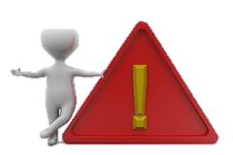
Present Danger Assessment Summary Examples:
Technical Advising Consultation Training (TACT) · University of South Florida · Child Welfare Training Consortium

Slide 17
Present Danger Threats:
Danger threats on handout are listed one per page in the same order as they appear in FSFN.
Technical Advising Consultation Training (TACT) · University of South Florida · Child Welfare Training Consortium

Slide 18

Activity #1
Read it, Review it, and Try it!
Purpose: To read and review documented present danger assessments and then re-work and/or create a new assessment summary based on the identified criteria and sufficiency of information.
Refer to PG page 27 for directions
Technical Advising Consultation Training (TACT) · University of South Florida · Child Welfare Training Consortium

Slide 19
Activity Debrief
Technical Advising Consultation Training (TACT) · University of South Florida · Child Welfare Training Consortium

Slide 20
Purpose of FFA
The purpose of the FFA is to document what is happening in the family and how there is or is not impending danger, as a result of the family conditions.
Just as the PDA is all about PRESENT DANGER the FFA is all about IMPENDING DANGER.
The FFA pulls together all the information needed to show how we made decisions and what information led to those decisions.
Technical Advising Consultation Training (TACT) · University of South Florida · Child Welfare Training Consortium

Slide 21
Impending Danger Threats:
Danger threats on handout are listed one per page in the same order as they appear in the FFA.
Technical Advising Consultation Training (TACT) · University of South Florida · Child Welfare Training Consortium

Slide 22
Structure of FFA:
Handout represents the structure and content of what should be documented with each field of our assessment instruction.
Technical Advising Consultation Training (TACT) · University of South Florida · Child Welfare Training Consortium

Slide 23
Safety Analysis Questions and Conditions for Return
The following 2 handouts represent examples for each safety analysis question and possible conditions for return.
Technical Advising Consultation Training (TACT) · University of South Florida · Child Welfare Training Consortium

Slide 24
Learning Objectives
Distinguish the role and purpose of documentation assessment instruments and develop a Present Danger Assessment summary that reflects practice standards.
Define and develop how the elements of information organization of case facts and written presentation supports a logical, objective and coherent flow of information within the FFA.
Construct and author an analysis, using the key components of the Practice Model to express and defend how danger threats, protective capacities and child vulnerability are reflected and evaluated within a domain, contributing to a justifiable and supported safety decision.
Technical Advising Consultation Training (TACT) · University of South Florida · Child Welfare Training Consortium

Slide 25
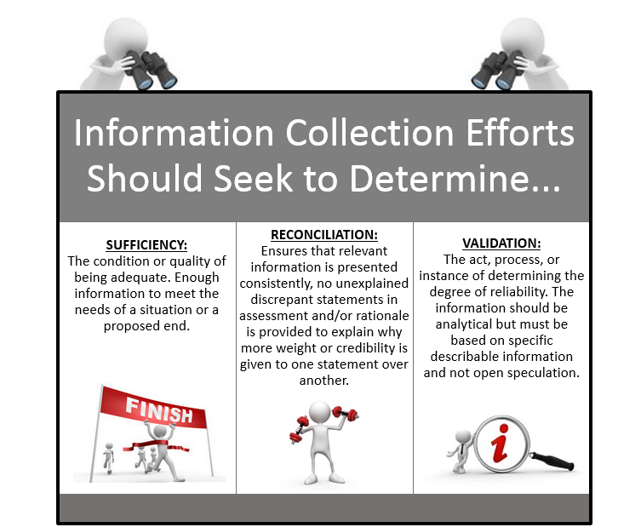

Slide 26

Writing Style: Caution Needed
Overuse of Quotes
Tone & Biases
Minimizing Language
Feuding Files
Technical Advising Consultation Training (TACT) · University of South Florida · Child Welfare Training Consortium

Slide 27
Activity #2
Domain Documentation Practice
Purpose: To write either an Adult Functioning domain or a Parenting General domain for a case brought in by each participant.
Refer to PG page 56 for directions.
Technical Advising Consultation Training (TACT) · University of South Florida · Child Welfare Training Consortium

Slide 28
Activity Debrief
Technical Advising Consultation Training (TACT) · University of South Florida · Child Welfare Training Consortium

Slide 29
Learning Objectives
Distinguish the role and purpose of documentation assessment instruments and develop a Present Danger Assessment summary that reflects practice standards.
Define and develop how the elements of information organization of case facts and written presentation supports a logical, objective and coherent flow of information within the FFA.
Construct and author an analysis, using the key components of the Practice Model to express and defend how danger threats, protective capacities and child vulnerability are reflected and evaluated within a domain, contributing to a justifiable and supported safety decision.
Technical Advising Consultation Training (TACT) · University of South Florida · Child Welfare Training Consortium

Slide 30
What is an Analysis?
A detailed examination of elements, as a basis for interpretation. It is a division of a whole into necessary parts to examine or determine their relationship or value to each other.
Example: Dividing information into each domain, information provided through research, and from multiple interview sources. This information is closely examined to determine its meaning/value within the context of each case.
Example: DCF priors are recorded one by one. This requires close examination of each prior, looking for patterns in maltreatments, patterns of allegations, patterns of perpetrators, patterns of victims, etc. in order to determine the whole meaning within context of each case.
Technical Advising Consultation Training (TACT) · University of South Florida · Child Welfare Training Consortium

Slide 31
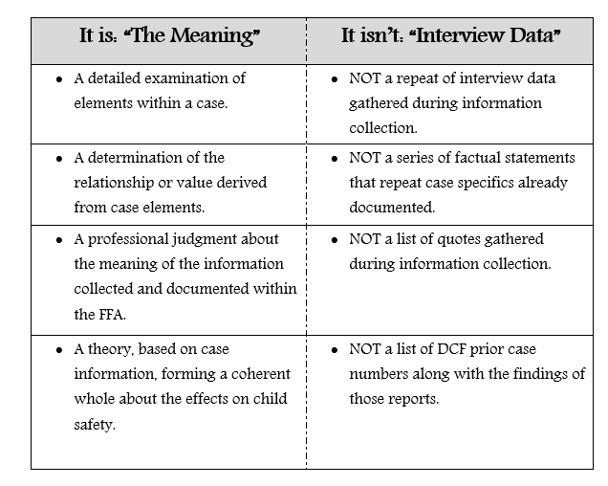
What Is an Analysis?
Technical Advising Consultation Training (TACT) · University of South Florida · Child Welfare Training Consortium

Slide 32
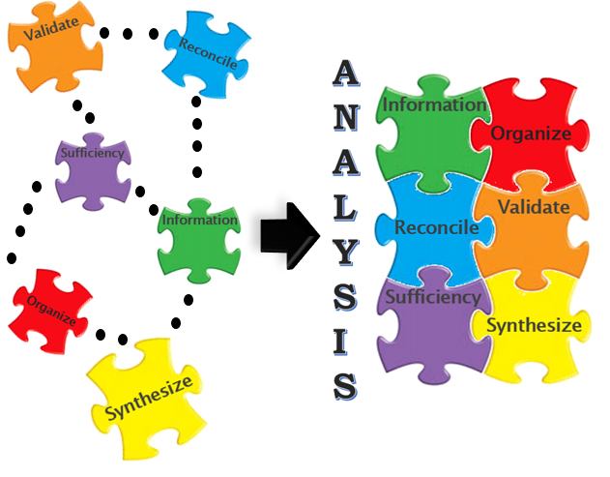
From Information Collection to Analysis
Technical Advising Consultation Training (TACT) · University of South Florida · Child Welfare Training Consortium

Slide 33
Activity #3
What Is Your Analysis?
Purpose: The purpose of this activity is to have participants practice skills for an analysis in one of their own cases. In order for the activity to have meaning for the participants, they will be using one of their own cases.
Refer to PG page 66 for directions.
Technical Advising Consultation Training (TACT) · University of South Florida · Child Welfare Training Consortium

Slide 34
Activity Debrief
Technical Advising Consultation Training (TACT) · University of South Florida · Child Welfare Training Consortium

Slide 35
Post-Test
Technical Advising Consultation Training (TACT) · University of South Florida · Child Welfare Training Consortium

Slide 36
What “Adds up” for you?
Lessons Learned
Ah Ha Moments
Technical Advising Consultation Training (TACT) · University of South Florida · Child Welfare Training Consortium

