Slide 1
Documenting a Sufficient Family Functioning Assessment

Slide 2
Workshop Introduction
Context for the Learning Circle
Fidelity of the Family Functioning Assessment
  Philosophy of practice
  Intervention purpose and framework
  Conceptual and criteria basis for practice and decision making
  Process, practice and outcomes

Slide 3

Participant Introductions
Notes:
This slide is not in the participant guide.

Slide 4
Workshop Training Objectives
As a result of this training, participants will be able to:
  Identify and explain the purpose and focus of the family functioning assessment;
  Identify the structure of the family functioning assessment;
  Identify and explain sufficient information collection;
  Identify a sufficient family functioning assessment;
  Complete the documentation for a sufficient family functioning assessment.

Slide 5
Learning Circle Structure
Participant Expectations:
  Commitment to structure of the learning circle:
    Weekly learning circle sessions.
  Identify a case that has been recently assigned.
Supervisor Expectations:
  Assist in identifying a case for use within the learning circle;
  Ensure full participation from staff;
  Provide weekly consultation for participants regarding the assessment process;
  Participate in the review of work product from learning circle.

Slide 6

Workshop Agenda
Notes:
This slide is not in the participant guide and the agenda will be dependent upon the structure of the learning circle:
Weekly
Daily over four days
One day

Slide 7
Questions?
Notes:
This slide is not in the participant guide.

Slide 8
Learning Circle Session #1
What is a Family Functioning Assessment?

Slide 9
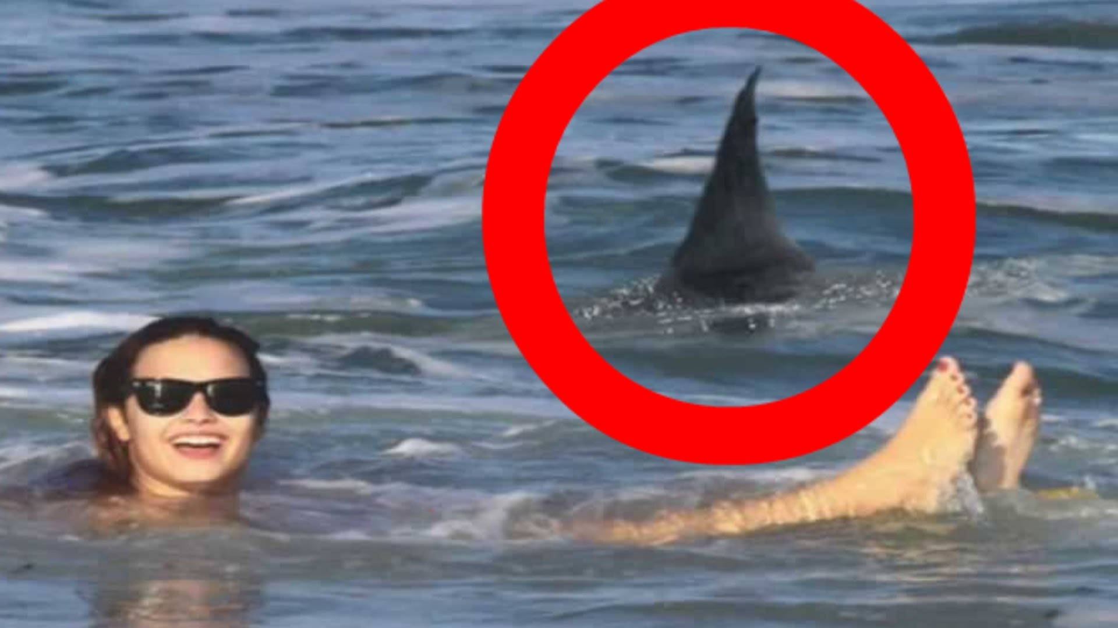
Two Types of Danger: Present Danger
PRESENT DANGER
Immediate
Significant
Clearly Observable
Family condition that is occurring in the present tense

Slide 10
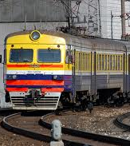
Two Types of Danger: Impending Danger
State of Danger in which family behaviors, attitudes, motives, emotions, and/or situations pose a threat to a child which may not be currently active, but can be anticipated to have severe effects on a child.
Child living or being in a position of continual or pervasive danger.
Threats are not immediate, obvious or active at the onset of investigation.
Are identified and understood upon gathering sufficient family functioning information.

Slide 11
Family Functioning Assessment (FFA)
Purpose | Practice Objectives
Identify families in which children are unsafe and in need of ongoing protective supervision (whether non-judicial or judicial in-home or out of home) | Determine children who are unsafe Protect children who are unsafe Establish and manage safety plans Verify the occurrence of maltreatment Identify problems associated with impending danger threats and caregiver protective capacities Refer families for community-based supports based upon risk assessment determination

Slide 12

“Focus” of the Family Functioning Assessment
Focus
  Whom are we assessing?
  What Household are we focusing on?

Slide 13
An Assessment:
Is NOT:
  A one time occurrence
  Myopic
  Deficit driven
  Legally driven
  One dimensional
Is:
  Process, not a destination
  Multi-dimensional
  Strength and child focused
  Drives decision making for child safety

Slide 14
Information Collection
KNOW THE FAMILY
Extent of Maltreatment
Surrounding Circumstances
Child Functioning
Adult Functioning
Disciplinary Practices/Behavior Management
General Parenting Practices

Slide 15

Sufficient Information: How Much is Enough?
Definition of Sufficient:
  Enough to meet the needs of a situation or a proposed end
    What is our proposed end?
    What are we trying to answer?
      Safety
      Impending Danger
      Planning for Safety

Slide 16
Assessment: Information Collection as Competency
I know what I must learn about a family. I know what information I must collect on each case I am assigned.
  I understand the purposes or reason for needing to know this information.
  I demonstrate the ability to gather the information.
  I demonstrate the awareness that everything I do before and during information collection influences the quantity and quality of the information I will collect.
  I can discuss and write about the information I collected logically, succinctly, and in a way that justifies my conclusions.

Slide 17
Questions?
Notes:
This slide is not in the participant guide.

Slide 18

Practice: Sufficient Information Analysis
In small groups of 4:
  Review written case information: FFA;
  Determine if each domain is sufficient;
  Provide justification for decision and if determined not sufficient-what information is needed.

Slide 19

Learning Circle Session #1: Take Away
Plan for Learning Circle Session #2:
  Focus on Maltreatment and Nature of Maltreatment Domains;
  Prepare for discussion and writing of two domains for Learning Circle Session #2.
Take Away from today:
  What did you find helpful?
  Questions still needing to be answered?
  More time on….

Slide 20
Documenting a Sufficient Family Functioning Assessment
Learning Circle Session #2
What is Maltreatment?
What is the Nature of Maltreatment?

Slide 21

Learning Circle Session #2: Welcome Back
Thoughts or Reflections from Learning Circle Session #1?
  Questions from Session #1?
  Feedback from Session #1?
  Reflections from Reflections from Session #1?

Slide 22
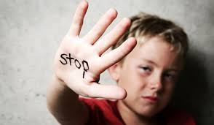
Family Functioning Assessment: Maltreatment
What is the Florida definition of Maltreatment?
  Behavior that is harmful and destructive to a child’s cognitive, social, emotional or physical development (Rule 65C-30.001 (72), F.A.C). Maltreatment is harm that occurred as a result of the maltreating behavior.

Slide 23
Maltreatment Domain Informs…..
What is the maltreatment that is alleged and/or occurring?
  Type AND Finding
    Child Maltreatment Index
Who is responsible for the maltreating behavior (alleged or confirmed)?
Who is alleged to have been harmed or who has been harmed?
  How were they NOT harmed or how WERE they harmed?
    Condition of the child(ren)
    Emotionally and physically
    Description of the events - either supporting OR negating the maltreatment
Notes:
.

Slide 24

Examples of Sufficient Maltreatment Domains
Sufficient Domains Answer:
  The WHAT
  The WHO
  The HOW
    Incidents of maltreatment;
    How bad is bad?
    How what is alleged is NOT occurring.
Notes:
Reference the case examples provided during Learning Circle Session #1

Slide 25
Questions?
Notes:
This slide is not in the participant guide.

Slide 26
Nature of Maltreatment Domain Informs…..
How long (DURATION and HISTORY) the maltreatment that is alleged has been occurring;
  What has been occurring in the home that has led to maltreatment?
EXPLANATION - What does the family, friends, collaterals say about the maltreating behavior (alleged or confirmed)?
  What was occurring during the alleged/confirmed maltreatment?
OTHER FACTORS - What is going on in the family that may assist in explaining either the occurrence of maltreatment or the reason for maltreatment being alleged?
Notes:
.

Slide 27
Examples of Sufficient Nature of Maltreatment Domain
Sufficient Domains Answer:
  The HOW and WHAT
  The HISTORY
    Incidents of maltreatment;
    Prior maltreatment;
    Negative conditions in the home.
Notes:
Reference the case examples provided during Learning Circle Session #1

Slide 28
Questions?
Notes:
This slide is not in the participant guide.

Slide 29

Practice: Documenting YOUR Domains
Working within your small groups:
  Review your case information;
  Document YOUR maltreatment and nature of maltreatment domain;
  Share your domain with your group for feedback and analysis;
  Refine domain if applicable for sufficiency.

Slide 30
Learning Circle Session #2: Take Away
Plan for Learning Circle Session #3:
  Focus on Child Functioning and Adult Functioning;
  Prepare for discussion and writing of child functioning and adult functioning domains for Learning Circle Session #3
Take Away from today:
  What did you find helpful?
  Questions still needing to be answered?
  More time on….
Notes:
This slide will be used if the learning circle is four days long versus one day. If only one day, remove slide from presentation and participant guides.

Slide 31
Documenting a Sufficient Family Functioning Assessment
Learning Circle Session #3
What is Child Functioning?
What is Adult Functioning?

Slide 32
Learning Circle Session #3: Welcome Back
Thoughts or Reflections from Learning Circle Session #2?
  Questions from Session #2?
  Feedback from Session #2?
  Reflections from Reflections from Session #2?

Slide 33
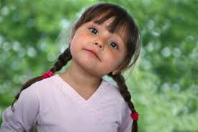
”How do you Function?”

Slide 34
Child Functioning
Who is this Child?
What do we know about the child?
What do others know about this child?
What do we see?
What do others see?
OVERALL functioning-day to day-not just the one time we see them!
Things to Consider:
  AGE
  MILESTONES
  HABITS
  LIKES/DISLIKES
  DAILY ABILITIES
  NEEDS
  GOALS-Older youth
  SCHOOL/SOCIAL EXPERIENCES
  FAMILY INTERACTION
Notes:
Reference CFOP 170-1 for ages and stages

Slide 35

What are we answering?
Child functioning answers:
  Whether or not children are developing on target or if they have needs related to maltreatment that may need to be addressed;
  Gives us an understanding of how the child is developing in regards to family and social relationships;
  Gives us an understanding of how others view the child.
Notes:
Reference CFOP 170-1 for ages and stages

Slide 36

Why we NEED to KNOW
Why do we need to know?
  Children that are safe - we need to confirm that their needs are being met by their parents/caregivers
  Children that are unsafe need to have their needs addressed (Well-Being):
    Mental Health
    Physical Health
    Social Interaction
Notes:
Reference CFOP 170-1 for ages and stages

Slide 37
Examples of Sufficient Child Functioning
Sufficient Domains Answer:
  Who is this child?
    What are the needs of this child?
    What are the strengths of this child?
Notes:
Reference the case examples provided during Learning Circle Session #1

Slide 38
Questions?
Notes:
This slide is not in the participant guide.

Slide 39

”How do you Function?”

Slide 40
Adult Functioning
Who are the parents/caregivers as PEOPLE?
What do we know about parent/caregiver?
What do others know about the parent/caregiver?
What do we see?
What do others see?
OVERALL functioning - day to day - not just when we see them.
Things to Consider:
  LIFE EXPERIENCES
  HABITS-Good and Negative
  LIKES/DISLIKES
  DAILY ABILITIES
  NEEDS
  EMPLOYMENT
  SOCIAL EXPERIENCES
    Relationships with others
  FAMILY INTERACTION
Notes:
Reference CFOP 170-1 for ages and stages

Slide 41
What are we Answering?
Adult functioning answers:
  Whether or not parents/caregivers are able to manage their lives - currently and historically;
  Gives us an understanding of how the parents/caregivers are managing negative family conditions-currently and historically;
  Gives us an understanding of how others view the parents/caregivers;
  Informs how parents/caregivers actions/behaviors/emotions are or are not resulting in threats to child safety.
.
Notes:
Reference CFOP 170-1 for ages and stages

Slide 42
Why WE need to KNOW
Why do we need to know?
  Children that are safe - we need to confirm that their parents/caregivers are able manage their own lives in order to provide safety for their children.
  Children that are unsafe - we need to understand how the parents/caregivers actions have resulted in the unsafe family condition in order to sufficiently plan for safety and to guide further case management actions.
Notes:
Reference CFOP 170-1 for ages and stages

Slide 43
Examples of Sufficient Adult Functioning
Sufficient Domains Answer:
  Who are the parents/caregivers as PEOPLE?
    What has shaped how they manage their lives?
    How are they managing their lives?
    What are their strengths and needs?
    What are the parents/caregivers’ actions/behaviors/emotions that are resulting in danger?
Notes:
Reference the case examples provided during Learning Circle Session #1

Slide 44
Questions?
Notes:
This slide is not in the participant guide.

Slide 45
Practice: Documenting YOUR Domains
Working within your small groups:
  Review your case information;
  Document YOUR child functioning and adult functioning domains;
  Share your domains with your group for feedback and analysis;
  Refine domains if applicable for sufficiency.

Slide 46
Learning Circle Session #3: Take Away
Plan for Learning Circle Session #4:
  Focus on Parenting General and Parenting Discipline;
  Prepare for discussion and writing of parenting general and parenting discipline domains for Learning Circle Session #4;
Take Away from today:
  What did you find helpful?
  Questions still needing to be answered?
  More time on….

Slide 47
Documenting a Sufficient Family Functioning Assessment
Learning Circle Session #4
What is Parenting General?
What is Parenting Discipline/Behavior Management?

Slide 48
Learning Circle Session #4: Welcome Back
Thoughts or Reflections from Learning Circle Session #3?
  Questions from Session #3?
  Feedback from Session #3?
  Reflections Session #3 ?

Slide 49
Parenting General
Parenting practices;
Belief about being a parent;
Reasons for being a parent;
Plan and approach to parenting;
Daily parenting practices;
Struggles and Challenges with parenting.
Things to Consider:
  AGE OF KIDS
  STRUCTURE/ROUTINE
  INVOLVEMENT WITH CHIDLREN
    School
    Activities
  NEEDS OF KIDS
  FAMILY INTERACTION
    Co-parenting
    Blended families

Slide 50
What are we answering?
Parenting General answers:
  Whether or not parents/caregivers are providing for the care, structure, and development of their children to meet their children’s needs;
  Gives us an understanding of how the parents/caregivers view their role and responsibilities as caregivers;
  Gives us an understanding of how others view the parenting.
Notes:
Reference CFOP 170-1 for ages and stages

Slide 51
Why we NEED to KNOW
Why do we need to know?
  Children that are safe - we need to confirm that their needs are being met by their parents/caregivers.
  Children that are unsafe - we need to have someone that is providing for their well-being:
    Food, shelter, supervision;
    Emotional and physical needs;
    Alignment and bonding.

Slide 52
Examples of Sufficient Parenting General
Sufficient Domains Answer:
  WHO parents/caregives the children and HOW they parent their children?
    What are the needs of the children and how are the parents/caregivers meeting those needs?
    Do parents/caregivers understand the role of parenting and are they demonstrating parenting practices that are supporting and guiding their children?
Notes:
Reference the case examples provided during Learning Circle Session #1

Slide 53
Questions?
Notes:
This slide is not in the participant guide.

Slide 54
Parenting Discipline/Behavior Management
What expectations do parents/caregivers have for their children?
How do they communicate those expectations?
What are the rewards and consequences for the child when expectations are or are not met?
What are the roles within the household for discipline and management of behavior?
Things to Consider:
  AGE OF THE CHILDREN
  RULES
    Established or not
    Understood by the household
  CONSQUENCES
    What are they and are they known?
    Are they reasonable?
  RATIONALE FOR RULES/EXPECTATIONS
  ROLES OF CAREGIVERS
Notes:
Reference CFOP 170-1 for ages and stages

Slide 55
What are we Answering?
Parenting Discipline answers:
  Whether or not parents/caregivers are able to manage children;
  Gives us an understanding of how the parents/caregivers are managing children’s emotional and social development around norms;
  Gives us an understanding of how others view the parents/caregivers expectations and consequences;
  Informs how parents/caregivers actions/behaviors/emotions when managing children’s behaviors are or are not resulting in threats to child safety.
.
Notes:
Reference CFOP 170-1 for ages and stages

Slide 56
Why WE need to KNOW
Why do we need to know?
  Children that are safe - we need to confirm that their parents/caregivers are able manage the development of children in regards to norms and structure.
  Children that are unsafe - we need to understand how the parent/caregivers inability to manage discipline and behaviors of children have resulted in the unsafe family condition in order to sufficiently plan for safety and to guide further case management actions.
Notes:
Reference CFOP 170-1 for ages and stages

Slide 57
Examples of Sufficient Parenting Discipline/Behavior Management
Sufficient Domains Answer
Rules/Expectations
Consequences of Actions-Both Positive and Negative
    What are the rules/expectations within the household?
    Are the rules/expectations reasonable and appropriate for the children in the home?
    Is the family aligned with the rules/expectations?
    Is there variation in the rules and expectations based upon the parent/caregiver or the child?
Notes:
Reference the case examples provided during Learning Circle Session #1

Slide 58
Questions?
Notes:
This slide is not in the participant guide.

Slide 59
Practice: Documenting YOUR Domains
Working within your small groups:
  Review your case information;
  Document YOUR parenting general and parenting discipline/behavior management domains;
  Share your domains with your group for feedback and analysis;
  Refine domains if applicable for sufficiency.

Slide 60

Learning Circle Session #4: Take Away
Take Away from the Learning Circle Sessions:
  What did you find helpful?
  Questions still needing to be answered?
  More time on….
Notes:
This slide will be used if the learning circle is four days long versus one day. If only one day, remove slide from presentation and participant guides.

