Slide 1
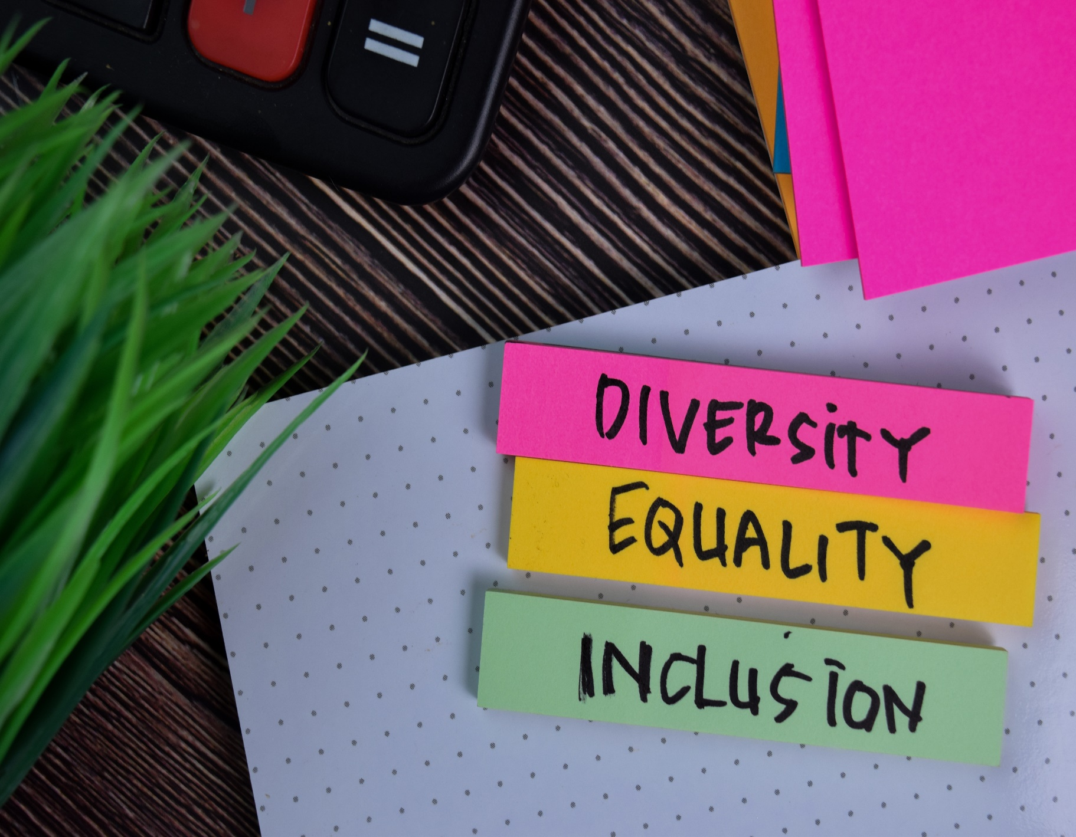
Supporting Social Inclusion and Advocacy
Module 7
Notes:
IN THIS NEXT MODULE OF OUR RECOVERY MANAGEMENT CURRICULUM WE ARE GOING TO EXPLORE
SUPPORTING SOCIAL INCLUSION AND ADVOCACY.

Slide 2
Module 7 Outline
Learning Objective 3
Learn to apply the best-practice of recovery support services
3
Learning Objective 4
Learn how social inclusion and advocacy impact recovery
4
Learning Objective 2
Identify services that are related to community integration
2
Learning Objective 1
Identify ways to involve environmental supports in the individual’s treatment and overall recovery
1

Slide 3
Core principle
Supporting Social Inclusion and Advocacy
Notes:
IN THIS NEXT SECTION WE ARE GOING TO EXPLORE
THE CORE PRINCIPLE OF SUPPORTING SOCIAL INCLUSION AND ADVOCACY.

Slide 4
Why Focus on Supporting Social Inclusion and Advocacy ?
Individuals living with substance use and mental health challenges have the right to access the same social, economic, educational, and employment opportunities as everyone else
Advocacy supports equal access to:
Housing
Transportation
Education
Employment
Income security
Health care
Civic participation
Mental Health Commission of Canada, 2015
Notes:
Individuals in recovery face various challenges in our society.
Share the social determinants of health:
Housing
Transportation
Education
Employment
Income security
Health care
Civic participation
Share that there could be a negative impact on the individual’s recovery if they do not have equal access to the main social determinants of health.

Slide 5
Why Focus on Supporting Social Inclusion and Advocacy ?
Fostering social inclusion means ensuring that individuals have opportunities for active community involvement and citizen participation.
Recovery-oriented behavioral health services help individuals in various ways.
Connect to their communities of choice
Assist in maintaining naturally occurring supports and networks
Promote a focus on social inclusion
Exercise citizenship rights
Access rights to basic needs and sources of income such as social security/disability
Mental Health Commission of Canada, 2015
Notes:
Social inclusion ensures opportunities for the individuals we serve to become involved with the community and participate as a community member.
As providers, we help connect the individuals we serve to their community and help them access their basic needs.

Slide 6
Social inclusion as a standard of care
Social inclusion is the act of making all groups of people within a society feel valued and important
Factors of social inclusion are social class, poverty, minority status, educational status, disability, culture, and language
Individuals living in recovery experience social exclusion
In the recovery process, there are still major barriers and obstacles to social inclusion
Social inclusion improves overall health and well-being
Magellan Healthcare, 2020
Notes:
Social inclusion is about making everyone feel valued and important.
The individuals we serve face social exclusion through stigma and discrimination.
Social inclusion improves overall health and well-being
Magellan Healthcare webinar Social Inclusion and Recovery https://www.magellanhealthcare.com/documents/2020/05/6510.pdf/

Slide 7
social inclusion and the role it plays in the recovery journey
Strong link to health and wellbeing
Provides equal access to basic needs
Eliminates or reduces barriers and challenges in recovery
Person-driven
Notes:
Emphasize that social inclusion helps the individual feel part of the community and not isolated from the community.
Remind the participants that we have understand social exclusion from the perspective of the person to effectively provide access to specific services.

Slide 8
Values & attitudes
Supporting Social Inclusion and Advocacy
Notes:
IN THIS NEXT SECTION WE ARE GOING TO EXPLORE THE VALUES AND ATTITUDES THAT ARE NECESSARY TO PROMOTE
THE CORE PRINCIPLE OF SUPPORTING SOCIAL INCLUSION AND ADVOCACY.
.

Slide 9
Social inclusion Values and attitudes
Accept and nurture the contribution of naturally occurring supports, community connections, and opportunities outside of behavioral health services to support a person’s recovery
Be willing to challenge barriers to social inclusion, outside of and within your organization, and to advocate for equity
Uphold the right of people experiencing behavioral health challenges to participate in community and social settings as full and equal citizens
Notes:
Uphold the right of people experiencing behavioral health challenges to participate in community and social settings as full and equal citizens.
All individuals have the right to participate in community and social settings.
All individuals are viewed as full and equal citizens.
Accept and nurture the contribution of naturally occurring supports, community connections, and opportunities outside of behavioral health services to support a person’s recovery.
Acceptance of the individual will help the individual feel seen and valued.
Be willing to challenge barriers to social inclusion, outside of and within your organization, and to advocate for equity.
Recognition of challenges and barriers and taking action to ensure that the individual has access to services is key to ensuring inclusion.

Slide 10
Social inclusion Values and attitudes
Value Diversity
Value all contributions from diverse groups to the social, economic, and cultural vitality of society
Respect the individual’s right to make choices that affect and impact their lives
Recognize the individual’s universal rights to services
Shookner, M and Social Inclusion Reference Group Atlantic Region (2002)
Notes:
Highlight the following:
Value the diversity and the unique needs of the individuals that we serve.
Respect for personal choice and autonomy helps the individual feel included in services and within the community.
Each individual we serve has the right to access services.
Shookner, M and Social Inclusion Reference Group Atlantic Region (2002). An Inclusion Lens: Workbook for Looking at Social and Economic Exclusion and Inclusion. http://www.oaith.ca/assets/files/Publications/inclusion_lens.pdf

Slide 11
advocacy in recovery core values
Respect - Honor the individual's right to autonomy
Diversity - Recognize the diverse needs of each individual
Collaboration - Learn from the individual
Inclusion - Provide access to all services and make the individual feel valued and important
Trust - Demonstrate trust and respect for the person’s right to autonomy
Equality - Ensure equal access to services and resources
Notes:
Part of these values is recognition of the individual’s autonomy, self-determination, and choice.

Slide 12
What we know
Supporting Social Inclusion and Advocacy
Notes:
IN THIS NEXT SECTION WE ARE GOING TO EXPLORE THE KNOWLEDGE BASE THAT IS NECESSARY TO PROMOTE
THE CORE PRINCIPLE OF SUPPORTING SOCIAL INCLUSION AND ADVOCACY.

Slide 13
Needed Knowledge base
Understanding certain concepts is necessary to put into practice Supporting Social Inclusion and Advocacy.
Know how to apply the Inclusion Lens
Recognize the universal right of inclusion
Understand the concepts of diversity, inclusion, equity, and autonomy
Notes:
Explain that efforts must be made to provide individuals with opportunities and access to services that address their unique needs.
Emphasize the importance of understanding that certain concepts are necessary to put into practice Supporting Social Inclusion and Advocacy.
Know how to apply the Inclusion Lens.
A new perspective to look at the root causes of old problems, like poverty, discrimination, disadvantage, and disability.
The term “Inclusion Lens” used here is a shorthand way of looking at social and economic exclusion and inclusion.
Shookner, M and Social Inclusion Reference Group Atlantic Region (2002). An Inclusion Lens: Workbook for Looking at Social and Economic Exclusion and Inclusion. http://www.oaith.ca/assets/files/Publications/inclusion_lens.pdf
Recognize the universal right of inclusion.
Consider the living conditions that can pose challenges to one’s recovery such as:
Access to health care
Poverty
Shelter
Access to services
Under/Unemployment
Under/Uninsured

Slide 14
Needed Knowledge base
Understand that social inclusion is a determinant of health and well-being and know how to make this a focus of practice
Recognize the potentially negative impact of poor and unequal living conditions on health, mental health, and recovery
Have up-to-date information about community services and resources for housing, education, transportation, employment, and income supports
Maintain knowledge of current legislation, instruments, protocols, and procedures governing people’s human and legal rights
Mental Health Commission of Canada, 2015
Notes:
Emphasize the impacts of unequal living conditions on recovery.
This means going far beyond simply “treating the symptoms and conditions” and considering the living conditions that can pose challenges to one’s recovery.

Slide 15
Needed Knowledge base
Go beyond the community resource guides
Know the community providers for housing, education, transportation, employment, and income supports
Meet the staff and visit the community organization to “see first-hand” what the individual may experience
Build a collaborative partnership to provide a “warm hand-off” to these providers to ensure a continuum of care for the individual
Establish a “warm hand-off” to initiate face-to-face contact between the individual and the contact for the referring organization
Notes:
Highlight the following:
Collaborative partnerships with network supports/community integration indicates that there are efforts being made in the planning and delivery of services.
These partnerships involve environmental supports in the individual’s treatment and overall recovery.
It is important to maintain these relationships as well as knowledge of current legislation, instruments, protocols, and procedures governing people’s human and legal rights.

Slide 16
HOW TO ADVOCATE FOR ACCESS TO SERVICES
Identify and maintain current roles, relationships, and activities with community organizations
Encourage the discovery of new sources of interest, meaning, and value
Identify the skills required to pursue new interests and develop, practice, and rehearse those new skills
Review progress regularly and plan accordingly
Notes:
Emphasize the importance of maintaining relationships with organizations and other support services in the community.
Share that maintaining these relationships help the with social inclusion by:
Becoming involved
Connect to a sense of belonging

Slide 17
Community Partnerships foster social inclusion
Becoming involved with social groups offers a sense of meaning
Motivating individuals to engage and befriend other group members, provides a sense of wellbeing, purpose, and belonging.
Forging connections with others hope, healing, and empowerment (Buckingham et.al, 2017)
Notes:
Accounts from persons in recovery make clear; much of what is being recovered is a way of being in the company of others.
Internal condition called connection captures the aspect of recovery that has to do with rejoining the social world--what some have called "getting a life."
References
Buckingham, S.A. & Best, D. (2017). Addiction, Behavioral Change and Social Identity: The path to resilience and recovery. Taylor & Francis Kindle Edition.bid.

Slide 18
impact of forming collaborative community partnerships
Fosters personal autonomy and supports personal choice by providing various recovery support services
Provides resources and support services to foster healthy relationships with friends, family, and the community
Promotes peer-led initiatives by providing recovery support services
Alleviates distress and lessens the possibility of setbacks or harmful risk by identifying gaps in services through asset and resource mapping
Guidelines for Recovery-Oriented Practice (2015)
Notes:
Emphasize connection and the role it plays in personal-autonomy, self-determination, empowerment, motivation, adherence to treatment and recovery plan, self-management, and resilience.

Slide 19
Network Supports/Community Integration
Demonstrates active involvement with community referrals and resources
Involves members of the individual’s support network in their treatment and recovery process (family, sponsor, recovery network)
Promotes inclusion with services such as:
Self-help
Non-behavioral health activities
Vocational services
Notes:
Demonstrates active involvement with community referrals and resources.
The individual will be involved with services related to community integration.
Involves members of the individual’s support network in their treatment and recovery process (family, sponsor, recovery network).
The individuals are selected by the individual to participate in their recovery.
Promotes inclusion with services such as:
Self-help
Self-help groups that are part of the recovery services
Non-behavioral health activities
Includes vocational, educational, recreational, social, or other interests and hobbies.
Vocational services
Job assessments, development, placement, coaching, and ongoing supports.

Slide 20
Advocating for Access to social Resources
When collaborating with organizations as part of social inclusion activities it is helpful to provide information and support so that they understand:
The skills of the individual joining them
The areas in which the individual may require help
How they might assist the individual adjust to their new role and environment
Notes:
Highlight the following to support the content on the slide:
A key role is to support individuals served to regain their place in the communities, take part in mainstream activities, and use opportunities for growth along with everyone else.
Supporting an individual to join and be an active member of his or her local bowling league – as opposed to a group outing for bowling that is a part of a treatment program.
Dr. David Best, an international expert on social inclusion, recommends a combination of two well-known approaches in this area - Asset-Based Community Development and Assertive Linkage (Best etal 2016).
References
Best, D., Irving, J., Collinson, B., et al. (2016). Recovery networks and community connections: Identifying connection needs and community linkage opportunities in early recovery populations. Alcoholism Treatment Quarterly, 35:1, 2-15, DOI: 10.1080/07347324.2016.1256718

Slide 21
The Inclusion Lens
The term “Inclusion Lens” is a way of looking at social and economic exclusion and inclusion.
The Inclusion Lens provides tools and resources to combat social exclusion by reducing or eliminating the circumstances and habits that lead to (or have led to) social exclusion.
Social exclusion is the inability of our society to keep all groups and individuals within reach of their full potential and participating fully in society in terms of opportunities, resources, voice, and respect for rights.
Shookner, M and Social Inclusion Reference Group Atlantic Region (2002)
Notes:
Social inclusion is a strategy to address the circumstances that excluded the individual.
Shookner, M and Social Inclusion Reference Group Atlantic Region (2002). An Inclusion Lens: Workbook for Looking at Social and Economic Exclusion and Inclusion. http://www.oaith.ca/assets/files/Publications/inclusion_lens.pdf

Slide 22
The road to Social Inclusion
The identification and presence of challenges
does not mean that there should be lowered expectations for those individuals.
(“Really can’t expect him stay clean and sober in that environment!”)
does not mean that any condition should be used as an “excuse” for a setback, relapse, or return of symptoms.
Challenges are part of the recovery landscape that an individual will need to navigate
Notes:
Highlight the following:
The need to focus on difficult and/or unequal living conditions allows us to see the “bigger picture” for individuals we serve.
The identification of such challenges allows for both staff and persons served to address them proactively.
Challenges are part of the landscape that an individual will need to navigate in their recovery.

Slide 23
Benefits of Social Inclusion and Becoming involved with social groups
Provides a sense of meaning
Develops more responsibility for self and others in the context of supportive recovery
Gains a sense of wellbeing and purposefulness that stem from a feeling of belonging
Notes:
Recovery is strongly linked to social inclusion.
There is consistent evidence showing that recovery pathways are initiated and enhanced by positive social networks and the underlying changes in social identity that is associated with the transition from stigmatized groups to positive and prosocial groups (Best etal, 2016).
There is also a growing literature that focuses on community engagement as a vital ingredient of recovery journeys, with engagement in recreational activities, training and employment, volunteering, and mutual aid and other peer activities seen as important components of a Recovery-Oriented System of Care (ROSC) (Buckingham etal, 2017)
References
Best, D., Irving, J., Collinson, B., et al. (2016). Recovery networks and community connections: Identifying connection needs and community linkage opportunities in early recovery populations. Alcoholism Treatment Quarterly, 35:1, 2-15, DOI: 10.1080/07347324.2016.1256718
Buckingham, S.A. & Best, D. (2017). Addiction, Behavioral Change and Social Identity: The path to resilience and recovery. Taylor & Francis Kindle Edition.bid.

Slide 24
Transforming services and systems To Initiate, Advocate, and Support Social Inclusion
Transformation of services and systems is…..
A paradigm shift
A process
Advocacy
Access to care
Linking to recovery support services
Linking to peers
Notes:
This slide is about setting the stage of the paradigm shift from a medical model that focuses on symptoms to a person-centered approach.
State that these four dimensions support the principles and values and will be introduced in the following slides and broken down in the upcoming modules.
Introduce to the participants that next, you will discuss recovery and their role.

Slide 25
Transforming services and systems To Initiate, Advocate, and Support Social Inclusion is working together
Create
a space for the individual receiving services to be the co-creator in the development of person-centered programming.
Learn
from individuals with lived experience.
Prioritize
workplace behavioral health.
Guideline for Recovery-Oriented Practice (2015)
Guidelines for Recovery-Oriented Practice (2015)
Notes:
When completing the slide, highlight the following:
Transforming services and systems creates a space for individuals.
The space is created by learning from individuals and prioritizing workplace behavioral health.

Slide 26
Collaborative Community Partnership, Advocacy, and Inclusion Intersect with Recovery Asset and Resource Mapping
The goal of a recovery asset and resource map is to
Guide recovery advocates toward solutions
Provide recovery support services
Identify recovery needs and gaps in services
On the following slide is an example of a recovery asset map
Notes:
Emphasize that recovery-oriented practice and service delivery are built upon mutually respectful and collaborative partnerships.
Explain that supporting another’s recovery requires reflection and awareness of one’s own culture, values, beliefs, and mental health.
Emphasize that high quality therapeutic relationships require ongoing critical reflection and continuous learning.

Slide 27
Using an assets approach to promote positive behavioral health
Actions
Determine availability of resources
Identify people, groups, networks, physical places, and cultural assets
Look through the eyes of those who use the services
Utilize “project champions”
Objectives
Promote community development
Build stronger connections
Empower individuals to self-manage and take control of their recovery
Promote protective factors
"You don't know what you need until you know what you have already."
-Anon
Notes:
Discuss the perspective of looking at the community through the eyes of those who use the services.
Iriss (2012). Using an assets approach for positive mental health and well-being. Retrieved from https://www.iriss.org.uk/resources/reports/using-assets-approach-positive-mental-health-and-well-being.

Slide 28
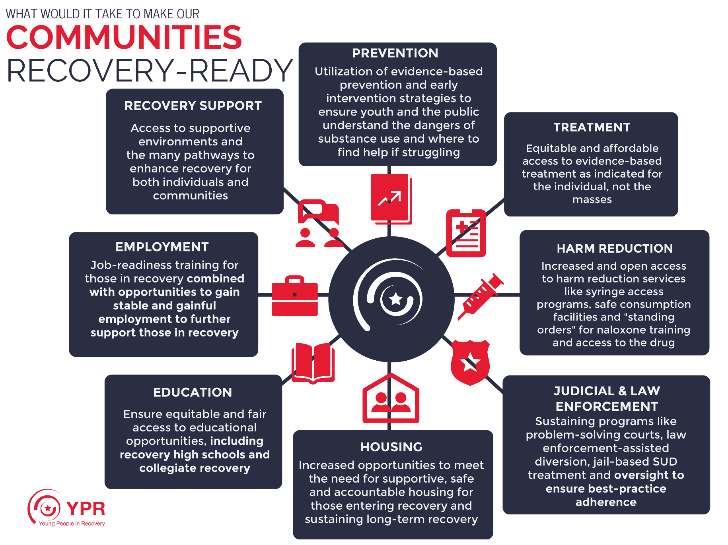
If there are gaps in any of the domains, advocacy groups would work with community partners to address thEM
(https://www.recoveryvoices.com/create-a-recovery-asset-and-resource-map ,2022)
Notes:
Review Recovery asset mapping and make the connection that part of collaboration is knowledge of services within the community.
Make the connection that part of advocacy is knowing where the gaps in services are and who to reach out to to start closing that gap.

Slide 29
Application to practice
Supporting Social Inclusion and Advocacy
Notes:
IN THIS NEXT SECTION WE ARE GOING TO EXPLORE HOW
THE CORE PRINCIPLE OF SUPPORTING SOCIAL INCLUSION AND ADVOCACY IS PUT INTO PRACTICE.

Slide 30
Skills and Behaviors required for Social Inclusion and Advocacy
Proactively draw attention to disparities, and work alongside people with lived experience and through community partnerships to mitigate disparities
Use knowledge of human and legal rights and systems operations to challenge social exclusion
Initiate discussion of recovery goals, and make referrals to services and resources that contribute to:
meaningful social engagement
education and employment opportunities
income security
housing stability
food security
general health and well-being
Notes:
Review the bulleted content and remind the participants of the following:
Social Inclusion and advocacy require collaborative partnerships to address disparities.
Knowledge of human and legal rights helps the individuals we serve to gain access to services.
Discussion of goals will drive the identification of resources to address unique needs.

Slide 31
Skills and Behaviors required for Social Inclusion and Advocacy
Create culturally safe and responsive services
Develop working relationships with community organizations, corrections, and probation and parole services
Help people connect to a family physician or community health team to address ongoing general health needs and co-occurring medical conditions
Notes:
Social Inclusion and advocacy requires:
Respect
Partnership

Slide 32
Advocate To support social inclusion By
Being
the stigma within the agency and community by using person-first language.
Creating
a culture and language of hope to foster a sense of belonging.
Reducing
non-judgmental
Notes:
Being non-judgmental
Understand the impact of culture, values, life experiences, roles, and power in interactions and relationships.
Reducing the stigma within the agency and community by using person-first language
Diversity is critical to addressing stigma.
Creating a culture and language of hope to foster a sense of belonging
Know a range of collaborative practices and communication techniques
Know the foundational elements of building trust and how to apply them to developing collaborative therapeutic relationships
Understand the relevance of the stages of change in order to align practice with a person’s motivational stage and readiness to move forward Guideline for Recovery-Oriented Practice 2015)
References:
Mental Health Commission of Canada (2015). Recovery Guidelines Ottawa, ON

Slide 33
Other ways to Advocate for social inclusion
Acknowledge
Acknowledge (with personal consent) the defined family and care givers, and circles of support of the individual served
Offer
Offer recovery events and support programs that foster healthy communication, healthy relationships, and encourage healthy community engagement
Assist
Notes:
Emphasize that advocacy and social inclusion begins with:
Acknowledging the support network
Offering recovery support services
Assisting in identifying resources
Building collaborative, mutually trusting and respectful partnerships with service users, their families and caregivers is foundational to recovery-oriented practice.
Recovery-oriented care respects the individual as a partner in all decisions that affect their behavioral health and emphasizes the importance of autonomy, self-determination, and self-management.

Slide 34
Activity
Review the domains and create your own Recovery Resource map.
Think about community groups and services for each domain and items that may be missing from each domain.
(https://www.recoveryvoices.com/create-a-recovery-asset-and-resource-map ,2022)
Notes:
Review the domains
Invite the participants to think about community groups and services for each domain and list items that may be missing from each domain.
Encourage the participants to “think outside of the box” and identify services like alternatives practices, yoga, nutrition, etc.
Take Away:
Recovery Asset Mapping will strengthen collaboration, assist with advocacy, and support personal autonomy and self-determination.
THIS CAN BE A HANDOUT

Slide 35
Questions for Reflection
Supporting Social Inclusion and Advocacy
Notes:
IN THIS NEXT SECTION WE ARE GOING TO EXPLORE QUESTIONS FOR REFLECTION REGARDING
THE CORE PRINCIPLE OF SUPPORTING SOCIAL INCLUSION AND ADVOCACY.

Slide 36
Reflective practice
Please reflect on the following questions and write down your responses.
Direct Service provider: How do support plans and service activities promote the inclusion of a person’s existing support network, social connections, and opportunities for participation in the community?
Management: How are staff members supported to be active partners in broad-based alliances that advocate for action on the social determinants of health and well-being and address discrimination?
Administrative: How do you model a positive service culture that promotes inclusion of people with lived experience and their families at all levels?
Notes:
Review reflective questions.
Encourage the participants to reflect on the questions when they return back to their tasks.

Slide 37
Connect To Hope
Recovery-Oriented Principles (CONNECT)
Practices (HOPE)
PRINCIPLES
Create a culture and language and hope
Offer a comprehensive and holistic service array
Non-judgmental
Navigating diverse needs
Engagement strategies
Collaborative relationships and reflective practice
Transforming services and systems
PRACTICES
Honor the differences and diverse needs of each individual served
Offer various opportunities and resources that support the recovery journey
Provide an environment to encourage personal control
Engage in personal recovery by understanding personal recovery narrative in the treatment process and within the community
Notes:
Review that the acronym CONNECT to HOPE anchors us in SUPPORTING SOCIAL INCLUSION AND ADVOCACY
Highlight that the principles are the essential components that reflect the beliefs and attitudes about a recovery-oriented system of care
and
The practices are how these principles “come to life” in order to facilitate a recovery-oriented system of care.
Engage in personal recovery by understanding personal recovery narrative in the treatment process and within the community
Highlight the following points:
Explain that recovery is a process that needs to be fueled by hope, expectation, and real fulfillment, as well as courage, commitment, and dedicated effort.
When services are aligned to support individuals receiving services in having control over their destiny, defining and achieving their goals, respecting their human rights, and sustaining their social and economic inclusion, recovery is promoted.
Engage in personal recovery by understanding personal recovery narrative in the treatment process and within the community.
Explain that the assisting individuals to identify strengths begins the process of engagement and helps connect to their resilience.
Emphasize the importance of alignment between principles and practices and the essential role we play in creating a recovery-oriented system of care.

Slide 38
REFERENCES
Buckingham, S.A. & Best, D. (2017). Addiction, Behavioral Change and Social Identity: The path to resilience and recovery. Taylor & Francis Kindle Edition.bid.
Iriss (2012). Using an assets approach for positive mental health and well-being. https://www.iriss.org.uk/resources/reports/using-assets-approach-positive-mental-health-and-well-being..
Magellan Healthcare webinar Social Inclusion and Recovery . https://www.magellanhealthcare.com/documents/2020/05/6510.pdf/.
Mental Health Commission of Canada (2015). Recovery Guidelines Ottawa, ON.

Slide 39
REFERENCES
The National Center on Advancing Person-Centered Practices and Systems (NCAPPS) (2020). https://ncapps.acl.gov
The National Center on Advancing Person-Centered Practices and Systems (NCAPPS) (2020). Stakeholder Engagement and Asset Mapping FAQs.
Shookner, M and Social Inclusion Reference Group Atlantic Region (2002). An Inclusion Lens: Workbook for Looking at Social and Economic Exclusion and Inclusion. http://www.oaith.ca/assets/files/Publications/inclusion_lens.pdf.

Slide 40
THANK YOU!
Questions?

