Slide 1
2018 FLORIDA YOUTH SUBSTANCE ABUSE SURVEY
St. Johns County

Slide 2
Methodology
Survey was administered in February of 2018.
Sampling strategy: schools and classrooms were selected to generate statistically representative county-level estimates.
Final sample size was 1,580 across grades 6 through 12.
The margin of error is less than 3.3 percentage points for prevalence rates for the combined middle school and high school sample.

Slide 3
Substance Use
Prevalence Rates
2018 Results

Slide 4
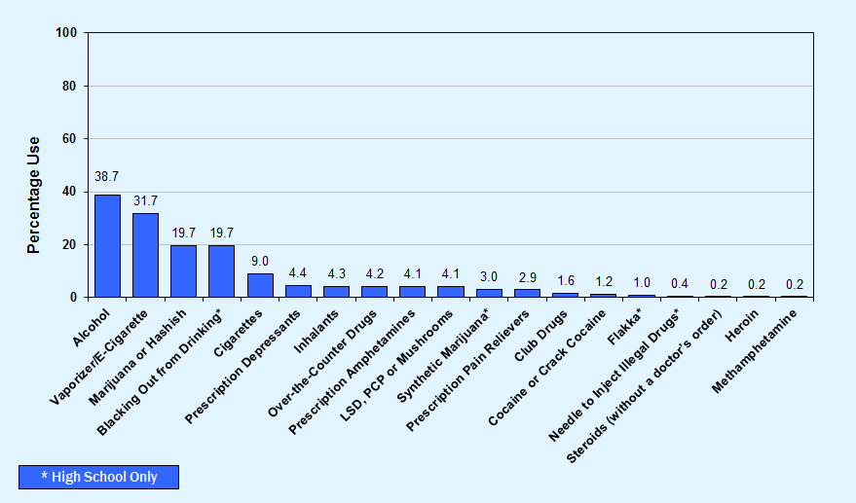
Graph 1
Lifetime use of alcohol, tobacco and other drugs among St. Johns County students, 2018

Slide 5
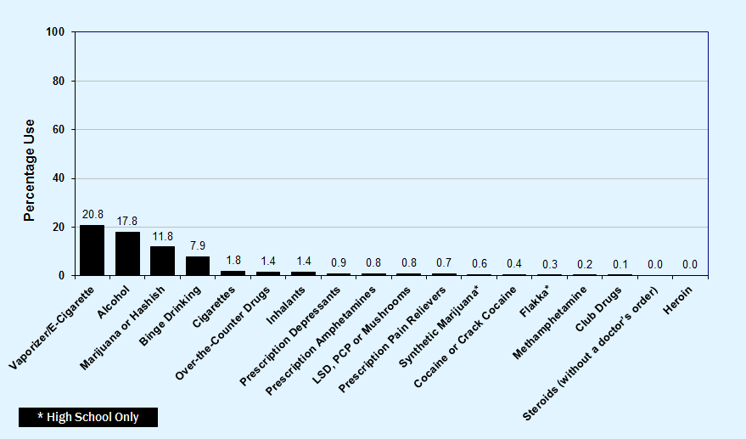
Graph 2
Past-30-day use of alcohol, tobacco and other drugs among St. Johns County students, 2018

Slide 6
Key Findings
With overall prevalence rates of 38.7% for lifetime use and 17.8% for past-30-day use, alcohol is the most commonly used drug among St. Johns County students.
After alcohol, students reported vaping/e-cigarettes (31.7% lifetime and 20.8% past-30-day) and marijuana (19.7% lifetime and 11.8% past-30-day) as the most commonly used drugs.
19.7% of high school students reported blacking out after drinking on one or more occasions.
For other drug use categories, past-30-day prevalence ranges from 1.8% for cigarettes to 0.0% for heroin and steroids.

Slide 7
Alcohol, Cigarettes
and Marijuana
2008-2018 Trends
Early Initiation and Risk of Harm
Substance Use and Driving

Slide 8
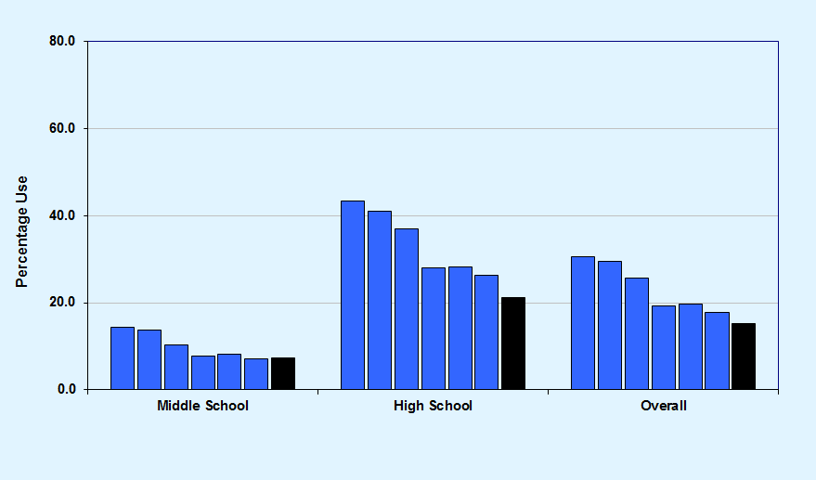
Graph 3
Past-30-day alcohol use, St. Johns County 2008-2018 and Florida Statewide 2018
St. Johns County 2008-2018
Florida Statewide 2018

Slide 9
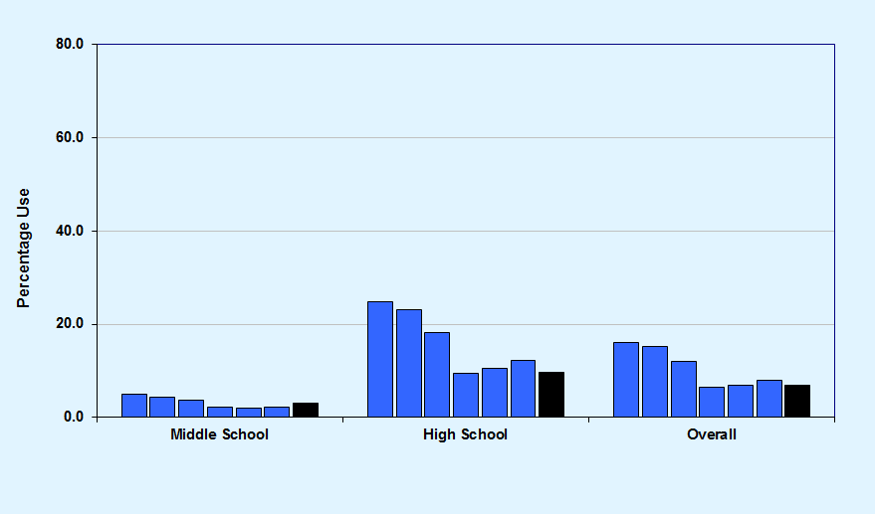
Graph 4
Binge Drinking, St. Johns County 2008-2018 and Florida Statewide 2018
St. Johns County 2008-2018
Florida Statewide 2018

Slide 10
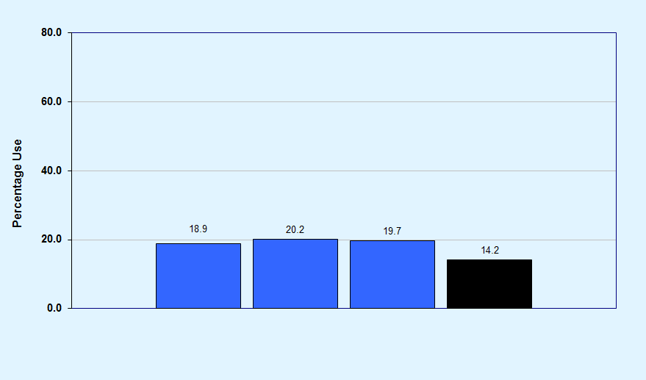
Graph 5
Blacking out from drinking, among high school students, St. Johns County 2014-2018 and Florida Statewide 2018
St. Johns County 2014-2018
Florida Statewide 2018

Slide 11
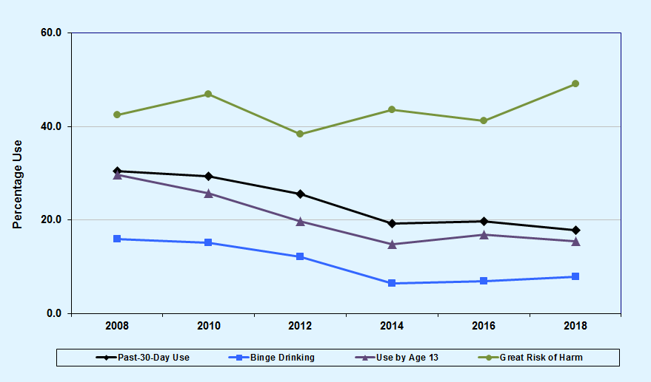
Graph 6
Alcohol trends summary for St. Johns County, 2008-2018

Slide 12
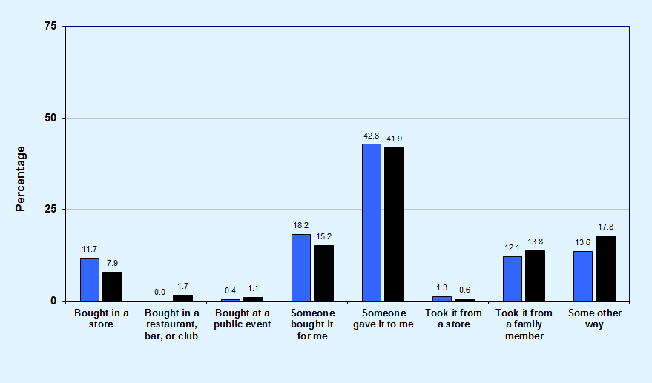
Graph 7
Usual source of alcohol within the past 30 days among high school drinkers, St. Johns County and Florida Statewide, 2018
St. Johns County
Florida Statewide

Slide 13
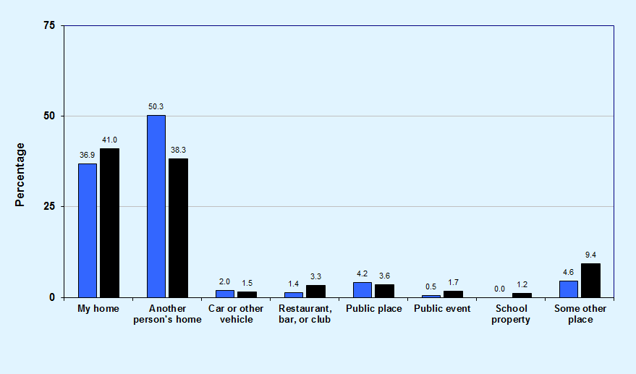
Graph 8
Usual drinking location within the past 30 days among high school drinkers, St. Johns County and Florida Statewide, 2018
St. Johns County
Florida Statewide

Slide 14
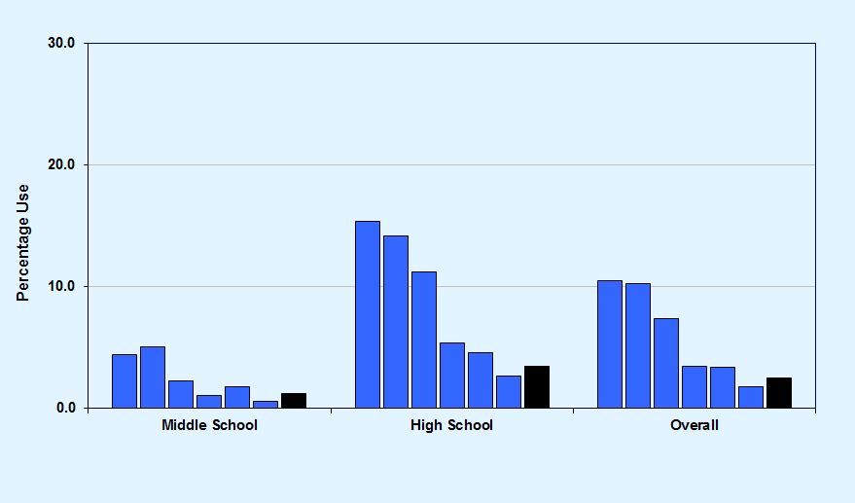
Graph 9
Past-30-day cigarette use, St. Johns County 2008-2018 and Florida Statewide 2018
St. Johns County 2008-2018
Florida Statewide 2018

Slide 15
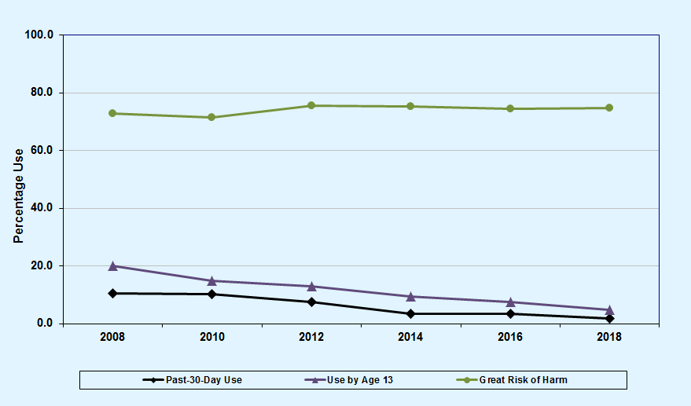
Graph 10
Cigarette trends summary for St. Johns County, 2008-2018

Slide 16
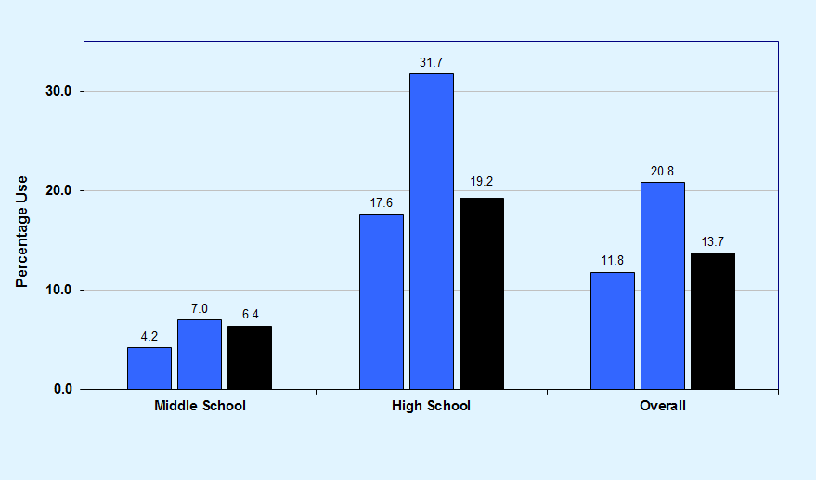
Graph 11
Past-30-day vaporizer/e-cigarette use, St. Johns County 2016-2018 and Florida Statewide 2018
St. Johns County 2016-2018
Florida Statewide 2018

Slide 17
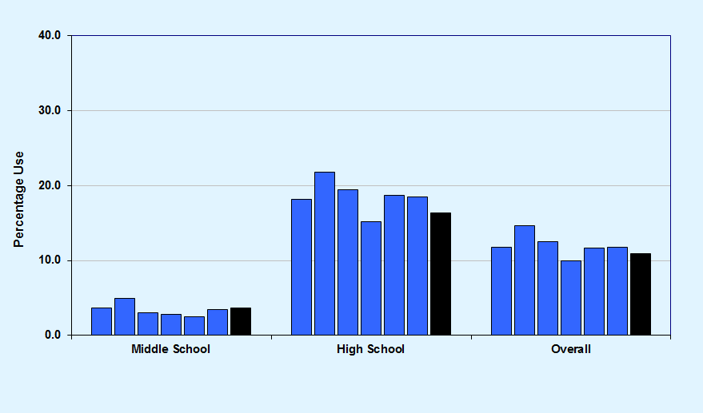
Graph 12
Past-30-day marijuana use, St. Johns County 2008-2018 and Florida Statewide 2018
St. Johns County 2008-2018
Florida Statewide 2018

Slide 18
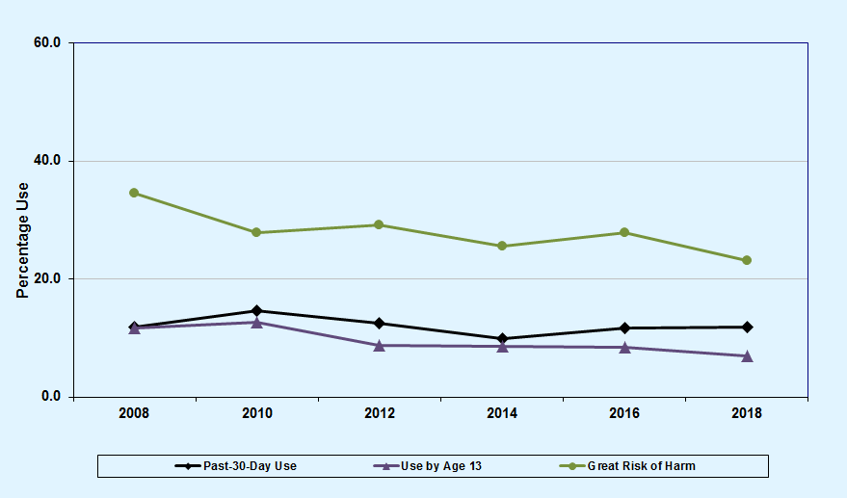
Graph 13
Marijuana trends summary for St. Johns County, 2008-2018

Slide 19
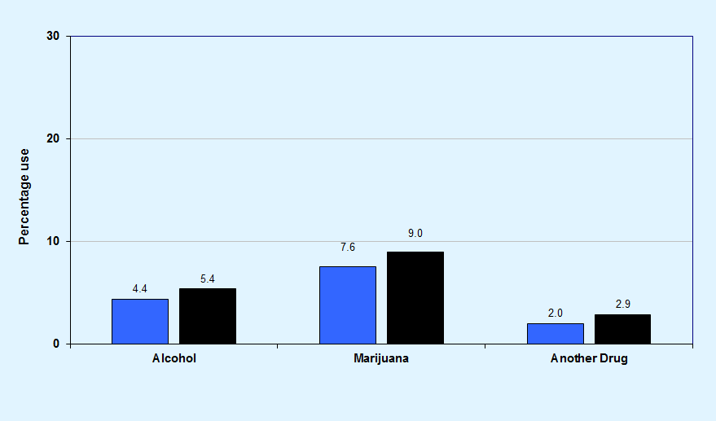
Graph 14
Substance use before or during school in the past 12 months, St. Johns County and Florida Statewide, 2018
St. Johns County
Florida Statewide

Slide 20
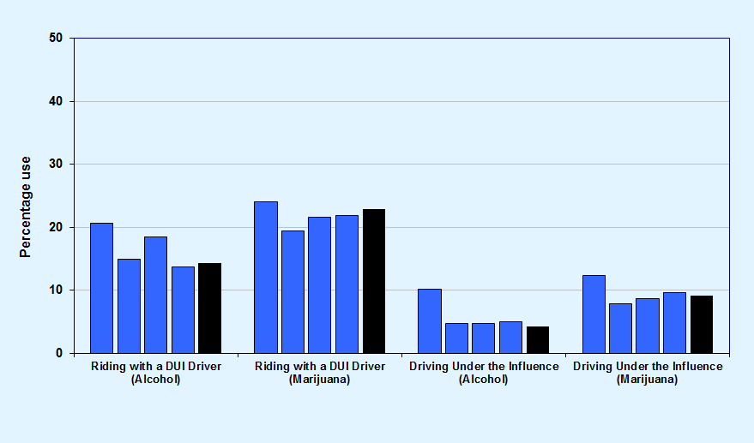
Graph 15
DUI or riding with a driver under the influence, among high school students, St. Johns County 2012-2018 and Florida Statewide 2018
St. Johns County 2012-2018
Florida Statewide 2018
Note: DUI does not imply intoxication but only indicates use prior to driving.

Slide 21
Key Findings
In St. Johns County, past-30-day alcohol use was reported at 17.8%, compared to 15.3% across the statewide sample.
Binge drinking declined from 16.0% in 2008 to 7.9% in 2018.
Past-30-day cigarette use declined from 10.5% in 2008 to 1.8% in 2018.
In the past 30 days, 13.7% of high school students have ridden in a car with a driver who was under the influence of alcohol, and 21.9% have ridden with a driver under the influence of marijuana.

Slide 22
Other Illicit,
Over-the-Counter, and
Prescription Drugs
2008-2018 Trends

Slide 23
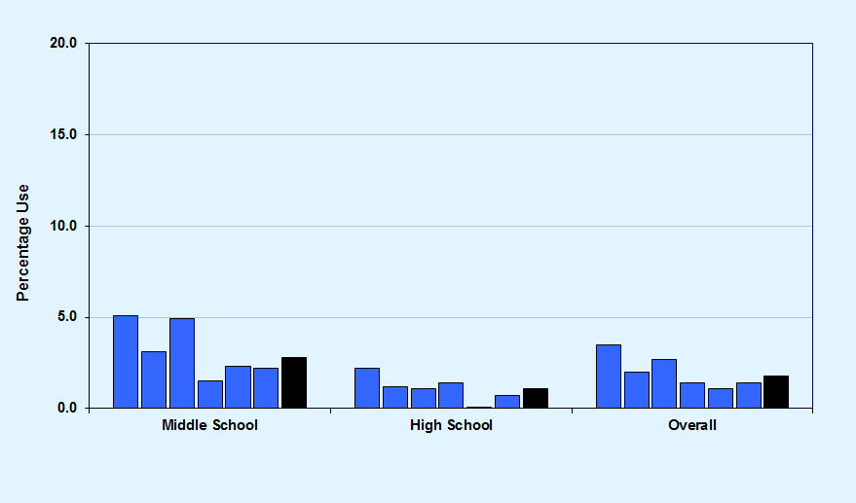
Graph 16
Past-30-day inhalant use, St. Johns County 2008-2018 and Florida Statewide 2018
St. Johns County 2008-2018
Florida Statewide 2018

Slide 24
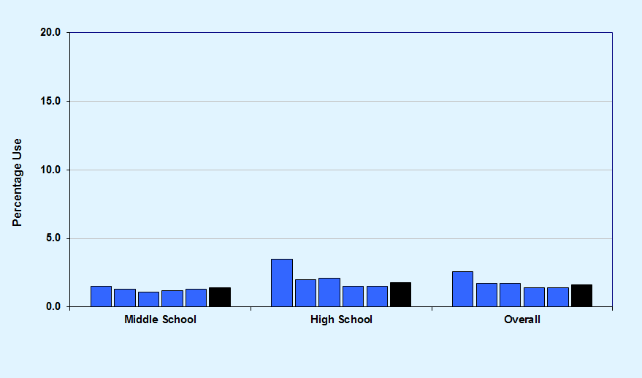
Graph 17
Past-30-day over-the-counter drug use, St. Johns County 2010-2018 and Florida Statewide 2018
St. Johns County 2010-2018
Florida Statewide 2018

Slide 25
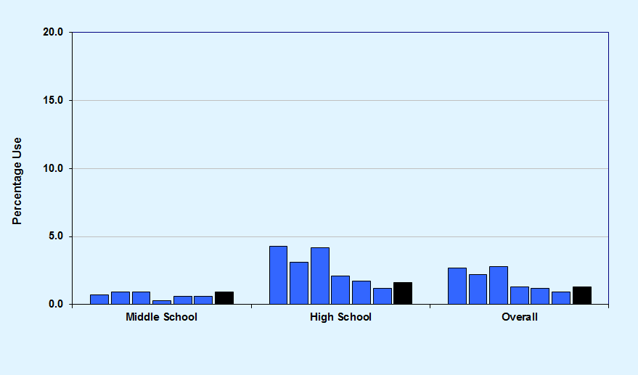
Graph 18
Past-30-day depressants use, St. Johns County 2008-2018 and Florida Statewide 2018
St. Johns County 2008-2018
Florida Statewide 2018

Slide 26
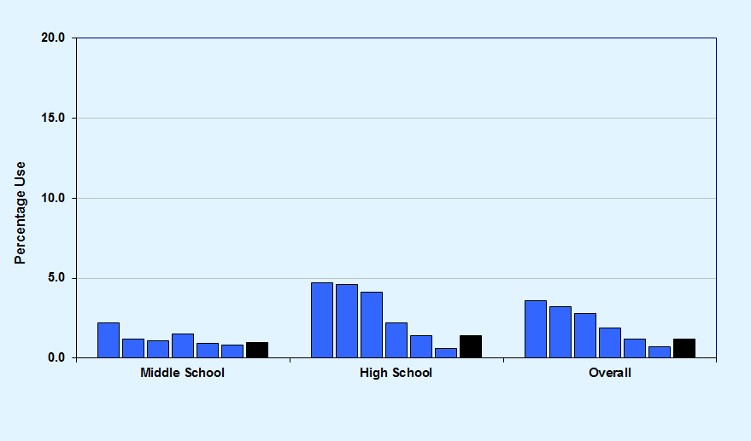
Graph 19
Past-30-day prescription pain reliever use, St. Johns County 2008-2018 and Florida Statewide 2018
St. Johns County 2008-2018
Florida Statewide 2018

Slide 27
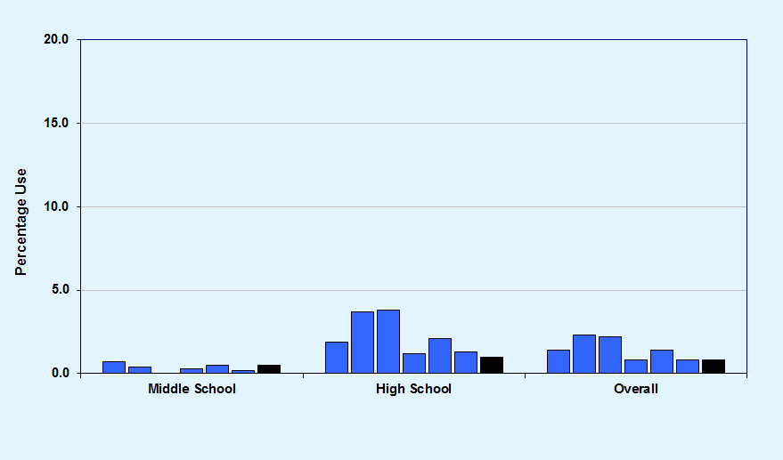
Graph 20
Past-30-day prescription amphetamines use, St. Johns County 2008-2018 and Florida Statewide 2018
St. Johns County 2008-2018
Florida Statewide 2018

Slide 28
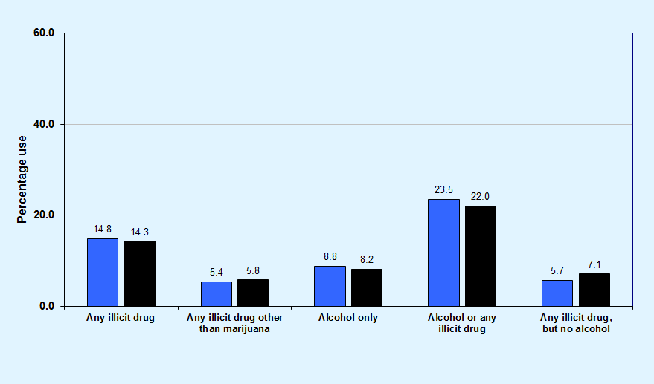
Graph 21
Past-30-day drug combination rates for St. Johns County and Florida Statewide, 2018
St. Johns County
Florida Statewide

Slide 29
Key Findings
In St. Johns County, 5.4% of surveyed students reported the use of any illicit drug other than marijuana in the past 30 days, compared to 5.8% across the statewide sample.
Past-30-day illicit drug other than marijuana use decreased from 9.3% in 2008 to 5.4% in 2018.
Among high school students, past-30-day synthetic marijuana use decreased from 3.5% in 2012 to 0.6% in 2018.
Among middle school students, 2.2% reported the use of inhalants in the past 30 days, a rate higher than any other illicit drug (except marijuana).

Slide 30
Other Antisocial Behaviors, Bullying, Symptoms of Depression, and Gang Involvement
2018 Results

Slide 31
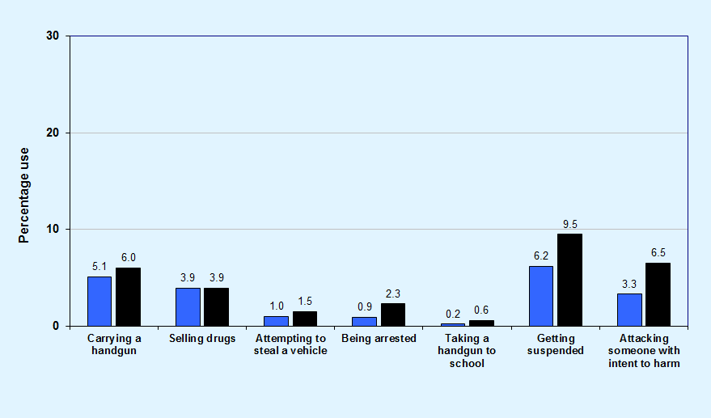
Graph 22
Comparisons of past-12-month delinquent behavior for St. Johns County and Florida Statewide, 2018
St. Johns County
Florida Statewide

Slide 32
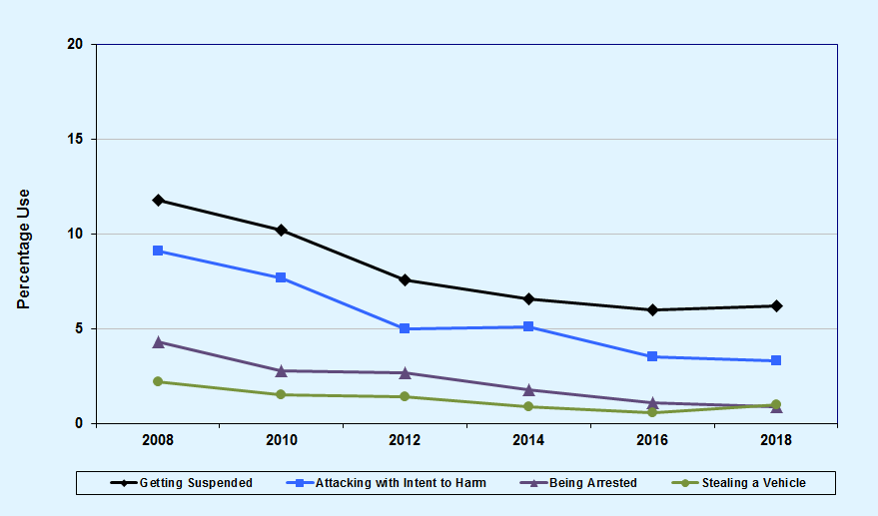
Graph 23
Other antisocial behaviors trend summary for St. Johns County, 2008-2018

Slide 33
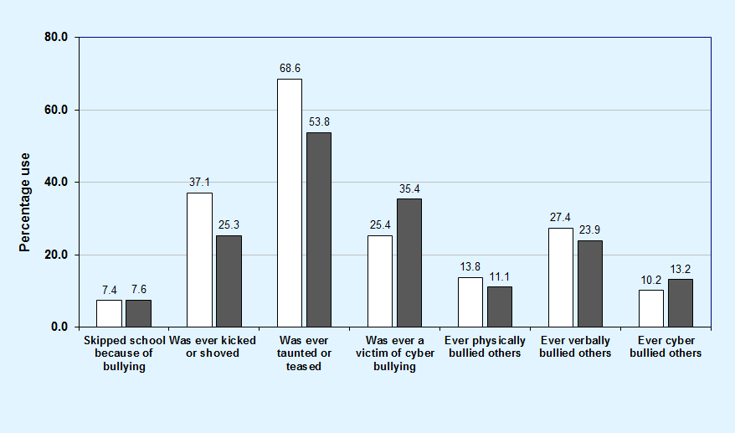
Graph 24
Bullying-related behaviors among St. Johns County middle and high school students, 2018
Middle School
High School

Slide 34
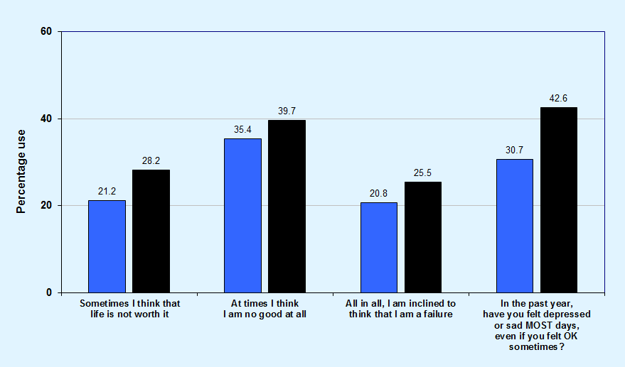
Graph 25
Comparisons of symptoms of depression for St. Johns County and Florida Statewide, 2018
St. Johns County
Florida Statewide

Slide 35
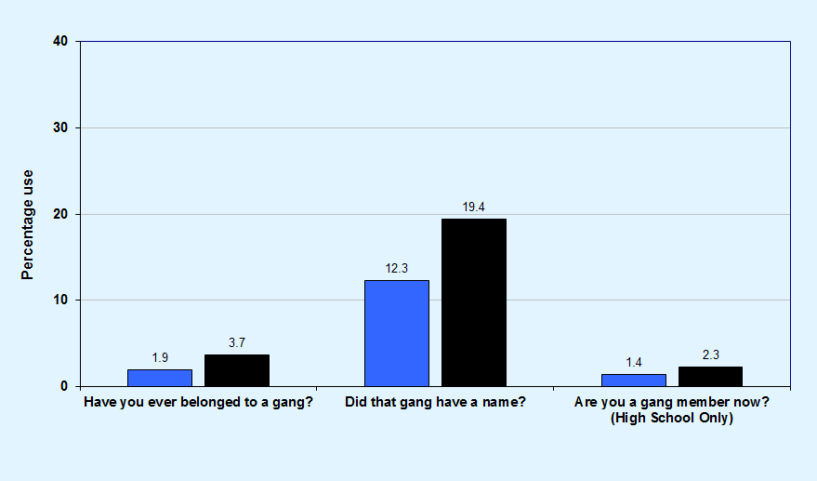
Graph 26
Gang involvement, St. Johns County and Florida Statewide, 2018
St. Johns County
Florida Statewide

Slide 36
Key Findings
In St. Johns County, prevalence rates for Attempting to Steal a Vehicle (1.0%), Being Arrested (0.9%), and Taking a Handgun to School (0.2%) are 3.0% or less.
Higher prevalence rates were reported for Getting Suspended (6.2%) and Carrying a Handgun (5.1%).
In St. Johns County, 60.3% of students have been socially bullied, 30.4% have been physically bullied, and 31.0% have been cyber bullied.
In St. Johns County, 30.7% of students reported feeling depressed or sad on most days in the past year.

Slide 37
Risk and Protective Factor Prevalence Rates for M.S. and H.S. Students
2018 Results

Slide 38
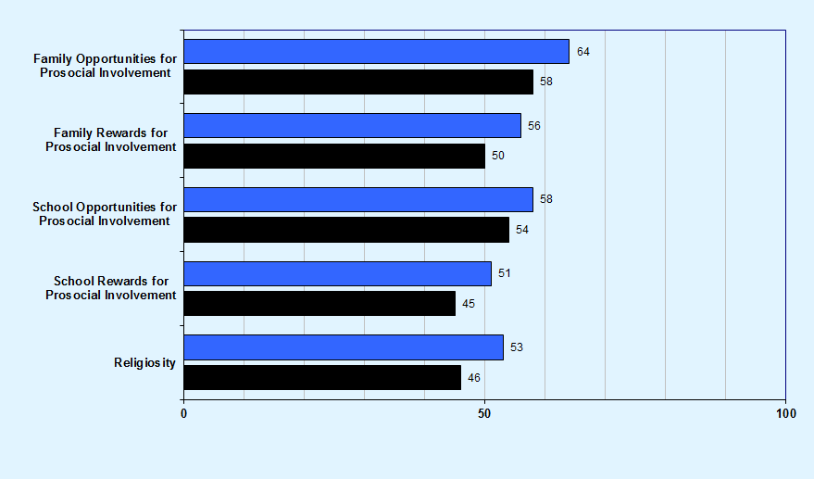
Graph 27
Protective factor prevalence rates for St. Johns County and Florida Statewide middle school students, 2018
St. Johns County
Florida Statewide

Slide 39
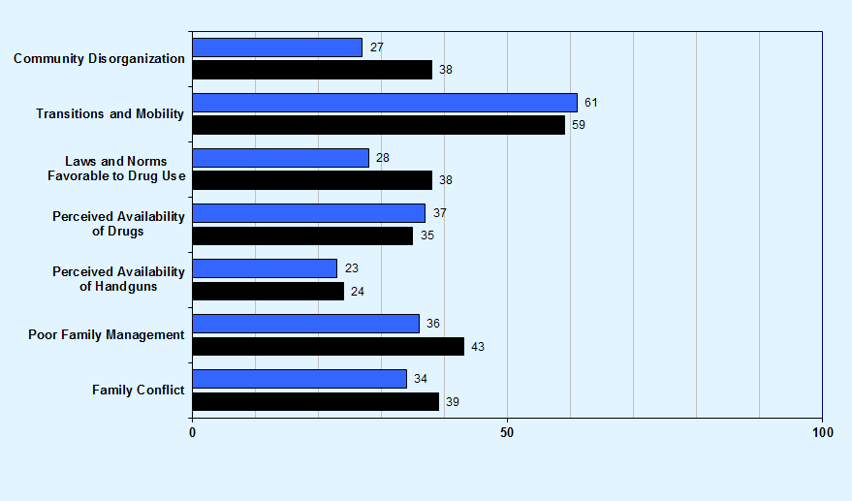
Community domain and family domain risk factor prevalence rates for St. Johns County and Florida Statewide middle school students, 2018
Graph 28
St. Johns County
Florida Statewide

Slide 40
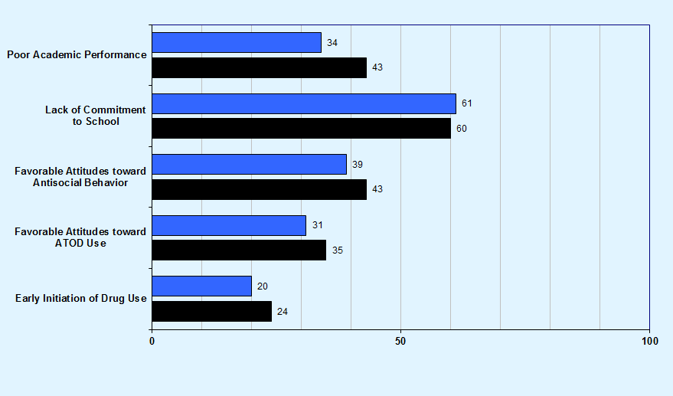
School domain and peer and individual domain risk factor prevalence rates for St. Johns County and Florida Statewide middle school students, 2018
Graph 29
St. Johns County
Florida Statewide

Slide 41
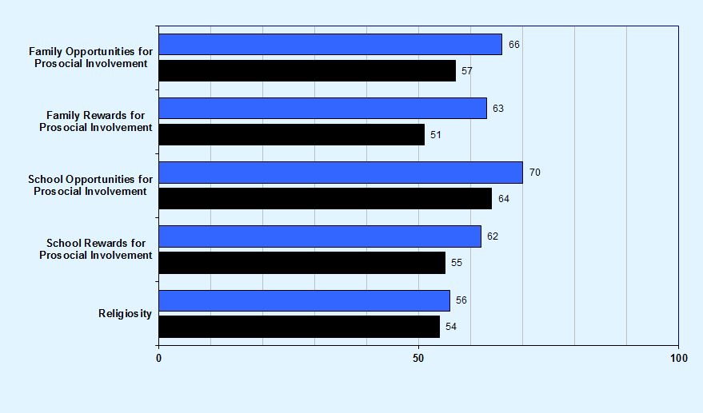
Graph 30
Protective factor prevalence rates for St. Johns County and Florida Statewide high school students, 2018
St. Johns County
Florida Statewide

Slide 42
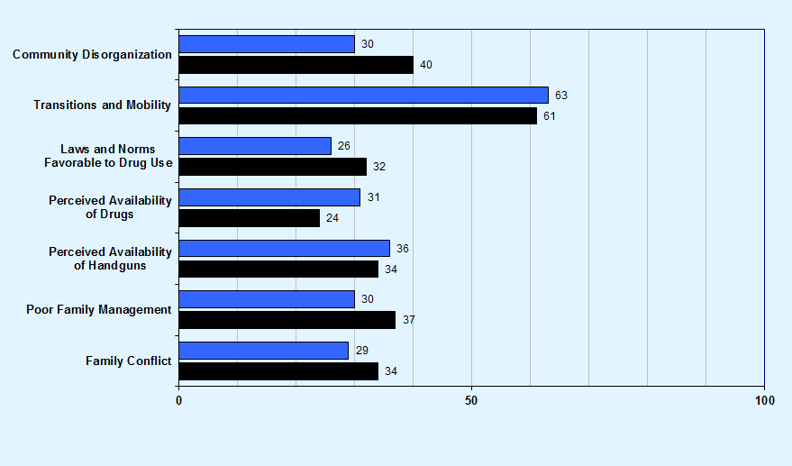
Community domain and family domain risk factor prevalence rates for St. Johns County and Florida Statewide high school students, 2018
Graph 31
St. Johns County
Florida Statewide

Slide 43
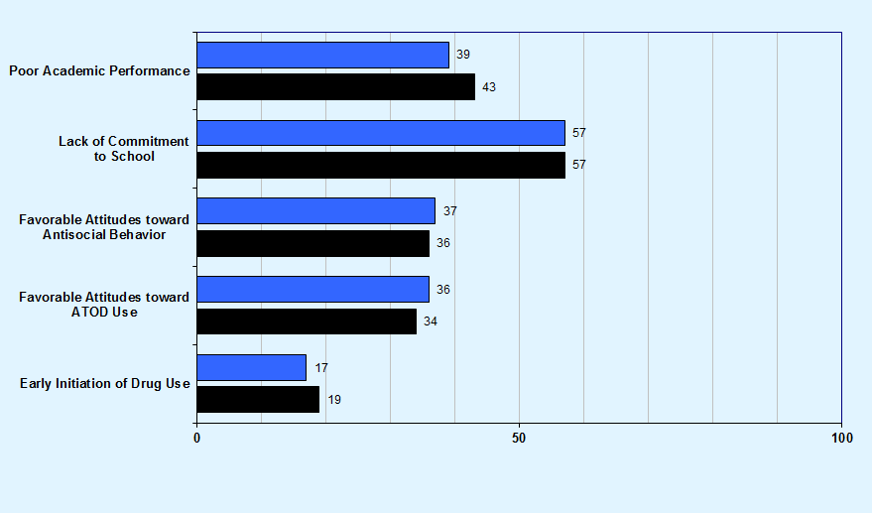
School domain and peer and individual domain risk factor prevalence rates for St. Johns County and Florida Statewide high school students, 2018
Graph 32
St. Johns County
Florida Statewide

Slide 44
Key Findings
Protective factor prevalence rates—opportunities for improvement:
Middle school students reported the lowest rates of protection for the School Rewards for Prosocial Involvement (51%) and Religiosity (53%) scales.
High school students reported the lowest rates of protection for the Religiosity (56%) and School Rewards for Prosocial Involvement (62%) scales.

Slide 45
Key Findings
Risk factor prevalence rates—opportunities for improvement:
Middle school students reported the highest rates of risk for the Transitions and Mobility (61%) and Lack of Commitment to School (61%) scales.
High school students reported the highest rates of risk for the Transitions and Mobility (63%) and Lack of Commitment to School (57%) scales.

