Slide 1
2018 FLORIDA YOUTH SUBSTANCE ABUSE SURVEY
Okaloosa County

Slide 2
Methodology
Survey was administered in February of 2018.
Sampling strategy: schools and classrooms were selected to generate statistically representative county-level estimates.
Final sample size was 2,166 across grades 6 through 12.
The margin of error is less than 2.8 percentage points for prevalence rates for the combined middle school and high school sample.

Slide 3
Substance Use
Prevalence Rates
2018 Results

Slide 4
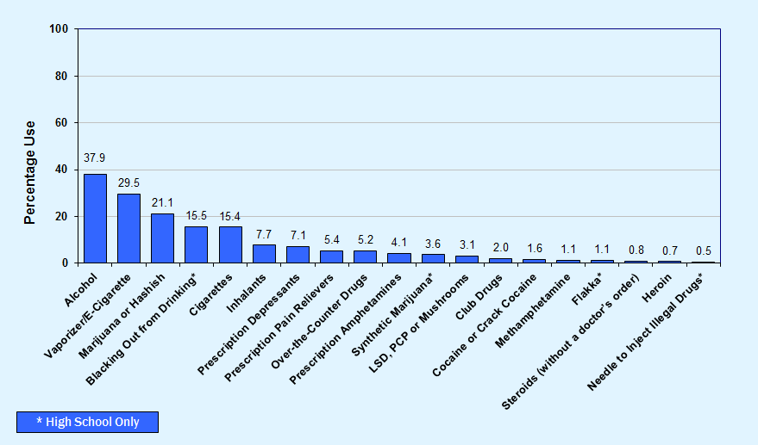
Graph 1
Lifetime use of alcohol, tobacco and other drugs among Okaloosa County students, 2018

Slide 5
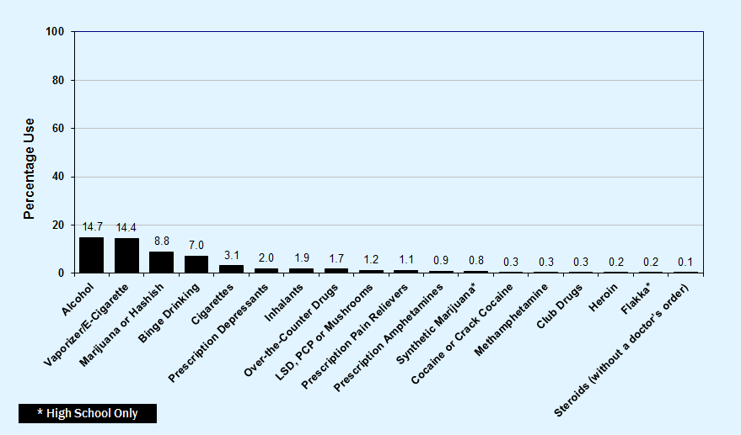
Graph 2
Past-30-day use of alcohol, tobacco and other drugs among Okaloosa County students, 2018

Slide 6
Key Findings
With overall prevalence rates of 37.9% for lifetime use and 14.7% for past-30-day use, alcohol is the most commonly used drug among Okaloosa County students.
After alcohol, students reported vaping/e-cigarettes (29.5% lifetime and 14.4% past-30-day) and marijuana (21.1% lifetime and 8.8% past-30-day) as the most commonly used drugs.
15.5% of high school students reported blacking out after drinking on one or more occasions.
For other drug use categories, past-30-day prevalence ranges from 3.1% for cigarettes to 0.1% for steroids.

Slide 7
Alcohol, Cigarettes
and Marijuana
2008-2018 Trends
Early Initiation and Risk of Harm
Substance Use and Driving

Slide 8
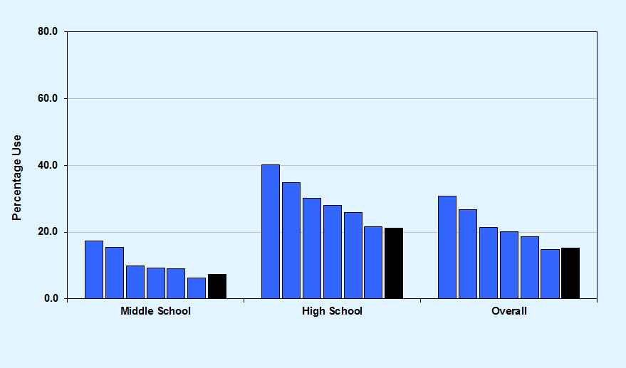
Graph 3
Past-30-day alcohol use, Okaloosa County 2008-2018 and Florida Statewide 2018
Okaloosa County 2008-2018
Florida Statewide 2018

Slide 9
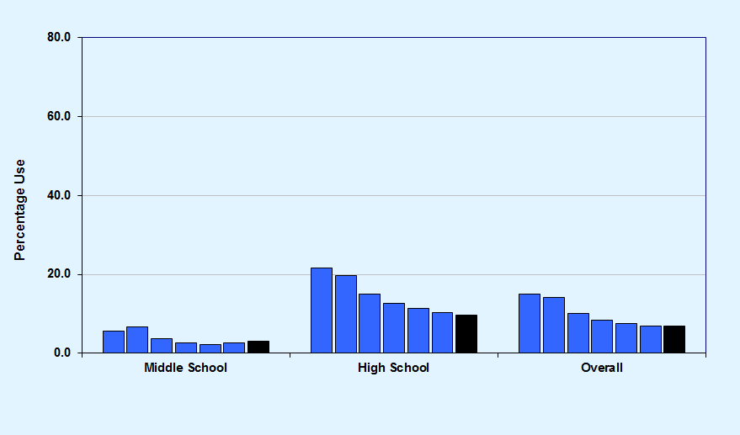
Graph 4
Binge Drinking, Okaloosa County 2008-2018 and Florida Statewide 2018
Okaloosa County 2008-2018
Florida Statewide 2018

Slide 10
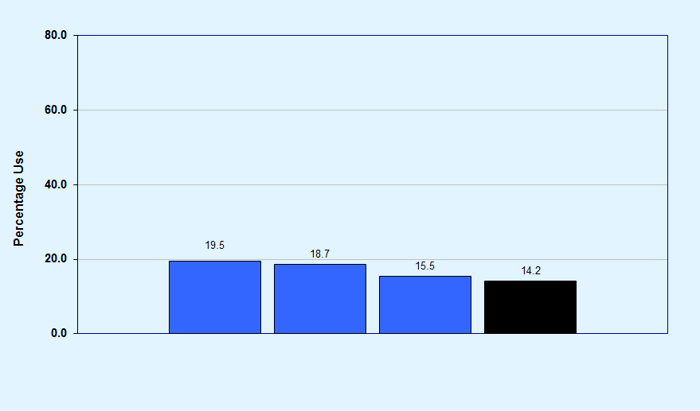
Graph 5
Blacking out from drinking, among high school students, Okaloosa County 2014-2018 and Florida Statewide 2018
Okaloosa County 2014-2018
Florida Statewide 2018

Slide 11
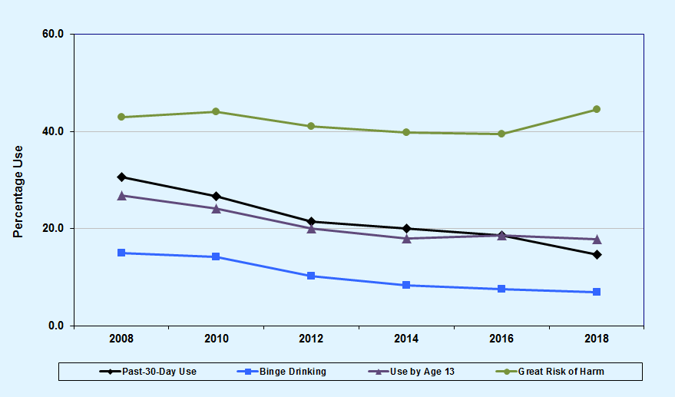
Graph 6
Alcohol trends summary for Okaloosa County, 2008-2018

Slide 12
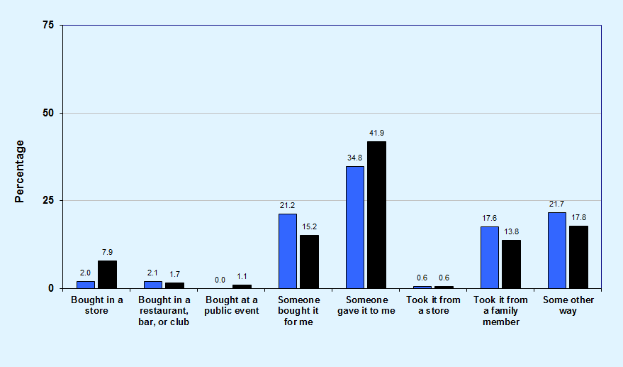
Graph 7
Usual source of alcohol within the past 30 days among high school drinkers, Okaloosa County and Florida Statewide, 2018
Okaloosa County
Florida Statewide

Slide 13
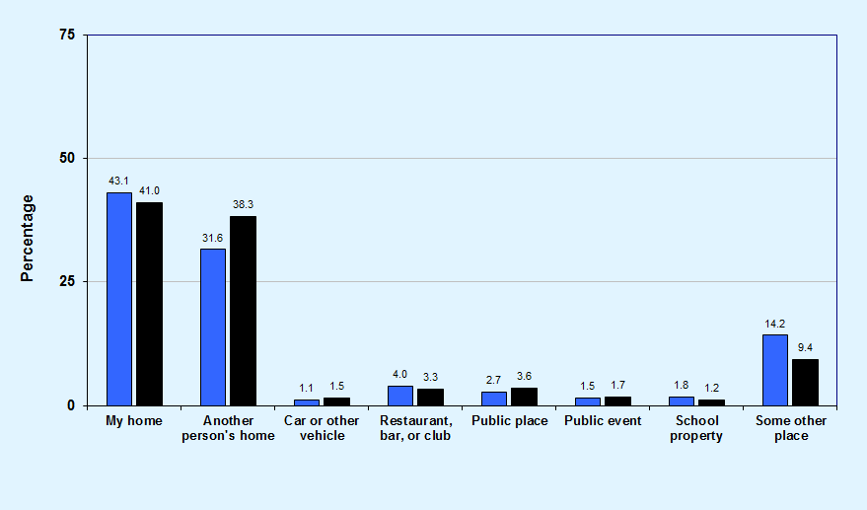
Graph 8
Usual drinking location within the past 30 days among high school drinkers, Okaloosa County and Florida Statewide, 2018
Okaloosa County
Florida Statewide

Slide 14
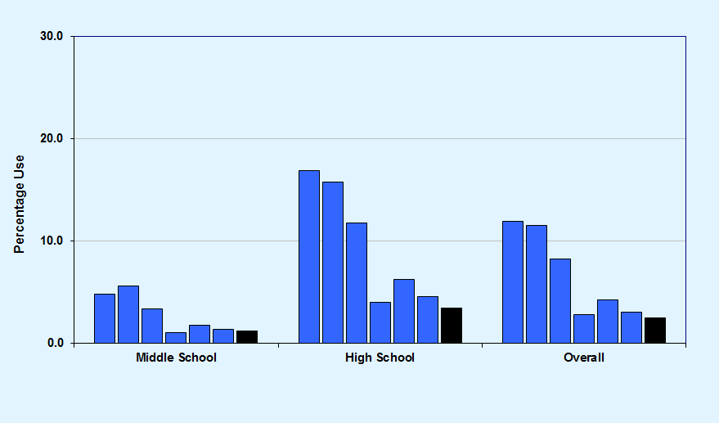
Graph 9
Past-30-day cigarette use, Okaloosa County 2008-2018 and Florida Statewide 2018
Okaloosa County 2008-2018
Florida Statewide 2018

Slide 15
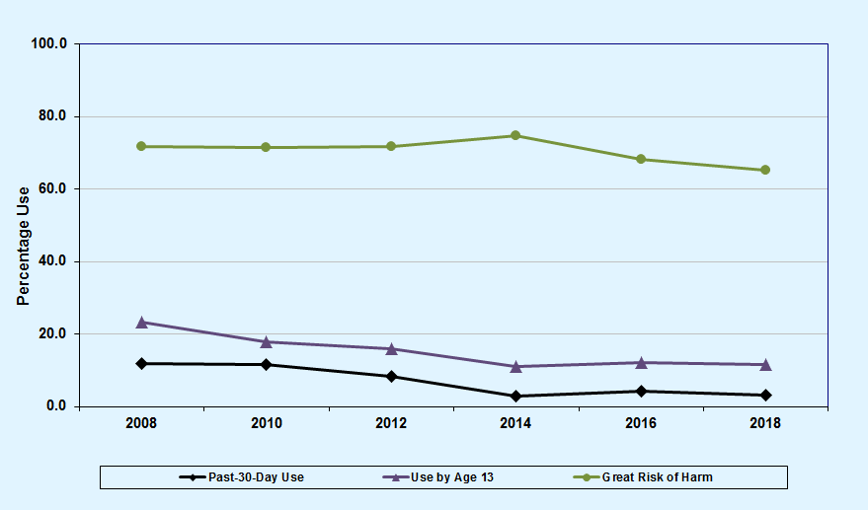
Graph 10
Cigarette trends summary for Okaloosa County, 2008-2018

Slide 16
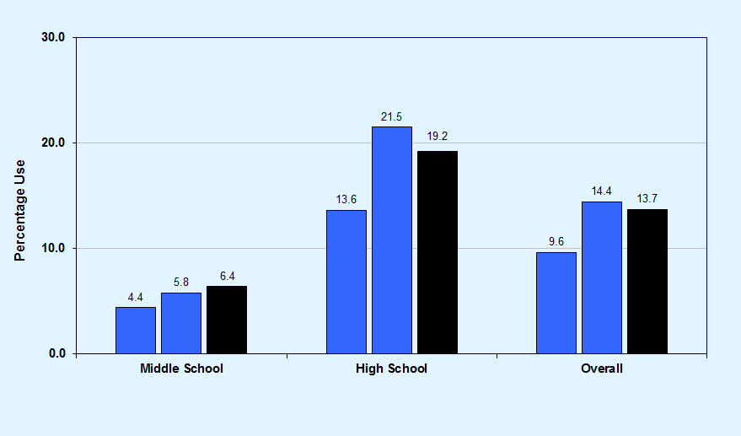
Graph 11
Past-30-day vaporizer/e-cigarette use, Okaloosa County 2016-2018 and Florida Statewide 2018
Okaloosa County 2016-2018
Florida Statewide 2018

Slide 17
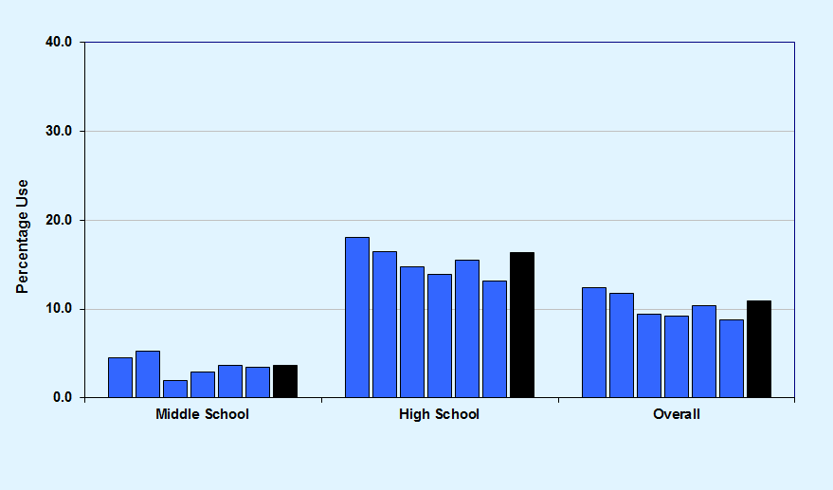
Graph 12
Past-30-day marijuana use, Okaloosa County 2008-2018 and Florida Statewide 2018
Okaloosa County 2008-2018
Florida Statewide 2018

Slide 18
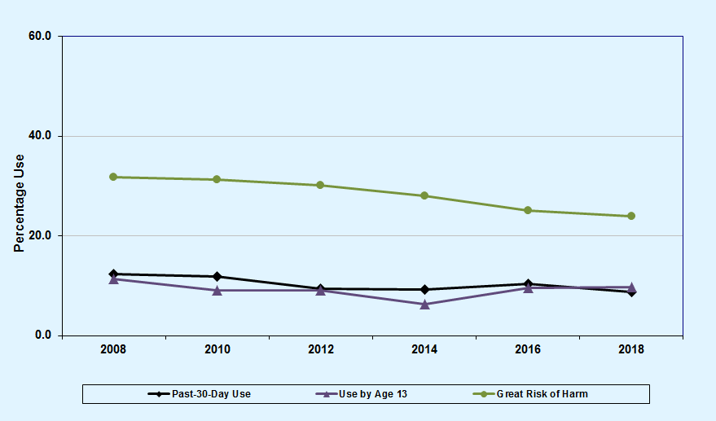
Graph 13
Marijuana trends summary for Okaloosa County, 2008-2018

Slide 19
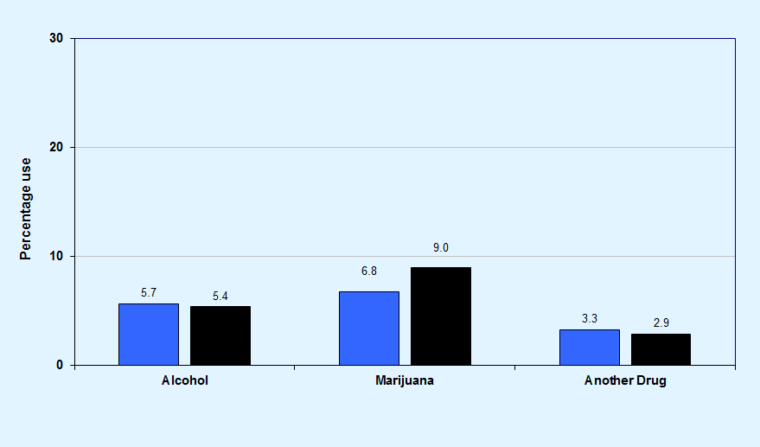
Graph 14
Substance use before or during school in the past 12 months, Okaloosa County and Florida Statewide, 2018
Okaloosa County
Florida Statewide

Slide 20
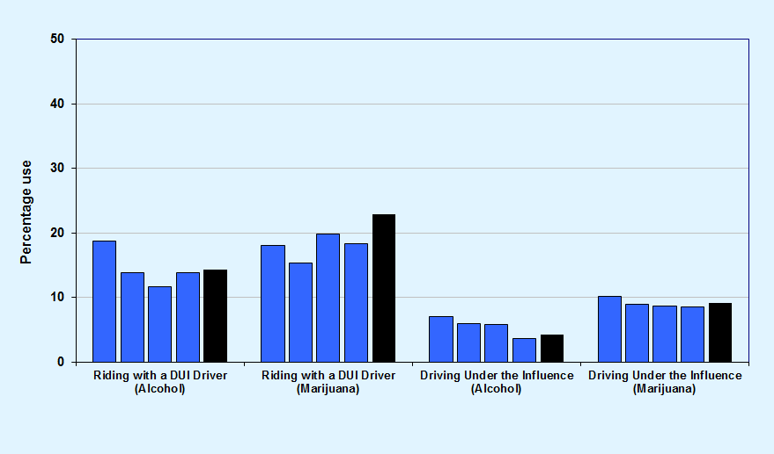
Graph 15
DUI or riding with a driver under the influence, among high school students, Okaloosa County 2012-2018 and Florida Statewide 2018
Okaloosa County 2012-2018
Florida Statewide 2018
Note: DUI does not imply intoxication but only indicates use prior to driving.

Slide 21
Key Findings
In Okaloosa County, past-30-day alcohol use was reported at 14.7%, compared to 15.3% across the statewide sample.
Binge drinking declined from 15.0% in 2008 to 7.0% in 2018.
Past-30-day cigarette use declined from 11.9% in 2008 to 3.1% in 2018.
In the past 30 days, 13.8% of high school students have ridden in a car with a driver who was under the influence of alcohol, and 18.3% have ridden with a driver under the influence of marijuana.

Slide 22
Other Illicit,
Over-the-Counter, and
Prescription Drugs
2008-2018 Trends

Slide 23
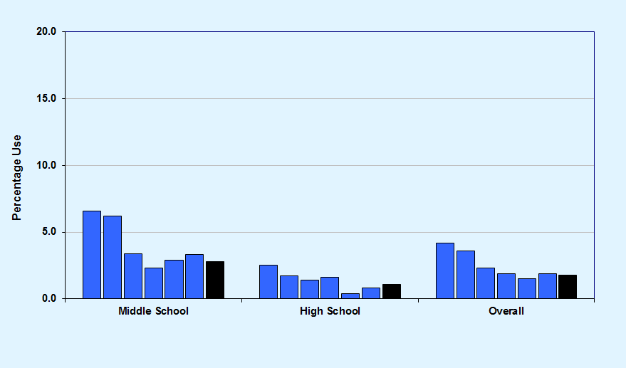
Graph 16
Past-30-day inhalant use, Okaloosa County 2008-2018 and Florida Statewide 2018
Okaloosa County 2008-2018
Florida Statewide 2018

Slide 24
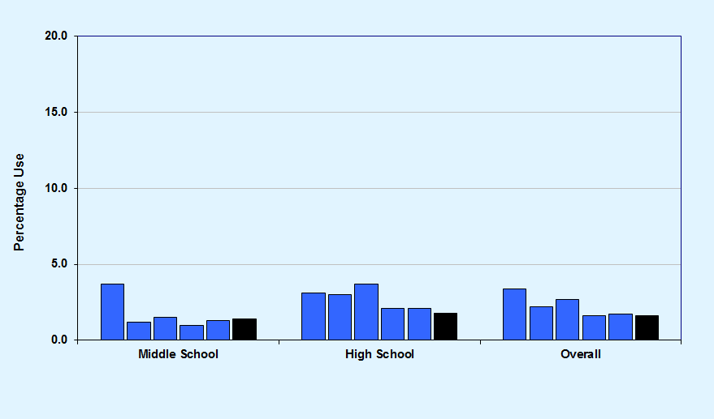
Graph 17
Past-30-day over-the-counter drug use, Okaloosa County 2010-2018 and Florida Statewide 2018
Okaloosa County 2010-2018
Florida Statewide 2018

Slide 25
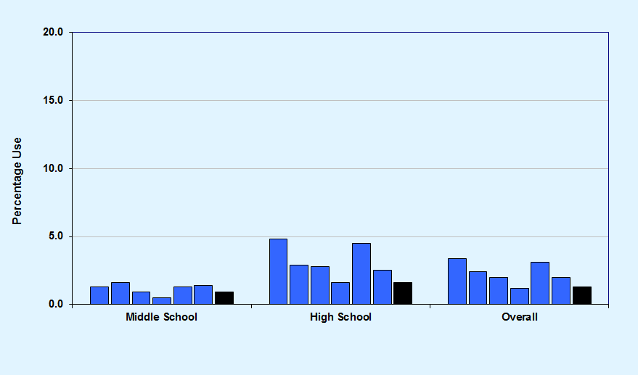
Graph 18
Past-30-day depressants use, Okaloosa County 2008-2018 and Florida Statewide 2018
Okaloosa County 2008-2018
Florida Statewide 2018

Slide 26
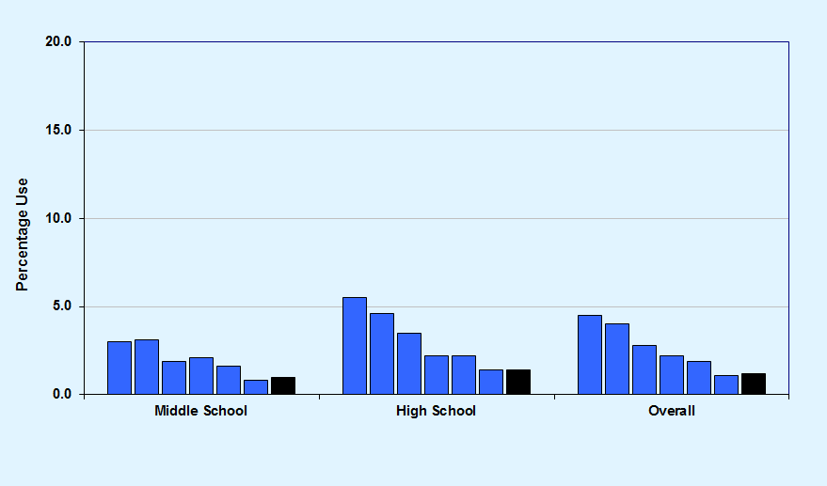
Graph 19
Past-30-day prescription pain reliever use, Okaloosa County 2008-2018 and Florida Statewide 2018
Okaloosa County 2008-2018
Florida Statewide 2018

Slide 27
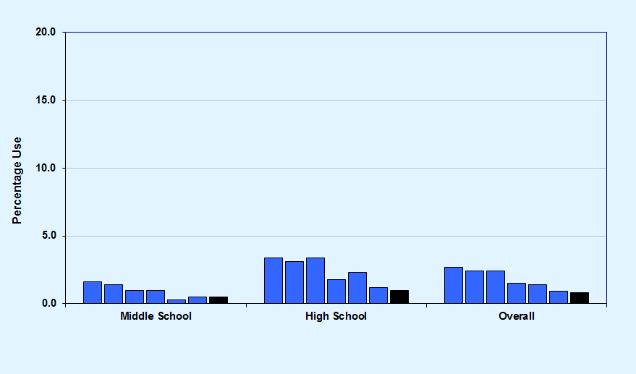
Graph 20
Past-30-day prescription amphetamines use, Okaloosa County 2008-2018 and Florida Statewide 2018
Okaloosa County 2008-2018
Florida Statewide 2018

Slide 28
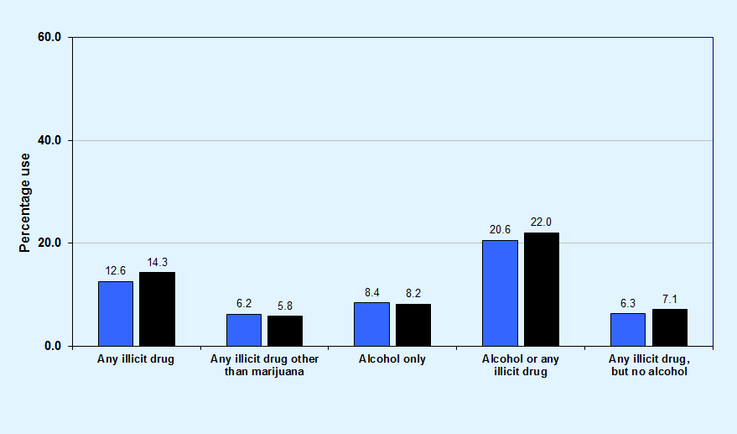
Graph 21
Past-30-day drug combination rates for Okaloosa County and Florida Statewide, 2018
Okaloosa County
Florida Statewide

Slide 29
Key Findings
In Okaloosa County, 6.2% of surveyed students reported the use of any illicit drug other than marijuana in the past 30 days, compared to 5.8% across the statewide sample.
Past-30-day illicit drug other than marijuana use decreased from 11.0% in 2008 to 6.2% in 2018.
Among high school students, past-30-day synthetic marijuana use decreased from 4.3% in 2012 to 0.8% in 2018.
Among middle school students, 3.3% reported the use of inhalants in the past 30 days, a rate higher than any other illicit drug (except marijuana).

Slide 30
Other Antisocial Behaviors, Bullying, Symptoms of Depression, and Gang Involvement
2018 Results

Slide 31
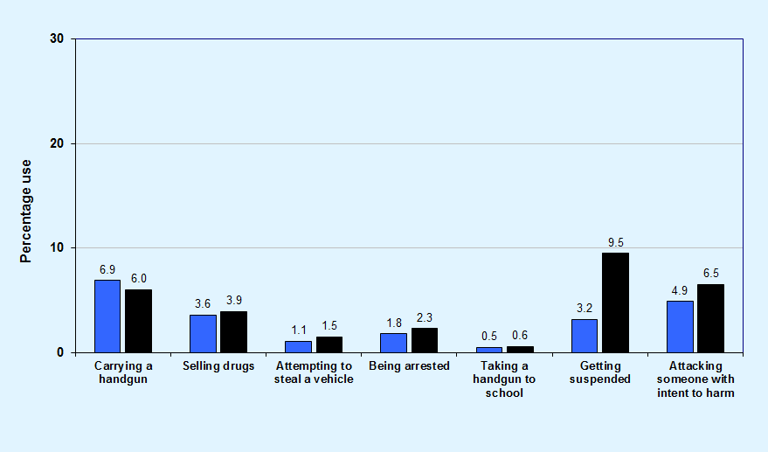
Graph 22
Comparisons of past-12-month delinquent behavior for Okaloosa County and Florida Statewide, 2018
Okaloosa County
Florida Statewide

Slide 32
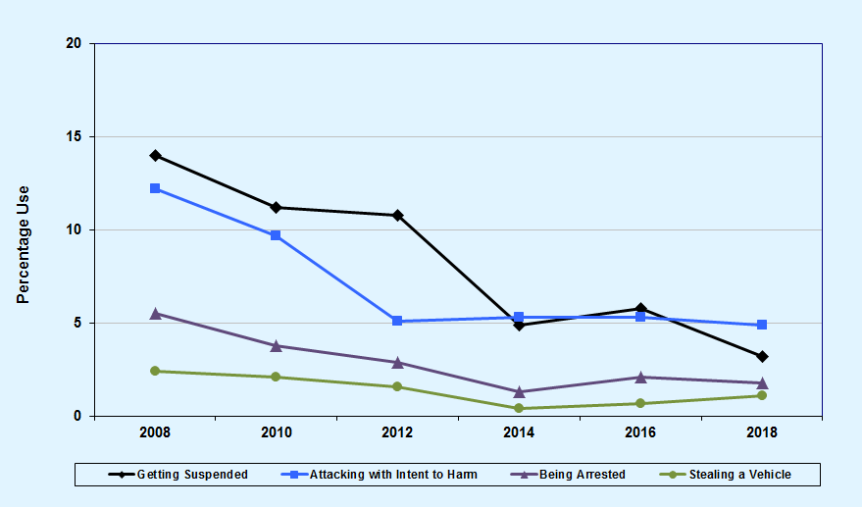
Graph 23
Other antisocial behaviors trend summary for Okaloosa County, 2008-2018

Slide 33
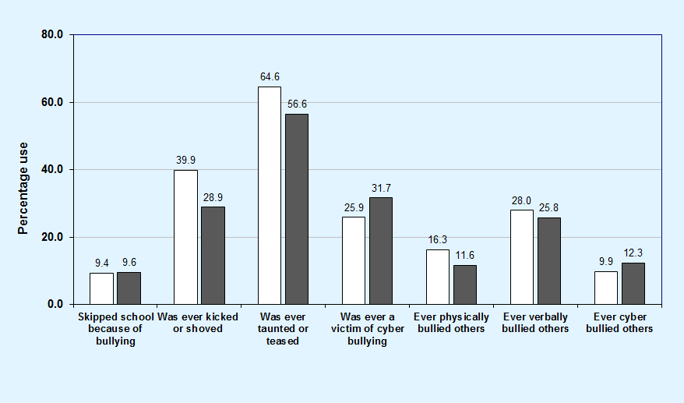
Graph 24
Bullying-related behaviors among Okaloosa County middle and high school students, 2018
Middle School
High School

Slide 34
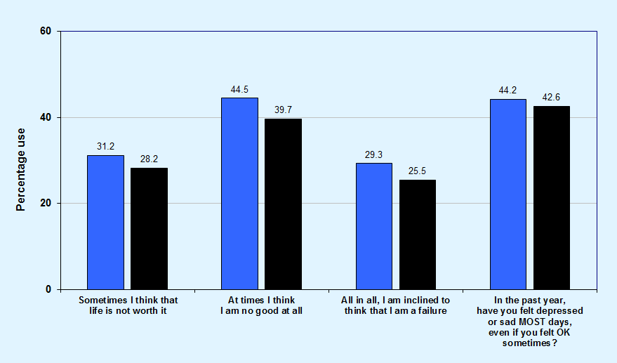
Graph 25
Comparisons of symptoms of depression for Okaloosa County and Florida Statewide, 2018
Okaloosa County
Florida Statewide

Slide 35
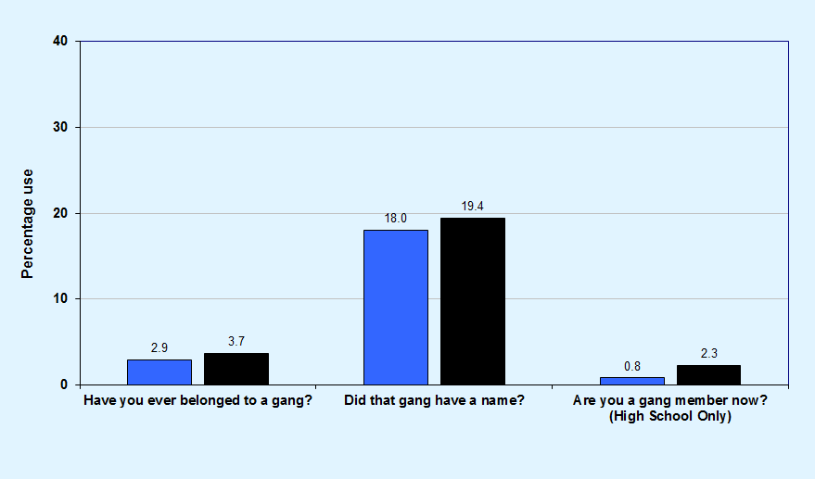
Graph 26
Gang involvement, Okaloosa County and Florida Statewide, 2018
Okaloosa County
Florida Statewide

Slide 36
Key Findings
In Okaloosa County, prevalence rates for Attempting to Steal a Vehicle (1.1%), Being Arrested (1.8%), and Taking a Handgun to School (0.5%) are 3.0% or less.
Higher prevalence rates were reported for Carrying a Handgun (6.9%) and Attacking Someone with Intent to Harm (4.9%).
In Okaloosa County, 60.2% of students have been socially bullied, 33.9% have been physically bullied, and 29.1% have been cyber bullied.
In Okaloosa County, 44.2% of students reported feeling depressed or sad on most days in the past year.

Slide 37
Risk and Protective Factor Prevalence Rates for M.S. and H.S. Students
2018 Results

Slide 38
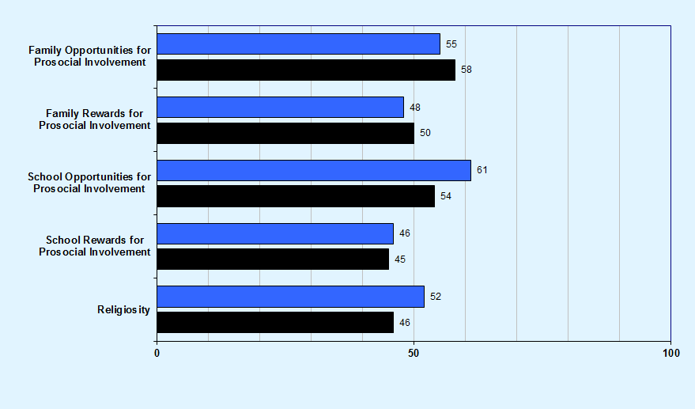
Graph 27
Protective factor prevalence rates for Okaloosa County and Florida Statewide middle school students, 2018
Okaloosa County
Florida Statewide

Slide 39
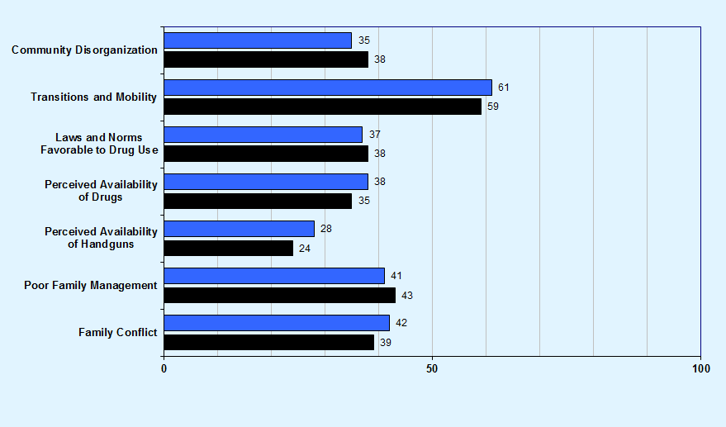
Community domain and family domain risk factor prevalence rates for Okaloosa County and Florida Statewide middle school students, 2018
Graph 28
Okaloosa County
Florida Statewide

Slide 40
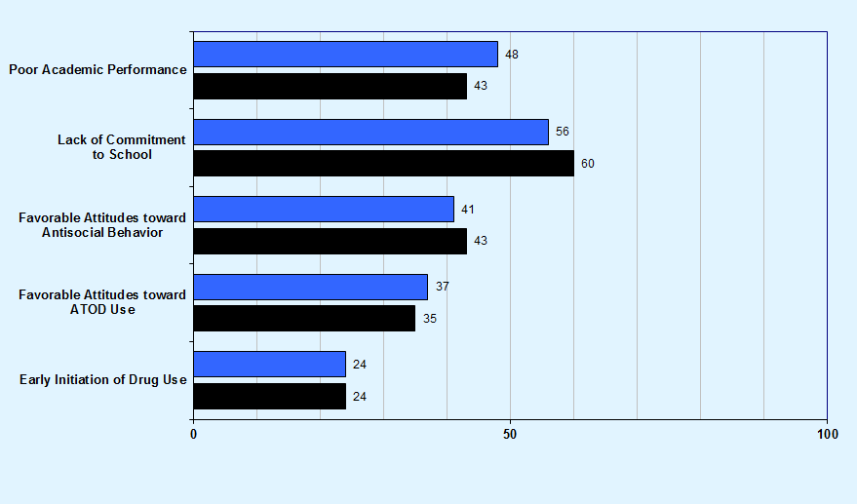
School domain and peer and individual domain risk factor prevalence rates for Okaloosa County and Florida Statewide middle school students, 2018
Graph 29
Okaloosa County
Florida Statewide

Slide 41
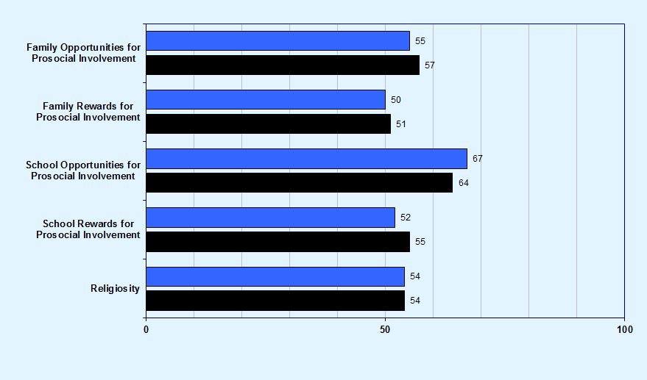
Graph 30
Protective factor prevalence rates for Okaloosa County and Florida Statewide high school students, 2018
Okaloosa County
Florida Statewide

Slide 42
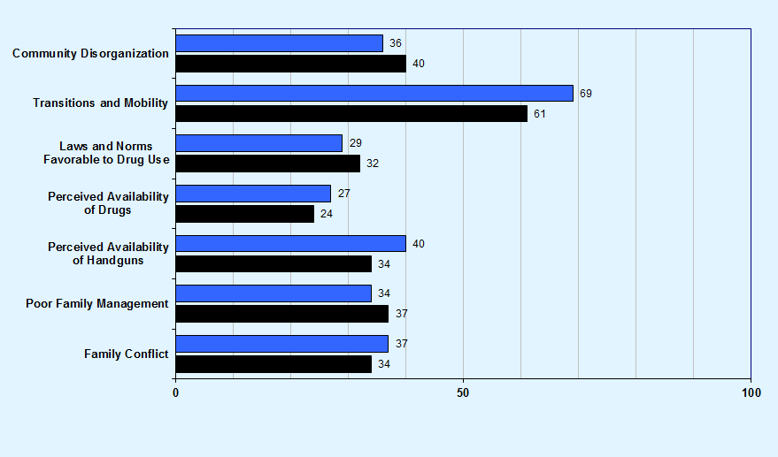
Community domain and family domain risk factor prevalence rates for Okaloosa County and Florida Statewide high school students, 2018
Graph 31
Okaloosa County
Florida Statewide

Slide 43
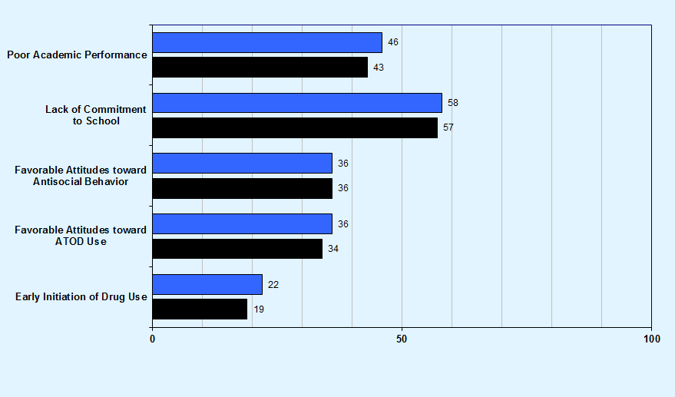
School domain and peer and individual domain risk factor prevalence rates for Okaloosa County and Florida Statewide high school students, 2018
Graph 32
Okaloosa County
Florida Statewide

Slide 44
Key Findings
Protective factor prevalence rates—opportunities for improvement:
Middle school students reported the lowest rates of protection for the School Rewards for Prosocial Involvement (46%) and Family Rewards for Prosocial Involvement (48%) scales.
High school students reported the lowest rates of protection for the Family Rewards for Prosocial Involvement (50%) and School Rewards for Prosocial Involvement (52%) scales.

Slide 45
Key Findings
Risk factor prevalence rates—opportunities for improvement:
Middle school students reported the highest rates of risk for the Lack of Commitment to School (56%) and Transitions and Mobility (61%) scales.
High school students reported the highest rates of risk for the Transitions and Mobility (69%) and Lack of Commitment to School (58%) scales.

