Slide 1
Commission on Mental Health and Substance Abuse – Data Presentation
Kathleen Moore, PhD | FMHI Executive Director
Louis de la Parte Florida Mental Health Institute (FMHI)
College of Behavioral and Community Sciences (CBCS)

Slide 2
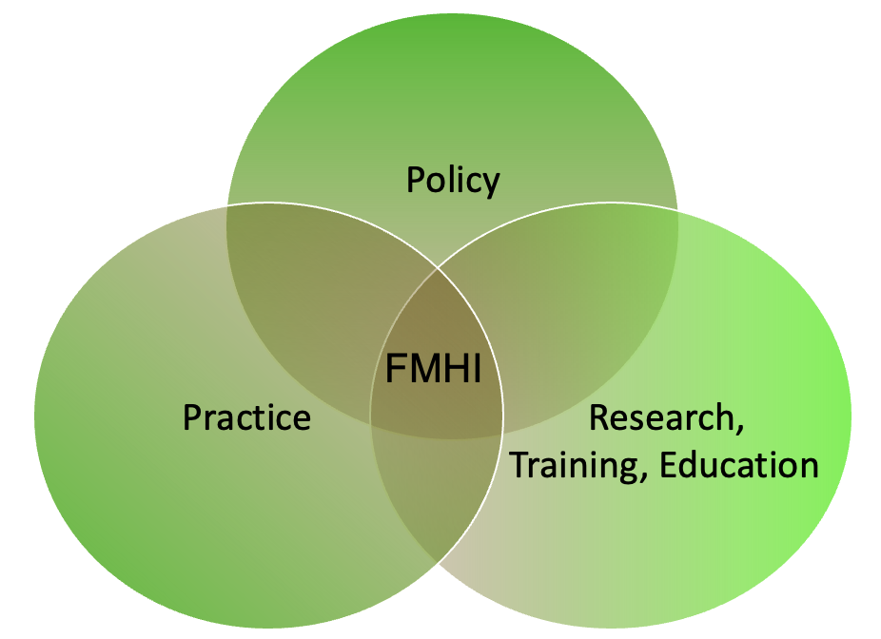
Statutory Mission of Louis de la Parte
Florida Mental Health Institute
“Improve lives of people with mental, addictive, and developmental disorders through research, training, and education”
(enacted in 1974)
Currently, FMHI serves as a national leader in behavioral health services research, policy, training and education, technical assistance, and dissemination

Slide 3
History of FMHI
1967
Florida Legislature provided $16 million to construct a mental health facility at the University of South Florida.
1980’s
Several research centers were developed related to Children's Mental Health, the Autism and Related Disabilities, Juvenile Justice, Aging, and HIV Education.
1983
FMHI was transferred to USF as an independent budget entity reporting to the University President on a level equivalent to that of a college. FMHI became enacted into law with Florida statute (540.214).
1990’s
FMHI focused more of its research and training on community-based project. The Institute was asked by the Legislature to help revise the state's civil commitment law, known as the Baker Act.
1996
The Florida Legislature honored former state Senator Louis de la Parte for his lifelong commitment to advocacy for improved social and mental health services by naming the Florida Mental Health Institute after him.
2008
FMHI became a part of the newly formed College of Behavioral and Community Sciences (CBCS).
1974
Florida Mental Health Institute (FMHI) officially opens.

Slide 4
College of Behavioral and Community Sciences (CBCS)
College of Behavioral and Community Sciences
Child & Family Studies
Communication Sciences & Disorders
Criminology
Louis de La Parte
Florida Mental Health Institute (FMHI)
Mental Health Law & Policy
School of Aging Studies
School of Social Work
FMHI continues to focus on some of society's most challenging problems through its research, consultation, and training carried out by FMHI Affiliates

Slide 5
Centers within College of Behavioral and Community Sciences (CBCS)
Center for Child Welfare
Policy and Services Research Data Center (PSRDC)
Baker Act Reporting Center
Criminal Justice Mental Health & Substance Abuse Technical Assistance Center (CJMHSA TAC)

Slide 6
Center for Child Welfare
Works in collaboration with the Department of Children and Families to ensure information on site is accurate and useful to child welfare professionals and others (funded by Florida's Department of Children and Families).
Key areas include:
  Comprehensive Resource and Video Training Library by Subject Area.
  Frequently Asked Questions (FAQs) – Processes and responds to requests on policy clarification.
  Web Events – Sponsors and hosts live web events and other web conferencing services such as training, meetings, and workgroup events.
  Online Training – Credentialed by Florida Certification Board to provide in-service training for re-certification of child welfare professionals and foster parents.
  Just in Time Training (Quality Parenting Initiative) - Responds to requests from foster parents for training topics and provides live and recorded training for foster parents, related caregivers, and child welfare professionals.

Slide 7
Criminal Justice, Mental Health, & Substance Abuse Technical Assistance Center (CJMHSA TAC)
Funded by Florida Department of Children and Families, CJMHSA TAC provides training and technical assistance CJMHSA Reinvestment grantees. Training and technical assistance occur on- and off-site based on need of grantees and type of assistance.
Conducts Sequential Intercept Mapping sessions throughout state. Model identifies six key points for “intercepting” or interacting with individuals who have behavioral health issues, and links them to services and supports that prevent further penetration into the criminal or juvenile justice system.
Quarterly conference calls (telephonically or via webinar) are conducted with grantees to share evidence-based practices and processes delivered by USF, state, and national subject matter experts. They review grantee quarterly reports and prepare an annual report summarizing technical assistance activities as well as the progress of grantees.

Slide 8
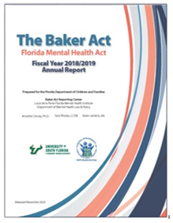
Baker Act Reporting Center (BARC)
Receives, processes, and analyzes statewide involuntary (Baker Act) examination data (since 2002).
  Disseminates fiscal year annual report for both children and adults. There were 210,992 involuntary (Baker Act) examinations in Fiscal Year 2018/2019.
Receives involuntary examination forms from 125+ receiving facilities. Baker Act specifies that the following must be mailed to DCF within one working day:
  Report of Law Enforcement Officers Initiating Involuntary Examination
  Certificate of Professional Initiating Involuntary Examination
  Ex-parte Order for Involuntary Examination
Receives petitions and orders for involuntary inpatient placement and involuntary outpatient services from Clerks of Court statewide.

Slide 9
Policy and Services Research
Data Center (PSRDC)
Examples of state datasets accessed by PSRDC
Agency for Healthcare Administration (AHCA)
Florida Department of Law Enforcement (FDLE)
Florida Department of Corrections (DOC)
Florida Department of Juvenile Justice (DJJ)
Florida Department of Health (DOH)
Florida Department of Children and Families
Florida Substance Abuse Mental Health (FSAMS)
Founded in 1996, PSRDC is a recognized leader in management and dissemination of mental health data generated throughout Florida and beyond.
Informs public policy and program development through the timely collection, integration, and analysis of data.
Located within Department of Mental Health and Policy, PSRDC serves academic departments across University of South Florida, along with a variety of local, state, and federal organizations.

Slide 10
Examples of Studies Utilizing Statewide Datasets
Carrfour Supportive Housing’s Coalition Lift Program Evaluation (Data included DCF, AHCA, and local agencies).
  Recipient of a special appropriation of funding through the Florida Housing Finance Corporation to fund one of three pilot sites demonstrating effectiveness of providing permanent supportive housing to high utilizers of crisis services who are experiencing housing instability.
Evaluation of Substance Abuse Treatment Service Access and Utilization in Florida’s Managed Medical Assistance Program (Data included SAMHIS and AHCA)
  Evaluated structure of and differences in access to substance abuse treatment services and utilization of services across Florida Medicaid Managed Medical Assistance (MMA) plans.
Firearm Laws, Mental Disorder, and Violence (Data included DCF, DOC and local data sources. Was denied use of FDLE data)
  Examined the impact of firearm laws and mental disorders on gun violence. We ended up focusing on just Pinellas and Miami Dade due to our inability to get statewide arrest data.

Slide 11
Example of County Data Collaborative
Pinellas County Data Collaborative was established in the fall of 1999 as a result of Chapter 163.62 Florida Statute, which allowed governmental and certain private agencies to share information.
It was created to enhance the delivery of mental health programs to Pinellas County residents by encouraging communication and collaboration among community providers, organizations, interested government agencies, and educational institutions:
  USF Policy and Services Research Data Center
  Pinellas County Board of County Commissioners
  Pinellas Clerk of Circuit Court
  Pinellas County Sheriff Office
  Pinellas County Department of Health and Human Services
  Sixth Judicial Circuit Court of Florida
  Emergency Medical Services
  Juvenile Welfare Board of Pinellas County
  Florida Department of Children and Families SunCoast Region
  Florida Department of Juvenile Justice

Slide 12
Data Challenges and Future Directions
Challenges:
  Data access
  Data use agreement approval
  Funding for data use and analysis by subject matter experts
  Data sharing and confidentiality
Future Directions:
  FMHI and our college has a long history of collaboration with state agencies on data analysis
  Opportunities to expand data collaboratives
Data Access & Approval
Funding
Subject Matter Experts
Better informed decision-making abilities at the state and county level

Slide 13

Thank you very much for the opportunity to present this morning
Kathleen Moore: kamoore@usf.edu

