Slide 1

Gadsden County Criminal Justice Diversionary Project (GCCJDP)
Presented By:
Sheriff Morris A. Young
Notes:
Begin the presentation by discussing:
1) How Substance Abuse and Mental Health issues have impacted Gadsden County.
2) How the Sheriff’s Office responded to these problems by first creating the Gadsden County Criminal Justice Diversionary Program in the Gadsden County Detention Facility.

Slide 2
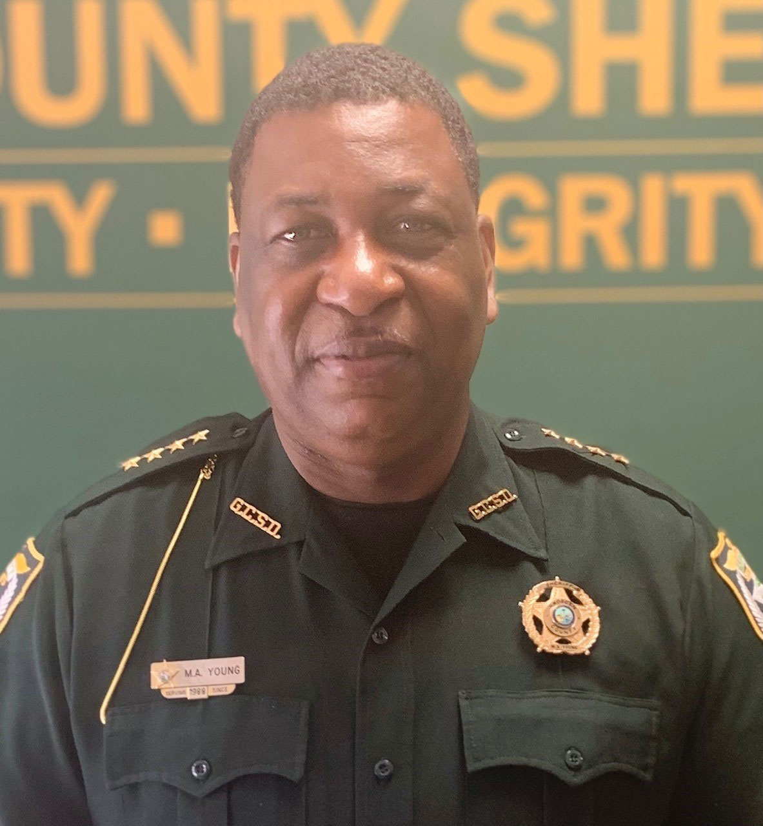
How the project originated
Gadsden County Sheriff’s Office sought to stem the rise of individuals entering the Gadsden County jail with substance abuse and or mental health issues, indicating that nearly 40% of the current inmates suffered from one or both of these conditions. We applied and received funding from the Department of Children and Families to assist these individuals in overcoming their substance abuse and mental health challenges. As result of these efforts, the Gadsden County Criminal Justice Diversionary Program was established in the Spring of 2020.
Vision
To produce a functional, comprehensive, and collaborative recovery-oriented system of care that promotes healthy living, community safety and stability
Goal
To divert persons with substance abuse disorders and co-occurring substance use and mental health disorders from incarceration and further involvement in the criminal justice system.
Notes:
Just a suggestion: is there a picture of Sheriff Young with the whole GCCJDP team? That would make an awesome addition here.

Slide 3
Services Offered
While detained in the Gadsden County Jail, clients are offered:
  Individual Therapeutic Counseling Sessions
  Psycho-educational Groups (Anger Management, Substance Abuse Prevention)
  HIV/STD Prevention Services
  Reentry Planning & Care Coordination (Housing assistance, SSI/SSDI assistance, vocational assistance, etc.)
When released into the community, clients are offered wrap around care, including:
  Care Coordination
  Counseling
  Crisis Care Outreach

Slide 4
The Impact of the Gadsden County Criminal Justice Diversionary Program
During Program Year 1, Program Year 2, and the first quarter of Program Year 3, the GCCJDP has successfully enrolled and provided the following services:
95 Clients were enrolled in the program receiving services.
77 Clients were provided HIV/STD Prevention services

Slide 5

GCSO DIVERSIONARY PROGRAM COST SAVINGS
From May 2020 - April 2022, GCSO Diversionary Program has served individuals in the jail by also maintaining their competency to stand trial via provision of therapeutic, psychoeducational, and health care services. During that time period, GCSO may have saved as much as $2.6 million $$$ by preventing forensic commitments to Florida State Hospital ($383/bed/day X median LOS 81 days x 84 served = $2,605,932 saved)
This does not begin to capture the dollars that would be saved from those who have not been re-arrested due to their participation in the program (i.e. potential detention costs saved).
It also does not capture the value brought to the community when jobs, housing, benefits, and supplemental health services (e.g. HIV/AIDS treatment & care coordination) are secured for these individuals.

Slide 6
We now aim to enhance substance abuse and mental health services before juveniles and adults are involved with the criminal justice system.
Because...
Once a person with mental illness enters the criminal justice system, treatment becomes significantly more expensive.
The deeper into the system an individual goes, the more expensive treatment becomes. The duration of treatment needed is also increased.
Expanding mental health services reduces recidivism to jails and to state hospitals.
Community based mental health care saves dollars and makes sense.

Slide 7

Vision
To produce a functional and comprehensive and preventative juvenile behavioral health program for Gadsden County, providing mental health, substance abuse, and behavioral support services to help at-risk youth succeed in society and in school.
Notes:
We will need the Department’s continued assistance as we continue to enhance services offered.

Slide 8
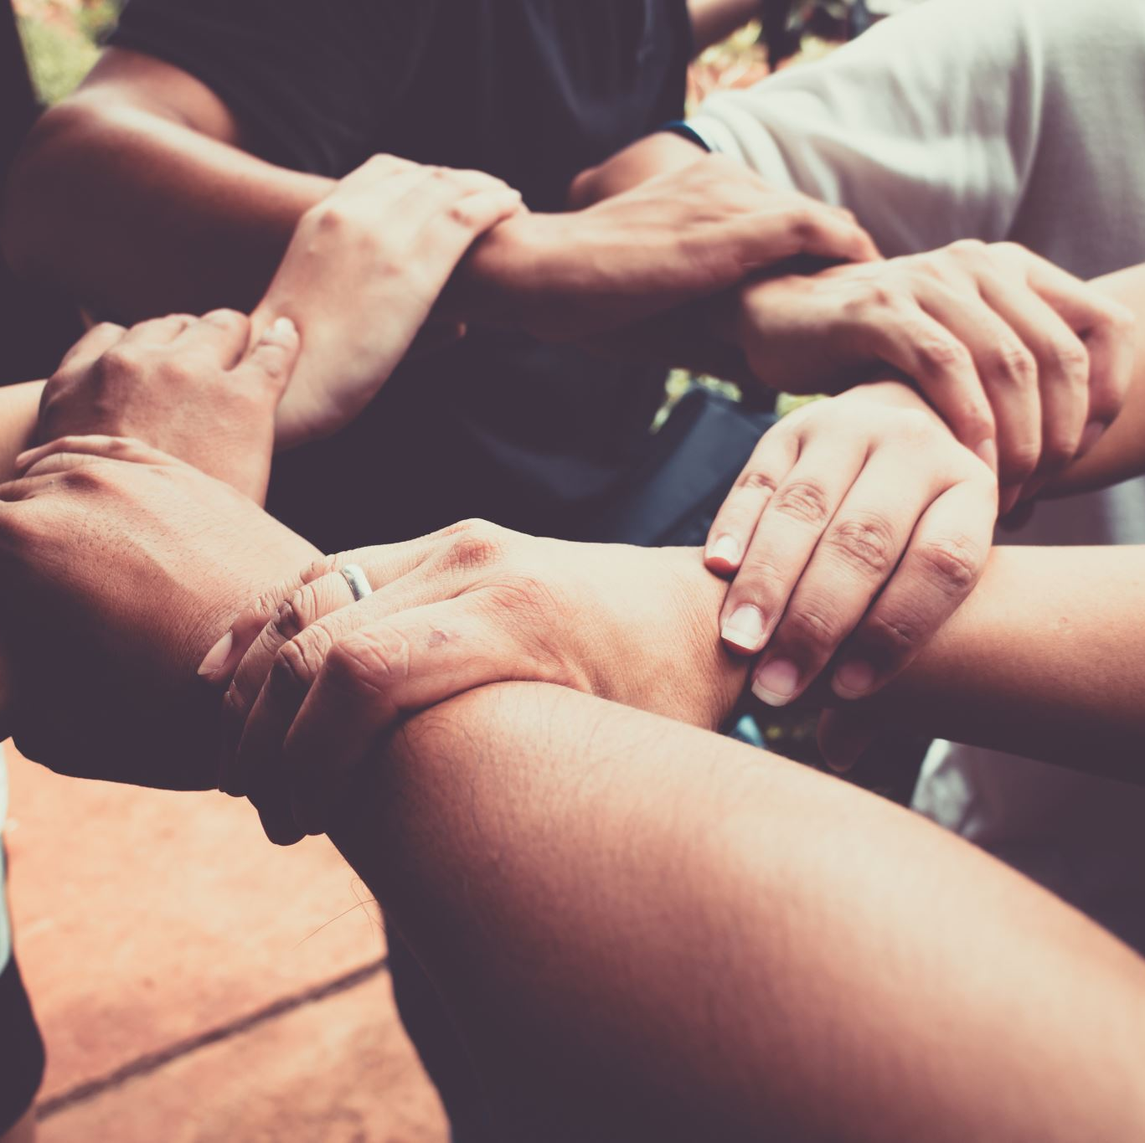
GOALS
DIVERT
YOUTH FROM DJJ INVOLVEMENT
DIVERT
PLACEMENT IN STATE MENTAL HEALTH TREATMENT FACILITIES
LOWER
AT RISK YOUTH INVOLVEMENT WITH LEO
INCREASE
ACADEMIC PERFORMANCE
BRING
AWARENESS TO MENTAL HEALTH & SUBSTANCE ABUSE
IMPROVE
POSITIVE YOUTH DEVELOPMENT
PROMOTE
POSITIVE SOCIETAL EXPOSURE
Notes:
We want to divert both low- and moderate-risk youth from: Arrest, Prosecutions, Detainment in DJJ facility, Commitment in treatment-based facility, Dropping out of school, Placement in alternative schools.

Slide 9

SHARED RESPONSIBILITY
Youth who are identified as at-risk because of their behavioral health issues often have multiple unmet needs.
Gadsden County Sheriff’s Office will adapt the concept
“it takes a village to raise a child!”
In adopting this concept, we will require assistance from DCF to engage the following stakeholders in this effort:
Parents
School Officials
Behavioral Health Providers
Substance Abuse Treatment Providers
Community Partners
Department of Juvenile Justice

Slide 10
FUTURE SERVICES FOR AT-RISK YOUTH IN GADSDEN COUNTY
The earlier we intervene, the greater the impact.
With strategic collaboration from our partners, we aim to provide:
BEHAVIORAL MODIFICATION
EMOTION REGULATION TRAINING
GREATER KNOWLEDGE OF TOBACCO, ALCOHOL, AND DRUGS
IMPROVED DECISION-MAKING SKILLS
IMPROVED RELATIONSHIPS & PRO-SOCIAL SKILLS
INCREASED SELF-AWARENESS AND SELF ESTEEM
INDIVIDUAL GOAL SETTING
MINDFULNESS TRAINING
POSITIVE ENCOURGAMENT
A HEALTHIER LIFESTYLE
GREATER RESILIENCY AND COPING SKILLS
IMPROVED ACADEMIC PERFORMANCE
LONG TERM RECOVERY
STRENGTHENED FAMILY/COMMUNITY RELATIONSHIPS
Notes:
The Department of Children and Families can support the Gadsden County Sheriff’s Office as we lead the charge in this effort to reduce arrests related to juvenile substance abuse and mental health issues.

Slide 11
Prevention is the way forward.
We need your support!
Notes:
Here, you should talk about
1) the ways DCF has already supported your Program and your County, and
2) what DCF and other State Agencies can do better, and/or what additional support is needed to support the efforts of law enforcement in Gadsden County.

