Slide 1
Behavioral Health System of Care Role of Community Treatment Providers and Care Coordination
Silvia Quintana Chief Executive Officer
Broward Behavioral Health Coalition

Slide 2
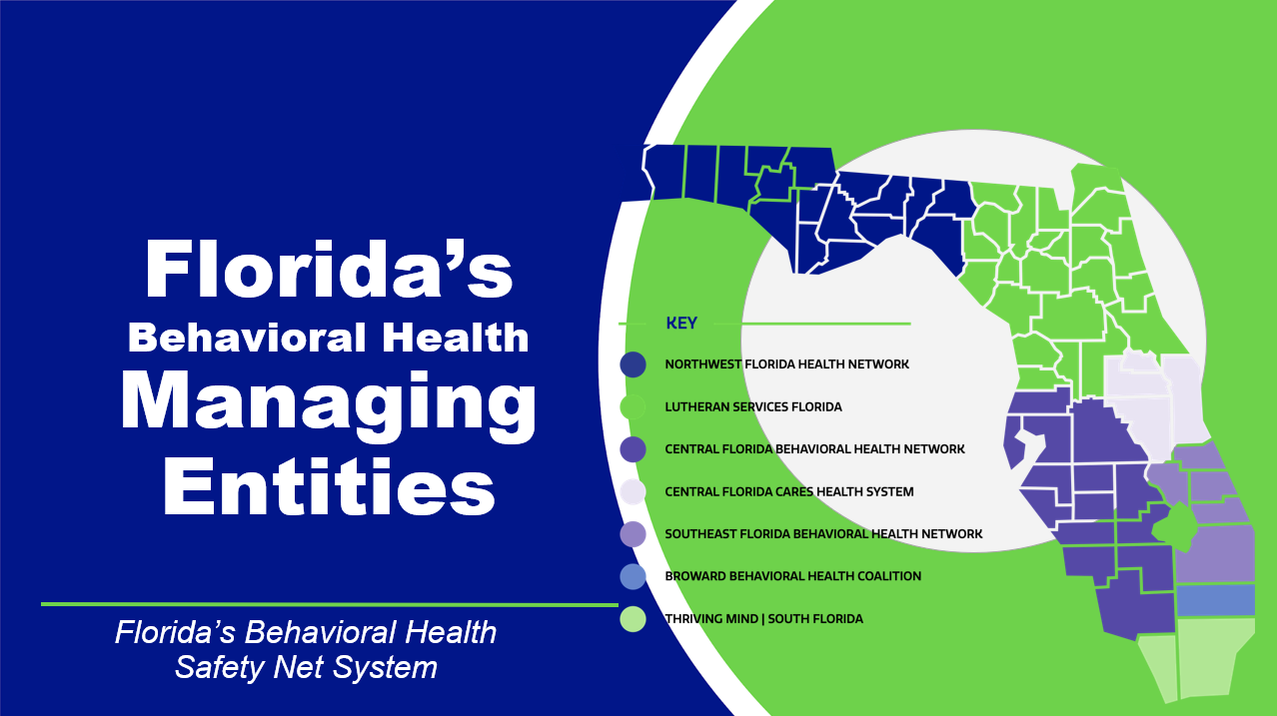

Slide 3
Background on Managing Entities
Who Managing Entities Serve
Managing Entities provide mental health and substance abuse services to more than 320,000 uninsured, underinsured and indigent Floridians. These patients include, among others:
DCF contracts with seven Managing Entities, which are not-for-profit businesses with local community boards
Managing Entities manage, administer and ensure accountability of state and federal funds for substance abuse and mental health services within a network of over 300 providers
Substance-abusing mothers and pregnant women
Families in the foster care system
Injecting drug users
Substance abusers who are infected with HIV
Individuals with a serious mental illness
Youth in the Juvenile Justice System
Veterans
Incarcerated Individuals
Chronically Homeless Individuals

Slide 4
Funding & Accountability
Funding for the safety net substance abuse and mental health services comes from:
Local governments
State general revenue
Managing Entities operate with high accountability and low overhead, operating with less than 5% in administrative costs
Private grants
State and federal grants

Slide 5
Services Provided in the Managing Entity Network
Crisis Stabilization
Residential Services
Outpatient Services
Community Support Services
Specialty Programs for Adults, Children and Families
Detox, Baker Act, Marchman Act assessment and treatment, Mobile Response Teams
Psychiatric and substance abuse treatment for children and adults
Mental health and substance abuse counseling, medication-assisted treatment, day treatment, drop-in centers, FACT teams
Case management, care coordination, respite, supported employment, supported housing, Peer Support Services, specialty courts (Mental Health Court and Drug Court, Criminal Justice Reinvestment Grants)
FACT Teams, CAT teams, FIT teams, Family Support Teams

Slide 6
Assessing Needs
Managing Entities employ a variety of evidence-based strategies to evaluate community need and service priority:
Asset Mapping
Community
Engagement
Data Analysis
Needs
Assessment
Provider
Satisfaction
System Mapping
Consumer Satisfaction

Slide 7
Care Coordination
Reducing Readmission Rates of High-Utilizers

Slide 8
Addressing the Problems
The Managing Entity’s coordination of care addresses problems and barriers that are endemic in physical and behavioral health care at the system level :
Ineffective transitioning of clients from one level of care or provider to
another
Lack of
accountability and agreed-upon responsibilities among multiple providers serving one client
Lack of timely sharing of needed treatment information
Lack of monitoring and follow-up
Fragmented, disjointed care

Slide 9
Stopping the Cycle
Detox Units
Emergency Rooms
Care coordination interrupts the current cycle of repetitive readmissions to crisis stabilization, detox and state mental health treatment facilities among the homeless, incarcerated, and other seriously mentally ill high utilizers and moves them to effective community based care.
Mental Health Treatment Facilities
CSUs

Slide 10
Broward Youth Baker Act
Data Integration Pilot

Slide 11
Broward Data Collaborative & Supporters
Sunshine & Beacon Health Insurance Plans
4 Youth Baker Act Facilities
Memorial/Joe DiMaggio
Fort Lauderdale
HCA Woodmount
Larkin
Notes:
BDC Created in 2017 with national technical assistance from UPENN Center for Actionable Intelligence for Social Policy. Broward Data Collaborative partners are providing legal, technology, programmatic, and sustainability planning staff time in partnership with private sector partners AWS & Velatura. Velatura received an AWS Health Equity grant to support the proof of concept.

Slide 12
Objectives
Demonstrate a cross-sector Proof of Concept (POC) data sharing solution to improve outcomes and reduce recidivism for children and youth leaving Baker Act facilities who are 17 years of age and younger with a focus on high utilizers
Do so in a way that reduces burden on care team with minimal disruption of existing workflows
Give parents more choices using consent mgt system
Expand to other high value use cases that:
increase access to health services for underserved communities
address social determinants of health
leverage data to promote more equitable and inclusive systems of care

Slide 13
Future State: Integrated Care Coordination & Successful Youth Outcomes
Christania
Hospital staff
Baker Act Facility
See positive behavioral changes and are comforted knowing they’re not alone
Connects with other services to develop a holistic discharge plan to ensure continued stability
Alfredo & Melanie
Foster Parents
Dennis
Case Manager/Care Coordinator
Broward Behavioral Health Coalition (BBHC)
Integrates a life coach, peer services, therapy and reinforces use of art as a positive outlet for feelings
Able to advocate for tailored treatment within programs better based on their longitudinal, whole person view of Christopher
Devon
Dependency Case Manager
ChildNet
Learns of Christopher’s truancy from school and connects him to a positive role model & a program that increases his ambition and interest in attending college someday
Nicole
Probation Officer
Dept of Juvenile Justice (DJJ)
Connects with Alisha to enroll Christopher a program for academic & personal enrichment to get him involved and engaged
James
Non Profit Coordinator
Children’s Services Council
Alisha
Social Worker
Broward County Public Schools
Christopher gets a tutor via the program and begins making friends through painting a community mural
Christopher’s attendance at school and his grades begin improving, he is making friends, and he is no longer shoplifting. He begins showing more enjoyment in everyday activities and his relationship with his foster parents is strengthened. Alisha is no longer concerned about his well-being and he is not readmitted to a Baker Act facility.
Notes:
Desired State
Enhanced & timely connection with agency staff
Robust & transparent consent process with parents
More secure data sharing
Minimal Required Data Sharing

Slide 14
Model & Best Practices for Integrated Data Systems for Florida Local & State Partners
Proven technology
Strong community collaborators
IDS
Legal and policy framework
Picture: https://www.freepik.com/premium-vector/triangle-figures-set-made-from-three-jigsaw-puzzle-vector-pieces_21835492.htm
Notes:
Broward Data Collaborative partners are providing legal, technology, programmatic, and sustainability planning staff time.

Slide 15
Share Minimal Necessary, Limited and Specified Data Fields
Data Fields Required for Matching: Name, DOB, address, phone, etc
Youth Services Prior to Admission
ChildNet
In Patient Youth Baker Act Facilities
Ft Lauderdale
Wraparound & Follow Up Care
ChildNet – DCM
DJJ
BBHC
BCPS
Private Services (Psychiatrist / Therapist)
Memorial
DJJ – JPO
BBHC – Care Coordinator/Therapist
BCPS – SEDNET
Private Services
Facility IOP & Outpatient
Facility with Youth Beds
Secure Facility (youth with >1 BA)
Managed Care Plans
Managed Care Plans
HCA W
Larkin
BBHC Children Care Coordination Teams
CONSENT MANAGEMENT
parents/legal guardians choose which institutions are allowed to have access to information
Admission
Discharge
Intake
Assessment
Diagnosis Medication
Service History
Discharge Plan
Assessment
Diagnosis Medication
Agencies to Integrate Data
BBHC ChildNet
Baker Act Facilities
BCPS
DJJ
CSC
Parent
Support &
Consent
Parent
Support &
Consent
Notes:
Proof of concept/pilot will be designed to share the minimally necessary data fields and a robust consent mgt system.

Slide 16
Broward Youth Baker Act Pilot
Commission Asks
Adopt, endorse, and/or sponsor the Broward Youth Baker Act Pilot by:
Allocating staff / staff time to the
Legal Workgroup – adapt successful MOUs & Data Sharing Agreements for Florida & Broward, identify new and/or amend existing statutes and agency policies to support the fully functional IDS after successful pilot
Technology Workgroup – create foundational platform that honors consent choices
Sustainability Planning – exploring and map ongoing funding opportunities through grants, legislation (ie., Medicaid Technology and Data APD, ONC Interoperability and Patient Access final rule, etc)
Notes:
AWS has provided support with a Health Equity grant to Velatura as well as in-kind staff support. Members of the Broward Data Collaborative and Velatura are providing hours of in-kind support to planning and implementing the proof of concept. Velatura is also providing a 25% match for work.

